Slide 1
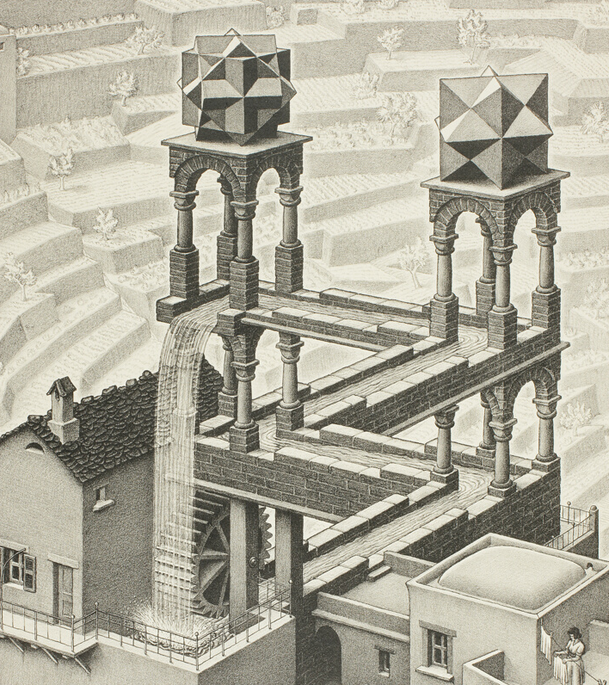
Logic and Paradox
Lecture 7 (Bonus):
Infinity
Rob Trueman
rob.trueman@york.ac.uk

Slide 2
Infinity
Galileo’s Paradox
Introducing sets
A foundation for mathematics?
Cardinals
Ordinals
Russell’s Paradox

Slide 3
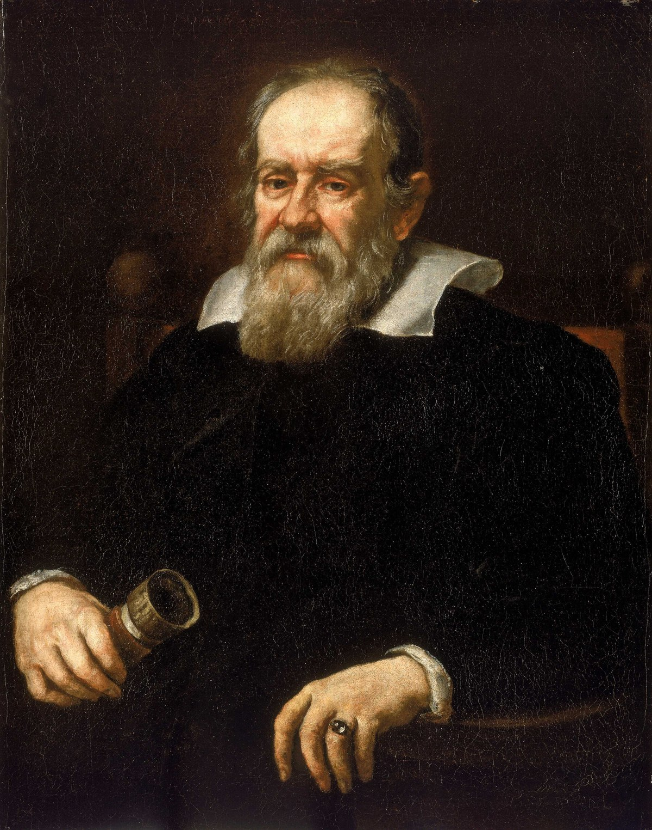
Galileo’s Paradox
Galileo presented a paradox of infinity in 1638
On the one hand, it seems obvious that there are more natural numbers than square numbers:
Natural Numbers: $0,1,2,3,4,5,6,7,8,9,10,…$
Square Numbers: $0,1,2,3,4,5,6,7,8,9,10,…$
But Galileo also offered an ingenious argument that there are just as many square numbers as there are natural numbers!

Slide 4
Children versus Cakes
How can you figure out if there are as many children as there are cakes?
Method 1: Count the children and the cakes
Method 2: Try to pair the children off with the cakes
If each child has one cake (different child, different cake), and no cakes are left over, then there are exactly as many children as there are cakes

Slide 5
Children versus Cakes
How can you figure out if there are as many children as there are cakes?
Method 1: Count the children and the cakes
Method 2: Try to pair the children off with the cakes
If each child has one cake (different child, different cake), and no cakes are left over, then there are exactly as many children as there are cakes
If each child has one cake (different child, different cake), and no cakes are left over, then there is a 1-1 correspondence between the children and the cakes

Slide 6
Children versus Cakes
How can you figure out if there are as many children as there are cakes?
Method 1: Count the children and the cakes
Method 2: Try to pair the children off with the cakes
If each child has one cake (different child, different cake), and no cakes are left over, then there is a 1-1 correspondence between the children and the cakes
If you always end up with a cake left-over, no matter how you try to pair them off with children, then there are more cakes than children

Slide 7
Children versus Cakes
How can you figure out if there are as many children as there are cakes?
Method 1: Count the children and the cakes
Method 2: Try to pair the children off with the cakes
If you always end up with a cake left-over, no matter how you try to pair them off with children, then there are more cakes than children
If you always end up with a child left-over, no matter how you try to pair them off with cakes, then there are more children than cakes

Slide 8
Naturals versus Squares
There is a 1-1 correspondence between natural numbers and square numbers
0
1
2
3
4
5
—
—
—
—
—
—
0
1
4
9
16
25
…
…
This list is infinitely long, but each natural is paired with a square and each square is paired with a natural (different natural, different square)
Each natural turns up eventually on this list, and so does each square

Slide 9
Understanding Infinity
Galileo’s Paradox is a paradox of infinity
The paradox only comes up because the naturals and the squares are both infinite collections
You might think that Galileo’s Paradox is just a demonstration that we don’t really understand infinity, or at least we cannot handle it mathematically
(That is what Galileo thought!)
However, modern mathematics offers ways of dealing with infinities in consistent and well-behaved ways

Slide 10
Infinity
Galileo’s Paradox
Introducing sets
A foundation for mathematics?
Cardinals
Ordinals
Russell’s Paradox

Slide 11
Sets: The Basic Idea
Intuitive: A set is a collection of individuals
The set of dogs is a collection that includes every dog (and nothing else)
The set of humans is a collection that includes every human (and nothing else)
The set of natural numbers is a collection that includes every natural number (and nothing else)
Philosophical: A set is an abstract mathematical object
Each dog is a concrete individual that exists in space and time
But the set of dogs is an abstract individual that exists outside of space and time

Slide 12
Set-Theoretic Notation
‘$∈$’ is the set-theoretic membership symbol: $a∈b$ symbolises $a$ is a member of $b$
Only sets have members: $∀x ∀y\left(y∈x→Sx\right)$
$\left\{x:Ax\right\}$ is the set of individuals that satisfy the formula $A$
$a∈\left\{x:x \text{is} \text{a} \text{dog}\right\}$ iff $a$ is a dog
$a∈\left\{x:x \text{is} \text{a} \text{dog} ∨x \text{is} \text{a} \text{cat}\right\}$ iff $a$ is a dog or a cat
If a set only has finitely many members, we can also refer to it just by listing its members: $\left\{a_{1},a_{2},…,a_{n}\right\}$
We can think of that as shorthand for $\left\{x:x=a_{1}∨x=a_{2}∨…∨x=a_{n}\right\}$

Slide 13
Extensionality
Sets are extensional: If set $a$ and set $b$ have exactly the same members, then $a$ is the same set as $b$
$∀x∀y\left(\left(Sx∧Sy\right)→\left(x=y↔∀z\left(z∈x↔z∈y\right)\right)\right)$
Extensionality is not automatically built into the idea of a collection, but it is built into the mathematical conception of a set
Since sets are extensional, it doesn’t matter how we order their members
$\left\{a,b\right\}=\left\{b,a\right\}= \left\{a,a,a,b,b,b,b,a,a,a,a,b\right\}$
However, we can introduce the idea of an ordered sequence
$\left\langle a,b\right\rangle =\left\langle c,d\right\rangle ↔\left(a=c∧b=d\right)$
$\left\langle a,b\right\rangle =\left\{\left\{a\right\},\left\{a,b\right\}\right\}$
$\left\langle a,b,c\right\rangle =⟨a,⟨b,c,⟩⟩$

Slide 14
Singletons and the Empty Set
Although sets are initially introduced as collections, we also allow there to be singleton sets, i.e. sets with just one member: $\{a\}$ is the singleton of $a$
IMPORTANT: $\left\{a\right\}≠a$
Galileo is a flesh and blood human; {Galileo} is an abstract mathematical object
We also admit the existence of the empty set, $∅$, which has no members
$∀x¬\left(x∈∅\right)$, but at the same time, $∅$ is still a set!
Extensionality guarantees that there is just one empty set
Singletons and the empty set can be counter-intuitive, but they are accepted parts of set theory

Slide 15
Subsets
Set $a$ is a subset of set $b$ iff every member of $a$ is a member of $b$
$a⊆b↔∀x\left(x∈a→x∈b\right)$
$∅$ is a subset of every set: $∀x∀y\left(x∈∅→x∈y\right)$
Here is another way of formulating extensionality:
$∀x∀y\left(\left(Sx∧Sy\right)→\left(x=y↔\left(x⊆y∧y⊆x\right)\right)\right)$
Set $a$ is a proper subset of set $b$ iff every member of $a$ is a member of $b$, but not vice versa
$a⊂b↔\left(a⊆b∧b⊈a\right)$
$a⊂b↔\left(∀x\left(x∈a→x∈b\right)∧∃x\left(x∈b∧x∉a\right)\right)$

Slide 16
Sets of Sets
Sets can also have sets as members
Example: The set of all sets of natural numbers – i.e. $\left\{x:Sx∧∀y\left(y∈x→Nx\right)\right\}$
On the face of it, it even looks like some sets can be members of themselves!
Example: The set of all sets that I (have or will) use as examples in this lecture
As we will see later, allowing sets to be members of themselves quickly leads to disaster
However, allowing sets to have other sets as members is incredibly mathematically fruitful
So the challenge for modern set theory is to find an elegant way of allowing sets to have other sets as members, without allowing a set to have itself as a member

Slide 17
Infinity
Galileo’s Paradox
Introducing sets
A foundation for mathematics?
Cardinals
Ordinals
Russell’s Paradox

Slide 18
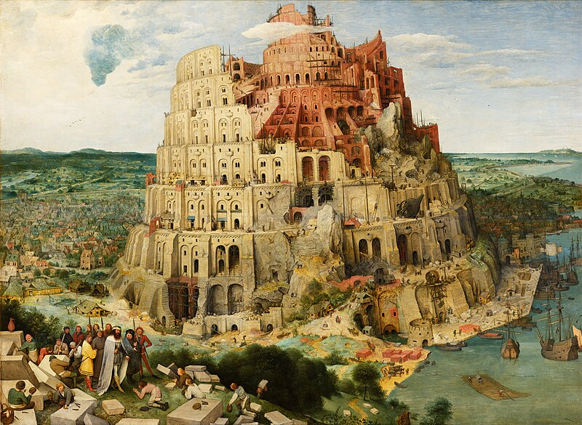
A Foundation for Mathematics?
It is often said that set theory is a (or maybe the) foundation for mathematics
That’s because most (or maybe all) mathematical entities can be modelled with sets
We have already laid out enough set theory to give a sense of how to model natural numbers, integers, rational numbers and real numbers

Slide 19
Natural Numbers
Natural numbers: $0,1,2,3,…$
Mathematically, what matters about the natural numbers is their structure
There is a first natural number: 0
Every natural number has a successor that is also a natural number (e.g. the successor of 0 is 1)
No two natural numbers have the same successor
We can construct sequences of sets that have just the same structure:
Zermelo: $∅,\left\{∅\right\},\left\{\left\{∅\right\}\right\},\left\{\left\{\left\{∅\right\}\right\}\right\},…$
Von Neumann: $∅,\left\{∅\right\}, \left\{∅,\left\{∅\right\}\right\},\left\{∅,\left\{∅\right\},\left\{∅,\left\{∅\right\}\right\}\right\},…$

Slide 20
Integers
Integers: $…, −3,−2,−1, 0,+1,+2,+3,…$
An integer is just like a natural, except it comes with a sign, $+$ or $−$ (apart from 0, which is unsigned, and can be identified with the natural 0)
So integers can be represented with an ordered pair of a natural and a sign
$+n=\left\langle n,+\right\rangle$
$−n=⟨n,−⟩$
We could also use natural numbers to represent the signs; then the integers will just be pairs of naturals
$+n=⟨n,0〉$
$−n=⟨n,1⟩$
So, since we know we can already model the naturals with sets, we can model the integers with sets too!

Slide 21
Rational Numbers
Rational numbers are ratios between integers
A rational is any number that can be represented as $\frac{i}{j}$, where $i$ and $j$are both integers
You might think that we could model a rational as a pair of integers: $\frac{i}{j}=⟨i,j⟩$
However, this won’t work, because one rational can be expressed as many ratios
$\frac{3}{4}=\frac{6}{8}$ but $\left\langle 3,4\right\rangle ≠\left\langle 6,8\right\rangle$
But we can model a rational as a set of pairs of integers
$\frac{i}{j}=\left\{\left\langle k,l\right\rangle :∃m\left(k=mi∧l=mj\right)\right\}$, where all the variables take integers as values
So, since we know we can already model the integers with sets, we can model the rationals with sets too!

Slide 22
Irrational Numbers
Geometry requires irrational numbers, i.e. numbers that cannot be written as ratios between integers
We can construct a triangle with a hypotenuse of $\sqrt{2}$, but $\sqrt{2}$ is not rational!
Suppose $\sqrt{2}$ is rational, and so can be written in lowest terms as $\frac{i}{j}$
$$\sqrt{2}$$
1
It follows that $2={\left(\frac{i}{j}\right)}^{2}=\frac{i^{2}}{j^{2}}$
So $i^{2}=2j^{2},$ and thus $i^{2}$ is even; it follows that $i$ is even
As $i$ is even, there is some $k$ s.t. $i=2k$, and so $2j^{2}{=i}^{2}={\left(2k\right)}^{2}=4k^{2}$
So $j^{2}=2k^{2}$, and thus $j^{2}$ is even; it follows that $j$ is even
But now $\frac{i}{j}$ is not written in lowest terms, because $i$ and $j$ are both divisible by 2!
CONTRADICTION!
1

Slide 23
Real Numbers
There are lots of irrational numbers that we know must exist because they turn up in geometry, e.g. $\sqrt{3},\sqrt[3]{25},π,e,…$
The real numbers are the rational numbers plus the irrational numbers
Dedekind demonstrated that we can model real numbers as sets of rationals
A
B
We have cut the rational number line into two halves, $A$ and $B$
$A$ includes all the rational numbers strictly below the cut ($A$ has no greatest member)
Every Dedekind cut models a real number, and every real is modelled by a Dedekind cut

Slide 24
Infinity
Galileo’s Paradox
Introducing sets
A foundation for mathematics?
Cardinals
Ordinals
Russell’s Paradox

Slide 25
Two Kinds of Counting
3
5
4
1
2
We use numbers to count, but there are two different things that we might be doing when we count
We might be trying to answer a ‘how many?’ question
We might be putting the things we are counting in a particular order
In finite cases, you always get the same number no matter what order you count things in
However, in infinite cases, we need to be very careful!

Slide 26
Two Kinds of Counting
3
4
1
4
3
5
1
2
2
5
We use numbers to count, but there are two different things that we might be doing when we count
We might be trying to answer a ‘how many?’ question
We might be putting the things we are counting in a particular order
In finite cases, you always get the same number no matter what order you count things in
However, in infinite cases, we need to be very careful!

Slide 27
Two Kinds of Counting
3
4
1
4
3
5
1
2
2
5
We use numbers to count, but there are two different things that we might be doing when we count
We might be trying to answer a ‘how many?’ question [CARDINALS]
We might be putting the things we are counting in a particular order
In finite cases, you always get the same number no matter what order you count things in
However, in infinite cases, we need to be very careful!

Slide 28
Two Kinds of Counting
3
4
1
4
3
5
1
2
2
5
We use numbers to count, but there are two different things that we might be doing when we count
We might be trying to answer a ‘how many?’ question [CARDINALS]
We might be putting the things we are counting in a particular order [ORDINALS]
In finite cases, you always get the same number no matter what order you count things in
However, in infinite cases, we need to be very careful!

Slide 29
Cardinals
We use cardinals to measure the cardinality of a set, i.e. how many members it has
Notation: $|a|$ is the cardinality of set $a$
Fundamental Rule: $\left|a\right|=|b|$ iff there is a 1-1 correspondence between $a$ and $b$
We can then introduce some familiar ideas:
$\left|a\right|≤|b|$ iff $∃x\left(x⊆b∧\left|a\right|=\left|x\right|\right)$; $\left|a\right|<|b|$ iff $\left(\left|a\right|≤\left|b\right|∧\left|b\right|≰\left|a\right|\right)$
Finite cardinals: $0=|∅|$; $\left|n\right|=n$; $n+1=\left\{m:m≤n\right\}$
$\left|a\right|+\left|b\right|=\left|\left\{\left\langle x,y\right\rangle :\left(x∈a∧y=0\right)∨\left(x∈b∧y=1\right)\right\}\right|$
$\left|a\right|×\left|b\right|=\left|\left\{\left\langle x,y\right\rangle :x∈a∧y∈b\right\}\right|$
${\left|a\right|}^{|b|}=\left|\left\{\begin{aligned}x:Sx∧∀y\left(y∈x→∃u∃v\left(y=\left\langle u,v\right\rangle ∧u∈b∧v∈a\right)\right) \\ ∧∀u(u∈b→∃v\left(\left\langle u,v\right\rangle ∈x\right) \\ ∧¬∃u∃v∃w\left(\left\langle u,v\right\rangle ∈x∧\left\langle u,w\right\rangle ∈x\right)\end{aligned}\right\}\right|$

Slide 33
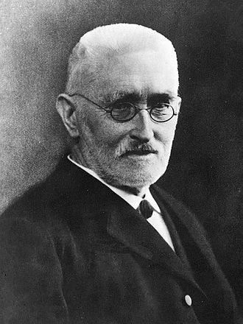
Dedekind-Infinite
There is a 1-1 correspondence between the squares and the naturals, so the cardinality of the squares equals the cardinality of the naturals!
This is surprising because the set of square numbers is a proper subset of the set of natural numbers
$\left\{n:∃m\left(m∈ℕ∧n=m^{2}\right)\right\}⊂ℕ$
Rather than thinking of this as a paradox, we now take it to be a hallmark of infinity! (This change was due to Dedekind)
Infinite: $x$ is an infinite set iff $\left|ℕ\right|≤\left|x\right|$
Dedekind-infinite: $x$ is a Dedekind-infinite set iff $∃y\left(y⊂x∧\left|y\right|=\left|x\right|\right)$
A set is infinite iff it is Dedekind-infinite (although it takes a lot of mathematical power to prove it!)

Slide 34
Are there More Integers than Naturals?
There are exactly as many integers as naturals: $\left|ℤ\right|=\left|ℕ\right|$
Here is a 1-1 correspondence between $ℕ$ and $ℤ$:
0 | 1 | 2 | 3 | 4 | 5 | 6 | 7 | 8 | 9 | 10 | 11 | 12 | 13 | 14 | 15 | 16 | 17 | 18 | 19 | …
0 | 1 |  | 2 |  | 3 |  | 4 |  | 5 |  | 6 |  | 7 |  | 8 |  | 9 |  | 10 | …
 |  | -1 |  | -2 |  | -3 |  | -4 |  | -5 |  | -6 |  | -7 |  | -8 |  | -9
0 | 1 | 2 | 3 | 4 | 5 | 6 | 7 | 8 | 9 | 10 | 11 | 12 | 13 | 14 | 15 | 16 | 17 | 18 | 19 | …
| | | | | | | | | | | | | | | | | | | | | | | | | | | | | | | | | | | | | | |
 |  |  |  |  |  |  |  |  |  |  |  |  |  |  |  |  |  |  |  | …
If $n$ is odd, it is mapped to ${n+1}/2$; if $n$ is even, it is mapped to $−2n$

Slide 35
Are there More Rationals than Naturals?
There are exactly as many rationals as naturals: $\left|ℚ\right|=\left|ℕ\right|$
$$1/1$$ | $$2/1$$ | $$3/1$$ | $$4/1$$ | $$5/1$$ | $$…$$
$$1/2$$ |  | $$3/2$$ |  | $$5/2$$ | $$…$$
$$1/3$$ | $$2/3$$ |  | $$4/3$$ | $$5/3$$ | $$…$$
$$1/4$$ |  | $$3/4$$ |  | $$5/4$$ | $$…$$
$$1/5$$ | $$2/5$$ | $$3/5$$ | $$4/5$$ |  | $$…$$
$$…$$ | $$…$$ | $$…$$ | $$…$$ | $$…$$ | $$…$$
$$1/1$$ | $$2/1$$ | $$3/1$$ | $$4/1$$ | $$5/1$$ | $$…$$
$$1/2$$ | $$2/2$$ | $$3/2$$ | $$4/2$$ | $$5/2$$ | $$…$$
$$1/3$$ | $$2/3$$ | $$3/3$$ | $$4/3$$ | $$5/3$$ | $$…$$
$$1/4$$ | $$2/4$$ | $$3/4$$ | $$4/4$$ | $$5/4$$ | $$…$$
$$1/5$$ | $$2/5$$ | $$3/5$$ | $$4/5$$ | $$5/5$$ | $$…$$
$$…$$ | $$…$$ | $$…$$ | $$…$$ | $$…$$ | $$…$$
This is a 1-1 correspondence between naturals and positive rationals
$1/1,2/1,1/2,3/1,1/3,4/1,3/2,2/3,1/4,5/1,1/5,…$
We can use the trick from the last slide to get a full 1-1 correspondence between naturals and all rationals
$0,1/1,{−1}/1,2/1,{−2}/1,1/2,{−1}/2,3/1,{−3}/1,1/3,{−1}/3,4/1,{−4}/1,3/2,{−3}/2,…$

Slide 36
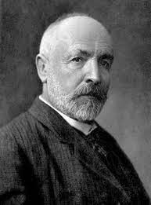
Are there More Reals than Naturals?
There are more reals than naturals: $|ℕ|<|ℝ|$
In fact, there are more reals between 0 and 1 than naturals: $|ℕ|<\left|\left[0,1\right]\right|$
This was first proven by Cantor, who established the result with his famous diagonalisation argument
The argument relies on the following fact:
Every real number between 0 and 1 can be written as an infinite decimal, $0.a_{1}a_{2}a_{3}…$
The argument uses this fact to show that you cannot pair off each real with a natural: no matter how you try, you will always end up with a left-over real

Slide 37
The Diagonalisation Argument
1 | 0.384736291…
2 | 0.497360940…
3 | 0.000000001…
4 | 0.121212121…
5 | 0.564794182…
… | …
Here’s a recipe for constructing a real number that is guaranteed not to appear on this list:
If the $n$th decimal of the $n$th entry on the list is 9, then the $n$th decimal in the new number will be 0; otherwise, the $n$th decimal in the new number will be 9
New number: 0.
This new number cannot appear on the list, since it is guaranteed to disagree with the $n$th entry at the $n$th decimal

Slide 38
The Diagonalisation Argument
1 | 0.384736291…
2 | 0.497360940…
3 | 0.000000001…
4 | 0.121212121…
5 | 0.564794182…
… | …
Here’s a recipe for constructing a real number that is guaranteed not to appear on this list:
If the $n$th decimal of the $n$th entry on the list is 9, then the $n$th decimal in the new number will be 0; otherwise, the $n$th decimal in the new number will be 9
New number: 0.9
This new number cannot appear on the list, since it is guaranteed to disagree with the $n$th entry at the $n$th decimal

Slide 39
The Diagonalisation Argument
1 | 0.384736291…
2 | 0.497360940…
3 | 0.000000001…
4 | 0.121212121…
5 | 0.564794182…
… | …
Here’s a recipe for constructing a real number that is guaranteed not to appear on this list:
If the $n$th decimal of the $n$th entry on the list is 9, then the $n$th decimal in the new number will be 0; otherwise, the $n$th decimal in the new number will be 9
New number: 0.90
This new number cannot appear on the list, since it is guaranteed to disagree with the $n$th entry at the $n$th decimal

Slide 40
The Diagonalisation Argument
1 | 0.384736291…
2 | 0.497360940…
3 | 0.000000001…
4 | 0.121212121…
5 | 0.564794182…
… | …
Here’s a recipe for constructing a real number that is guaranteed not to appear on this list:
If the $n$th decimal of the $n$th entry on the list is 9, then the $n$th decimal in the new number will be 0; otherwise, the $n$th decimal in the new number will be 9
New number: 0.909
This new number cannot appear on the list, since it is guaranteed to disagree with the $n$th entry at the $n$th decimal

Slide 41
The Diagonalisation Argument
1 | 0.384736291…
2 | 0.497360940…
3 | 0.000000001…
4 | 0.121212121…
5 | 0.564794182…
… | …
Here’s a recipe for constructing a real number that is guaranteed not to appear on this list:
If the $n$th decimal of the $n$th entry on the list is 9, then the $n$th decimal in the new number will be 0; otherwise, the $n$th decimal in the new number will be 9
New number: 0.9099
This new number cannot appear on the list, since it is guaranteed to disagree with the $n$th entry at the $n$th decimal

Slide 42
The Diagonalisation Argument
1 | 0.384736291…
2 | 0.497360940…
3 | 0.000000001…
4 | 0.121212121…
5 | 0.564794182…
… | …
Here’s a recipe for constructing a real number that is guaranteed not to appear on this list:
If the $n$th decimal of the $n$th entry on the list is 9, then the $n$th decimal in the new number will be 0; otherwise, the $n$th decimal in the new number will be 9
New number: 0.90990
This new number cannot appear on the list, since it is guaranteed to disagree with the $n$th entry at the $n$th decimal

Slide 43
The Diagonalisation Argument
1 | 0.384736291…
2 | 0.497360940…
3 | 0.000000001…
4 | 0.121212121…
5 | 0.564794182…
… | …
Here’s a recipe for constructing a real number that is guaranteed not to appear on this list:
If the $n$th decimal of the $n$th entry on the list is 9, then the $n$th decimal in the new number will be 0; otherwise, the $n$th decimal in the new number will be 9
New number: 0.90990…
This new number cannot appear on the list, since it is guaranteed to disagree with the $n$th entry at the $n$th decimal

Slide 44
The Diagonalisation Argument
1 | 0.384736291…
2 | 0.497360940…
3 | 0.000000001…
4 | 0.121212121…
5 | 0.564794182…
… | …
1 | 0.999999999…
2 | 0.738920981…
3 | 0.333333334…
4 | 0.513912317…
5 | 0.246836948…
… | …
Here’s a recipe for constructing a real number that is guaranteed not to appear on this list:
If the $n$th decimal of the $n$th entry on the list is 9, then the $n$th decimal in the new number will be 0; otherwise, the $n$th decimal in the new number will be 9
New number: 0.90990…
This new number cannot appear on the list, since it is guaranteed to disagree with the $n$th entry at the $n$th decimal
New number: 0.09909…

Slide 45
Cantor’s Theorem
Notation: $\left|ℕ\right|=ℵ_{0}$
Cantor also demonstrated that $\left|ℝ\right|=2^{ℵ_{0}}$
So, the diagonalisation argument demonstrates that $ℵ_{0}<2^{ℵ_{0}}$
Cantor managed to generalise this result: $κ<2^{κ}$, for any cardinal $κ$
There is a never ending hierarchy of larger and larger infinities!
Terminology: The cardinals from $ℵ_{0}$ are known as transfinite
Any infinity larger than $ℵ_{0}$ is called uncountable; so there is an uncountable infinity of real numbers

Slide 46
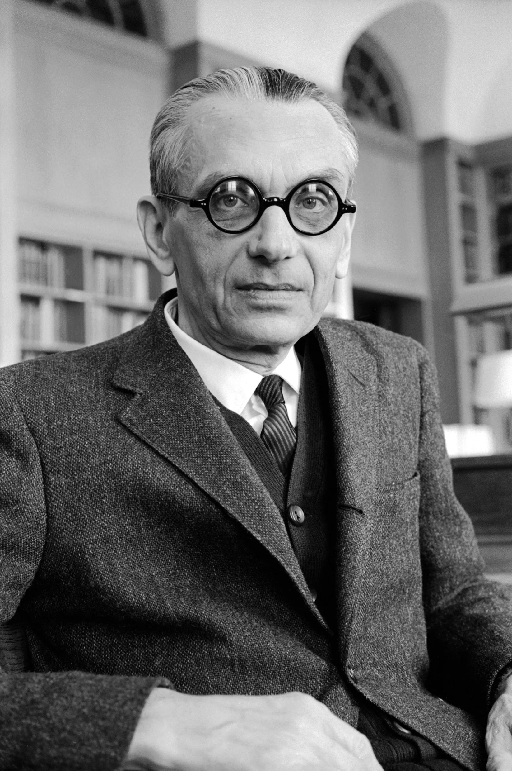
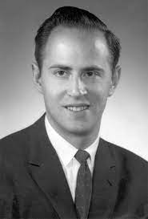
The Continuum Hypothesis
$ℵ_{1}$ is the next cardinal after $ℵ_{0}$
$ℵ_{0}<ℵ_{1}$, and $¬∃κ\left(ℵ_{0}<κ<ℵ_{1}\right)$
The Continuum Hypothesis: $ℵ_{1}=2^{ℵ_{0}}$
Generalised: $ℵ_{α+1}=2^{ℵ_{α}}$
The (Generalised) Continuum Hypothesis is independent of standard set theory
The standard axioms of set theory are consistent with the (Generalised) Continuum Hypothesis, but do not imply it
This independence result was established by Kurt Gödel and Paul Cohen

Slide 47
Infinity
Galileo’s Paradox
Introducing sets
A foundation for mathematics?
Cardinals
Ordinals
Russell’s Paradox

Slide 48
Well-Orderings
The members of a set are not automatically put in any order, but we can order them if we wish
For example, we can order the natural numbers in the standard way: $0,1,2,3,…$
But we could also order the natural numbers so that all of the even numbers come first, and then all of the odd numbers: $0,2,4,6,8,…,1,3,5,7,9,…$
A relation, $<$, well-orders a set, $a$, iff both:
1. $∀x∀y\left(\left(x∈a∧y∈a\right)→\left(x<y∨x=y∨y<x\right)\right)$
2. $∀x\left(\left(x⊆a∧x≠∅\right)→∃y\left(y∈x∧∀z\left(z∈x→z≮y\right)\right)\right)$
We use ordinals to measure the length of a well-ordering, i.e. a pair $⟨a,<⟩$, where $<$ well-orders $a$

Slide 49
Transfinite Ordinals
It doesn’t matter how you order a finite set, you always get the same ordinal
However, we can get different ordinals by re-ordering infinite sets!
$ω:0,1,2,3,4,…$
$ω+1:1,2,3,4,…,0$
$ω+ω:0,2,4,6,…,1,3,5,7,…$
In general, $α+1>α$, for any ordinal $α$ (including transfinite ordinals)
However, $1+ω=ω$, and so this law does not generally hold: $α+β=β+α$
$1+ω=a,0,1,2,3,…$
The easiest way to see that $1+ω=ω$ is to note that the above sequence is just a relabelling of the $ω$-sequence

Slide 50
Successor Ordinals and Limit Ordinals
A successor ordinal is an ordinal which comes immediately after another ordinal
$α$ is a successor ordinal iff there is some ordinal $β$ s.t. $α=β+1$
Every finite ordinal greater than 0 is a successor ordinal, but so is the transfinite ordinal $ω+1$
Limit ordinal is any ordinal that is not a successor ordinal
0 is the first limit ordinal
All other limit ordinals come after infinitely many steps from a successor ordinal
Some early ordinals:
$0,1,2,3,…,ω,ω+1,ω+2,…ω+ω=ω×2, \left(ω×2\right)+1,…ω×3,…ω×4,…,$
$$ω×ω=ω^{2},…ω^{3},…,ω^{ω},…,ω^{ω^{ω}},…,ω^{ω^{ω^{⋰}}}=ε_{0},…,ε_{0}^{ε_{0}^{ε_{0}^{⋰}}}=ε_{1},…$$

Slide 51
Successor Ordinals and Limit Ordinals
A successor ordinal is an ordinal which comes immediately after another ordinal
$α$ is a successor ordinal iff there is some ordinal $β$ s.t. $α=β+1$
Every finite ordinal greater than 0 is a successor ordinal, but so is the transfinite ordinal $ω+1$
Limit ordinal is any ordinal that is not a successor ordinal
0 is the first limit ordinal
All other limit ordinals come after infinitely many steps from a successor ordinal
Some early ordinals:
$0,1,2,3,…,ω,ω+1,ω+2,…ω+ω=ω×2, \left(ω×2\right)+1,…ω×3,…ω×4,…,$
$$ω×ω=ω^{2},…ω^{3},…,ω^{ω},…,ω^{ω^{ω}},…,ω^{ω^{ω^{⋰}}}=ε_{0},…,ε_{0}^{ε_{0}^{ε_{0}^{⋰}}}=ε_{1},…$$

Slide 52
Successor Ordinals and Limit Ordinals
A successor ordinal is an ordinal which comes immediately after another ordinal
$α$ is a successor ordinal iff there is some ordinal $β$ s.t. $α=β+1$
Every finite ordinal greater than 0 is a successor ordinal, but so is the transfinite ordinal $ω+1$
Limit ordinal is any ordinal that is not a successor ordinal
0 is the first limit ordinal
All other limit ordinals come after infinitely many steps from a successor ordinal
Some early ordinals:
$0,1,2,3,…,ω,ω+1,ω+2,…,ω+ω=ω×2, \left(ω×2\right)+1,…ω×3,…ω×4,…,$
$$ω×ω=ω^{2},…ω^{3},…,ω^{ω},…,ω^{ω^{ω}},…,ω^{ω^{ω^{⋰}}}=ε_{0},…,ε_{0}^{ε_{0}^{ε_{0}^{⋰}}}=ε_{1},…$$

Slide 53
Successor Ordinals and Limit Ordinals
A successor ordinal is an ordinal which comes immediately after another ordinal
$α$ is a successor ordinal iff there is some ordinal $β$ s.t. $α=β+1$
Every finite ordinal greater than 0 is a successor ordinal, but so is the transfinite ordinal $ω+1$
Limit ordinal is any ordinal that is not a successor ordinal
0 is the first limit ordinal
All other limit ordinals come after infinitely many steps from a successor ordinal
Some early ordinals:
$0,1,2,3,…,ω,ω+1,ω+2,…,ω+ω=ω×2, \left(ω×2\right)+1,…ω×3,…ω×4,…,$
$$ω×ω=ω^{2},…ω^{3},…,ω^{ω},…,ω^{ω^{ω}},…,ω^{ω^{ω^{⋰}}}=ε_{0},…,ε_{0}^{ε_{0}^{ε_{0}^{⋰}}}=ε_{1},…$$

Slide 54
Successor Ordinals and Limit Ordinals
A successor ordinal is an ordinal which comes immediately after another ordinal
$α$ is a successor ordinal iff there is some ordinal $β$ s.t. $α=β+1$
Every finite ordinal greater than 0 is a successor ordinal, but so is the transfinite ordinal $ω+1$
Limit ordinal is any ordinal that is not a successor ordinal
0 is the first limit ordinal
All other limit ordinals come after infinitely many steps from a successor ordinal
Some early ordinals:
$0,1,2,3,…,ω,ω+1,ω+2,…,ω+ω=ω×2, \left(ω×2\right)+1,…,ω×3,…,ω×4,…,$
$$ω×ω=ω^{2},…ω^{3},…,ω^{ω},…,ω^{ω^{ω}},…,ω^{ω^{ω^{⋰}}}=ε_{0},…,ε_{0}^{ε_{0}^{ε_{0}^{⋰}}}=ε_{1},…$$

Slide 55
Successor Ordinals and Limit Ordinals
A successor ordinal is an ordinal which comes immediately after another ordinal
$α$ is a successor ordinal iff there is some ordinal $β$ s.t. $α=β+1$
Every finite ordinal greater than 0 is a successor ordinal, but so is the transfinite ordinal $ω+1$
Limit ordinal is any ordinal that is not a successor ordinal
0 is the first limit ordinal
All other limit ordinals come after infinitely many steps from a successor ordinal
Some early ordinals:
$0,1,2,3,…,ω,ω+1,ω+2,…,ω+ω=ω×2, \left(ω×2\right)+1,…,ω×3,…,ω×4,…,$
$$ω×ω=ω^{2},…ω^{3},…,ω^{ω},…,ω^{ω^{ω}},…,ω^{ω^{ω^{⋰}}}=ε_{0},…,ε_{0}^{ε_{0}^{ε_{0}^{⋰}}}=ε_{1},…$$

Slide 56
Successor Ordinals and Limit Ordinals
A successor ordinal is an ordinal which comes immediately after another ordinal
$α$ is a successor ordinal iff there is some ordinal $β$ s.t. $α=β+1$
Every finite ordinal greater than 0 is a successor ordinal, but so is the transfinite ordinal $ω+1$
Limit ordinal is any ordinal that is not a successor ordinal
0 is the first limit ordinal
All other limit ordinals come after infinitely many steps from a successor ordinal
Some early ordinals:
$0,1,2,3,…,ω,ω+1,ω+2,…,ω+ω=ω×2, \left(ω×2\right)+1,…,ω×3,…,ω×4,…,$
$$ω×ω=ω^{2},…ω^{3},…,ω^{ω},…,ω^{ω^{ω}},…,ω^{ω^{ω^{⋰}}}=ε_{0},…,ε_{0}^{ε_{0}^{ε_{0}^{⋰}}}=ε_{1},…$$

Slide 57
Successor Ordinals and Limit Ordinals
A successor ordinal is an ordinal which comes immediately after another ordinal
$α$ is a successor ordinal iff there is some ordinal $β$ s.t. $α=β+1$
Every finite ordinal greater than 0 is a successor ordinal, but so is the transfinite ordinal $ω+1$
Limit ordinal is any ordinal that is not a successor ordinal
0 is the first limit ordinal
All other limit ordinals come after infinitely many steps from a successor ordinal
Some early ordinals:
$0,1,2,3,…,ω,ω+1,ω+2,…,ω+ω=ω×2, \left(ω×2\right)+1,…,ω×3,…,ω×4,…,$
$$ω×ω=ω^{2},…,ω^{3},…,ω^{ω},…,ω^{ω^{ω}},…,ω^{ω^{ω^{⋰}}}=ε_{0},…,ε_{0}^{ε_{0}^{ε_{0}^{⋰}}}=ε_{1},…$$

Slide 58
Successor Ordinals and Limit Ordinals
A successor ordinal is an ordinal which comes immediately after another ordinal
$α$ is a successor ordinal iff there is some ordinal $β$ s.t. $α=β+1$
Every finite ordinal greater than 0 is a successor ordinal, but so is the transfinite ordinal $ω+1$
Limit ordinal is any ordinal that is not a successor ordinal
0 is the first limit ordinal
All other limit ordinals come after infinitely many steps from a successor ordinal
Some early ordinals:
$0,1,2,3,…,ω,ω+1,ω+2,…,ω+ω=ω×2, \left(ω×2\right)+1,…,ω×3,…,ω×4,…,$
$$ω×ω=ω^{2},…,ω^{3},…,ω^{ω},…,ω^{ω^{ω}},…,ω^{ω^{ω^{⋰}}}=ε_{0},…,ε_{0}^{ε_{0}^{ε_{0}^{⋰}}}=ε_{1},…$$

Slide 59
Successor Ordinals and Limit Ordinals
A successor ordinal is an ordinal which comes immediately after another ordinal
$α$ is a successor ordinal iff there is some ordinal $β$ s.t. $α=β+1$
Every finite ordinal greater than 0 is a successor ordinal, but so is the transfinite ordinal $ω+1$
Limit ordinal is any ordinal that is not a successor ordinal
0 is the first limit ordinal
All other limit ordinals come after infinitely many steps from a successor ordinal
Some early ordinals:
$0,1,2,3,…,ω,ω+1,ω+2,…,ω+ω=ω×2, \left(ω×2\right)+1,…,ω×3,…,ω×4,…,$
$$ω×ω=ω^{2},…,ω^{3},…,ω^{ω},…,ω^{ω^{ω}},…,ω^{ω^{ω^{⋰}}}=ε_{0},…,ε_{0}^{ε_{0}^{ε_{0}^{⋰}}}=ε_{1},…$$

Slide 60
Successor Ordinals and Limit Ordinals
A successor ordinal is an ordinal which comes immediately after another ordinal
$α$ is a successor ordinal iff there is some ordinal $β$ s.t. $α=β+1$
Every finite ordinal greater than 0 is a successor ordinal, but so is the transfinite ordinal $ω+1$
Limit ordinal is any ordinal that is not a successor ordinal
0 is the first limit ordinal
All other limit ordinals come after infinitely many steps from a successor ordinal
Some early ordinals:
$0,1,2,3,…,ω,ω+1,ω+2,…,ω+ω=ω×2, \left(ω×2\right)+1,…,ω×3,…,ω×4,…,$
$$ω×ω=ω^{2},…,ω^{3},…,ω^{ω},…,ω^{ω^{ω}},…,ω^{ω^{ω^{⋰}}}=ε_{0},…,ε_{0}^{ε_{0}^{ε_{0}^{⋰}}}=ε_{1},…$$

Slide 61
Successor Ordinals and Limit Ordinals
A successor ordinal is an ordinal which comes immediately after another ordinal
$α$ is a successor ordinal iff there is some ordinal $β$ s.t. $α=β+1$
Every finite ordinal greater than 0 is a successor ordinal, but so is the transfinite ordinal $ω+1$
Limit ordinal is any ordinal that is not a successor ordinal
0 is the first limit ordinal
All other limit ordinals come after infinitely many steps from a successor ordinal
Some early ordinals:
$0,1,2,3,…,ω,ω+1,ω+2,…,ω+ω=ω×2, \left(ω×2\right)+1,…,ω×3,…,ω×4,…,$
$$ω×ω=ω^{2},…,ω^{3},…,ω^{ω},…,ω^{ω^{ω}},…,ω^{ω^{ω^{⋰}}}=ε_{0},…,ε_{0}^{ε_{0}^{ε_{0}^{⋰}}}=ε_{1},…$$

Slide 62
Successor Ordinals and Limit Ordinals
A successor ordinal is an ordinal which comes immediately after another ordinal
$α$ is a successor ordinal iff there is some ordinal $β$ s.t. $α=β+1$
Every finite ordinal greater than 0 is a successor ordinal, but so is the transfinite ordinal $ω+1$
Limit ordinal is any ordinal that is not a successor ordinal
0 is the first limit ordinal
All other limit ordinals come after infinitely many steps from a successor ordinal
Some early ordinals:
$0,1,2,3,…,ω,ω+1,ω+2,…,ω+ω=ω×2, \left(ω×2\right)+1,…,ω×3,…,ω×4,…,$
$$ω×ω=ω^{2},…,ω^{3},…,ω^{ω},…,ω^{ω^{ω}},…,ω^{ω^{ω^{⋰}}}=ε_{0},…,ε_{0}^{ε_{0}^{ε_{0}^{⋰}}}=ε_{1},…$$

Slide 63
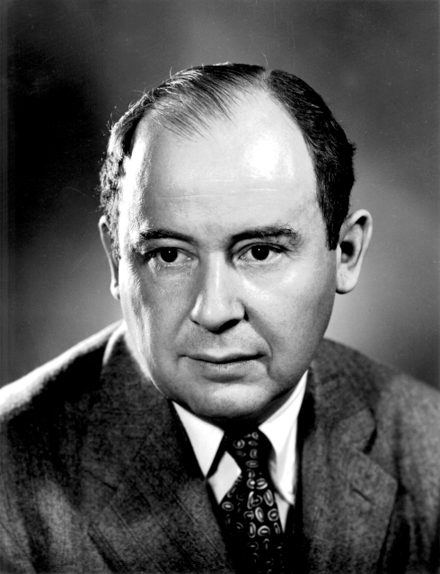
Ordinals as Sets
Von Neumann presented the now-standard definition of ordinals as sets
A set $x$ is an ordinal iff it meets both of the following two conditions:
Every member of $x$ is a set: $∀y\left(y∈x→Sy\right)$
Every member of a member of $x$ is a member of $x$: $∀y\left(∃z\left(y∈z∧z∈x\right)→y∈x\right)$
We can use set membership to order these ordinals: $α<β↔α∈β$
Examples: $0=∅,1=\left\{0\right\},2=\left\{0,1\right\},3=\left\{0,1,2\right\},…,ω=\left\{α:α \text{is} \text{finite} \text{ordinal}\right\},$
$$ω+1=\left\{0,1,2,3,…,ω\right\},…$$

Slide 64
Ordinals versus Cardinals
There is no difference between finite ordinals and cardinals, but transfinite ordinals behave very differently from transfinite cardinals
Cardinals | Ordinals
$$ℵ_{0}+1=ℵ_{0}$$ | $$∀α\left(α<α+1\right)$$
$$∀κ∀θ\left(κ+θ=θ+κ\right)$$ | $$ω+1≠1+ω$$
However, we can define cardinals as particular ordinals:
Let $\left|x\right|$ be the least ordinal $α$ s.t. there is a 1-1 correspondence between $x$ and $α$
An ordinal, $α$, is a cardinal iff $\left|α\right|=α$
This definition of cardinals as ordinals only works if we assume that every set can be well-ordered
This is known as the Axiom of Choice, and it is a powerful set-theoretic axiom!

Slide 65
Infinity
Galileo’s Paradox
Introducing sets
A foundation for mathematics?
Cardinals
Ordinals
Russell’s Paradox

Slide 66
Naïve Comprehension
We have been helping ourselves to all sorts of sets, but what principle actually governs what sets there are?
Naïve Comprehension: $∃x∀y\left(y∈x↔Ay\right)$ – for any formula $Ay$ that does not contain $x$
$∃x∀y\left(y∈x↔y \text{is} \text{a} \text{dog}\right)$
$∃x∀y\left(y∈x↔\left(y \text{is} \text{a} \text{cat} ∨ y \text{is} \text{a} \text{human}\right)\right)$
$∃x∀y\left(y∈x↔y∈y\right)$
$∃x∀y\left(y∈x↔y∉y\right)$
We can reformulate Naïve Comprehension as the principle that $\left\{x:Ax\right\}$ exists, no matter what condition $A$ expresses
$\left\{x:x \text{is} \text{a} \text{cat} ∨ x \text{is} \text{a} \text{human}\right\}$ exists
$\left\{x:x∈x\right\}$ exists
$\left\{x:x∉x\right\}$ exists

Slide 67
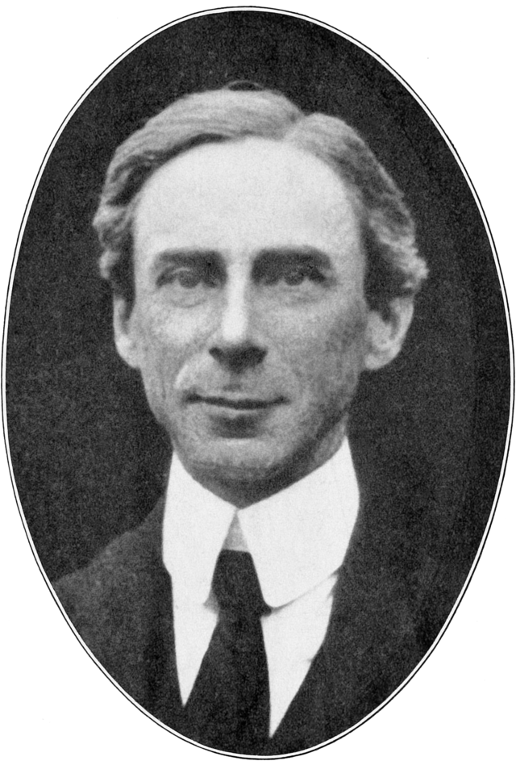
Russell’s Paradox
Russell presented a famous paradox which demonstrated that Naïve Comprehension is inconsistent
Russell’s original target was Frege, who had an axiom that was equivalent to Naïve Comprehension
Naïve Comprehension implies that $\left\{x:x∉x\right\}$ exists; call it $r$ for ‘Russell Set’
Suppose $r∈r$. It follows that $r$ must meet its own condition for membership, and so $r∉r$. Contradiction!
So $r∉r$. But it follows that $r$ does meet its own condition for membership, and so $r∈r$. Contradiction!
If $r$ exists, we are led to contradiction, so $r$ must not exist, and thus Naïve Comprehension must be false!

Slide 68
Responding to Russell’s Paradox
There are many ways of solving Russell’s Paradox, but we will focus on the standard solution
Note that Russell’s Paradox would never have got going if we were not allowed to form sets of sets
However, we have already seen that allowing ourselves sets of sets is extremely fruitful
So what we need is a way of introducing sets of sets in a careful, controlled way
That is exactly what the iterative conception of set does!

Slide 69
The Iterative Conception
Sets are formed in stages
At stage 0, we have ordinary non-sets, called urelements. (We don’t have to include any urelements if we don’t want: then stage 0 will be empty)
Stage 1 includes everything from stage 0, plus every set we can make from things in stage 0
Stage 2 includes everything from stage 1, plus every set we can make from things in stage 1
…
Stage $ω$ includes everything from all finite stages
And so on forever!
$$…$$
$$ω$$
$$…$$
2
1
0

Slide 70
Solving Russell’s Paradox
The iterative conception motivates a standard axiomatisation of set theory (ZFC), but even without going through the formalities, we can see how Russell’s Paradox is blocked
According to the iterative conception, no set is a member of itself
A set appears for the first time at a later stage than its members
It follows that $\left\{x:x∉x\right\}$ doesn’t exist on iterative conception!
No set is a member of itself
Each set must appear for the first time at a later stage than its members
So $\left\{x:x∉x\right\}$ would have to appear at a stage later than any set appears!
It obviously follows that Naïve Comprehension is false on the iterative conception
However, you can still have a restricted version of Naïve Comprehension on every stage
$∀α∃x∀y\left(y \text{appears} \text{in} \text{stage} α→\left(y∈x↔Ay\right)\right)$

Slide 71
Absolute Infinity
The iterative conception also tells us that there is no universal set: $¬∃x∀y\left(y∈x\right)$
There is also no set of all ordinals; it follows that no ordinal measures the length of the ordinals (arranged in the standard order)
There is also no set of all cardinals; it follows that no cardinal measures how many cardinals there are
We can use this observation to draw a distinction between two types of infinity:
Infinite: A set, $x$, is an infinite set iff $\left|ℕ\right|≤\left|x\right|$
Absolutely Infinite: A collection is absolutely infinite iff it is too big to form a set
Naively, people often assume that the natural numbers are absolutely infinite, but modern mathematics disagrees
However, the absolutely infinite reappears when we consider sets, ordinals, and cardinals!

Slide 72
For the Next Seminar and Lecture
No Seminar Reading!
Lecture Reading
Sainsbury (2009). Paradoxes (CUP), ch.6

