Slide 1
Logic and Paradox
Lecture 6:
Newcomb’s Paradox
Rob Trueman
rob.trueman@york.ac.uk

Slide 2
Newcomb’s Paradox
Introducing Newcomb’s Paradox
The Dominance Principle
Evidential Decision Theory
Causal Decision Theory
Why ain’cha rich?
A medical problem
Where are we now?

Slide 14
An Argument for One-Boxing
If you two-box (i.e. take both boxes), then the Predictor will almost certainly have predicted this, and so left Box B empty
In that case, you’ll just get the £1,000 in Box A
If you one-box (i.e. just take Box B), then the Predictor will almost certainly have predicted this, and so put the money in Box B
In that case, you’ll get £1,000,000
So you should one-box!
(Assuming you want more money rather than less)

Slide 15
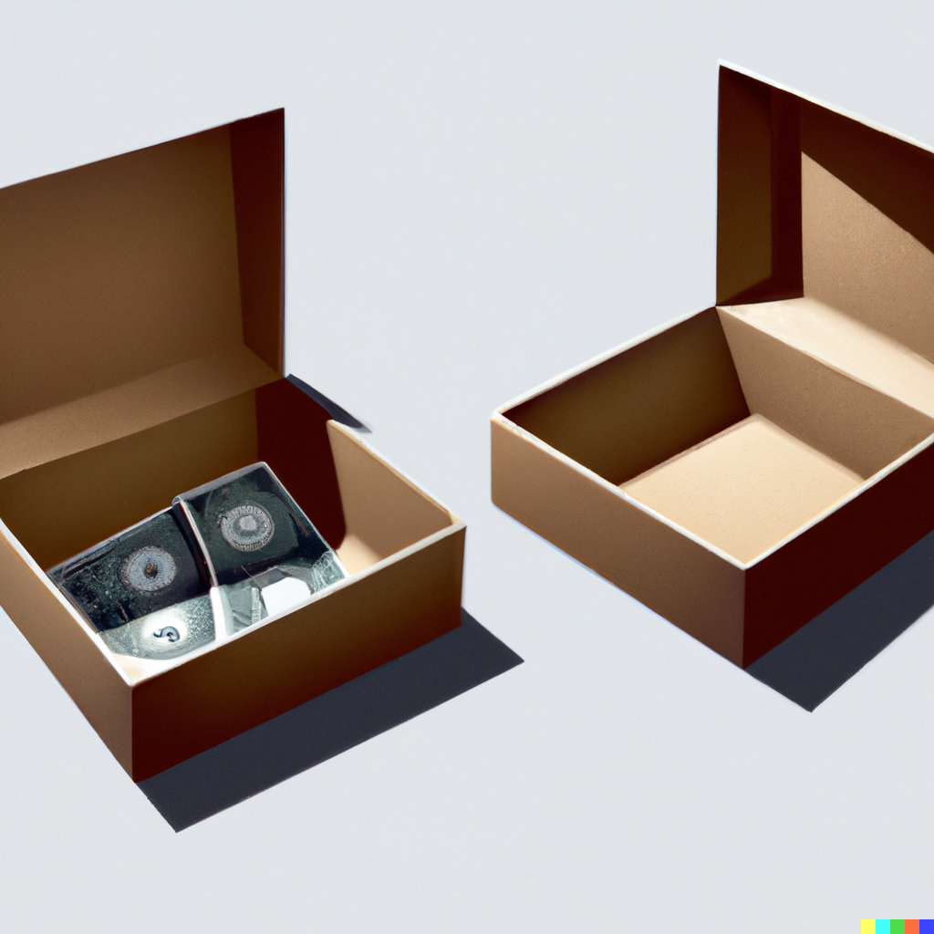
An Argument for Two-Boxing
The Predictor decided whether to put the money in Box B a week ago
Nothing you can do now could affect what the Predictor did a week ago
If the Predictor decided to put the money in Box B, then you end up with more money if you two-box
You get £1,001,000 instead of (just!) £1,000,000
If the Predictor decided not to put the money in Box B, then you end up with more money if you two-box
You get £1,000 rather than nothing at all
So whatever the Predictor decided to do a week ago, you should two-box now

Slide 16
Newcomb’s Paradox
We have two arguments
One tells us we should one-box
The other tells us that we should two-box
When we put them together, we get given contradictory advice
You should only take Box B, but you should also take both boxes!
This is known as Newcomb’s Paradox
To solve it, we need to figure out which (if either) argument is sound

Slide 17
Newcomb’s Paradox
Introducing Newcomb’s Paradox
The Dominance Principle
Evidential Decision Theory
Causal Decision Theory
Why ain’cha rich?
A medical problem
Where are we now?

Slide 18
The Argument for Two-Boxing Again
States:
(ways things might be)
 | B is empty | B is full
One-Box | 0 | 1,000,000
Two-Box | 1,000 | 1,001,000
Acts:
(things you can choose to do)
Outcomes:
(measured by utilities)

Slide 19
The Argument for Two-Boxing Again
 | B is empty | B is full
One-Box | 0 | 1,000,000
Two-Box | 1,000 | 1,001,000
The utility of an outcome is a numerical measurement of how good for you that outcome is – you get to decide the criteria for goodness!
The higher the number, the better the outcome
You can also infer things from the differences between utilities (e.g. two-boxing is better than one-boxing by the same amount no matter whether Box B is empty or full)
We are pretending for simplicity’s sake that there is a linear relationship between utility and money
Outcomes:
(measured by utilities)

Slide 20
The Argument for Two-Boxing Again
 | B is empty | B is full
One-Box | 0 | 1,000,000
Two-Box | 1,000 | 1,001,000
You should two-box because that way, you’re guaranteed to be better off (by 1,000 utility), whether Box B is empty or full!
This is an application of the Dominance Principle
DP: You should prefer act $a$ to act $b$ if: $a$ results in a strictly better outcome than $b$ in every state
Two-boxing dominates one-boxing, because it always leads to a better outcome, so DP dictates that we should two-box
The utility of an outcome is a numerical measurement of how good for you that outcome is – you get to decide the criteria for goodness!
The higher the number, the better the outcome
You can also infer things from the differences between utilities (e.g. two-boxing is better than one-boxing by the same amount no matter whether Box B is empty or full)
We are pretending for simplicity’s sake that there is a linear relationship between utility and money

Slide 25
Never Revise!
 | Pass | Fail
Revise | 2 | 0
Don’t revise | 3 | 1
Not revising dominates revising
So, according to DP, you should never waste your time revising for an exam!

Slide 26
Never Revise!
Ignore That Argument!
You should revise for your exams!!!
Whether or not you revise affects how likely you are to pass or fail
DP totally ignores this fact!
So what the last argument really shows is that you need to be very careful when you apply DP: you can only apply it when the states are independent of the acts
Independent in what sense?
Answer 1: probabilistically independent
Answer 2: causally independent
 | Pass | Fail
Revise | 2 | 0
Don’t revise | 3 | 1
Not revising dominates revising
So, according to DP, you should never waste your time revising for an exam!

Slide 27
Newcomb’s Paradox
Introducing Newcomb’s Paradox
The Dominance Principle
Evidential Decision Theory
Causal Decision Theory
Why ain’cha rich?
A medical problem
Where are we now?

Slide 28
Maximising Expected Utility
If you have to choose between two acts, how should you do it?
Intuitive idea: you should choose the act which has the best expected utility
But what is the expected utility of an act?
It isn’t just the utility of the outcome that you think is most likely
Sometimes it is rational to perform an act because there is a very unlikely possibility of it having a really wonderful outcome! ‘It is worth the risk!’
Rather, you need to sum together all of the possible outcomes of an act, with each outcome weighted by its probability

Slide 29
Varieties of Probability
Probability as statistics
Probabilities are measures of frequency
To say that the probability of a flipped coin landing heads is $1/2$ is just to say that, across the whole run of coin flips that there have ever been, 50% of them involved the coin landing heads
Probability as subjective credence
Probabilities are measures of how likely an agent thinks an event is
You can get a lot of insight into an agent’s credence in a given event by looking at their gambling behaviour: if a lottery pays out £1,000, and tickets cost £1, then it is rational for you to buy a ticket iff your credence in winning is greater than $1/{1000}$
Probability as objective chance
Probabilities are real objective features of (possible) events, that cannot be reduced to mere frequencies
Probability as subjective credence
Probabilities are measures of how likely an agent thinks an event is
You can get a lot of insight into an agent’s credence in a given event by looking at their gambling behaviour: if a lottery pays out £1,000, and tickets cost £1, then it is rational for you to buy a ticket iff your credence in winning is greater than $1/{1000}$
We are interested in figuring out what act you should choose
We should, then, focus on how likely you think it is that various events will happen

Slide 30
Conditional Probability
$\operatorname{Pr}\left(A\right)$ is the absolute, or unconditional, probability of $A$
$\operatorname{Pr}\left(A | B\right)$ is the conditional probability of $A$ given $B$
Roughly: $\operatorname{Pr}\left(A | B\right)$ is the credence you would assign to $A$ if you were assuming $B$
Conditional probability can be defined in terms of the probability of a conjunction
$\operatorname{Pr}\left(A | B\right)={Pr⁡(A∧B)}/{\operatorname{Pr}\left(B\right)}$
Alternatively, we can take conditional probability to be primitive, and define the probability of a conjunction in terms of it
$\operatorname{Pr}\left(A∧B\right)=\operatorname{Pr}\left(A | B\right)×\operatorname{Pr}\left(B\right)=\operatorname{Pr}\left(B | A\right)×\operatorname{Pr}\left(A\right)$
$A$ is probabilistically independent of $B$ iff $\operatorname{Pr}\left(A | B\right)=Pr⁡(A)$
Note: if $\operatorname{Pr}\left(A | B\right)=Pr⁡(A)$ then $\operatorname{Pr}\left(B | A\right)=Pr⁡(B)$
Also note: if $\operatorname{Pr}\left(A | B\right)=Pr⁡(A)$ then $\operatorname{Pr}\left(A∧B\right)=\operatorname{Pr}\left(A\right)×\operatorname{Pr}\left(B\right)$

Slide 31
Evidential Decision Theory
Evidential Decision Theory (EDT) offers a method for calculating the expected utility of an act
Suppose that $S_{1},…, S_{n}$ are the possible states of the world
Let $U\left(a∧S_{i}\right)$ be the utility of performing act $a$ if the world ends up being in state $S_{i}$
This is how you calculate expected utility of act $a$ according to EDT:
$EU_{e}\left(a\right)=\left(\operatorname{Pr}\left(S_{1} | a\right)×U\left(a∧S_{1}\right)\right)+…+\left(\operatorname{Pr}\left(S_{n} | a\right)×U\left(a∧S_{n}\right)\right)$
EDT: You should prefer act $a$ to act $b$ iff $EU_{e}\left(a\right)>EU_{e}\left(b\right)$
If you act in a minimally rational way, we can prove that we can numerically represent utilities and credences that would make your actions conform with EDT
See Section 3.2 of plato.stanford.edu/entries/decision-theory

Slide 32
Back to Your Exam!
 | Pass | Fail
Revise | 2 | 0
Don’t revise | 3 | 1
$\operatorname{Pr}\left(P | R\right)=0.8; \operatorname{Pr}\left(F | R\right)=0.2$
$\operatorname{Pr}\left(P | ¬R\right)=0.1; \operatorname{Pr}\left(F | ¬R\right)=0.9$
$EU_{e}\left(R\right)=\left(0.8×2\right)+\left(0.2×0\right)=1.6$
$EU_{e}\left(¬R\right)=\left(0.1×3\right)+\left(0.9×1\right)=1.2$

Slide 33
Back to Your Exam!
 | Pass | Fail
Revise | 2 | 0
Don’t revise | 3 | 1
$\operatorname{Pr}\left(P | R\right)=0.8; \operatorname{Pr}\left(F | R\right)=0.2$
$\operatorname{Pr}\left(P | ¬R\right)=0.1; \operatorname{Pr}\left(F | ¬R\right)=0.9$
$EU_{e}\left(R\right)=\left(0.8×2\right)+\left(0.2×0\right)=1.6$ ✓
$EU_{e}\left(¬R\right)=\left(0.1×3\right)+\left(0.9×1\right)=1.2$ ✗

Slide 34
Dominance and Independence
EDT says you can still use DP when the state that the world ends up in is probabilistically independent of any act you can choose
 | Good Weather | Bad Weather
Fly | 2 | 0
Sail | 3 | 1
$\operatorname{Pr}\left(G | F\right)=\operatorname{Pr}\left(G\right); \operatorname{Pr}\left(B | F\right)=Pr\left(B\right)$
$\operatorname{Pr}\left(G | S\right)=\operatorname{Pr}\left(G\right); \operatorname{Pr}\left(B | S\right)=\operatorname{Pr}\left(B\right)$
$EU_{e}\left(F\right)=\left(\operatorname{Pr}\left(G\right)×2\right)+\left(\operatorname{Pr}\left(B\right)×0\right)$
$EU_{e}\left(S\right)=\left(\operatorname{Pr}\left(G\right)×3\right)+\left(\operatorname{Pr}\left(B\right)×1\right)$

Slide 35
Dominance and Independence
EDT says you can still use DP when the state that the world ends up in is probabilistically independent of any act you can choose
 | Good Weather | Bad Weather
Fly | 2 | 0
Sail | 3 | 1
$\operatorname{Pr}\left(G | F\right)=\operatorname{Pr}\left(G\right); \operatorname{Pr}\left(B | F\right)=Pr\left(B\right)$
$\operatorname{Pr}\left(G | S\right)=\operatorname{Pr}\left(G\right); \operatorname{Pr}\left(B | S\right)=\operatorname{Pr}\left(B\right)$
$EU_{e}\left(F\right)=\left(\operatorname{Pr}\left(G\right)×2\right)+\left(\operatorname{Pr}\left(B\right)×0\right)$
$EU_{e}\left(S\right)=\left(\operatorname{Pr}\left(G\right)×3\right)+\left(\operatorname{Pr}\left(B\right)×1\right)$
$EU_{e}\left(F\right)=2x+0y$
$EU_{e}\left(S\right)=3x+1y$

Slide 36
Dominance and Independence
EDT says you can still use DP when the state that the world ends up in is probabilistically independent of any act you can choose
 | Good Weather | Bad Weather
Fly | 2 | 0
Sail | 3 | 1
$\operatorname{Pr}\left(G | F\right)=\operatorname{Pr}\left(G\right); \operatorname{Pr}\left(B | F\right)=Pr\left(B\right)$
$\operatorname{Pr}\left(G | S\right)=\operatorname{Pr}\left(G\right); \operatorname{Pr}\left(B | S\right)=\operatorname{Pr}\left(B\right)$
$EU_{e}\left(F\right)=2x+0y$ ✗
$EU_{e}\left(S\right)=3x+1y$ ✓

Slide 37
Back to Newcomb’s Paradox!
 | B is empty | B is full
One-Box | 0 | 1,000,000
Two-Box | 1,000 | 1,001,000
$\operatorname{Pr}\left(E | O\right)=0; \operatorname{Pr}\left(F | O\right)=1$
$\operatorname{Pr}\left(E | T\right)=1; \operatorname{Pr}\left(F | T\right)=0$
$EU_{e}\left(O\right)=\left(0×0\right)+\left(1×1,000,000\right)=1,000,000$
$EU_{e}\left(T\right)=\left(1×1,000\right)+\left(0×1,001,000\right)=1,000$

Slide 38
Back to Newcomb’s Paradox!
 | B is empty | B is full
One-Box | 0 | 1,000,000
Two-Box | 1,000 | 1,001,000
$\operatorname{Pr}\left(E | O\right)=0; \operatorname{Pr}\left(F | O\right)=1$
$\operatorname{Pr}\left(E | T\right)=1; \operatorname{Pr}\left(F | T\right)=0$
$EU_{e}\left(O\right)=\left(0×0\right)+\left(1×1,000,000\right)=1,000,000$ ✓
$EU_{e}\left(T\right)=\left(1×1,000\right)+\left(0×1,001,000\right)=1,000$ ✗

Slide 39
Back to Newcomb’s Paradox!
 | B is empty | B is full
One-Box | 0 | 1,000,000
Two-Box | 1,000 | 1,001,000
$\operatorname{Pr}\left(E | O\right)=0; \operatorname{Pr}\left(F | O\right)=1$
$\operatorname{Pr}\left(E | T\right)=1; \operatorname{Pr}\left(F | T\right)=0$
$EU_{e}\left(O\right)=\left(0×0\right)+\left(1×1,000,000\right)=1,000,000$ ✓
$EU_{e}\left(T\right)=\left(1×1,000\right)+\left(0×1,001,000\right)=1,000$ ✗
$\operatorname{Pr}\left(E | O\right)=0.2; \operatorname{Pr}\left(F | O\right)=0.8$
$\operatorname{Pr}\left(E | T\right)=0.8; \operatorname{Pr}\left(F | T\right)=0.2$
$EU_{e}\left(O\right)=\left(0.2×0\right)+\left(0.8×1,000,000\right)=800,000$ ✓
$EU_{e}\left(T\right)=\left(0.8×1,000\right)+\left(0.2×1,001,000\right)=201,000$ ✗

Slide 40
Back to Newcomb’s Paradox!
 | B is empty | B is full
One-Box | 0 | 1,000,000
Two-Box | 1,000 | 1,001,000
$\operatorname{Pr}\left(E | O\right)=0.2; \operatorname{Pr}\left(F | O\right)=0.8$
$\operatorname{Pr}\left(E | T\right)=0.8; \operatorname{Pr}\left(F | T\right)=0.2$
$EU_{e}\left(O\right)=\left(0.2×0\right)+\left(0.8×1,000,000\right)=800,000$ ✓
$EU_{e}\left(T\right)=\left(0.8×1,000\right)+\left(0.2×1,001,000\right)=201,000$ ✗
$\operatorname{Pr}\left(E | O\right)=0.4995; \operatorname{Pr}\left(F | O\right)=0.5005$
$\operatorname{Pr}\left(E | T\right)=0.5005; \operatorname{Pr}\left(F | T\right)=0.4995$
$EU_{e}\left(O\right)=\left(0.4995×0\right)+\left(0.5005×1,000,000\right)=500,500$
$EU_{e}\left(T\right)=\left(0.5005×1,000\right)+\left(0.4995×1,001,000\right)=500,500$

Slide 41
Back to Newcomb’s Paradox!
 | B is empty | B is full
One-Box | 0 | 1,000,000
Two-Box | 1,000 | 1,001,000
$\operatorname{Pr}\left(E | O\right)=1−\left(x+0.001\right); \operatorname{Pr}\left(F | O\right)=x+0.001$
$\operatorname{Pr}\left(E | T\right)=1−x; \operatorname{Pr}\left(F | T\right)=x$
$EU_{e}\left(O\right)=0+\left(\left(x+0.001\right)×1,000,000\right)=1,000,000x+1,000$
$EU_{e}\left(T\right)=\left(\left(1−x\right)×1,000\right)+1,001,000x=1,000,000x+1,000$
$\operatorname{Pr}\left(E | O\right)=0.4995; \operatorname{Pr}\left(F | O\right)=0.5005$
$\operatorname{Pr}\left(E | T\right)=0.5005; \operatorname{Pr}\left(F | T\right)=0.4995$
$EU_{e}\left(O\right)=\left(0.4995×0\right)+\left(0.5005×1,000,000\right)=500,500$
$EU_{e}\left(T\right)=\left(0.5005×1,000\right)+\left(0.4995×1,001,000\right)=500,500$

Slide 42
Back to Newcomb’s Paradox!
 | B is empty | B is full
One-Box | 0 | 1,000,000
Two-Box | 1,000 | 1,001,000
$\operatorname{Pr}\left(E | O\right)=1−\left(x+0.001\right); \operatorname{Pr}\left(F | O\right)=x+0.001$
$\operatorname{Pr}\left(E | T\right)=1−x; \operatorname{Pr}\left(F | T\right)=x$
$EU_{e}\left(O\right)=0+\left(\left(x+0.001\right)×1,000,000\right)=1,000,000x+1,000$
$EU_{e}\left(T\right)=\left(\left(1−x\right)×1,000\right)+1,001,000x=1,000,000x+1,000$
$\operatorname{Pr}\left(E | O\right)=0.5998; \operatorname{Pr}\left(F | O\right)=0.4002$
$\operatorname{Pr}\left(E | T\right)=0.6; \operatorname{Pr}\left(F | T\right)=0.4$
$EU_{e}\left(O\right)=\left(0.5998×0\right)+\left(0.4002×1,000,000\right)=402,000$ ✓
$EU_{e}\left(T\right)=\left(0.6×1,000\right)+\left(0.4×1,001,000\right)=401,000$ ✗

Slide 43
Newcomb’s Paradox
Introducing Newcomb’s Paradox
The Dominance Principle
Evidential Decision Theory
Causal Decision Theory
Why ain’cha rich?
A medical problem
Where are we now?

Slide 44
Introducing Causal Dependence
 | Pass | Fail
Revise | 2 | 0
Don’t revise | 3 | 1
You cannot apply DP because the state that the world ends up in is dependent on the act you choose to perform
Advocates of EDT say that the kind of dependence that matters here is probabilistic dependence
But advocates of Causal Decision Theory (CDT) say that it is causal dependence

Slide 45
Introducing Causal Dependence
 | Pass | Fail
Revise | 2 | 0
Don’t revise | 3 | 1
The odds of passing or failing your exam are causally affected by whether or not you revise
If you revise, then that will cause the odds of passing to increase
If you do not revise, then that will cause the odds of failing to increase
You cannot apply DP because the state that the world ends up in is dependent on the act you choose to perform
Advocates of EDT say that the kind of dependence that matters here is probabilistic dependence
But advocates of Causal Decision Theory (CDT) say that it is causal dependence

Slide 46
Why Should Causation Matter?
Decision Theory is meant to tell you how to act in various situations
Action is a fundamentally causal notion
To act in a certain way is, at least in part, to cause certain things to happen
It is then natural to think that an action is better (or worse) for you if it causes better (or worse) outcomes
So our Decision Theory should advise us to choose actions which have the best expected causal outcomes!

Slide 47
Causation and Counterfactuals
Many philosophers think that we can offer a counterfactual analysis of causation
Pressing the pedal will cause the car to accelerate
If you were to press the pedal, then the car would accelerate
You press the pedal $⇛$ the car accelerates
David Lewis famously developed this kind of analysis, and it has recently been defended by our own Paul Noordhof
Lewis (1987) Collected Papers, vol.2 (OUP)
Noordhof (2020) A Variety of Causes (OUP)
For the purposes of this lecture, though, we can stick with an informal understanding of counterfactuals
(And if you don’t like the counterfactual analysis of causation, you could swap it for your preferred theory!)

Slide 48
Causal Decision Theory
According to EDT, this is how to calculate the expected utility of an act:
$EU_{e}\left(a\right)=\left(\operatorname{Pr}\left(S_{1} | a\right)×U\left(a∧S_{1}\right)\right)+…+\left(\operatorname{Pr}\left(S_{n} | a\right)×U\left(a∧S_{n}\right)\right)$
CDT offers an alternative way of calculating expected utility:
$EU_{c}\left(a\right)=\left(\operatorname{Pr}\left(a⇛S_{1}\right)×U\left(a∧S_{1}\right)\right)+…+\left(\operatorname{Pr}\left(a⇛S_{n}\right)×U\left(a∧S_{n}\right)\right)$
(This is one standard definition, but not the only one! Lewis gives an alternative in his ‘Causal Decision Theory’, 1981, Australasian Journal of Philosophy)
According to CDT, we shouldn’t use conditional probabilities to calculate expected utility
We should use unconditional probabilities of counterfactual conditionals
CDT: You should prefer act $a$ to act $b$ iff $EU_{c}\left(a\right)>EU_{c}\left(b\right)$

Slide 49
Back to Your Exam (again)!
 | Pass | Fail
Revise | 2 | 0
Don’t revise | 3 | 1
$\operatorname{Pr}\left(R⇛P\right)=0.8; \operatorname{Pr}\left(R ⇛F\right)=0.2$
$\operatorname{Pr}{(¬R⇛P)}=0.1; \operatorname{Pr}{(¬R⇛F)}=0.9$
$EU_{c}\left(R\right)=\left(0.8×2\right)+\left(0.2×0\right)=1.6$
$EU_{c}\left(¬R\right)=\left(0.1×3\right)+\left(0.9×1\right)=1.2$

Slide 50
Back to Your Exam (again)!
 | Pass | Fail
Revise | 2 | 0
Don’t revise | 3 | 1
$\operatorname{Pr}\left(R⇛P\right)=0.8; \operatorname{Pr}\left(R ⇛F\right)=0.2$
$\operatorname{Pr}{(¬R⇛P)}=0.1; \operatorname{Pr}{(¬R⇛F)}=0.9$
$EU_{c}\left(R\right)=\left(0.8×2\right)+\left(0.2×0\right)=1.6$ ✓
$EU_{c}\left(¬R\right)=\left(0.1×3\right)+\left(0.9×1\right)=1.2$ ✗

Slide 51
Dominance and Independence (again)
CDT says you can still use DP when the state that the world ends up in is causally independent of any act you can choose
$S_{i}$ is causally independent of any act you can choose iff: for any two acts you can choose from, $a$ and $b$, $\operatorname{Pr}\left(a⇛S_{i}\right)=\operatorname{Pr}\left(b⇛S_{i}\right)$
 | Good Weather | Bad Weather
Fly | 2 | 0
Sail | 3 | 1
$\operatorname{Pr}\left(F⇛G\right)=\operatorname{Pr}\left(S⇛G\right)$
$\operatorname{Pr}\left(F⇛B\right)=\operatorname{Pr}\left(S⇛B\right)$
$EU_{c}\left(F\right)=\left(\operatorname{Pr}\left(F⇛G\right)×2\right)+\left(\operatorname{Pr}\left(F⇛B\right)×0\right)$
$EU_{c}\left(S\right)=\left(\operatorname{Pr}\left(S⇛G\right)×3\right)+\left(\operatorname{Pr}\left(S⇛B\right)×1\right)$

Slide 52
Dominance and Independence (again)
CDT says you can still use DP when the state that the world ends up in is causally independent of any act you can choose
$S_{i}$ is causally independent of any act you can choose iff: for any two acts you can choose from, $a$ and $b$, $\operatorname{Pr}\left(a⇛S_{i}\right)=\operatorname{Pr}\left(b⇛S_{i}\right)$
 | Good Weather | Bad Weather
Fly | 2 | 0
Sail | 3 | 1
$\operatorname{Pr}\left(F⇛G\right)=\operatorname{Pr}\left(S⇛G\right)$
$\operatorname{Pr}\left(F⇛B\right)=\operatorname{Pr}\left(S⇛B\right)$
$EU_{c}\left(F\right)=2x+0y$
$EU_{c}\left(S\right)=3x+y$
$\operatorname{Pr}\left(F⇛G\right)=\operatorname{Pr}\left(S⇛G\right)$
$\operatorname{Pr}\left(F⇛B\right)=\operatorname{Pr}\left(S⇛B\right)$
$EU_{c}\left(F\right)=\left(\operatorname{Pr}\left(F⇛G\right)×2\right)+\left(\operatorname{Pr}\left(F⇛B\right)×0\right)$
$EU_{c}\left(S\right)=\left(\operatorname{Pr}\left(S⇛G\right)×3\right)+\left(\operatorname{Pr}\left(S⇛B\right)×1\right)$

Slide 53
Dominance and Independence (again)
CDT says you can still use DP when the state that the world ends up in is causally independent of any act you can choose
$S_{i}$ is causally independent of any act you can choose iff: for any two acts you can choose from, $a$ and $b$, $\operatorname{Pr}\left(a⇛S_{i}\right)=\operatorname{Pr}\left(b⇛S_{i}\right)$
 | Good Weather | Bad Weather
Fly | 2 | 0
Sail | 3 | 1
$\operatorname{Pr}\left(F⇛G\right)=\operatorname{Pr}\left(S⇛G\right)$
$\operatorname{Pr}\left(F⇛B\right)=\operatorname{Pr}\left(S⇛B\right)$
$EU_{c}\left(F\right)=2x+0y$ ✗
$EU_{c}\left(S\right)=3x+y$ ✓

Slide 54
Back to Newcomb’s Paradox (again)!
 | B is empty | B is full
One-Box | 0 | 1,000,000
Two-Box | 1,000 | 1,001,000
What you do now cannot causally affect what’s in Box B, since the Predictor decided that a week ago!
$\operatorname{Pr}\left(O⇛E\right)=Pr⁡(T⇛E)$
$\operatorname{Pr}\left(O⇛F\right)=Pr⁡(T⇛F)$
$EU_{c}\left(O\right)=\left(\operatorname{Pr}\left(O⇛E\right)×0\right)+\left(\operatorname{Pr}\left(O⇛F\right)×1,000,000\right)$
$EU_{c}\left(T\right)=\left(\operatorname{Pr}\left(T⇛E\right)×1,000\right)+\left(\operatorname{Pr}\left(T⇛F\right)×1,001,000\right)$

Slide 55
Back to Newcomb’s Paradox (again)!
 | B is empty | B is full
One-Box | 0 | 1,000,000
Two-Box | 1,000 | 1,001,000
What you do now cannot causally affect what’s in Box B, since the Predictor decided that a week ago!
$\operatorname{Pr}\left(O⇛E\right)=Pr⁡(T⇛E)$
$\operatorname{Pr}\left(O⇛F\right)=Pr⁡(T⇛F)$
$EU_{c}\left(O\right)=\left(\operatorname{Pr}\left(O⇛E\right)×0\right)+\left(\operatorname{Pr}\left(O⇛F\right)×1,000,000\right)$
$EU_{c}\left(T\right)=\left(\operatorname{Pr}\left(T⇛E\right)×1,000\right)+\left(\operatorname{Pr}\left(T⇛F\right)×1,001,000\right)$
What you do now cannot causally affect what’s in Box B, since the Predictor decided that a week ago!
$\operatorname{Pr}\left(O⇛E\right)=Pr⁡(T⇛E)$
$\operatorname{Pr}\left(O⇛F\right)=Pr⁡(T⇛F)$
$EU_{c}\left(O\right)=0x+1,000,000y$
$EU_{c}\left(T\right)=1,000x+1,001,000y$

Slide 56
Back to Newcomb’s Paradox (again)!
 | B is empty | B is full
One-Box | 0 | 1,000,000
Two-Box | 1,000 | 1,001,000
What you do now cannot causally affect what’s in Box B, since the Predictor decided that a week ago!
$\operatorname{Pr}\left(O⇛E\right)=Pr⁡(T⇛E)$
$\operatorname{Pr}\left(O⇛F\right)=Pr⁡(T⇛F)$
$EU_{c}\left(O\right)=0x+1,000,000y$ ✗
$EU_{c}\left(T\right)=1,000x+1,001,000y$ ✓

Slide 57
Newcomb’s Paradox
Introducing Newcomb’s Paradox
The Dominance Principle
Evidential Decision Theory
Causal Decision Theory
Why ain’cha rich?
A medical problem
Where are we now?

Slide 58
An Argument for EDT
Everyone agrees that if you take EDT’s advice and one-box, you’ll probably end up with £1,000,000
And everyone agrees that if you take CDT’s advice and two-box, you’ll probably end up with just £1,000
So isn’t it obvious that EDT is the right theory of rational decision making?
Following EDT predictably gets you more of what you value!
The Challenge to CDT: Why ain’cha rich?

Slide 59
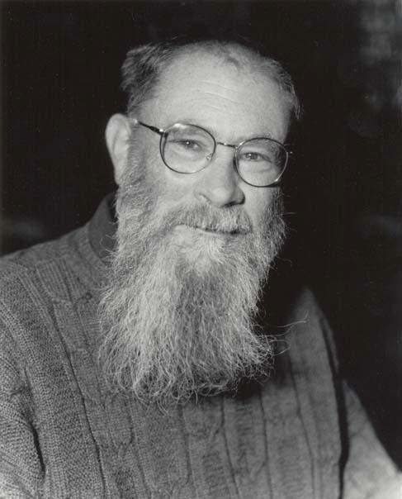
Lewis’s Answer
Why aren’t I rich? Because it was never an option for me to get rich!
Lewis (1981) ‘Why ain’cha rich?’ Noûs 15, pp.377-80
A two-boxer takes all of the money that is available to them; it’s just that there’s only £1,000 in the two boxes!
The two-boxer’s decision to take both boxes didn’t deprive them of any money
They caused themself to get the most money they could out of the situation!

Slide 60
A Point in EDT’s Favour
According to Lewis, Newcomb’s Paradox is generated by the Predictor’s announcement that they will reward people who irrationally one-box
However, Lewis recognises an important asymmetry between EDT and CDT
Some terminology
An act is E-rational iff it is recommended by EDT, and E-irrational iff it is recommended against by EDT
An act is C-rational iff it is recommended by CDT, and C-irrational iff it is recommended against by CDT
The standard Newcomb story, in which the Predictor rewards people who are C-irrational, is logically coherent
But a Newcomb-style problem in which the Predictor rewards people who are E-irrational would be logically incoherent

Slide 61
A Point in EDT’s Favour
According to Lewis, Newcomb’s Paradox is generated by the Predictor’s announcement that they will reward people who irrationally one-box
However, Lewis recognises an important asymmetry between EDT and CDT
Some terminology
An act is E-rational iff it is recommended by EDT, and E-irrational iff it is recommended against by EDT
An act is C-rational iff it is recommended by CDT, and C-irrational iff it is recommended against by CDT
The standard Newcomb story, in which the Predictor rewards people who are C-irrational, is logically coherent
But a Newcomb-style problem in which the Predictor rewards people who are E-irrational would be logically incoherent
If the Predictor announces that she will reward an E-irrational act, she thereby makes that act E-rational!
The Predictor announces that she will put the £1,000,000 in Box B iff she predicted that you would make the E-irrational choice (if neither is E-irrational, then Box B is left empty)
There are three possibilities:
1. $Pr\left(F | O\right)<Pr\left(F | T\right)+0.001$, and so one-boxing is E-irrational and two-boxing isn’t. So now the Predictor will reward one-boxing, and $Pr\left(F | O\right)>Pr\left(F | T\right)+0.001$. Contradiction!
2. $Pr\left(F | O\right)=Pr\left(F | T\right)+0.001$, and so neither one-boxing nor two-boxing is E-irrational. So now the Predictor will reward neither, and $Pr\left(F | O\right)=Pr\left(F | T\right)$. Contradiction!
3. $Pr\left(F | O\right)>Pr\left(F | T\right)+0.001$, and so two-boxing is E-irrational and one-boxing isn’t. So now the Predictor will reward two-boxing, and $Pr\left(F | O\right)<Pr\left(F | T\right)+0.001$. Contradiction!

Slide 62
A Point in EDT’s Favour
If the Predictor announces that she will reward an E-irrational act, she thereby makes that act E-rational!
The Predictor announces that she will put the £1,000,000 in Box B iff she predicted that you would make the E-irrational choice (if neither is E-irrational, then Box B is left empty)
There are three possibilities (and assuming that the Predictor is sufficiently reliable):
1. $Pr\left(F | O\right)<Pr\left(F | T\right)+0.001$, and so one-boxing is E-irrational and two-boxing isn’t. So now the Predictor will reward one-boxing, and $Pr\left(F | O\right)>Pr\left(F | T\right)+0.001$. Contradiction!
2. $Pr\left(F | O\right)=Pr\left(F | T\right)+0.001$, and so neither one-boxing nor two-boxing is E-irrational. Predictor will reward neither, and $Pr\left(F | O\right)=Pr\left(F | T\right)$. Contradiction!
3. $Pr\left(F | O\right)>Pr\left(F | T\right)+0.001$, and so two-boxing is E-irrational and one-boxing isn’t. So now the Predictor will reward two-boxing, and $Pr\left(F | O\right)<Pr\left(F | T\right)+0.001$. Contradiction!

Slide 63
A Point in EDT’s Favour
If the Predictor announces that she will reward an E-irrational act, she thereby makes that act E-rational!
The Predictor announces that she will put the £1,000,000 in Box B iff she predicted that you would make the E-irrational choice (if neither is E-irrational, then Box B is left empty)
There are three possibilities (and assuming that the Predictor is sufficiently reliable):
1. $Pr\left(F | O\right)<Pr\left(F | T\right)+0.001$, and so one-boxing is E-irrational and two-boxing isn’t. So now the Predictor will reward one-boxing, and $Pr\left(F | O\right)>Pr\left(F | T\right)+0.001$. Contradiction!
2. $Pr\left(F | O\right)=Pr\left(F | T\right)+0.001$, and so neither one-boxing nor two-boxing is E-irrational. Predictor will reward neither, and $Pr\left(F | O\right)=Pr\left(F | T\right)$. Contradiction!
3. $Pr\left(F | O\right)>Pr\left(F | T\right)+0.001$, and so two-boxing is E-irrational and one-boxing isn’t. So now the Predictor will reward two-boxing, and $Pr\left(F | O\right)<Pr\left(F | T\right)+0.001$. Contradiction!

Slide 64
A Point in EDT’s Favour
If the Predictor announces that she will reward an E-irrational act, she thereby makes that act E-rational!
The Predictor announces that she will put the £1,000,000 in Box B iff she predicted that you would make the E-irrational choice (if neither is E-irrational, then Box B is left empty)
There are three possibilities (and assuming that the Predictor is sufficiently reliable):
1. $Pr\left(F | O\right)<Pr\left(F | T\right)+0.001$, and so one-boxing is E-irrational and two-boxing isn’t. So now the Predictor will reward one-boxing, and $Pr\left(F | O\right)>Pr\left(F | T\right)+0.001$. Contradiction!
2. $Pr\left(F | O\right)=Pr\left(F | T\right)+0.001$, and so neither one-boxing nor two-boxing is E-irrational. So now the Predictor will reward neither, and $Pr\left(F | O\right)=Pr\left(F | T\right)$. Contradiction!
3. $Pr\left(F | O\right)>Pr\left(F | T\right)+0.001$, and so two-boxing is E-irrational and one-boxing isn’t. So now the Predictor will reward two-boxing, and $Pr\left(F | O\right)<Pr\left(F | T\right)+0.001$. Contradiction!

Slide 65
A Point in EDT’s Favour
If the Predictor announces that she will reward an E-irrational act, she thereby makes that act E-rational!
The Predictor announces that she will put the £1,000,000 in Box B iff she predicted that you would make the E-irrational choice (if neither is E-irrational, then Box B is left empty)
There are three possibilities (and assuming that the Predictor is sufficiently reliable):
1. $Pr\left(F | O\right)<Pr\left(F | T\right)+0.001$, and so one-boxing is E-irrational and two-boxing isn’t. So now the Predictor will reward one-boxing, and $Pr\left(F | O\right)>Pr\left(F | T\right)+0.001$. Contradiction!
2. $Pr\left(F | O\right)=Pr\left(F | T\right)+0.001$, and so neither one-boxing nor two-boxing is E-irrational. So now the Predictor will reward neither, and $Pr\left(F | O\right)=Pr\left(F | T\right)$. Contradiction!
3. $Pr\left(F | O\right)>Pr\left(F | T\right)+0.001$, and so two-boxing is E-irrational and one-boxing isn’t. So now the Predictor will reward two-boxing, and $Pr\left(F | O\right)<Pr\left(F | T\right)+0.001$. Contradiction!

Slide 66
Newcomb’s Paradox
Introducing Newcomb’s Paradox
The Dominance Principle
Evidential Decision Theory
Causal Decision Theory
Why ain’cha rich?
A medical problem
Where are we now?

Slide 67
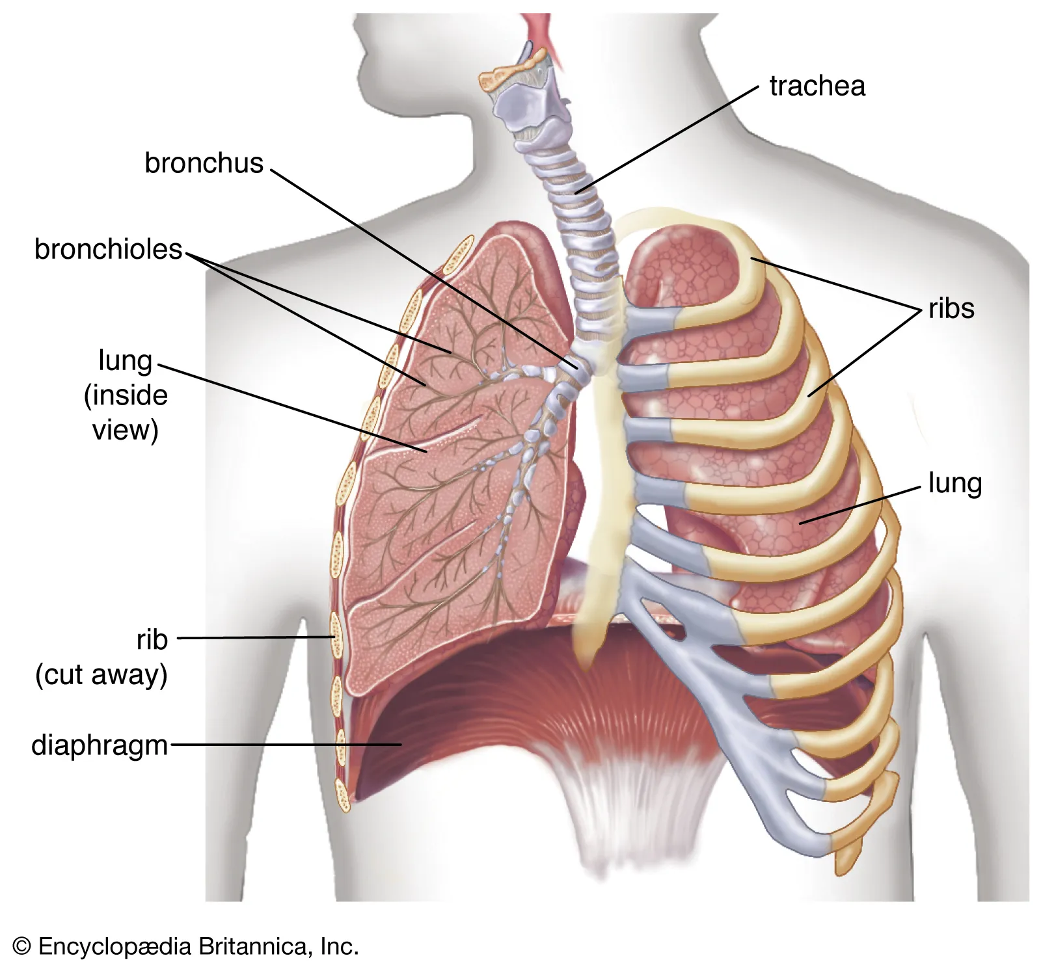
A Medical Problem
Smoking causes cancer! But imagine it didn’t…
Imagine that there was a causal correlation between smoking and cancer, but because of a common cause:
There is a gene that makes you want to smoke
And that gene also increases your risk of cancer
In this situation, it’s bad news if you find yourself choosing to smoke
You should increase your credence that you have the gene, and so have cancer
But, intuitively, there’s no reason not to smoke
If you don’t have the gene, smoking won’t increase your risk of cancer
If you do, then not smoking won’t decrease your risk of cancer

Slide 68
What EDT Says
 | Cancer | No Cancer
Don’t smoke | -150 | 0
Smoke | -100 | 50
$\operatorname{Pr}\left(C | ¬S\right)=0.2; \operatorname{Pr}\left(¬C | ¬S\right)=0.8$
$\operatorname{Pr}\left(C | S\right)=0.9; \operatorname{Pr}\left(¬C | ¬S\right)=0.1$
$EU_{e}\left(¬S\right)=\left(0.2×−150\right)+\left(0.8×0\right)=−30$
$EU_{e}\left(S\right)=\left(0.9×−100\right)+\left(0.1×50\right)=−85$

Slide 69
What EDT Says
 | Cancer | No Cancer
Don’t smoke | -150 | 0
Smoke | -100 | 50
$\operatorname{Pr}\left(C | ¬S\right)=0.2; \operatorname{Pr}\left(¬C | ¬S\right)=0.8$
$\operatorname{Pr}\left(C | S\right)=0.9; \operatorname{Pr}\left(¬C | ¬S\right)=0.1$
$EU_{e}\left(¬S\right)=\left(0.2×−150\right)+\left(0.8×0\right)=−30$ ✓
$EU_{e}\left(S\right)=\left(0.9×−100\right)+\left(0.1×50\right)=−85$ ✗

Slide 70
What EDT Says
What CDT Says
 | Cancer | No Cancer
Don’t smoke | -150 | 0
Smoke | -100 | 50
Whether you smoke cannot causally affect whether you get cancer (in this made-up story!)
$\operatorname{Pr}\left(S⇛C\right)=Pr⁡(¬S⇛C)$
$\operatorname{Pr}\left(S⇛¬C\right)=Pr⁡(¬S⇛¬C)$
$EU_{c}\left(¬S\right)=\left(\operatorname{Pr}\left(¬S⇛C\right)×−150\right)+\left(\operatorname{Pr}\left(¬S⇛¬C\right)×0\right)$
$EU_{c}\left(S\right)=\left(\operatorname{Pr}\left(S⇛C\right)×−100\right)+\left(\operatorname{Pr}\left(S⇛¬C\right)×50\right)$
$\operatorname{Pr}\left(C | ¬S\right)=0.2; \operatorname{Pr}\left(¬C | ¬S\right)=0.8$
$\operatorname{Pr}\left(C | S\right)=0.9; \operatorname{Pr}\left(¬C | ¬S\right)=0.1$
$EU_{e}\left(¬S\right)=\left(0.2×−150\right)+\left(0.8×0\right)=−30$ ✓
$EU_{e}\left(S\right)=\left(0.9×−100\right)+\left(0.1×50\right)=−85$ ✗

Slide 71
What CDT Says
 | Cancer | No Cancer
Don’t smoke | -150 | 0
Smoke | -100 | 50
Whether you smoke cannot causally affect whether you get cancer (in this made-up story!)
$\operatorname{Pr}\left(S⇛C\right)=Pr⁡(¬S⇛C)$
$\operatorname{Pr}\left(S⇛¬C\right)=Pr⁡(¬S⇛¬C)$
$EU_{c}\left(¬S\right)=\left(\operatorname{Pr}\left(¬S⇛C\right)×−150\right)+\left(\operatorname{Pr}\left(¬S⇛¬C\right)×0\right)$
$EU_{c}\left(S\right)=\left(\operatorname{Pr}\left(S⇛C\right)×−100\right)+\left(\operatorname{Pr}\left(S⇛¬C\right)×50\right)$
Whether you smoke cannot causally affect whether you get cancer (in this made-up story!)
$\operatorname{Pr}\left(S⇛C\right)=Pr⁡(¬S⇛C)$
$\operatorname{Pr}\left(S⇛¬C\right)=Pr⁡(¬S⇛¬C)$
$EU_{c}\left(¬S\right)=−150x+0y$
$EU_{c}\left(S\right)=−100x+50y$

Slide 72
What CDT Says
 | Cancer | No Cancer
Don’t smoke | -150 | 0
Smoke | -100 | 50
Whether you smoke cannot causally affect whether you get cancer (in this made-up story!)
$\operatorname{Pr}\left(S⇛C\right)=Pr⁡(¬S⇛C)$
$\operatorname{Pr}\left(S⇛¬C\right)=Pr⁡(¬S⇛¬C)$
$EU_{c}\left(¬S\right)=−150x+0y$ ✗
$EU_{c}\left(S\right)=−100x+50y$ ✓

Slide 73
A Formal Analogy?
The Newcomb Problem and the Medical Problem appear to be formally analogous
 | B is empty | B is full
One-box | 0 | 1,000,000
Two-box | 1,000 | 1,001,000
 | Cancer | No Cancer
Don’t smoke | -150 | 0
Smoke | -100 | 50
Two-boxing dominates one-boxing; smoking dominates not smoking
The states are probabilistically dependent on, but causally independent of, the acts
So if CDT gives the right advice in the Medical Problem, mustn’t it also give the right advice in the Newcomb Problem?

Slide 74
The Tickle Defence
Some philosophers have argued that there is an important disanalogy between the two cases
Presumably, the gene makes you smoke by making you want to smoke
So, if you feel yourself wanting to smoke, that is bad news (since it’s evidence that you have the gene)
But if you already want to smoke, finding yourself actually smoking isn’t further bad news!
So, in the Medical Problem, EDT ends up recommending smoking!
This is known as the Tickle Defence
Horwich (1987) Asymmetries in Time (MIT Press), ch.11
Ahmed (2014) Evidence, Decision, and Causality (CUP)

Slide 75
No News
Here’s how we formalise the idea that, once you know whether you want to smoke, finding out whether you actually smoke or not isn’t news:
$\operatorname{Pr}\left(C | W∧S\right)=\operatorname{Pr}\left(C | W∧¬S\right)=\operatorname{Pr}\left(C | W\right)$
$\operatorname{Pr}\left(C | ¬W∧S\right)=\operatorname{Pr}\left(C | ¬W∧¬S\right)=\operatorname{Pr}\left(C | ¬W\right)$
These equations tell you that, although assuming that you do or don’t want to smoke may affect your credence that you will get cancer, adding further assumptions about whether you actually smoke makes no difference

Slide 76
Updating Your Credences
In the Medical Problem, you should first check whether you want to smoke, and update your credence that you will get cancer
If you want to smoke, then set your credence as: $\operatorname{Pr}\left(C\right)=\operatorname{Pr}\left(C | W\right)$
In that case: $\operatorname{Pr}\left(C | S\right)=\operatorname{Pr}\left(C | W∧S\right)$, and $\operatorname{Pr}\left(C | ¬S\right)=\operatorname{Pr}\left(C | W∧¬S\right)$
If you don’t want to smoke, then set your credence as: $\operatorname{Pr}\left(C\right)=\operatorname{Pr}\left(C | ¬W\right)$
In that case: $\operatorname{Pr}\left(C | S\right)=\operatorname{Pr}\left(C | ¬W∧S\right)$, and $\operatorname{Pr}\left(C | ¬S\right)=\operatorname{Pr}\left(C | ¬W∧¬S\right)$
We already noted that actually smoking or not isn’t news once you know whether you want to smoke
$\operatorname{Pr}\left(C | W∧S\right)=\operatorname{Pr}\left(C | W∧¬S\right)=\operatorname{Pr}\left(C | W\right)$
$\operatorname{Pr}\left(C | ¬W∧S\right)=\operatorname{Pr}\left(C | ¬W∧¬S\right)=\operatorname{Pr}\left(C | ¬W\right)$
Therefore, $\operatorname{Pr}\left(C | S\right)=\operatorname{Pr}\left(C | ¬S\right)=\operatorname{Pr}\left(C\right)$

Slide 77
Updating Your Credences
In the Medical Problem, you should first check whether you want to smoke, and update your credence that you will get cancer
If you want to smoke, then set your credence as: $\operatorname{Pr}\left(C\right)=\operatorname{Pr}\left(C | W\right)$
In that case: $\operatorname{Pr}\left(C | S\right)=\operatorname{Pr}\left(C | W∧S\right)$, and $\operatorname{Pr}\left(C | ¬S\right)=\operatorname{Pr}\left(C | W∧¬S\right)$
We already noted that actually smoking or not isn’t news once you know whether you want to smoke
$\operatorname{Pr}\left(C | W∧S\right)=\operatorname{Pr}\left(C | W∧¬S\right)=\operatorname{Pr}\left(C | W\right)$
Therefore, $\operatorname{Pr}\left(C | S\right)=\operatorname{Pr}\left(C | ¬S\right)=\operatorname{Pr}\left(C\right)$
$\operatorname{Pr}\left(C | S\right)=\operatorname{Pr}\left(C | W∧¬S\right)=\operatorname{Pr}\left(C | W\right)$

Slide 78
Updating Your Credences
In the Medical Problem, you should first check whether you want to smoke, and update your credence that you will get cancer
If you want to smoke, then set your credence as: $\operatorname{Pr}\left(C\right)=\operatorname{Pr}\left(C | W\right)$
In that case: $\operatorname{Pr}\left(C | S\right)=\operatorname{Pr}\left(C | W∧S\right)$, and $\operatorname{Pr}\left(C | ¬S\right)=\operatorname{Pr}\left(C | W∧¬S\right)$
We already noted that actually smoking or not isn’t news once you know whether you want to smoke
$\operatorname{Pr}\left(C | S\right)=\operatorname{Pr}\left(C | W∧¬S\right)=\operatorname{Pr}\left(C | W\right)$
Therefore, $\operatorname{Pr}\left(C | S\right)=\operatorname{Pr}\left(C | ¬S\right)=\operatorname{Pr}\left(C\right)$
$\operatorname{Pr}\left(C | S\right)=\operatorname{Pr}\left(C | ¬S\right)=\operatorname{Pr}\left(C | W\right)$

Slide 79
Updating Your Credences
In the Medical Problem, you should first check whether you want to smoke, and update your credence that you will get cancer
If you want to smoke, then set your credence as: $\operatorname{Pr}\left(C\right)=\operatorname{Pr}\left(C | W\right)$
In that case: $\operatorname{Pr}\left(C | S\right)=\operatorname{Pr}\left(C | W∧S\right)$, and $\operatorname{Pr}\left(C | ¬S\right)=\operatorname{Pr}\left(C | W∧¬S\right)$
We already noted that actually smoking or not isn’t news once you know whether you want to smoke
$\operatorname{Pr}\left(C | S\right)=\operatorname{Pr}\left(C | ¬S\right)=\operatorname{Pr}\left(C | W\right)$
Therefore, $\operatorname{Pr}\left(C | S\right)=\operatorname{Pr}\left(C | ¬S\right)=\operatorname{Pr}\left(C\right)$
$\operatorname{Pr}\left(C | S\right)=\operatorname{Pr}\left(C | ¬S\right)=\operatorname{Pr}\left(C\right)$

Slide 80
Updating Your Credences
In the Medical Problem, you should first check whether you want to smoke, and update your credence that you will get cancer
If you want to smoke, then set your credence as: $\operatorname{Pr}\left(C\right)=\operatorname{Pr}\left(C | W\right)$
In that case: $\operatorname{Pr}\left(C | S\right)=\operatorname{Pr}\left(C | W∧S\right)$, and $\operatorname{Pr}\left(C | ¬S\right)=\operatorname{Pr}\left(C | W∧¬S\right)$
If you don’t want to smoke, then set your credence as: $\operatorname{Pr}\left(C\right)=\operatorname{Pr}\left(C | ¬W\right)$
In that case: $\operatorname{Pr}\left(C | S\right)=\operatorname{Pr}\left(C | ¬W∧S\right)$, and $\operatorname{Pr}\left(C | ¬S\right)=\operatorname{Pr}\left(C | ¬W∧¬S\right)$
We already noted that actually smoking or not isn’t news once you know whether you want to smoke
$\operatorname{Pr}\left(C | W∧S\right)=\operatorname{Pr}\left(C | W∧¬S\right)=\operatorname{Pr}\left(C | W\right)$
$\operatorname{Pr}\left(C | ¬W∧S\right)=\operatorname{Pr}\left(C | ¬W∧¬S\right)=\operatorname{Pr}\left(C | ¬W\right)$
Therefore, $\operatorname{Pr}\left(C | S\right)=\operatorname{Pr}\left(C | ¬S\right)=\operatorname{Pr}\left(C\right)$
$\operatorname{Pr}\left(C | S\right)=\operatorname{Pr}\left(C | ¬S\right)=\operatorname{Pr}\left(C\right)$

Slide 81
Updating Your Credences
In the Medical Problem, you should first check whether you want to smoke, and update your credence that you will get cancer
If you don’t want to smoke, then set your credence as: $\operatorname{Pr}\left(C\right)=\operatorname{Pr}\left(C | ¬W\right)$
In that case: $\operatorname{Pr}\left(C | S\right)=\operatorname{Pr}\left(C | ¬W∧S\right)$, and $\operatorname{Pr}\left(C | ¬S\right)=\operatorname{Pr}\left(C | ¬W∧¬S\right)$
We already noted that actually smoking or not isn’t news once you know whether you want to smoke
$\operatorname{Pr}\left(C | ¬W∧S\right)=\operatorname{Pr}\left(C | ¬W∧¬S\right)=\operatorname{Pr}\left(C | ¬W\right)$
Therefore, $\operatorname{Pr}\left(C | S\right)=\operatorname{Pr}\left(C | ¬S\right)=\operatorname{Pr}\left(C\right)$
$\operatorname{Pr}\left(C | S\right)=\operatorname{Pr}\left(C | ¬W∧¬S\right)=\operatorname{Pr}\left(C | ¬W\right)$

Slide 82
Updating Your Credences
In the Medical Problem, you should first check whether you want to smoke, and update your credence that you will get cancer
If you don’t want to smoke, then set your credence as: $\operatorname{Pr}\left(C\right)=\operatorname{Pr}\left(C | ¬W\right)$
In that case: $\operatorname{Pr}\left(C | S\right)=\operatorname{Pr}\left(C | ¬W∧S\right)$, and $\operatorname{Pr}\left(C | ¬S\right)=\operatorname{Pr}\left(C | ¬W∧¬S\right)$
We already noted that actually smoking or not isn’t news once you know whether you want to smoke
$\operatorname{Pr}\left(C | S\right)=\operatorname{Pr}\left(C | ¬W∧¬S\right)=\operatorname{Pr}\left(C | ¬W\right)$
Therefore, $\operatorname{Pr}\left(C | S\right)=\operatorname{Pr}\left(C | ¬S\right)=\operatorname{Pr}\left(C\right)$
$\operatorname{Pr}\left(C | S\right)=\operatorname{Pr}\left(C | ¬S\right)=\operatorname{Pr}\left(C | ¬W\right)$

Slide 83
Updating Your Credences
In the Medical Problem, you should first check whether you want to smoke, and update your credence that you will get cancer
If you don’t want to smoke, then set your credence as: $\operatorname{Pr}\left(C\right)=\operatorname{Pr}\left(C | ¬W\right)$
In that case: $\operatorname{Pr}\left(C | S\right)=\operatorname{Pr}\left(C | ¬W∧S\right)$, and $\operatorname{Pr}\left(C | ¬S\right)=\operatorname{Pr}\left(C | ¬W∧¬S\right)$
We already noted that actually smoking or not isn’t news once you know whether you want to smoke
$\operatorname{Pr}\left(C | S\right)=\operatorname{Pr}\left(C | ¬S\right)=\operatorname{Pr}\left(C | ¬W\right)$
Therefore, $\operatorname{Pr}\left(C | S\right)=\operatorname{Pr}\left(C | ¬S\right)=\operatorname{Pr}\left(C\right)$
$\operatorname{Pr}\left(C | S\right)=\operatorname{Pr}\left(C | ¬S\right)=\operatorname{Pr}\left(C\right)$

Slide 84
Updating Your Credences
In the Medical Problem, you should first check whether you want to smoke, and update your credence that you will get cancer
If you want to smoke, then set your credence as: $\operatorname{Pr}\left(C\right)=\operatorname{Pr}\left(C | W\right)$
In that case: $\operatorname{Pr}\left(C | S\right)=\operatorname{Pr}\left(C | W∧S\right)$, and $\operatorname{Pr}\left(C | ¬S\right)=\operatorname{Pr}\left(C | W∧¬S\right)$
If you don’t want to smoke, then set your credence as: $\operatorname{Pr}\left(C\right)=\operatorname{Pr}\left(C | ¬W\right)$
In that case: $\operatorname{Pr}\left(C | S\right)=\operatorname{Pr}\left(C | ¬W∧S\right)$, and $\operatorname{Pr}\left(C | ¬S\right)=\operatorname{Pr}\left(C | ¬W∧¬S\right)$
We already noted that actually smoking or not isn’t news once you know whether you want to smoke
$\operatorname{Pr}\left(C | W∧S\right)=\operatorname{Pr}\left(C | W∧¬S\right)=\operatorname{Pr}\left(C | W\right)$
$\operatorname{Pr}\left(C | ¬W∧S\right)=\operatorname{Pr}\left(C | ¬W∧¬S\right)=\operatorname{Pr}\left(C | ¬W\right)$
Therefore, $\operatorname{Pr}\left(C | S\right)=\operatorname{Pr}\left(C | ¬S\right)=\operatorname{Pr}\left(C\right)$
$\operatorname{Pr}\left(C | S\right)=\operatorname{Pr}\left(C | ¬S\right)=\operatorname{Pr}\left(C\right)$

Slide 85
What EDT Says Now
 | Cancer | No Cancer
Don’t smoke | -150 | 0
Smoke | -100 | 50
Given the Tickle Defence, smoking is probabilistically independent of getting cancer, and so we can use DP!
$\operatorname{Pr}\left(C|S\right)=\operatorname{Pr}\left(C | ¬S\right)=\operatorname{Pr}\left(C\right)$
$\operatorname{Pr}\left(¬C|S\right)=\operatorname{Pr}\left(¬C | ¬S\right)=\operatorname{Pr}\left(¬C\right)$
$EU_{e}\left(¬S\right)=\left(\operatorname{Pr}\left(C\right)×−150\right)+\left(\operatorname{Pr}\left(¬C\right)×0\right)$
$EU_{e}\left(S\right)=\left(\operatorname{Pr}\left(C\right)×−100\right)+\left(\operatorname{Pr}\left(¬C\right)×50\right)$

Slide 86
What EDT Says Now
 | Cancer | No Cancer
Don’t smoke | -150 | 0
Smoke | -100 | 50
Given the Tickle Defence, smoking is probabilistically independent of getting cancer, and so we can use DP!
$\operatorname{Pr}\left(C|S\right)=\operatorname{Pr}\left(C | ¬S\right)=\operatorname{Pr}\left(C\right)$
$\operatorname{Pr}\left(¬C|S\right)=\operatorname{Pr}\left(¬C | ¬S\right)=\operatorname{Pr}\left(¬C\right)$
$EU_{e}\left(¬S\right)=\left(\operatorname{Pr}\left(C\right)×−150\right)+\left(\operatorname{Pr}\left(¬C\right)×0\right)$
$EU_{e}\left(S\right)=\left(\operatorname{Pr}\left(C\right)×−100\right)+\left(\operatorname{Pr}\left(¬C\right)×50\right)$
$EU_{e}\left(¬S\right)=−150x+0y$
$EU_{e}\left(S\right)=−100x+50y$

Slide 87
What EDT Says Now
 | Cancer | No Cancer
Don’t smoke | -150 | 0
Smoke | -100 | 50
Given the Tickle Defence, smoking is probabilistically independent of getting cancer, and so we can use DP!
$\operatorname{Pr}\left(C|S\right)=\operatorname{Pr}\left(C | ¬S\right)=\operatorname{Pr}\left(C\right)$
$\operatorname{Pr}\left(¬C|S\right)=\operatorname{Pr}\left(¬C | ¬S\right)=\operatorname{Pr}\left(¬C\right)$
$EU_{e}\left(¬S\right)=−150x+0y$ ✗
$EU_{e}\left(S\right)=−100x+50y$ ✓

Slide 88
Lewis’s Objection
The Tickle Defence only works if you know whether you want to smoke (before you start smoking)
More generally, the Tickle Defence only works when you have appropriate kinds of self-knowledge
In some cases, this may mean that the Tickle Defence won’t work for ordinary agents (rather than ideally rational ones)
See Lewis (1981) ‘Causal Decision Theory’, Australasian Journal of Philosophy 59, pp.10-11

Slide 89
Newcomb’s Paradox
Introducing Newcomb’s Paradox
The Dominance Principle
Evidential Decision Theory
Causal Decision Theory
Why ain’cha rich?
A medical problem
Where are we now?

Slide 90
EDT versus CDT
Evidential Decision Theory
It will probably make you rich in the Newcomb Problem
You cannot invent a Newcomb-style scenario in which E-irrational behaviour is rewarded
It tells you leave money on the table in the Newcomb Problem!
It might tell you to do the wrong thing in cases like the Medical Problem
Causal Decision Theory
It doesn’t tell you to leave any money on the table in the Newcomb Problem!
It gives the right advice in the Medical Problem
It probably won’t make you rich

Slide 94
Not So Fast!
Remember that the Predictor doesn’t need to be very accurate for EDT to recommend one-boxing!
More importantly, David Lewis has argued that the Newcomb Problem is structurally identical to the Prisoners’ Dilemma, which is one of the fundamental problems of game theory
Lewis (1979) ‘Prisoners’ Dilemma is a Newcomb Problem’, Philosophy & Public Affairs 8, pp.235-40
We will discuss that in the seminar!

Slide 95
For the Next Seminar and Lecture
Seminar Reading
Lewis (1979) ‘Prisoners’ Dilemma is a Newcomb Problem’, Philosophy & Public Affairs 8, pp.235-40
Hurley (1991) ‘Newcomb’s Problem, Prisoners’ Dilemma, and Collective Action’, Synthese 86, pp.173-96
The next lecture will be a bonus lecture on infinity!

