Slide 1
Logic and Paradox
Lecture 5:
Epistemicism
Rob Trueman
rob.trueman@york.ac.uk

Slide 2
Epistemicism
Recap
An argument for bivalence
Introducing epistemicism
Accepting necessary ignorance
Meaning and use
Explaining necessary ignorance
Where are we?

Slide 3
The Sorites Paradox
Intuitively, a vague concept lacks sharp boundaries
It definitely applies to some things, definitely doesn’t apply to some others, and leaves some inbetween
Vague concepts give rise to sorties paradoxes
A newborn infant is a baby
One second never makes the difference between being a baby and not
So everyone is a baby, no matter how old they are!
A good theory of vagueness needs to provide a solution to these paradoxes

Slide 4
Many-Valued Logics
It is very tempting to say that accommodating vagueness requires rejecting bivalence (every sentence is true or false)
Three-valued logic introduces a new ‘neither true nor false’ value, and continuum-valued logic has a whole continuum of intermediate truth-values
Two problems
Higher-order vagueness: Intuitively, it should sometimes be vague whether someone is definitely tall, but many-valued logics have no obvious way of allowing that
Truth-functionality: Many-valued logics are usually truth-functional, but that leads to some odd results (e.g. some contradictions get truth-value 0.5 instead of 0)

Slide 5
Supervaluationism
BALD
NOT BALD
We can artificially precisify vague concepts so that they have sharp boundaries
A sentence is supertrue iff it is true on every admissible precisification
Simon
Daniel
A sentence is superfalse iff it is false on every admissible precisification
Supervaluationism: truth = supertruth; falsehood = superfalsehood
According to supervaluationism, some sentences are neither true nor false (e.g. ‘Simon is bald’, and ‘Daniel is bald’)
But supervaluationism is not truth-functional: ‘Simon is bald and Daniel is not bald’ is neither true nor false, but ‘Simon is bald and Simon is not bald’ is false

Slide 6
Sharp Cut-Offs or Not?
According to supervaluationism, Tolerance Principles are false
‘$∀n\left(Bn→B\left(n+1\right)\right)$’ is superfalse
Equivalently: ‘$∃n\left(Bn∧¬B\left(n+1\right)\right)$’ is supertrue
However, there is no supertrue instance of ‘$Bn∧¬B(n+1)$’
On every precisification, there is a sharp cut-off between bald people and not-bald people
But, the different precisifications draw the sharp cut-off in different places
It is uncler whether this means supervaluationism is really committed to sharp cut-offs for vague predicates or not

Slide 7
Classical Logic
Supervaluationists usually define validity as follows:
Global: $A_{1},…,A_{n}⊨_{G}B$ iff there is no supervaluationist interpretation in which $A_{1},…,A_{n}$ are all supertrue, and $B$ is not supertrue
It is often said that supervaluationism retains classical logic, since: $A_{1},…,A_{n}⊨_{G}B$ iff $A_{1},…,A_{n}⊨_{C}B$
However, that only holds in a single-conclusion logic: $A∨B⊨_{C}A,B$ but $A∨B⊭_{G}A,B$
There are further divergences from classical logic once we introduce a ‘definitely’ operator
$DA$ is true relative to a precisification in a given interpretation iff $A$ is true relative to every precisification in that interpretation
$A⊨_{C}B$ iff $⊨_{C}A→B$, but $A⊨_{G}DA$ and $⊭_{G}A→DA$

Slide 8
Higher-Order Vagueness
Admissible precisifications must count every definitely bald person as bald
But, intuitively, there is no definite answer to the question, ‘Who is definitely bald?’
This is a return of the problem of higher-order vagueness
To solve this problem, supervaluationists must say that ‘admissible precisification’ itself is vague
They must also tweak their semantics for ‘definitely’
$DA$ is true relative to a given precisification iff $A$ is true relative to every precisification admissible relative to the first
It is controversial whether this adequately deals with higher-order vagueness, especially when you consider super-definiteness
$D^{∗}A$ is true relative to a precisification iff $A, DA, DDA, DDDA, DDDDA…$ are all true relative to that precisification

Slide 9
Epistemicism
Recap
An argument for bivalence
Introducing epistemicism
Accepting necessary ignorance
Meaning and use
Explaining necessary ignorance
Where are we?

Slide 16
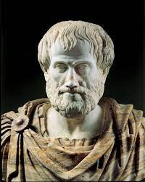
Truth and Meaning
Aristotle’s Dictum: ‘To say of what is that it is not, or of what is not that it is, is false; while to say of what is that it is, or of what is not that it is not, is true’
A sentence is true iff things are the way that it says they are; a sentence is false iff things are not the way it says they are
Examples
‘Snow is white’ says that snow is white, and so is true iff snow is white
‘Grass is green’ says that grass is green, and so is false iff grass is not green
‘Londres est bondée’ says that London is crowded, and so it is true iff London is crowded
‘Simon is tall’ says that Simon is tall, and so is true (or false) iff Simon is tall (or not)
T-Scheme: If $s$ says that $A$, then $s$ is true iff $A$
F-Scheme: If $s$ says that $A$, then $s$ is false iff $¬A$

Slide 17
Truth and Meaning
Williamson’s Argument
Aristotle’s Dictum: ‘To say of what is that it is not, or of what is not that it is, is false; while to say of what is that it is, or of what is not that it is not, is true’
A sentence is true iff things are the way that it says they are; a sentence is false iff things are not the way it says they are
Examples
‘Snow is white’ says that snow is white, and so is true iff snow is white
‘Grass is green’ says that grass is green, and so is false iff grass is not green
‘Londres est bondée’ says that London is crowded, and so it is true iff London is crowded
‘Simon is tall’ says that Simon is tall, and so is true (or false) iff Simon is tall (or not)
T-Scheme: If $s$ says that $A$, then $s$ is true iff $A$
F-Scheme: If $s$ says that $A$, then $s$ is false iff $¬A$

Slide 18
Williamson’s Argument
T-Scheme: If $s$ says that $A$, then $s$ is true iff $A$
F-Scheme: If $s$ says that $A$, then $s$ is false iff $¬A$
Williamson uses these schemes to argue for the following version of bivalence: if $s$ says that $A$, then $s$ is true or false
Suppose that $s$ says that $A$
Now suppose that $s$ is neither true nor false
So $¬A$ (by T-Scheme and modus tollens)
But $¬¬A$ (by F-Scheme and modus tollens)
Contradiction!
So $s$ is true or false (by Negation Introduction and DNE)
So if $s$ says that $A$, then $s$ is true or false (by Conditional Introduction)
Williamson (1994), Vagueness (Routledge), pp.187-98

Slide 19
Williamson’s Argument
T-Scheme: If $s$ says that Simon is bald, then $s$ is true iff Simon is bald
F-Scheme: If $s$ says that Simon is bald, then $s$ is false iff Simon is not bald
Williamson uses these schemes to argue for the following version of bivalence: if $s$ says that Simon is bald, then $s$ is true or false
Suppose that $s$ says that Simon is bald
Now suppose that $s$ is neither true nor false
So Simon is not bald (by T-Scheme and modus tollens)
But Simon is not not bald (by F-Scheme and modus tollens)
Contradiction!
So $s$ is true or false (by Negation Introduction and DNE)
So if $s$ says that Simon is bald, then $s$ is true or false (by Conditional Introduction)
T-Scheme: If $s$ says that $A$, then $s$ is true iff $A$
F-Scheme: If $s$ says that $A$, then $s$ is false iff $¬A$
Williamson uses these schemes to argue for the following version of bivalence: if $s$ says that $A$, then $s$ is true or false
Suppose that $s$ says that $A$
Now suppose that $s$ is neither true nor false
So $¬A$ (by T-Scheme and modus tollens)
But $¬¬A$ (by F-Scheme and modus tollens)
Contradiction!
So $s$ is true or false (by Negation Introduction and DNE)
So if $s$ says that $A$, then $s$ is true or false (by Conditional Introduction)
Williamson (1994), Vagueness (Routledge), pp.187-98

Slide 20
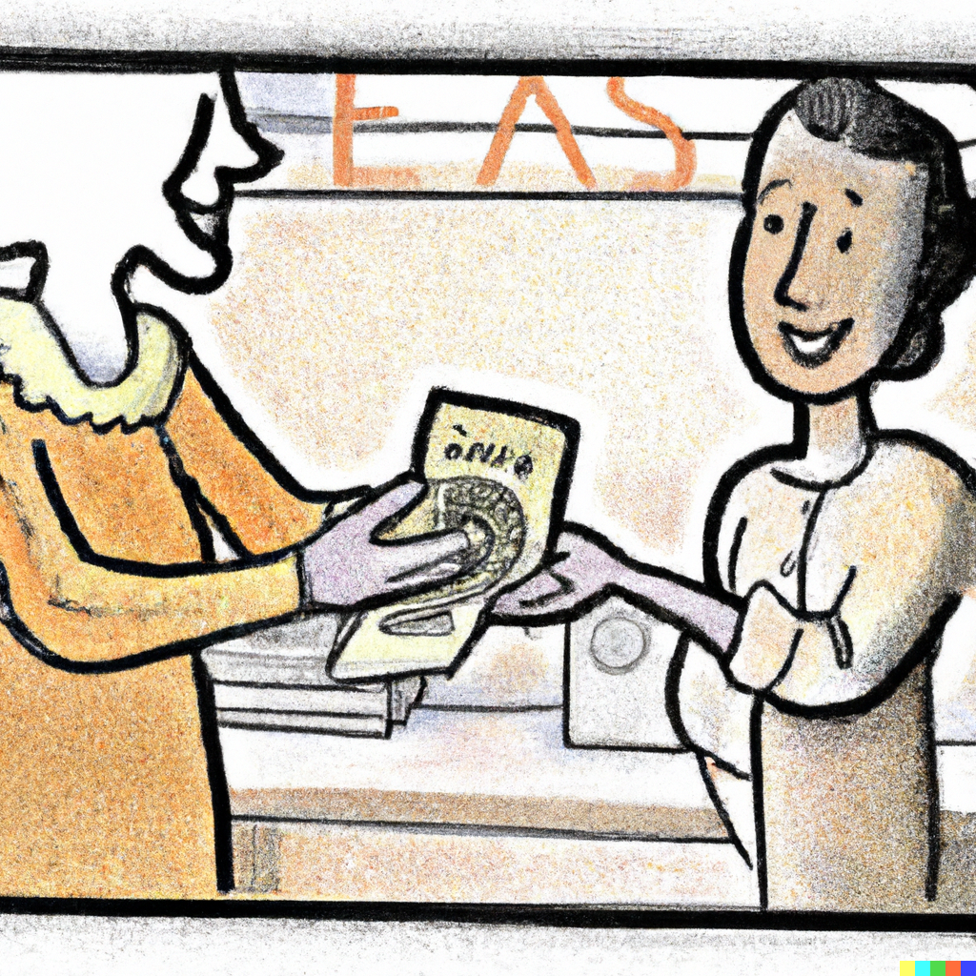
The Cost of Rejecting Bivalence
If you want to reject bivalence, you must do one (or more) of the following:
Restrict your logic to make Williamson’s argument invalid
Reject some instances of the T-Scheme: If $s$ says that $A$, then $s$ is true iff $A$
Reject some instances of the F-Scheme: If $s$ says that $A$, then $s$ is false iff $¬A$
Supervaluationists already reject instances of the T-Scheme and the F-Scheme
Supervaluationism: truth = supertruth; falsehood = superfalsehood
Suppose that $s$ says that Simon is bald, and that Simon is borderline bald
$s$ is definitely neither supertrue nor superfalse, but Simon is bald on some precisifications and not bald on others
However, if you restrict the T-Scheme and the F-Scheme, are you really talking about truth and falsehood?

Slide 21
Epistemicism
Recap
An argument for bivalence
Introducing epistemicism
Accepting necessary ignorance
Meaning and use
Explaining necessary ignorance
Where are we?

Slide 22
Sharp Cut-Offs Accepted!
Let’s imagine that we want to retain bivalence in full generality: every sentence is either true or false
It would then be very hard to deny that vague concepts have sharp cut-offs
For each $n$, it is either true or false that someone with $n$ hairs is bald
Let $n$ be the largest number of hairs for which it is still true to say that someone with $n$ hairs is bald
Then it must be false to say that someone with $n+1$ hairs is bald
So someone with $n$ hairs is bald, but someone with $n+1$ hairs isn’t
All the theories of vagueness that we have looked at so far have tried to avoid sharp cut-offs
But maybe it is time just to accept them?

Slide 23
Epistemicism
According to epistemicism, all concepts – including vague ones – have sharp boundaries
Epistemicists think that one hair can make the difference between being bald and not: $∃n\left(Bn∧¬B\left(n+1\right)\right)$
Not only that, unlike supervaluationists, epistemicists also accept that there is a true instance of ‘$Bn∧¬B\left(n+1\right)$’
Maybe someone is bald iff they have 10,000 or fewer hairs? Or maybe it’s 10,001 or fewer hairs? Or maybe it’s 9,999 or fewer hairs?
However, while epistemicists accept that vague concepts have sharp cut-offs, they deny that we could ever know where they lie
Vagueness is an epistemic phenomenon: what it is for a concept to be vague is for it to have unknowable sharp boundaries

Slide 24
Sorites Solved
Epistemicism might initially sound incredible, but it has been developed and defended by Williamson
Williamson (1994), Vagueness (Routledge), esp. chapters 7-8
Epistemicism gives us an easy solution to the sorites paradoxes
We do not need to mess with classical logic at all
We just reject one of the premises: some conditional of the form ‘$Bn→B\left(n+1\right)$’ is false
Epistemicists usually advertise the fact that they retain classical logic as one of their best features
Classical logic behaves (mostly) intuitively
Classical logic is powerful and simple to use
Mathematicians, scientists, etc., all tend to use classical logic

Slide 27
A Theory of Vagueness!
By asserting that vague concepts have sharp boundaries, aren’t epistemicists really just denying that there are any vague concepts?
Epistemicists emphasise that this unfairly builds a rejection of epistemicism into the characterisation of vague concepts
Epistemicists believe in vague concepts, they just don’t think that they should be characterised as concepts which lack sharp boundaries
Concept $F$ is vague iff it admits borderline cases
Some things are definitely $F$, some things are definitely not $F$, and others are borderline: neither definitely $F$ nor definitely not $F$
According to epistemicism, $x$ is a borderline case for $F$ iff we cannot know whether $Fx$ because we cannot know exactly where the cut-off for $F$ is

Slide 28
The Epistemic Account of ‘Definitely’
Epistemicists treat ‘definitely’ as an epistemic operator: $DA$ iff $A$ and we can know that $A$
(Or at least, we are not prohibited from knowing $A$ just because we cannot know the sharp cut-offs of vague concepts)
This account makes the difference between being bald and being definitely bald very clear
Recall that even supervaluationists are committed to: $D∃n\left(\left(Bn∧¬DBn\right)∨\left(¬Bn∧¬D¬Bn\right)\right)$
Epistemicists also seem to have an easy time dealing with higher-order vagueness, i.e. the fact that $DA$ can itself be vague

Slide 29
Higher-Order Vagueness
Higher-order vagueness is a problem only if your theory of vagueness requires that $DDA∨D¬DA$
We can avoid this disjunction by denying that $DA$ implies $DDA$
Suppose $DA$
$D¬DA$ surely implies $¬DA$, so we can infer that $¬D¬DA$
And if $DA$ doesn’t imply $DDA$, we can consistently add $¬DDA$
So we can consistently assert $¬\left(DDA∨D¬DA\right)$
For an epistemicist, the claim that $DA$ implies $DDA$ is a kind of KK-Principle
KK-Principle: If you know that $A$, then you know that you know that $A$
$DA⊨DDA$: If you can know that $A$, then you can know that you can know that $A$
Most philosophers nowadays (especially Williamson!) reject the KK-Principle

Slide 30
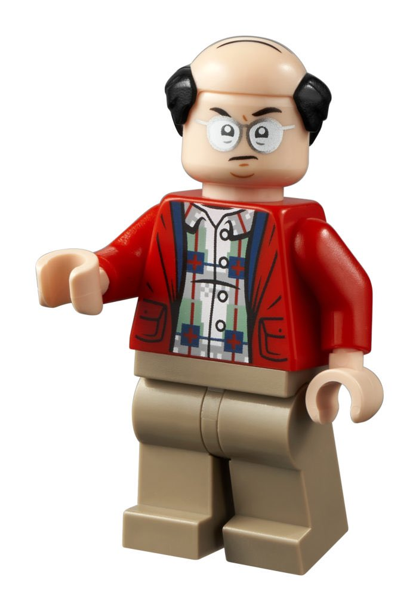
A Toy Model
$DBn$ iff $B\left(n+5\right)$
According to epistemicism, you can’t know where the cut-off for bald is
So if you believe that someone with $n$ hairs is bald, but $n$ is too close to the cut-off, then that is just a lucky guess!
Similarly, $DDBn$ iff $DB\left(n+5\right)$
You can know that $Bn$ iff $B\left(n+5\right)$
According to epistemicism, you can’t know where the cut-off for bald is
So if you believe that someone with $n$ hairs is bald, but $n$ is too close to the cut-off, then that is just a lucky guess!
Similarly, you can know that $DBn$ iff $DB\left(n+5\right)$
Putting this together, we can show that there is some $n$ such that $DBn$ but $¬DDBn$
$DB\left(n+5\right)$ iff $B\left(n+10\right)$
Suppose $B\left(n+5\right)$ but $¬B\left(n+10\right)$
In that case, $DBn$ but $¬DDBn$
This is obviously a silly toy model, but we could make it more realistic and get the same result

Slide 34
Epistemicism
Recap
An argument for bivalence
Introducing epistemicism
Accepting necessary ignorance
Meaning and use
Explaining necessary ignorance
Where are we?

Slide 35
Necessary Ignorance
According to epistemicism, there are many truths of which we are necessarily ignorant
Every vague concept has a sharp cut-off, but we cannot know where it is
Many philosophers have been attracted to the idea that every truth is knowable
Weak Verificationism: $A→It is knowable that A$
When we say that a truth is knowable, we are not saying that is known; it might not even be that it can be known by humans with our current limitations
If weak verificationism is right, then epistemicism must be wrong
However, weak verificationism faces some tricky cases
Is the total state of the universe knowable?
If there is a god, is that knowable? And if there isn’t, is that knowable?
More strikingly, it looks like we can prove that weak verificationism is false!

Slide 36
Fitch’s Paradox
Even if you thought that every truth is knowable, you would surely want to deny that every truth is known
But surprisingly, it turns out that this combination is inconsistent!
Suppose $A$ and it is not known that $A$
So, by weak verificationism, it is knowable that: $A$ and it is not known that $A$
So it is possible that it is known that $A$ and it is known that it is not known that $A$ (since you can’t know a conjunction without knowing each conjunct)
So it is possible that it is known that $A$ and it is not known that $A$ (since knowledge is factive)
Contradiction!
It seems that if you want to accept the obvious fact that some truths are unknown, you have to reject weak verificationism, and accept that some truths are unknowable
Or maybe you can spot a fallacy in the above reasoning…

Slide 37
Supervaluationism and Necessary Ignorance
Even if you reject weak verificationism in general, it can still seem a bit much to accept that there is an unknowable fact about who is and isn’t bald, or tall, or…
However, that is very hard to avoid: even supervaluationists must accept that there are some people such that we cannot know whether they are tall or not
No matter how good we get at measuring heights, we will never be able to determine someone’s exact height
It would take infinite precision to identify the exact real number that represents someone’s height in metres
So, there is some $ε$ such that we cannot measure the difference between being $r$ metres tall and being $r−ε$ metres tall

Slide 38
Supervaluationism and Necessary Ignorance
Now imagine a sorites series of people, starting with someone who is definitely tall and ending with someone who is definitely not tall, where each person is $ε$ metres shorter than the last
$∀n\left(\left(it is knowable that Tn\right)→T\left(n+1\right)\right)$
We can’t tell the difference between the height of these people, and so if $¬T\left(n+1\right)$, our belief that $Tn$ could at best be a lucky guess
Now suppose that $∀n\left(Tn→it is knowable that Tn\right)$
It follows that $∀n\left(Tn→T\left(n+1\right)\right)$
But that is superfalse, and so by supervaluationist reasoning, we can infer that $∃n\left(Tn∧it is not knowable that Tn\right)$
Of course, there’s no supertrue instance of ‘$Tn∧it is not knowable that Tn$’…
Even if you reject weak verificationism in general, it can still seem a bit much to accept that there is an unknowable fact about who is and isn’t bald, or tall, or…
However, that is very hard to avoid: even supervaluationists must accept that there are some people such that we cannot know whether they are tall or not
No matter how good we get at measuring heights, we will never be able to determine someone’s exact height
It would take infinite precision to identify the exact real number that represents someone’s height in metres
So, there is some $ε$ such that we cannot measure the difference between being $r$ metres tall and being $r−ε$ metres tall
If we can know that the $nth$ person in the series is tall, then the $\left(n+1\right)$th person must also be tall

Slide 39
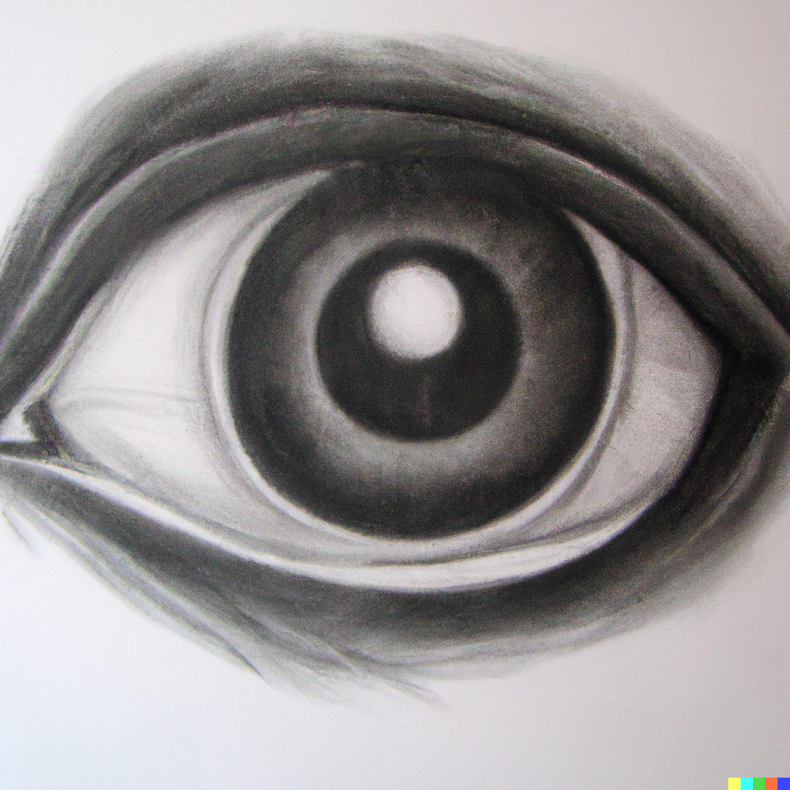
Appearances
Language about how things appear (e.g. ‘appears tall’) is inherently vague
Epistemicists will, then, have to say that that ‘appears tall’ has a sharp cut-off, but we just can’t know where it is
But intuitively, you know whether or not something appears tall to you; so if ‘appears tall’ has a cut-off, you should know where it is!
Epistemicists must reject this intuition. Is it a KK-Principle again?
Worse than counterintuitive, you might think it is just false
Imagine a sorites series of people, where each person is shorter than the last, but by a quantity that you cannot detect
According to epistemicism, there is a first person in this series who does not appear tall to you
But when you look at them, won’t they still strike you as tall?

Slide 40
Why Can’t We Know!?
Grant for the sake of argument that vague concepts have sharp cut-offs
Why can’t we know where they are?
Epistemicists need to provide an explanation
Without an explanation, our necessary ignorance of sharp cut-offs would be a systematic mystery!
Williamson provides an explanation, but before we can get to that, we need to look at the relation between meaning and use

Slide 41
Epistemicism
Recap
An argument for bivalence
Introducing epistemicism
Accepting necessary ignorance
Meaning and use
Explaining necessary ignorance
Where are we?

Slide 42
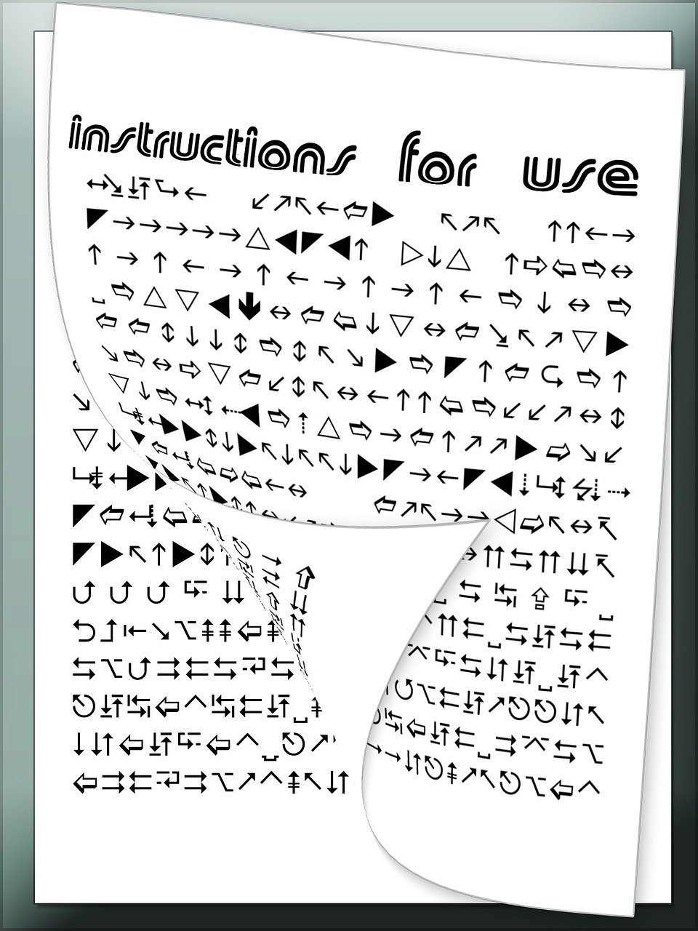
The Semantic Argument against Epistemicism
If vague predicates have sharp cut-offs, then those cut-offs are surely fixed by the meanings of those predicates
But, in some important sense, meaning is use
Our words get their meanings from the ways in which we use them
But, intuitively, we don’t use vague predicates in a way that would fix sharp cut-offs for them!
Nothing in the way we use ‘baby’ fixes at which second someone stops being a baby
So vague predicates don’t have sharp cut-offs!

Slide 43
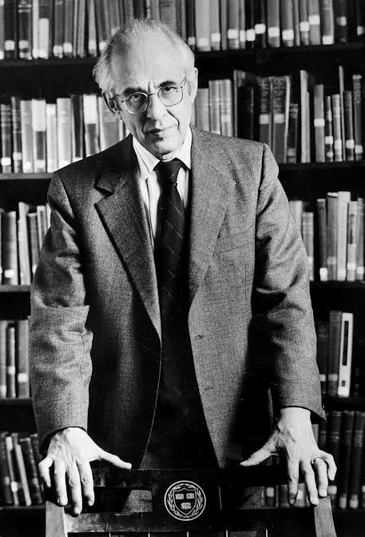
Use + Environment
Most philosophers think it is a bit too simple to identify meaning with use: we need to factor in the environment too
Why does ‘water’ mean H₂O?
Partly because of the way that we use ‘water’, but also partly because of the substances in our environment
If a different chemical substance filled our rivers and seas, fell from the sky, refreshed us when we drank it, etc., then ‘water’ would mean that substance instead
Putnam (1975), ‘The meaning of “meaning”’. Midwest Studies in the Philosophy of Science 7, pp.131-93
In principle, then, it might be that our environment fixes the cut-offs for our vague predicates, even if our use doesn’t
But it still seems far-fetched to think that the environment could fix a sharp cut-off for ‘bald’ or ‘tall’!

Slide 44
Meaning = Use + Environment?
Strong Claim: The meaning of a word can somehow be inferred from its use and environment
This claim does seem incompatible with the epistemicist claim that vague words have sharp cut-offs
However, no one has ever managed to explain how to infer meaning from use + environment!
Weak Claim: The meaning of a word supervenes on its use and environment
$A$ supervenes on $B$ iff there can be no change in $A$ without a change in $B$
So the weak claim states that there can be no change in meaning without a change in use or environment
That is very plausible, but it seems compatible with epistemicism: if two vague predicates are used in the same way in the same environment, then they will have the same sharp cut-off
Williamson (1994), Vagueness (Routledge), pp.205-9

Slide 47
Epistemicism
Recap
An argument for bivalence
Introducing epistemicism
Accepting necessary ignorance
Meaning and use
Explaining necessary ignorance
Where are we?

Slide 48
Knowledge and Safety
Standard Safety: If $x$ knows that $A$, then in all nearby worlds where $¬A$, $x$ does not believe that $A$
A nearby world is a world that is not too different from ours; it is as similar as it can be, given that $¬A$ at that world
Standard Safety is meant to rule out lucky guesses as cases of knowledge
Imagine you and I are asked how many people are in this room
You count everyone up, and answer that there are $n$ people
I close my eyes and answer by picking my favourite number, which happens to be $n$
Intuitively, your belief counts as knowledge and mine doesn’t, and that is what Standard Safety tells us
If there had been one more person in the room, you would have believed that there were $n+1$ people, but I still would have believed that there were $n$

Slide 49
The Limits of Standard Safety
Suppose that 10,000 is the smallest number of hairs you can have and without being bald
Now imagine that you believe Simon (who in fact has 9,999 hairs) is bald
Standard Safety neatly explains why your belief isn’t knowledge
In the nearby world where Simon has 10,000 hairs, you would still believe he was bald
But epistemicists also need to explain why you can’t know that 10,000 is the smallest number of hairs you can have without being bald
Standard Safety can’t help here, because (presumably) it is a necessary truth that 10,000 is the smallest number of hairs you can have without being bald
Epistemicists usually assume that vague properties supervene on non-vague ones
If it is necessary, then there is no world (nearby or not) where the cut-off lies elsewhere

Slide 50
Williamsonian Safety
Williamsonian Safety: If $x$ knows the proposition they express with sentence ‘$A$’, then there is no nearby world where $x$ would still assert sentence ‘$A$’, but it is false
Williamson (1994), Vagueness (Routledge), pp.230-2
Imagine that the sentence ‘$∀n\left(Bn↔n<10,000\right)$’ in fact expresses a true proposition
It expresses this proposition (in part) because the predicate ‘$B$’ expresses a particular concept, bald
However, we could have used ‘$B$’ to express a similar concept, bald*, which is exactly like bald, except it draws it also applies to people with 10,000 hairs
Since we cannot read meaning off of use (says Williamson!), there is a nearby world where we use ‘$B$’ to express bald*, but would still assert ‘$∀n\left(Bn↔n<10,000\right)$’
In that world, ‘$∀n\left(Bn↔n<10,000\right)$’ is false
So we cannot know the proposition we in fact express with ‘$∀n\left(Bn↔n<10,000\right)$’

Slide 51
Williamsonian Safety
Williamsonian Safety: If $x$ knows the proposition they express with sentence ‘$A$’, then there is no nearby world where $x$ would still assert sentence ‘$A$’, but it is false
Imagine there are two identical twins, called ‘Joe’ and ‘Bill’
The parents chose which name to give which twin by flipping a coin, and then quite often got them confused as babies; you are introduced to an adult twin as ‘Joe’, and luckily, that was the twin originally given that name
‘Joe is taller than 1.8m’ expresses a true proposition, which you come to believe
There is a nearby world where ‘Joe’ picks out the other twin (who grows up to be 1.7m tall); in that world, you would still assert ‘Joe is taller than 1.8m’, but it would be false
But surely that doesn’t mean you don’t know proposition you actually express with ‘Joe is taller than 1.8m’?
Kearns and Magidor (2008), ‘Epistemicism about vagueness and Meta-Linguistic Safety’, Philosophical Perspectives 22, pp.277-304

Slide 52
Epistemicism
Recap
An argument for bivalence
Introducing epistemicism
Accepting necessary ignorance
Meaning and use
Explaining necessary ignorance
Where are we?

Slide 62
For the Next Seminar and Lecture
Seminar Reading
Williamson (1994), Vagueness (Routledge), ch.7
Lecture Reading (for after Consolidation Week!)
Sainsbury (2009). Paradoxes (CUP), ch.4

