Slide 1
Logic and Paradox
Lecture 10:
Dialetheism
Rob Trueman
rob.trueman@york.ac.uk

Slide 2
Dialetheism
Introducing dialetheism
The Logic of Paradox
Features of LP
The Liar Paradox
Assertion and denial
Rational disagreement

Slide 6
Dialetheism
The thesis that some contradictions are true is known today as dialetheism
Equivalently: dialetheism is the thesis that some sentences are true and false
All contradictions are false, so if there are some true contradictions, then some sentences are true and false
If $A$ is true and false, then $A$ and $¬A$ are both true, and so $A∧¬A$ is true
Dialetheism might initially sound too ridiculous to take seriously, but plenty of contemporary philosophers have argued that it is the best way to respond to a variety of paradoxes
The most influential dialetheist is Graham Preist

Slide 7
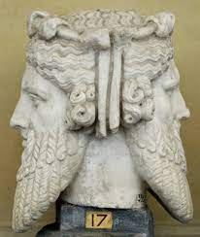
Weird Name…
“The inspiration for the name [dialetheism] was a passage in Wittgenstein’s Remarks on the Foundations of Mathematics, concerning Russell’s paradox:
‘Why should Russell’s contradiction not be conceived as something supra-propositional, something that towers above the propositions and looks in both directions like a Janus head? The proposition that contradicts itself would stand like a monument (with a Janus head) over the propositions of logic (1978, III.59)
A dialethia is a two-way truth, facing both truth and falsity like a Janus-headed figure.”
Priest et al (2022), Dialetheism. Stanford Encyclopedia of Philosophy

Slide 8
Dialetheism
Introducing dialetheism
The Logic of Paradox
Features of LP
The Liar Paradox
Assertion and denial
Rational disagreement

Slide 9
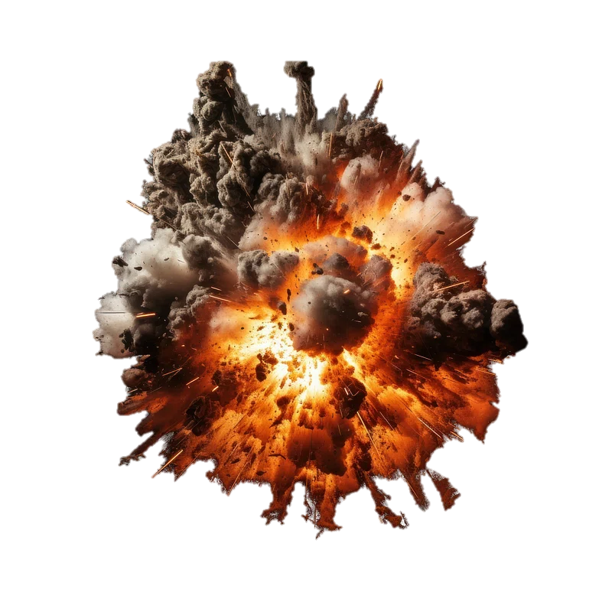
Explosion
According to the Explosion rule, contradictions entail everything
Explosion has also been known as ex falso quodlibet and ex contradictione quodlibet
Explosion is valid in classical logic
An argument is valid iff every interpretation that makes all the premises true also makes the conclusion true
Classically, no interpretation is allowed to make $A$and $¬A$ both true
So, classically, $A∧¬A∴B$ is always valid, no matter what sentence $B$ we pick

Slide 10
Dialetheism versus Trivialism
Objection: There can’t be any true contradictions, because if there were, then Explosion would imply that every sentence is true
Priest calls the thesis that every sentence is true trivialism
Everybody agrees that trivialism is absurd, because we know that some sentences aren’t true (e.g. ‘Rob is a 500 year old oak tree’)
Although it is surprisingly hard to know how you would convince a trivialist to reject their position
Whatever you said, they would agree with you (since they think everything is true), but they would still assert the negation of what you said (since they think everything is true!)
So we can reformulate the objection above: dialetheism must be false because, by Explosion, it implies trivialism

Slide 11
Paraconsistent Logic
If dialetheists want to avoid trivialism, they need to reject Explosion
A logic which doesn’t validate Explosion is called paraconsistent
Dialetheists need a paraconsistent logic, but there are other reasons to develop a paraconsistent logic too
Many logicians think that the conclusion of a valid argument should be relevant to the premises; but Explosion violates this idea, since any contradiction entails everything
You could try to develop a paraconsistent logic by revising the standard definition of validity
An argument is valid iff every interpretation that makes all the premises true also makes the conclusion true
However, Priest instead recommends sticking with the standard definition, and tweaking the way that interpretations work

Slide 12
Classical Interpretations
An interpretation of a given language is an assignment of truth-values to all of the sentences in that language
We start by assigning truth-values at random to the atomic sentences
(I am ignoring quantifiers for now; if we wanted to include them, we could assign truth-values to atomic formulas relative to an assignment of values to variables)
The only rules imposed by classical logic are that every atomic sentence must be true or false, but no atomic sentence can be true and false
We then have some rules that tell us how to figure out the truth-values of complex sentences

Slide 13
Complex Sentences
$¬A$ is true iff: $A$ is false
$¬A$ is false iff: $A$ is true
$A∧B$ is true iff: $A$ is true and $B$ is true
$A∧B$ is false iff: $A$ is false or $B$ is false or both
$A∨B$ is true iff: $A$ is true or $B$ is true or both
$A∨B$ is false iff: $A$ is false and $B$ is false

Slide 14
Contradictions cannot be True
It is easy to see that these rules will not allow any contradiction to be true on a classical interpretation
For reductio, suppose that some contradiction, $A∧¬A$, is true
By the rules for conjunction, that means $A$ is true and $¬A$ is true
By the rules for negation, $A$ is false (as well as true)
The rules won’t allow a complex sentence to be true and false unless some atomic sentence is true and false
So some atomic sentence must be true and false
But classical interpretations never allow an atomic sentence to be true and false
So $A∧¬A$ can never be true on a classical interpretation, which is why Explosion is classically valid

Slide 15
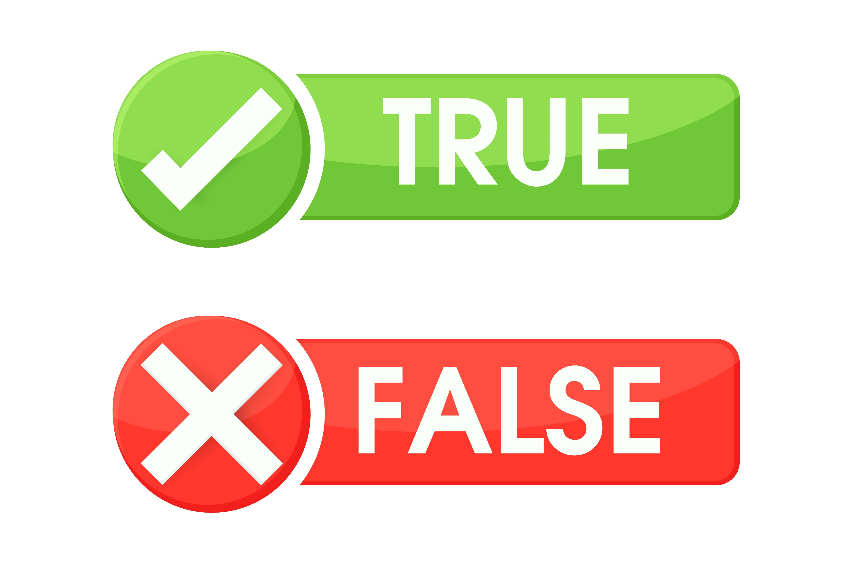
The Logic of Paradox
Priest has developed a paraconsistent logic which he calls the Logic of Paradox (LP)
LP interpretations work just like classical interpretations, except for one difference
Every atomic sentence must be true or false, but they can also be both!
Everything else stays the same, including the rules for determining the truth-values of complex sentences
(Apart from the conditionals – we’ll get to that later!)

Slide 16
Complex Sentences
$¬A$ is true iff: $A$ is false
$¬A$ is false iff: $A$ is true
$A∧B$ is true iff: $A$ is true and $B$ is true
$A∧B$ is false iff: $A$ is false or $B$ is false or both
$A∨B$ is true iff: $A$ is true or $B$ is true or both
$A∨B$ is false iff: $A$ is false and $B$ is false

Slide 17
Strong Kleene Truth-Tables
$$A$$ | $$¬A$$
T | F
N | N
F | T
$$A$$ | $$B$$ | $$A∨B$$
T | T | T
T | N | T
T | F | T
N | T | T
N | N | N
N | F | N
F | T | T
F | N | N
F | F | F
$$A$$ | $$B$$ | $$A∧B$$
T | T | T
T | N | N
T | F | F
N | T | N
N | N | N
N | F | F
F | T | F
F | N | F
F | F | F

Slide 18
Strong Kleene Truth-Tables
LP Truth-Tables
$$A$$ | $$¬A$$
T | F
N | N
F | T
$$A$$ | $$¬A$$
T | F
B | B
F | T
$$A$$ | $$B$$ | $$A∨B$$
T | T | T
T | B | T
T | F | T
B | T | T
B | B | B
B | F | B
F | T | T
F | B | B
F | F | F
$$A$$ | $$B$$ | $$A∨B$$
T | T | T
T | N | T
T | F | T
N | T | T
N | N | N
N | F | N
F | T | T
F | N | N
F | F | F
$$A$$ | $$B$$ | $$A∧B$$
T | T | T
T | N | N
T | F | F
N | T | N
N | N | N
N | F | F
F | T | F
F | N | F
F | F | F
$$A$$ | $$B$$ | $$A∧B$$
T | T | T
T | B | B
T | F | F
B | T | B
B | B | B
B | F | F
F | T | F
F | B | F
F | F | F

Slide 19
Defused Explosives
Since atomic sentences can be true and false on an LP interpretation, contradictions can be true on them too
If the atomic sentence $A$ is true and false, then by the rules for conjunction and negation, $A∧¬A$ is true (and false) too
As a result, Explosion fails in LP
Let $ℐ$ be an LP interpretation that makes $A$ true and false, and $B$ just false
$A∧¬A$ is true on $ℐ$, but $B$ is not true on $ℐ$
So $A∧¬A∴B$ is invalid (by the standard definition of validity)

Slide 20
Dialetheism
Introducing dialetheism
The Logic of Paradox
Features of LP
The Liar Paradox
Assertion and denial
Rational disagreement

Slide 21
The Law of Non-Contradiction
Classical logic obeys the Law of Non-Contradiction
LNC: $¬\left(A∧¬A\right)$
LP allows contradictions to be true, and so you might have expected it to reject LNC
However, LNC is a law of LP too!
On every interpretation, $A$ is true or false
If $A$ is false, then $A∧¬A$ is false
If $A$ is true, then $¬A$ is false, and so $A∧¬A$ is false
In fact, more generally, every law of classical logic is a law of LP too, and vice versa
$⊨_{C}A$ iff $⊨_{LP}A$
The big difference is that, in LP, you can still assert things that contradict laws of logic (but that’s dialetheism for you!)

Slide 22
Disjunctive Syllogism
Here is a well-known argument for Explosion (usually attributed to C.I. Lewis):
1. $A∧¬A$ [Assumption]
2. $∴A$ [Conjunction Elimination]
3. $∴¬A$ [Conjunction Elimination]
4. $∴A∨B$ [Disjunction Introduction]
5. $∴B$ [Disjunctive Syllogism, i.e. $A∨B, ¬A⊢B$]
No one wants to reject Conjunction Elimination or Disjunction Introduction, so paraconsistent systems usually reject Disjunctive Syllogism
That’s exactly what happens in LP
Let $ℐ$ be an LP interpretation that makes $A$ true and false, and $B$ just false
$A∨B$ and $¬A$ are both true on $ℐ$, but $B$ is not true on $ℐ$
So $A∨B,¬A⊭_{LP}B$

Slide 23
The Material Conditional
Here are the standard semantic rules for the material conditional
$A→B$ is true iff: $A$ is false or $B$ is true or both
$A→B$ is false iff: $A$ is true and $B$ is false
There is nothing wrong with these rules as rules in LP, but they don’t behave much like a conditional
They don’t validate modus ponens: $A→B, A⊭_{LP}B$
Let $ℐ$ be an LP interpretation that makes $A$ true and false, and $B$ just false
$A→B$ and $A$ are both true on $ℐ$, but $B$ is not true on $ℐ$
This is very similar to the failure of disjunctive syllogism, and that is no coincidence: the material conditional is equivalent to $¬A∨B$ in LP (just as it is in classical logic)
$$A$$ | $$B$$ | $$A→B$$
T | T | T
T | B | B
T | F | F
B | T | T
B | B | B
B | F | B
F | T | T
F | B | T
F | F | T

Slide 24
Alternative Conditionals
You can define a variety of conditionals in LP that do obey modus ponens (although they aren’t truth-functional)
See Priest (2006), In Contradiction (2nd ed, OUP), ch. 6
However, they do not always behave as you would expect!
You cannot just assume, for example, that your conditional will validate modus tollens: $A→B,¬B⊨¬A$
Relatedly, note that $¬B⊨_{LP}¬A$ doesn’t automatically follow from $A⊨_{LP}B$
$P⊨_{LP}¬\left(Q∧¬Q\right)$, since $⊨_{LP}¬\left(Q∧¬Q\right)$
But $¬¬\left(Q∧¬Q\right)⊭_{LP}¬P$: just consider an LP interpretation where $Q$ is true and false and $P$ is just true
GENERAL RULE: Treat conditionals in LP with care!

Slide 28
FEEDBACK BREAK!
We value your feedback!
So give us some feedback to value at this link: https://tinyurl.com/3bp3nemj
Thank you!

Slide 29
Dialetheism
Introducing dialetheism
The Logic of Paradox
Features of LP
The Liar Paradox
Assertion and denial
Rational disagreement

Slide 30
The Case for Dialetheism
The Liar Paradox: We should just accept that liar sentences are true and false (In Contradiction ch.1; Doubt Truth to be a Liar)
The Sorites Paradox: If Joe is on the borderline of being a baby, then he both is and is not a baby (‘Dialetheism and the Sorites Paradox’, in Oms and Zardni eds The Sorites Paradox)
Russell’s Paradox: We should just accept that the set of all sets that are not members of themselves both is and is not a member of itself (In Contradiction ch.2)
Change and motion: At the moment that something changes from being in one state to being in another incompatible one, it is in both states (In Contradiction ch.11-12)
Unity: Complex entities are unified by each part being identical and distinct from one and the same unifying entity (One: Being an Investigation into the Unity of Reality and of its Parts, Including the Singular Object which is Nothingness)

Slide 31
Truth and Falsity
Dialetheists can stand by fully unrestricted Truth and Falsity Schemes
(T) ‘$P$’ is true $↔$ $P$
(F) ‘$P$’ is false $↔$ $¬P$
For now, we will not assume anything about the biconditional other than that $A↔B,A⊨B$ and $A↔B,B⊨A$
They can also allow the language to have the resources to construct liar sentences
They do not need to draw any distinction between the object-language and the metalanguage
$$…$$
$$L_{2}$$
$$L_{1}$$
$$L_{0}$$

Slide 32
The Weak Liar
Let’s start with a weaker version of the Liar Paradox:
1. $α$ $=$ ‘$α$ is false’ [Liar Sentence]
2. ‘$α$ is false’ is true $↔$ $α$ is false [T-Scheme]
3. $∴$ $α$ is true $↔$ $α$ is false [Substitution of Identicals]
4. $∴α$ is true $∧$ $α$ is false [Every sentence is true or false]
Line 4 is a contradiction, but that’s no problem in LP
This paradox is veridical!

Slide 33
The Strengthened Liar
Now consider the Strengthened Liar Paradox
1. $λ$ $=$ ‘$λ$ is not true’ [Strengthened Liar Sentence]
2. ‘$λ$ is not true’ is true $↔$ $λ$ is not true [T-Scheme]
3. $∴$ $λ$ is true $↔$ $λ$ is not true [Substitution of Identicals]
4. $λ$ is true $∧$ $λ$ is not true [LP inference]
Dialetheists think this version of the paradox is veridical too
However, this requires more than just thinking that some sentences are true and false
$λ$ is both true and not true!

Slide 34
Falsity versus Untruth
You might have thought that every dialethia (i.e., every sentence that is both true and false) is true and untrue
Recall the (T) and (F) schemes:
(T) ‘$P$’ is true $↔$ $P$
(F) ‘$P$’ is false $↔$ $¬P$
If ‘$P$’ is a dialethia, then it is false, and so $¬P$ follows by (F); so doesn’t it follow that ‘$P$’ is not true by (T)?
Not automatically: it only follows if the biconditional in (T) validates modus tollens
But if the conditional does validate modus tollens, you get the following strange result:
Dialetheism declares itself false, since no sentence is true and false (i.e. if a sentence is false, it is not true)
Dialetheists would have to be dialetheists about dialetheism!

Slide 35
Revenge?
In the previous lectures, we saw that many solutions to the Liar Paradox face revenge paradoxes
Does dialetheism have a revenge problem?
The obvious strategy would be to introduce a sentence which says of itself that it is only untrue (not untrue and true)
$\left(ψ\right):$ $ψ$ is not true $∧$ $¬(ψ$ is true $∧$ $ψ$ is not true)
However, in LP, ‘$ψ$ is not true $∧$ $¬(ψ$ is true $∧$ $ψ$ is not true)’ is just equivalent to: $ψ$ is not true
So this ‘new’ liar sentence is just the standard strengthened liar!

Slide 36
Dialetheism
Introducing dialetheism
The Logic of Paradox
Features of LP
The Liar Paradox
Assertion and denial
Rational disagreement

Slide 40
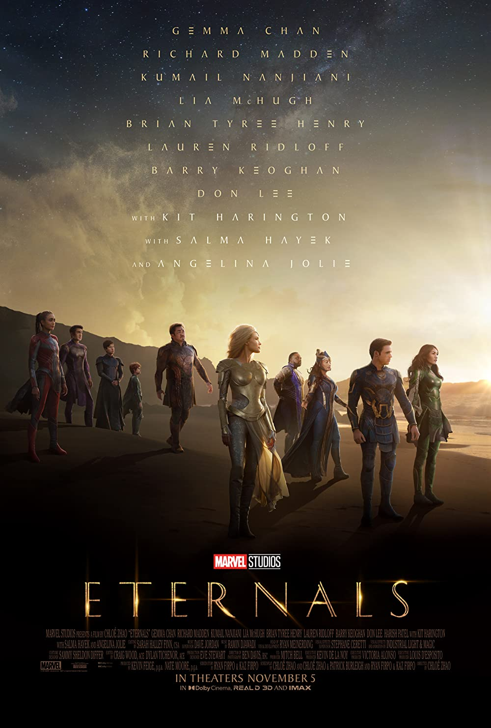
Is Disagreement Impossible?
Imagine that I assert ‘The MCU films are just as good as they used to be’, and you want to disagree with me
How would you do it?
Obvious answer: You just assert ‘The MCU films are not just as good as they used to be’
However, if you happen to be a dialetheist, you might assert that and still agree with me!
Complex answer: You assert ‘The MCU films are not just as good as they used to be, and that’s not a dialethia!’
However, we have already seen that dialetheists must declare some dialethia (e.g. $λ=$ ‘$λ$ is not true) not to be dialethia!
So does dialetheism make disagreement impossible?

Slide 41
Assertion, Denial and Negation
We need to draw a conceptual distinction between denial and negation
Denial is a speech-act: it is something we do with a sentence
Denial is the dual of assertion: when we assert a sentence, we put it forward as true; when we deny a sentence, we reject it as not to be asserted
There are lots of other speech-acts: commanding, questioning, promising, apologising…
Negation is an operation on sentences: negation is part of a sentence
The negation sign, ‘$¬$’, is part of the sentence ‘$¬A$’, and the meaning of ‘$¬$’ helps to determine the meaning of ‘$¬A$’
Even once we have drawn this distinction, it is widely assumed that to deny a sentence is just to assert its negation
Dialetheists reject this!

Slide 42
The Possibility of Disagreement
Let’s use ✓ to indicate that a sentence is being asserted, and ✗ to indicate that it’s being denied
I make this assertion:
The MCU films are just as good as they used to be✓
You disagree with what I asserted simply by denying the very same sentence:
The MCU films are just as good as they used to be✗
IMPORTANT: The assertion and denial signs are not part of these sentences; they indicate what is being done with the sentences
Symbols like this are sometimes called force markers
Other force markers include the question mark and the exclamation mark: ‘You will go the shops.’ versus ‘You will go to the shops?’ versus ‘You will go to the shops!’
This will be a way of disagreeing with me (so long as it is a background rule of the language that you ought not deny what you also assert)

Slide 43
Revenge Again?
Earlier we saw that merely asserting that a sentence is not a dialethia doesn’t prevent a dialetheist from asserting that it is one too
A dialetheist will assert that $λ$ (i.e. ‘$λ$ is not true’) is not true, and so not a dialethia
But they will also assert that $λ$ is a dialethia!
But a dialetheist can deny that a sentence is a dialethia, and that should prohibit asserting that it is one
Are we now faced with a revenge paradox?
1. $ω$ $=$ ‘$ω$ is true✗’ [Liar Sentence]
2. ‘$ω$ is true✗’ is true $↔$ ($ω$ is true✗) [T-Scheme]
3. $∴$ $ω$ is true $↔$ ($ω$ is true✗) [Substitution of Identicals]
4. $∴ω$ is true $∧$ ($ω$ is true✗) [LP inference]
No! The denial sign is not part of a sentence, and so cannot be embedded in complex sentences (see Priest, Doubt Truth to be a Liar, ch.6)
1. $ω$ $=$ ‘$ω$ is true✗’ [Liar Sentence]
2. ‘$ω$ is true✗’ is true $↔$ ($ω$ is true✗) [T-Scheme]
3. $∴$ $ω$ is true $↔$ ($ω$ is true✗) [Substitution of Identicals]
4. $∴ω$ is true $∧$ ($ω$ is true✗) [LP inference]
1. $ω$ $=$ ‘$ω$ is true?’ [Liar Sentence]
2. ‘$ω$ is true?’ is true $↔$ ($ω$ is true?) [T-Scheme]
3. $∴$ $ω$ is true $↔$ ($ω$ is true?) [Substitution of Identicals]
4. $∴ω$ is true $∧$ ($ω$ is true?) [LP inference]

Slide 44
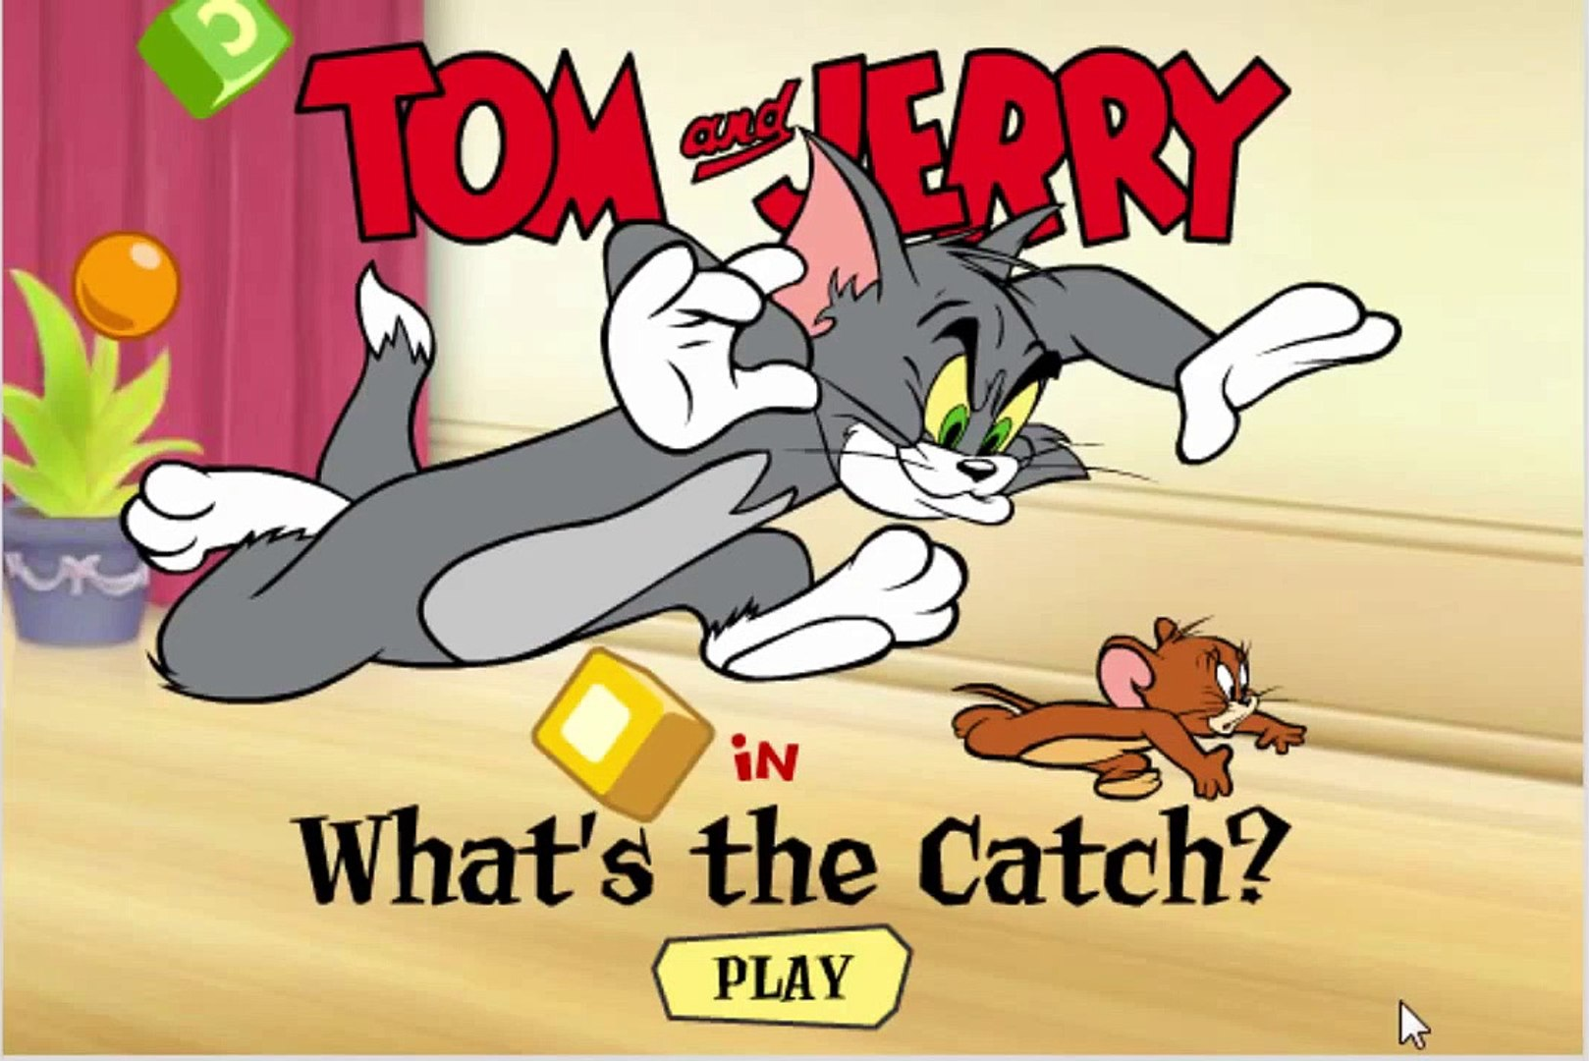
The Catch…
It would be really helpful if dialetheists could say things like this:
If $A$ and $B$ are not dialethia, then $A∨B,¬A∴B$ is valid
However, we could simultaneously assert the antecedent and its negation, and so this conditional can’t quite serve the purposes we would like
We might have thought we could get around this problem by swapping negation for denial
If ($A$ and $B$ are dialethia✗), then $A∨B,¬A∴B$ is valid
But, to repeat, the denial sign is not part of the sentence, and so cannot be embedded!

Slide 45
Dialetheism
Introducing dialetheism
The Logic of Paradox
Features of LP
The Liar Paradox
Assertion and denial
Rational disagreement

Slide 51
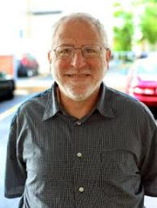
Is Rational Disagreement Impossible?
“It is difficult for a critic to know what to say. One can refute other opponents by showing that their views lead to contradiction, especially if the inconsistency comes by the opponent’s own lights. The debate usually turns on whether the view does in fact entail a contradiction. This cuts no ice against the dialetheist, since she embraces contradictions. For her, a reductio at contradictionem is not a reductio ad absurdum.”
Shapiro (2004), ‘Simple truth, contradiction and consistency’ in Priest et al (eds) The Law of Non-Contradiction (OUP), p.337

Slide 52
Rational Dialetheism
Priest emphasises that dialetheists only assert some contradictions, not all of them
Only trivialists assert all contradictions!
So you can still rationally disagree with a dialetheist by demonstrating that what they have asserted implies a contradiction they deny
More broadly, dialetheists are involved in the same kind of rational theory choice as everybody else
We are confronted by a variety of theories on a given topic
Each theory has some strengths (consistency, or explanatory power, or simplicity, or…) and some weaknesses (inconsistency, or explanatory weaknesses, or complexity, or…)
We try to pick the theory with the best balance of strengths and weaknesses
The only difference between a dialetheist and anybody else is that dialetheists don’t insist that consistency is the one strength every acceptable theory must have

Slide 53
In Priest’s Words
“there are criteria for rationality other than consistency, and […] some of these are even more powerful than consistency. The point is, in fact, a familiar one from the philosophy of science. There are many features of belief that are rational virtues, such as simplicity, problem-solving ability, non-adhocness, fruitfulness, and, let us grant, consistency. However, these criteria are all independent, and may even be orthogonal, pulling in opposite directions.

Slide 54
In Priest’s Words
“Now what should one do if, for a certain belief, all the criteria pull towards acceptance, except consistency – which pulls the other way? It may be silly to be a democrat about this, and simply count the number of criteria on each side, but it seems natural to suppose that the combined force of the other criteria may trump inconsistency. In such a case, then, it is rational to have an inconsistent belief”
Priest (1998), What is so bad about contradictions? The Journal of Philosophy 95, p.420

Slide 55
Just This Once!
However, the point remains that whenever you point out a contradiction in a dialetheist’s theory, they are free to accept that contradiction
They can insist that they don’t make a habit of believing contradictions, but this one is worth it
Note: there can be no formal test for when a contradiction is assertable
It can be so hard to weigh the strengths and weaknesses of a theory that we are unlikely to convince such a (self-avowedly) reluctant dialetheist that they are being irrational
But then, there are lots of silly theories that aren’t inconsistent, and it can be hard to convince people who believe them that they are irrational too!

Slide 58
For the Next Seminar and Lecture
Seminar Reading
Priest (1998). What is so bad about contradictions? The Journal of Philosophy 95, pp.410-26
Next Week
Write an essay plan, and book a feedback slot with me to discuss it!

