Slide 1
Logic and Paradox
Lecture 9:
Paracompleteness
Rob Trueman
rob.trueman@york.ac.uk

Slide 2
Paracompleteness
Recap
Truth and grounding
The fixed-point construction
Internal or external?
Curry’s Paradox

Slide 3
The Liar Paradox
The (Strengthened) Liar Paradox starts by introducing a liar sentence which says of itself that it is not true
$(λ)$ $λ$ is not true
We then generate a paradox by plugging $λ$ into the T-Scheme
(T) ‘$P$’ is true iff $P$
Here’s how we derive the contradiction
1. $λ$ $=$ ‘$λ$ is not true’ [Liar Sentence]
2. ‘$λ$ is not true’ is true iff $λ$ is not true [T-Scheme]
3. $∴$ $λ$ is true iff $λ$ is not true [Substitution of Identicals]
4. $∴λ$ is true and $λ$ is not true [Classical Logic]

Slide 4
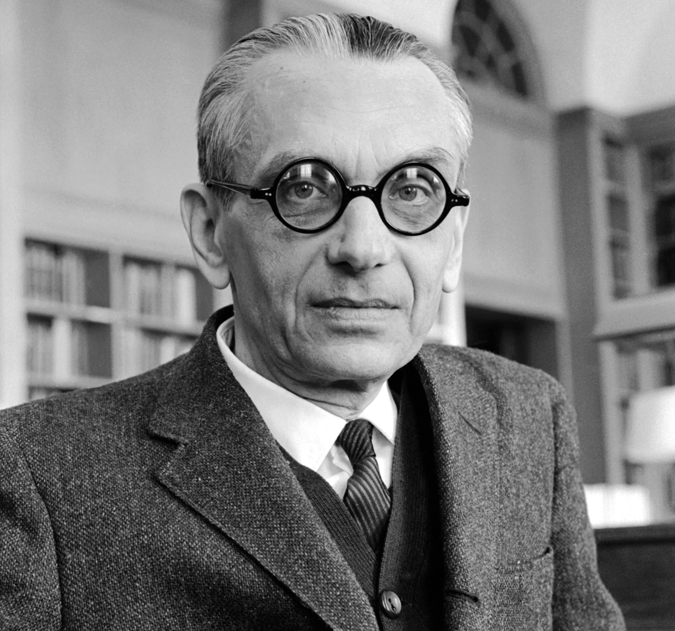
Self-Reference
The liar sentence is self-referential, and you might initially be tempted to take the Liar Paradox as a proof that self-reference isn’t permitted
However, ever since Gödel’s work on syntax and arithmetic, we have known that self-reference is unobjectionable
Moreover, sentences can be contingently (or empirically) self-referential
The third sentence on this slide is not true
If we cannot block the Liar Paradox by outlawing self-reference, we only have three options:
Restrict the T-Scheme
Revise classical logic
Accept the contradictory conclusion

Slide 5
Tarski’s Hierarchy
Tarskian Slogan: No language can contain its own truth predicate
$L_{0}$: includes sentences about the world (e.g. ‘2+2=4’), but none about truth
$L_{1}$: includes all the sentences in $L_{0}$, plus ‘${\text{true}}_{0}$’, which can be applied to the sentences in $L_{0}$
$L_{2}$: includes all the sentences in $L_{1}$, plus ‘${\text{true}}_{1}$’, which can be applied to the sentences in $L_{1}$
…
$$…$$
$$L_{2}$$
$$L_{1}$$
$$L_{0}$$

Slide 6
Solving the Liar Paradox
Tarski rejected the T-Scheme as we had formulated it, because we assumed that there was a universal truth-predicate, rather than a hierarchy of language-specific truth-predicates
(T) ‘$P$’ is true $↔$ $P$
However, he insisted that we should accept this reformulated version of the scheme for every sentence in $L_{n}$
($T_{n}$) ‘$P$’ is ${true}_{n}↔P$
It is impossible to generate a Liar Paradox with this scheme
No sentence can say of itself that it is not true (full stop)
We can generate a sentence $λ_{n}$ $=$ ‘$λ_{n}$ is not ${\text{true}}_{n}$’, but that isn’t paradoxical
$λ_{n}$ mentions ${truth}_{n}$, and so it isn’t eligible to be ${true}_{n}$
So, although $λ_{n}$ is not ${\text{true}}_{n}$, it is ${\text{true}}_{n+1}$!

Slide 7
Expressive Limitations
Bivalence: Every sentence is true or false
When people assert Bivalence, they do not usually think they are talking about some restricted set of sentences: they think that every sentence is true or false
Likewise, when people reject Bivalence, they are denying that every sentence is true or false
But if Tarski is right, then we can’t take Bivalence as a truly universal generalisation over every sentence
We can assert $Bivalence_{n}$ for language $L_{n}$: every sentence in $L_{n}$ is ${true}_{n}$ or ${false}_{n}$
But $Bivalence_{n}$ itself belongs to $L_{n+1}$, and so doesn’t apply to itself
We can then assert $Bivalence_{n+1}$, but that principle will belong to $L_{n+2}$, and so also won’t apply to itself
…

Slide 8
Natural Language
Tarski didn’t want to apply his theory to natural languages like English, but lots of philosophers have tried to do just that
English contains infinitely many truth-predicates
‘${true}_{0}$’ is used to evaluate English sentences that don’t mention truth (or other semantic notions)
‘${true}_{1}$’ is used to evaluate English sentences that mention ${truth}_{0}$, but no higher notion of truth
…
Just as in Tarski’s theory, each truth-predicate is governed by a restricted version of the T-Scheme (for any sentence ‘$P$’ that doesn’t mention any notion of truth at or above ${truth}_{n}$)
($T_{n}$) ‘$P$’ is ${true}_{n}$ iff $P$

Slide 9
No Stable Interpretation
The problem case
Fatma: Nothing Simon says is true
Simon: Nothing Fatma says is true
We need to assign indexes on Fatma’s and Simon’s uses of ‘true’; let’s just index Fatma’s as ‘${true}_{n}$’
Presumably Simon meant his assertion to apply to Fatma’s, and so we will need to index Simon’s use of ‘true’ as ‘${true}_{n+1}$’
But now Fatma’s assertion doesn’t apply to Simon’s!
To fix this, Fatma’s use of ‘true’ must be interpreted as ‘${true}_{n+2}$’; but then Simon’s should be interpreted as ‘${true}_{n+3}$’, and round we go again!
Things can get even worse if Simon said ‘Everything Fatma says is true’

Slide 10
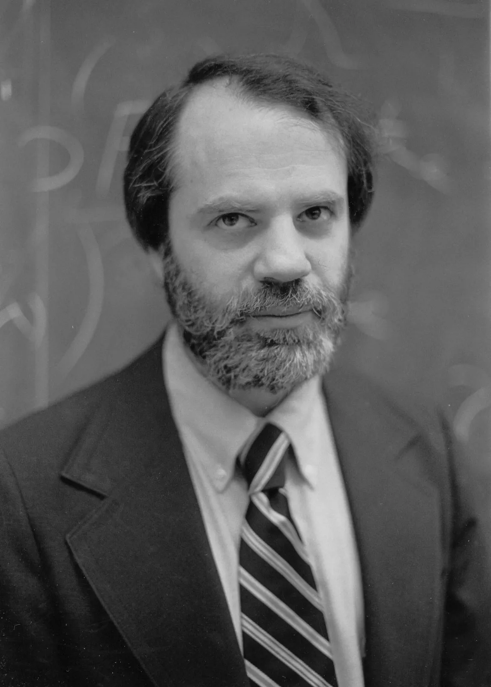
Saul Kripke
The last objections are due to Saul Kripke
Kripke (1975), ‘Outline of a theory of truth’. The Journal of Philosophy 72, pp.690-716
Kripke took it to show that we shouldn’t try to work within a Tarskian hierarchy, and he offered an alternative solution to the Liar Paradox
Kripke’s alternative solution has been extremely influential, but it is also quite challenging
Aims for the lecture
Explain Kripke’s solution
Consider some limitations of that solution
Point towards some of the ways that people have built on Kripke’s solution

Slide 11
Paracompleteness
Recap
Truth and grounding
The fixed-point construction
Internal or external?
Curry’s Paradox

Slide 12
Introducing Grounding
An intuitive idea: the sentence ‘ “$P$” is true’ inherits its truth-value from the sentence ‘$P$’
‘ “Snow is white” is true’ is true because ‘snow is white’ is true
‘ “Rob is 6ft tall” is true’ is false because ‘Rob is 6ft tall’ is false
If I said ‘grass is green’, then ‘Rob said something true’ is true because ‘grass is green’ is true
Call a sentence grounded iff it has the truth-value it has ultimately because some sentence that doesn’t mention truth has the truth-value it has

Slide 20
The Liar is Ungrounded
The liar sentence is ungrounded, in the sense that it doesn’t ultimately inherit its truth-value from a sentence that doesn’t mention truth
‘$λ$ is not true’ should inherit its truth from $λ$
If ‘$λ$ is not true’ is true, that should be because $λ$ is not true
If ‘$λ$ is not true’ is not true, that should be because $λ$ is true
But $λ$ $=$ ‘$λ$ is not true’, and so we run in a circle
A tempting thought: the liar sentence is defective because it is ungrounded
$λ$ is true
$λ$ is not true

Slide 21
Ungrounded versus Self-Referential
We noted last week that it might be tempting to dismiss the liar sentence as defective because it is self-referential
However, we also noted that that wouldn’t solve every form of the Liar Paradox, because they don’t all involve self-reference
A Circular Paradox
$γ$ $=$ ‘$δ$ is not true’
$δ$ = ‘$γ$ is true
Yablo’s Paradox
$s_{n}$: for all $m>n$, $s_{m}$ is not true
However, both of these paradoxes involves ungrounded sentences!
$s_{1}$ is true
$γ$ is true
$s_{2}$ is true
$δ$ is true
$s_{3}$ is true

Slide 22
The Truth-Teller
Ungrounded sentences aren’t always paradoxical
Consider the truth-teller sentence:
$(τ)$ $τ$ is true
‘$τ$ is true’ should inherit its truth from $τ$
If ‘$τ$ is true’ is true, that should be because $τ$ is true
If ‘$τ$ is true’ is not true, that should be because $τ$ is not true
But $τ$ $=$ ‘$τ$ is not true’, and so we run in a circle
There is no contradiction: $τ$ could consistently be true or false
But nothing determines which $τ$ should be!
$τ$ is true

Slide 23
Kripke’s Project
To turn these intuitive ideas into a real solution to the Liar Paradox, we need to do two things:
Give a formal characterisation of when a sentence is grounded and when it is ungrounded
Offer a theory of truth which explains what is wrong with ungrounded sentences
Kripke’s aim is to do both of these things!

Slide 24
Paracompleteness
Recap
Truth and grounding
The fixed-point construction
Internal or external?
Curry’s Paradox

Slide 25
`
Intuitive Idea
THE RULES
You are entitled to assert ‘$s$ is true’ iff you are entitled to assert $s$
You are entitled to deny ‘$s$ is true’ iff you are entitled to deny $s$
We start with sentences that don’t mention truth
Then we keep applying the rules to more and more sentences
If we carry this process on for long enough (transfinitely!), every grounded sentence will end up true or false
But ungrounded sentences will be neither
TRUE
NOT TRUE
‘ “Grass is green” is true’ is not true
‘Snow is purple’ is not true
This sentence is true
‘Snow is purple’ is true
Snow is purple
This sentence is not true
‘Grass is green’ is true
Grass is green

Slide 26
Languages, Languages, Languages!
We start with a formal FOL language: $ℒ$
We assume that $ℒ$ has the resources to talk about its own expressions, but doesn’t contain a truth-predicate
We will provide a straightforward semantics for $ℒ$
We will then extend that into a semantics for $ℒ^{+}$, which is just like $ℒ$ except it adds the predicate ‘is true’
The truth-predicate does not come with a level index, as in Tarski’s theory
It can be applied to any sentence in $ℒ^{+}$, including sentences that use ‘is true’
IMPORTANT NOTE:
$ℒ$ and $ℒ^{+}$ are both object-languages: they are both languages we are talking about
The metalanguage is assumed to be entirely classical, and to have the resources to do any maths that might be handy

Slide 27
Three-Valued Semantics
Our semantics will be three-valued: $1, 0.5, 0$
For now, we can think of 1 as representing true, 0 as representing false, and $1/2$ as representing neither true nor false
HOWEVER: we will need to revisit this later!
We will use the strong Kleene rules to deal with our three values

Slide 28
Strong Kleene Truth-Tables
$$P$$ | $$¬P$$
1 | 0
0.5
0 | 1
$$P$$ | $$Q$$ | $$P∨Q$$
1 | 1 | 1
1 | 0.5
1 | 0 | 1
0.5 | 1
0.5 | 0.5
0.5 | 0
0 | 1 | 1
0 | 0.5
0 | 0 | 0
$$P$$ | $$Q$$ | $$P∧Q$$
1 | 1 | 1
1 | 0.5
1 | 0 | 0
0.5 | 1
0.5 | 0.5
0.5 | 0
0 | 1 | 0
0 | 0.5
0 | 0 | 0
$$P$$ | $$Q$$ | $$P→Q$$
1 | 1 | 1
1 | 0.5
1 | 0 | 0
0.5 | 1
0.5 | 0.5
0.5 | 0
0 | 1 | 1
0 | 0.5
0 | 0 | 1

Slide 29
Strong Kleene Truth-Tables
$$P$$ | $$¬P$$
1 | 0
0.5 | 0.5
0 | 1
$$P$$ | $$Q$$ | $$P∨Q$$
1 | 1 | 1
1 | 0.5
1 | 0 | 1
0.5 | 1
0.5 | 0.5
0.5 | 0
0 | 1 | 1
0 | 0.5
0 | 0 | 0
$$P$$ | $$Q$$ | $$P∧Q$$
1 | 1 | 1
1 | 0.5
1 | 0 | 0
0.5 | 1
0.5 | 0.5
0.5 | 0
0 | 1 | 0
0 | 0.5
0 | 0 | 0
$$P$$ | $$Q$$ | $$P→Q$$
1 | 1 | 1
1 | 0.5
1 | 0 | 0
0.5 | 1
0.5 | 0.5
0.5 | 0
0 | 1 | 1
0 | 0.5
0 | 0 | 1

Slide 30
Strong Kleene Truth-Tables
$$P$$ | $$¬P$$
1 | 0
0.5 | 0.5
0 | 1
$$P$$ | $$Q$$ | $$P∨Q$$
1 | 1 | 1
1 | 0.5 | 1
1 | 0 | 1
0.5 | 1 | 1
0.5 | 0.5
0.5 | 0
0 | 1 | 1
0 | 0.5
0 | 0 | 0
$$P$$ | $$Q$$ | $$P∧Q$$
1 | 1 | 1
1 | 0.5
1 | 0 | 0
0.5 | 1
0.5 | 0.5
0.5 | 0
0 | 1 | 0
0 | 0.5
0 | 0 | 0
$$P$$ | $$Q$$ | $$P→Q$$
1 | 1 | 1
1 | 0.5
1 | 0 | 0
0.5 | 1
0.5 | 0.5
0.5 | 0
0 | 1 | 1
0 | 0.5
0 | 0 | 1

Slide 31
Strong Kleene Truth-Tables
$$P$$ | $$¬P$$
1 | 0
0.5 | 0.5
0 | 1
$$P$$ | $$Q$$ | $$P∨Q$$
1 | 1 | 1
1 | 0.5 | 1
1 | 0 | 1
0.5 | 1 | 1
0.5 | 0.5 | 0.5
0.5 | 0 | 0.5
0 | 1 | 1
0 | 0.5 | 0.5
0 | 0 | 0
$$P$$ | $$Q$$ | $$P∧Q$$
1 | 1 | 1
1 | 0.5
1 | 0 | 0
0.5 | 1
0.5 | 0.5
0.5 | 0
0 | 1 | 0
0 | 0.5
0 | 0 | 0
$$P$$ | $$Q$$ | $$P→Q$$
1 | 1 | 1
1 | 0.5
1 | 0 | 0
0.5 | 1
0.5 | 0.5
0.5 | 0
0 | 1 | 1
0 | 0.5
0 | 0 | 1

Slide 32
Strong Kleene Truth-Tables
$$P$$ | $$¬P$$
1 | 0
0.5 | 0.5
0 | 1
$$P$$ | $$Q$$ | $$P∨Q$$
1 | 1 | 1
1 | 0.5 | 1
1 | 0 | 1
0.5 | 1 | 1
0.5 | 0.5 | 0.5
0.5 | 0 | 0.5
0 | 1 | 1
0 | 0.5 | 0.5
0 | 0 | 0
$$P$$ | $$Q$$ | $$P∧Q$$
1 | 1 | 1
1 | 0.5
1 | 0 | 0
0.5 | 1
0.5 | 0.5
0.5 | 0 | 0
0 | 1 | 0
0 | 0.5 | 0
0 | 0 | 0
$$P$$ | $$Q$$ | $$P→Q$$
1 | 1 | 1
1 | 0.5
1 | 0 | 0
0.5 | 1
0.5 | 0.5
0.5 | 0
0 | 1 | 1
0 | 0.5
0 | 0 | 1

Slide 33
Strong Kleene Truth-Tables
$$P$$ | $$¬P$$
1 | 0
0.5 | 0.5
0 | 1
$$P$$ | $$Q$$ | $$P∨Q$$
1 | 1 | 1
1 | 0.5 | 1
1 | 0 | 1
0.5 | 1 | 1
0.5 | 0.5 | 0.5
0.5 | 0 | 0.5
0 | 1 | 1
0 | 0.5 | 0.5
0 | 0 | 0
$$P$$ | $$Q$$ | $$P∧Q$$
1 | 1 | 1
1 | 0.5 | 0.5
1 | 0 | 0
0.5 | 1 | 0.5
0.5 | 0.5 | 0.5
0.5 | 0 | 0
0 | 1 | 0
0 | 0.5 | 0
0 | 0 | 0
$$P$$ | $$Q$$ | $$P→Q$$
1 | 1 | 1
1 | 0.5
1 | 0 | 0
0.5 | 1
0.5 | 0.5
0.5 | 0
0 | 1 | 1
0 | 0.5
0 | 0 | 1

Slide 34
Strong Kleene Truth-Tables
$$P$$ | $$¬P$$
1 | 0
0.5 | 0.5
0 | 1
$$P$$ | $$Q$$ | $$P∨Q$$
1 | 1 | 1
1 | 0.5 | 1
1 | 0 | 1
0.5 | 1 | 1
0.5 | 0.5 | 0.5
0.5 | 0 | 0.5
0 | 1 | 1
0 | 0.5 | 0.5
0 | 0 | 0
$$P$$ | $$Q$$ | $$P∧Q$$
1 | 1 | 1
1 | 0.5 | 0.5
1 | 0 | 0
0.5 | 1 | 0.5
0.5 | 0.5 | 0.5
0.5 | 0 | 0
0 | 1 | 0
0 | 0.5 | 0
0 | 0 | 0
$$P$$ | $$Q$$ | $$P→Q$$
1 | 1 | 1
1 | 0.5
1 | 0 | 0
0.5 | 1 | 1
0.5 | 0.5
0.5 | 0
0 | 1 | 1
0 | 0.5 | 1
0 | 0 | 1

Slide 35
Strong Kleene Truth-Tables
$$P$$ | $$¬P$$
1 | 0
0.5 | 0.5
0 | 1
$$P$$ | $$Q$$ | $$P∨Q$$
1 | 1 | 1
1 | 0.5 | 1
1 | 0 | 1
0.5 | 1 | 1
0.5 | 0.5 | 0.5
0.5 | 0 | 0.5
0 | 1 | 1
0 | 0.5 | 0.5
0 | 0 | 0
$$P$$ | $$Q$$ | $$P∧Q$$
1 | 1 | 1
1 | 0.5 | 0.5
1 | 0 | 0
0.5 | 1 | 0.5
0.5 | 0.5 | 0.5
0.5 | 0 | 0
0 | 1 | 0
0 | 0.5 | 0
0 | 0 | 0
$$P$$ | $$Q$$ | $$P→Q$$
1 | 1 | 1
1 | 0.5 | 0.5
1 | 0 | 0
0.5 | 1 | 1
0.5 | 0.5 | 0.5
0.5 | 0 | 0.5
0 | 1 | 1
0 | 0.5 | 1
0 | 0 | 1

Slide 36
Strong Kleene Quantifiers
Universal Quantifier
$\left[∀xAx\right]=1$ iff $\left[Ax\right]=1$ for all values of $x$
$\left[∀xAx\right]=0$ iff $\left[Ax\right]=0$ for some value of $x$
$\left[∀xAx\right]=0.5$ otherwise
Existential Quantifier
$\left[∃xAx\right]=1$ iff $\left[Ax\right]=1$ for some value of $x$
$\left[∃xAx\right]=0$ iff $\left[Ax\right]=0$ for all values of $x$
$\left[∃xAx\right]=0.5$ otherwise

Slide 37
The Semantics for $ℒ$
Although our semantics can assign three truth-values, we will only use two for the sentences in $ℒ$
The semantics for $ℒ$ follows exactly the rules you learnt in Reason & Argument
Each name is assigned an individual to refer to
Each predicate is assigned a set of individuals as its extension
$\left[Fa\right]=1$ iff the individual referred to by $a$ is in the extension of $F$; $\left[Fa\right]=0$ otherwise
We only start to use the third truth-value when we upgrade to $ℒ^{+}$ and deal with ‘is true’

Slide 38
The Semantics for $ℒ^{+}$
The predicate ‘is true’ has an extension and an anti-extension: $\left\langle E,A\right\rangle$
$E$ and $A$ are mutually exclusive: nothing can be in both
But they are not jointly exhaustive: something can be in neither
INTUITVE: The predicate ‘is true’ is true of everything in $E$, false of everything in $A$, and neither of everything else
FORMAL:
$\left[a \text{is} \text{true}\right]=1$ iff the individual referred to by $a$ is in $E$
$\left[a \text{is} \text{true}\right]=0$ iff the individual referred to by $a$ is in $A$
$\left[a \text{is} \text{true}\right]=0.5$ otherwise
Everything that isn’t a sentence is automatically in $A$, because ‘is true’ is only true of sentences – from now on we will ignore non-sentences!
We then add sentences into $E$ and $A$ in careful steps

Slide 39
Step-by-Step
EXAMPLE: imagine that, in the semantics for $ℒ$, $\left[Fa\right]=1$ and $\left[Ga\right]=0$
Step 0: $E=∅=A$
At Step 0, we don’t count ‘is true’ as being true or false of anything
Step $1$: $E=\left\{x:\left[x\right]=1 \text{at} \text{Step} 0\right\}$; $A=\left\{x:\left[x\right]=\text{0} \text{at} \text{Step} 0\right\}$
At Step 1, we add all the true sentences of $ℒ$ to E, and all of the false sentences of $ℒ$ to $A$
So now [‘$Fa$’ is true$]=1$ and [‘$Ga$’ is true$]=0$
Step $2$: $E=\left\{x:\left[x\right]=1 \text{at} \text{Step} 1\right\}$; $A=\left\{x:\left[x\right]=\text{0} \text{at} \text{Step} 1\right\}$
At Step 2, we add all the sentences that were true at Step 1 to $E$, and all the sentences that were false at Step 1 to $A$
So now [‘ “$Fa$” is true’ is true$]=1$ and [‘ “$Ga$” is true’ is true$]=0$
And [‘ “$Fa$” is not true’ is true$]=0$ and [‘ “$Ga$” is not true’ is true$]=1$
And so on!

Slide 40
The Fixed-Point Theorem
We carry on this step-by-step process into the transfinite
If $α=β+1,$ Step $α$: $E=\left\{x:\left[x\right]=1 \text{at} \text{Step} β\right\}$; $A=\left\{x:\left[x\right]=\text{0} \text{at} \text{Step} β\right\}$
If $α$ is a limit, Step $α$: $E=\left\{x:\left[x\right]=1 \text{at} \text{some} \text{Step}\text{ <}α\right\}$; $A=\left\{x:\left[x\right]=\text{0} \text{at} \text{some} \text{Step}\text{ <}α\right\}$
IMPORTANT: Once a sentence enters $E$ or $A$, it never leaves
TERMINOLOGY: the process is monotonic
As a result, there must come a point in this process when $E$ and $A$ stop growing: any sentence that will ever end up in $E$ or $A$ is already there
There are only countably many sentences in $ℒ^{+}$, but we can carry the process on as far up the ordinals as we like
This is known as the minimal fixed-point of the process
Notation: $\left[\left[P\right]\right]=\left[P\right]$ at the minimal fixed-point

Slide 41
A Theory of Truth
A sentence is true iff it is true at the minimal fixed-point
‘$P$’ is true iff $\left[\left[P\right]\right]=1$
A sentence is false iff it is false at the minimal fixed-point
‘$P$’ is false iff $\left[\left[P\right]\right]=0$
IMPORTANT RESULT: $\left[\left[\text{′}P\text{′} \text{is} \text{true}\right]\right]=\left[\left[P\right]\right]$, for every sentence ‘$P$’ in $L^{+}$
If $\left[\left[P\right]\right]=1$, then ‘$P$’ entered $E$at some stage $α$; therefore ‘ “$P$” is true’ entered $E$ at stage $α+1$, and so $\left[\left[\text{′}P\text{′} \text{is} \text{true}\right]\right]=1$
If $\left[\left[P\right]\right]=0$, then ‘$P$’ entered $A$at some stage $α$; therefore ‘ “$P$” is true’ entered $A$ at stage $α+1$, and so $\left[\left[\text{′}P\text{′} \text{is} \text{true}\right]\right]=0$
If $\left[\left[P\right]\right]=0.5$, then ‘$P$’ never enters $E$or $A$; therefore ‘ “$P$” is true’ never enters $E$ or $A$, and so $\left[\left[\text{′}P\text{′} \text{is} \text{true}\right]\right]=0.5$

Slide 42
A Theory of Grounding
A sentence is grounded iff it is in $E$ or $A$ at the minimal fixed-point
Equivalently: ‘$P$’ is ungrounded iff $\left[\left[P\right]\right]=0.5$
So ungrounded sentences are neither true nor false
It is also easy to show that $λ$ (i.e. ‘$λ$ is not true’) is ungrounded in this sense
Suppose $λ$ is in $E$ at the minimal fixed-point
So $λ$ must have entered $E$ for the first time at some stage $α$
But $λ=$ ‘$λ$ is not true’, and ‘$λ$ is not true’ can enter $E$ at stage $α$ only if $λ$ entered $A$ at an earlier stage, $β$
But $λ=$ ‘$λ$ is not true’, and ‘$λ$ is not true’ can enter $A$ at a stage $β$ only if $λ$ entered $E$ at an even earlier stage; but $α$ was meant to be the stage that $λ$ first entered $E$!
Similar reasoning applies if $λ$ is in $A$ at the minimal fixed-point
So we have a stable valuation for $λ$: it is neither true nor false!

Slide 43
Paracompleteness
Recap
Truth and grounding
The fixed-point construction
Internal or external?
Curry’s Paradox

Slide 44
Revenge?
In the last lecture, we saw that denying that $λ$ is true or false leads to a revenge paradox
If $λ$ is neither true nor false, then $λ$ is not true
But $λ=$ ‘$λ$ is not true’, and so $λ$ says of itself that it is not true
So things are as $λ$ says they are, and so $λ$ is true after all!
This intuitive reasoning can be validated in Kripke’s system:
Suppose $\left[\left[λ \text{is} \text{not} \text{true} ∧ λ \text{is} \text{not} \text{false}\right]\right]=1$
According to the strong Kleene rules, it follows that $\left[\left[λ \text{is} \text{not} \text{true}\right]\right]=1$
But $λ=$ ‘$λ$ is not true’, and in general, $\left[\left[\text{′}P\text{′ }\text{is} \text{true}\right]\right]=\left[\left[P\right]\right]$
So $\left[\left[λ \text{is} \text{true}\right]\right]=1$
How does Kripke avoid this problem?

Slide 45
You Can’t Say It In $ℒ^{+}$!
It turns out that $\left[\left[λ \text{is} \text{not} \text{true} ∧ λ \text{is} \text{not} \text{false}\right]\right]≠1$!
$\left[\left[λ \text{is} \text{not} \text{true}\right]\right]=0.5$
On the most plausible account of falsehood, ‘ “$P$” is false’ is equivalent to ‘ “$¬P$” is true’
So $\left[\left[λ \text{is} \text{not} \text{false}\right]\right]=\left[\left[\text{′}λ \text{is} \text{not} \text{not} \text{true}\text{′} \text{is} \text{not} \text{true}\right]\right]=\left[\left[λ \text{is} \text{not} \text{true}\right]\right]=0.5$
According to the strong Kleene truth-tables, when $\left[P\right]=\left[Q\right]=0.5$, $\left[P∧Q\right]=0.5$
So $\left[\left[λ \text{is} \text{not} \text{true} ∧ λ \text{is} \text{not} \text{false}\right]\right]=0.5$
So, in $ℒ^{+}$, you cannot truly say that $λ$ is neither true nor false: if you try, you just end up saying something else which is neither true nor false!
Kripke was aware of this problem, and concluded that, in order to say that $λ$ is neither true nor false, we need to ascend from $ℒ^{+}$ to a metalanguage

Slide 46
The Ghost of the Tarski Hierarchy
“There are assertions we can make about the object language ($ℒ^{+}$) which we cannot make in the object language. For example, Liar sentences are not true in the object language, in the sense that the inductive process never makes them true; but we are precluded from saying this in the object language by our interpretation of negation and the truth predicate.

Slide 47
The Ghost of the Tarski Hierarchy
“If we think of the minimal fixed point, say under the Kleene valuation, as giving a model of natural language, then the sense in which we can say, in natural language, that a Liar sentence is not true must be thought of as associated with some later stage in the development of natural language, one in which speakers reflect on the generation leading to the minimal fixed point. It is not itself part of that process.
“There are assertions we can make about the object language ($ℒ^{+}$) which we cannot make in the object language. For example, Liar sentences are not true in the object language, in the sense that the inductive process never makes them true; but we are precluded from saying this in the object language by our interpretation of negation and the truth predicate.

Slide 48
The Ghost of the Tarski Hierarchy
“If we think of the minimal fixed point, say under the Kleene valuation, as giving a model of natural language, then the sense in which we can say, in natural language, that a Liar sentence is not true must be thought of as associated with some later stage in the development of natural language, one in which speakers reflect on the generation leading to the minimal fixed point. It is not itself part of that process.
“The necessity to ascend to a metalanguage may be one of the weaknesses of the present theory. The ghost of the Tarski hierarchy is still with us.”
Kripke (1975), ‘An outline of a theory of truth’. The Journal of Philosophy 72, p.714

Slide 51
External versus Internal
Not everyone agrees with Kripke’s own assessment of his situation
It all depends on whether you are working with the internal or external version of Kripke’s theory
In some literature, the internal theory is called KFS, and the external theory is called FM (or, confusingly, KF)
In the process of outlining Kripke’s theory, we appealed to the notion of truth in two different places
Kripke’s theory defines a truth-predicate, ‘is true’, in the object-language $ℒ^{+}$
But Kripke also uses a notion of truth in the metalanguage: $1$ represents true, $0$ represents false, and $0.5$ represents neither true nor false
Which notion of truth is the real notion, the one that matters?
Internal: the real notion of truth is the notion expressed by ‘is true’ in $ℒ^{+}$
External: the real notion of truth is the notion expressed in the metalanguage

Slide 52
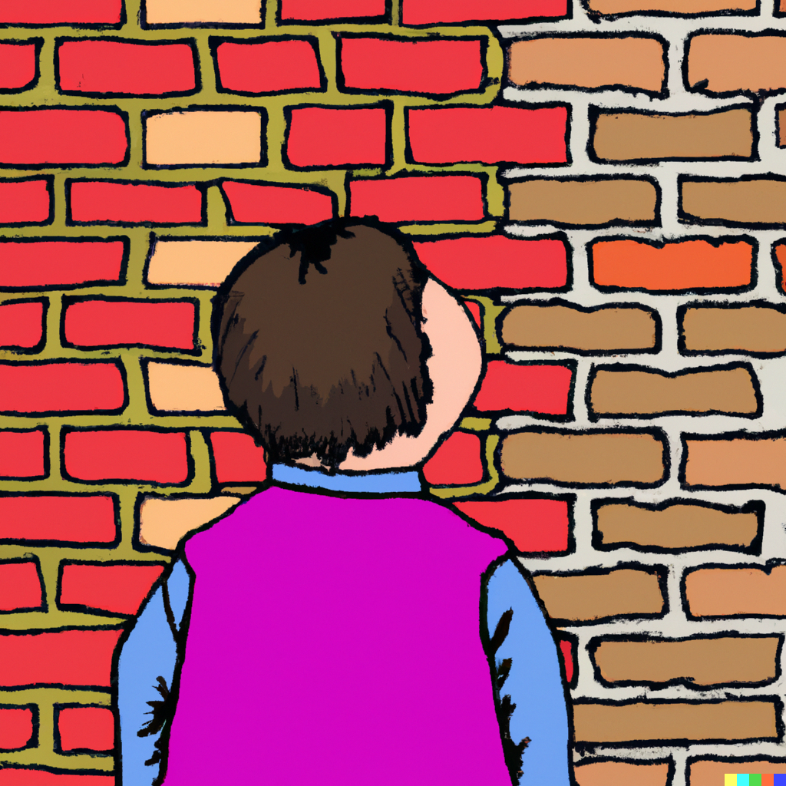
The External Theory
According to the external theory, $1$ really does represent truth
A sentence from $ℒ^{+}$, ‘$P$’, is true iff $\left[\left[P\right]\right]=1$
So $λ$ (i.e. ‘$λ$ is not true’) is not true, since $\left[\left[λ \text{is} \text{not} \text{true}\right]\right]≠1$
It follows that we cannot fully capture truth in $ℒ^{+}$: we have to ascend to a metalanguage, and we are left with the ghost of the Tarski hierarchy
Kripke’s definition of truth still looks like an improvement over Tarski’s
We can do a lot more truth-talk within $ℒ^{+}$ than Tarski allows!
However, we still haven’t fundamentally changed the situation as Tarski saw it
We still haven’t got a semantically closed language!

Slide 53
The Internal Theory
The internal theory of truth is expressed within $ℒ^{+}$ itself, not the metalanguage that we used to describe $ℒ^{+}$
The theory is made up of all the sentences in $ℒ^{+}$ that get value 1 at the minimal fixed-point
More accurately, it is made up of all the sentences in $ℒ^{+}$ that would get value 1 at the minimal fixed-point, no matter what initial interpretation you gave $ℒ$
AN IMPORTANT DIFFERENCE
The external theory obeys classical logic, since we assumed the metalanguage was classical
The internal theory is non-classical, since it doesn’t validate the Law of Excluded Middle: neither ‘$λ$ is true’ nor ‘$λ$ is not true’ gets value 1 at the minimal fixed-point
A logic which rejects LEM in this way is known as paracomplete

Slide 54
What about those Numbers!?
If we accept the internal theory, then we shouldn’t really have identified the values in the metalanguage $\left(1, 0.5, 0\right)$ as true, false and neither true nor false
They were a tool for constructing the internal theory
We constructed the internal theory from the outside: we characterised it as the set of sentences which get value 1 at the minimal fixed-point
They are a tool for figuring out what entails what in the paracomplete logic
An argument in $ℒ^{+}$ is valid iff there is no interpretation which assigns all of the premises value 1, but assigns the conclusion a value less than 1 (i.e. $0$ or $0.5$)
They are a tool for figuring out what can be asserted in the internal theory
If a sentence is assigned value 1, it should be asserted; and if it is assigned value 0, it should be denied (i.e. its negation should be asserted)
If a sentence is assigned value $0.5$, it should be rejected (i.e. neither asserted nor denied)

Slide 55
Avoiding Revenge
If you accept the internal theory, you should not deny that $λ$ is true
You also shouldn’t assert that $λ$ is true
You should reject both ‘$λ$ is true’ and ‘$λ$ is not true’; in other words, you should just remain silent about the $λ$
But that is not because you are agnostic about the status of $λ$ – you should also reject (i.e. neither accept nor deny) this instance of LEM:
$λ$ is true $∨$ $λ$ is not true
You think it is simply misguided to enter into any discussion of the status of $λ$!
I leave it to you to decide whether you can stomach this paracompleteness!

Slide 56
Paracompleteness
Recap
Truth and grounding
The fixed-point construction
Internal or external?
Curry’s Paradox

Slide 57
The T-Scheme?
There is an important sense in which ‘$A$’ and ‘ “$A$” is true’ are equivalent in the internal theory
$\left[\left[\text{′}P\text{′ }\text{is} \text{true}\right]\right]=\left[\left[P\right]\right]$
$\left[\left[\text{′}P\text{′ }\text{is} \text{not} \text{true}\right]\right]=\left[\left[¬P\right]\right]$
But what about the T-Scheme?
(T) ‘$P$’ is true $↔$ $P$
It turns out that not every instance of the T-Scheme is true at the minimal fixed-point; in particular, it fails for $λ$ (i.e. ‘$λ$ is not true’)
‘$λ$ is not true’ is true $↔$ $λ$ is not true
The reason for this is that the strong Kleene conditional is just too weak to be much good

Slide 58
Strong Kleene Conditional
$$P$$ | $$Q$$ | $$P∧Q$$
1 | 1 | 1
1 | 0.5 | 0.5
1 | 0 | 0
0.5 | 1 | 0.5
0.5 | 0.5 | 0.5
0.5 | 0 | 0
0 | 1 | 0
0 | 0.5 | 0
0 | 0 | 0
$$P$$ | $$Q$$ | $$P→Q$$
1 | 1 | 1
1 | 0.5 | 0.5
1 | 0 | 0
0.5 | 1 | 1
0.5 | 0.5 | 0.5
0.5 | 0 | 0.5
0 | 1 | 1
0 | 0.5 | 1
0 | 0 | 1
$$P$$ | $$Q$$ | $$P↔Q$$
1 | 1 | 1
1 | 0.5
1 | 0 | 0
0.5 | 1
0.5 | 0.5
0.5 | 0
0 | 1 | 0
0 | 0.5
0 | 0 | 1

Slide 59
Strong Kleene Conditional
$$P$$ | $$Q$$ | $$P∧Q$$
1 | 1 | 1
1 | 0.5 | 0.5
1 | 0 | 0
0.5 | 1 | 0.5
0.5 | 0.5 | 0.5
0.5 | 0 | 0
0 | 1 | 0
0 | 0.5 | 0
0 | 0 | 0
$$P$$ | $$Q$$ | $$P→Q$$
1 | 1 | 1
1 | 0.5 | 0.5
1 | 0 | 0
0.5 | 1 | 1
0.5 | 0.5 | 0.5
0.5 | 0 | 0.5
0 | 1 | 1
0 | 0.5 | 1
0 | 0 | 1
$$P$$ | $$Q$$ | $$P↔Q$$
1 | 1 | 1
1 | 0.5 | 0.5
1 | 0 | 0
0.5 | 1 | 0.5
0.5 | 0.5 | 0.5
0.5 | 0 | 0.5
0 | 1 | 0
0 | 0.5 | 0.5
0 | 0 | 1
$\left[\left[\text{′}λ \text{is} \text{not} \text{true}\text{′ }\text{is} \text{true}\right]\right]=\left[\left[λ \text{is} \text{not} \text{true}\right]\right]=0.5$
Therefore, by the strong Kleene rules, $\left[\left[\text{′}λ \text{is} \text{not} \text{true}\text{′ }\text{is} \text{true}↔λ \text{is} \text{not} \text{true}\right]\right]=0.5$
Generally: if $\left[P\right]=0.5$, then by the strong Kleene rules, $\left[P↔P\right]=0.5$

Slide 60
Strong Kleene Conditional
Łukasiewicz Truth-Tables
$$P$$ | $$Q$$ | $$P∧Q$$
1 | 1 | 1
1 | 0.5 | 0.5
1 | 0 | 0
0.5 | 1 | 0.5
0.5 | 0.5 | 0.5
0.5 | 0 | 0
0 | 1 | 0
0 | 0.5 | 0
0 | 0 | 0
$$P$$ | $$Q$$ | $$P→Q$$
1 | 1 | 1
1 | 0.5 | 0.5
1 | 0 | 0
0.5 | 1 | 1
0.5 | 0.5 | 0.5
0.5 | 0 | 0.5
0 | 1 | 1
0 | 0.5 | 1
0 | 0 | 1
$$P$$ | $$Q$$ | $$P↔Q$$
1 | 1 | 1
1 | 0.5 | 0.5
1 | 0 | 0
0.5 | 1 | 0.5
0.5 | 0.5 | 1
0.5 | 0 | 0.5
0 | 1 | 0
0 | 0.5 | 0.5
0 | 0 | 1
$$P$$ | $$Q$$ | $$P↔Q$$
1 | 1 | 1
1 | 0.5 | 0.5
1 | 0 | 0
0.5 | 1 | 0.5
0.5 | 0.5 | 0.5
0.5 | 0 | 0.5
0 | 1 | 0
0 | 0.5 | 0.5
0 | 0 | 1
$\left[\left[\text{′}λ \text{is} \text{not} \text{true}\text{′ }\text{is} \text{true}\right]\right]=\left[\left[λ \text{is} \text{not} \text{true}\right]\right]=0.5$
Therefore, by the strong Kleene rules, $\left[\left[\text{′}λ \text{is} \text{not} \text{true}\text{′ }\text{is} \text{true}↔λ \text{is} \text{not} \text{true}\right]\right]=0.5$
Generally: if $\left[P\right]=0.5$, then by the strong Kleene rules, $\left[P↔P\right]=0.5$
$\left[\left[\text{′}λ \text{is} \text{not} \text{true}\text{′ }\text{is} \text{true}\right]\right]=\left[\left[λ \text{is} \text{not} \text{true}\right]\right]=0.5$
Therefore, by the Łukasiewicz rules, $\left[\left[\text{′}λ \text{is} \text{not} \text{true}\text{′ }\text{is} \text{true}↔λ \text{is} \text{not} \text{true}\right]\right]=1$
Generally: by the Łukasiewicz rules, $\left[P↔P\right]=1$

Slide 61
Another Paradox!
Swapping the strong Kleene conditional for the Łukasiewicz conditional might sound like an easy fix, but we need to be on guard against another Liar-like paradox!
Whereas the Liar Paradox is a paradox about negation, Curry’s Paradox is a paradox about the conditional
To get this paradox up-and-running, we only need to make three assumptions:
T-Scheme: ‘$P$’ is true $↔P$
Modus Ponens: $P, P→Q⊢Q$
Contraction: $P→\left(P→Q\right)⊢P→Q$

Slide 62
Curry’s Paradox
We start by introducing a new self-referential sentence (called a Curry sentence)
$(γ)$ $γ$ is true $→$ the Moon is made of cheese
We can now offer a proof that the Moon is made of cheese, as follows:
1. $γ$ is true $↔$ $(γ$ is true $→$ $M)$ [T-Scheme]
2. $∴γ$ is true $→$ $(γ$ is true $→$ $M)$ [1, left-to-right]
3. $∴(γ$ is true $→M)→γ$ is true [1, right-to-left]
4. $∴γ$ is true $→$ $M$ [2, Contraction]
5. $∴$ $γ$ is true [3 and 4, Modus Ponens]
6. $∴M$ [4 and 5, Modus Ponens]

Slide 63
Paradox Solved!
We can avoid Curry’s Paradox by rejecting any of these three assumptions
T-Scheme: ‘$P$’ is true $↔P$
Modus Ponens: $P, P→Q⊢Q$
Contraction: $P→\left(P→Q\right)⊢P→Q$
GOOD NEWS: the Łukasiewicz truth-table doesn’t validate Contraction!
If $\left[P\right]=0.5$ and $\left[Q\right]=0$, then $\left[P→Q\right]=0.5$
But then $\left[P→\left(P→Q\right)\right]=1$
$$P$$ | $$Q$$ | $$P→Q$$
1 | 1 | 1
1 | 0.5 | 0.5
1 | 0 | 0
0.5 | 1 | 1
0.5 | 0.5 | 1
0.5 | 0 | 0.5
0 | 1 | 1
0 | 0.5 | 1
0 | 0 | 1
So Contraction can take you from a sentence with value 1 to a conclusion with value $0.5$, and so is invalid
Since $\left[\text{The} \text{moon} \text{is} \text{made} \text{of} \text{cheese}\right]=0$, we can solve Curry’s Paradox just by setting $\left[γ \text{is} \text{true}\right]=0.5$

Slide 64
Another Way of Presenting It
Here is another way of presenting the Łukasiewicz rule for the conditional:
$\left[P→Q\right]=$ $1$ if $\left[P\right]≤\left[Q\right]$
$1−\left(\left[P\right]−\left[Q\right]\right)$ otherwise
Intuitively: the value of a conditional depends on whether it takes you from a higher-value antecedent to a lower-value consequent
A conditional gets value 1 iff the antecendent isn’t higher-value than the consequent
Otherwise, the conditional falls short of 1 by exactly the degree that $\left[P\right]$ is greater than $\left[Q\right]$
We want $\left[γ \text{is} \text{true}\right]=\left[γ \text{is} \text{true}→M\right]$, and we know that $\left[M\right]=0$
So, by the Łukasiewicz rule, $\left[γ \text{is} \text{true}\right]=\left[γ \text{is} \text{true}→M\right]=1−(\left[γ \text{is} \text{true}\text{]}−0\right)$
So $\left[γ \text{is} \text{true}\right]=1−\left[γ \text{is} \text{true}\right]$, and hence $\left[γ \text{is} \text{true}\right]=0.5=\left[γ \text{is} \text{true}→M\right]$

Slide 65
Another Curry
But now imagine we introduce this new sentence (with $C_{0}$ abbreviating our original Curry sentence, ‘$γ$ is true $→$ the Moon is made of cheese’):
$(γ_{1})$ $γ_{1}$ is true $→$ $C_{0}$
We again want $\left[γ_{1} \text{is} \text{true}\right]=\left[γ_{1} \text{is} \text{true}→C_{0}\right]$, and we know that $\left[C_{0}\right]=0.5$
So, by the Łukasiewicz rule, $\left[γ_{1} \text{is} \text{true}\right]=\left[γ_{1} \text{is} \text{true}→C_{0}\right]=1−(\left[γ_{1} \text{is} \text{true}\text{]}−0.5\right)$
This requires that $\left[γ_{1} \text{is} \text{true}\right]=0.75$, but we don’t have that value in our three-valued semantics!

Slide 66
Continuum-Valued Semantics
We can, of course, solve this problem by adding a new value to our semantics: $0.75$
We’ll also need to add $0.25$ to serve as our value for ‘$γ_{1}$ is not true’, assuming that $\left[¬P\right]=1−\left[P\right]$
But we can keep cooking up new Curry sentences that will force us to introduce more and more truth-values
For each $n>0$, let ‘$C_{n}$’ abbreviate ‘$γ_{n}$ is true $→$ $C_{n−1}$’, and then introduce $γ_{n+1}$ as:
$(γ_{n+1})$ $γ_{n+1}$ is true $→$ $C_{n}$
The solution will have to be to introduce infinitely many values (and, to keep things safe, we may as well make it a full continuum of values)

Slide 70
The Determinate Liar
Imagine we introduce a new determinacy operator, with the following semantics
$\left[DP\right]=$ $1$ if $\left[P\right]=1$
$0$ otherwise
And now let’s introduce a new determinate liar sentence
$(δ)$ $¬D\left(δ \text{is} \text{true}\right)$
We cannot assign a stable value to $δ$, if we assume that $\left[\text{‘}P\text{’ }\text{is} \text{true}\right]=\left[P\right]$
Suppose $\left[δ \text{is} \text{true}\right]=1$; then $\left[¬D\left(δ \text{is} \text{true}\right)\right]=1$, and so $\left[δ \text{is} \text{true}\right]<1$
Suppose $\left[δ \text{is} \text{true}\right]<1$; then $\left[¬D\left(δ \text{is} \text{true}\right)\right]<1$, and so $\left[¬D\left(δ \text{is} \text{true}\right)\right]=0$; and so $\left[δ \text{is} \text{true}\right]=1$

Slide 71
Defining Determinacy
To block this paradox, we must deny that $D$ is a legitimate operator in our object-language
But, once we have a Łukasiewicz conditional, we can define it in the object-language!
First we define $D_{0}^{−}P$ as $P$, and $D_{n+1}^{−}P$ as $¬\left(D_{n}^{−}P→¬D_{n}^{−}P\right)$
Then we define $DP$ as $P∧D_{1}^{−}P∧D_{2}^{−}P∧D_{3}^{−}P∧…$
We can prove that, so defined, $\left[DP\right]=1$ iff $\left[P\right]=1,$ and $\left[DP\right]=0$ otherwise
Roughly, each time we add a conjunct, we limit the range of values the sentence can get; after adding infinitely many of them, the only options are 1 or 0
But is that infinite conjunction really legitimate?
YES, if we have a truth-predicate which follows the rule that $\left[\text{‘}P\text{’ }\text{is} \text{true}\right]$ always equals $[P]$, and well-behaved quantifiers
Remember that we can use a truth-predicate that obeys this rule to simulate infinite quantification

Slide 72
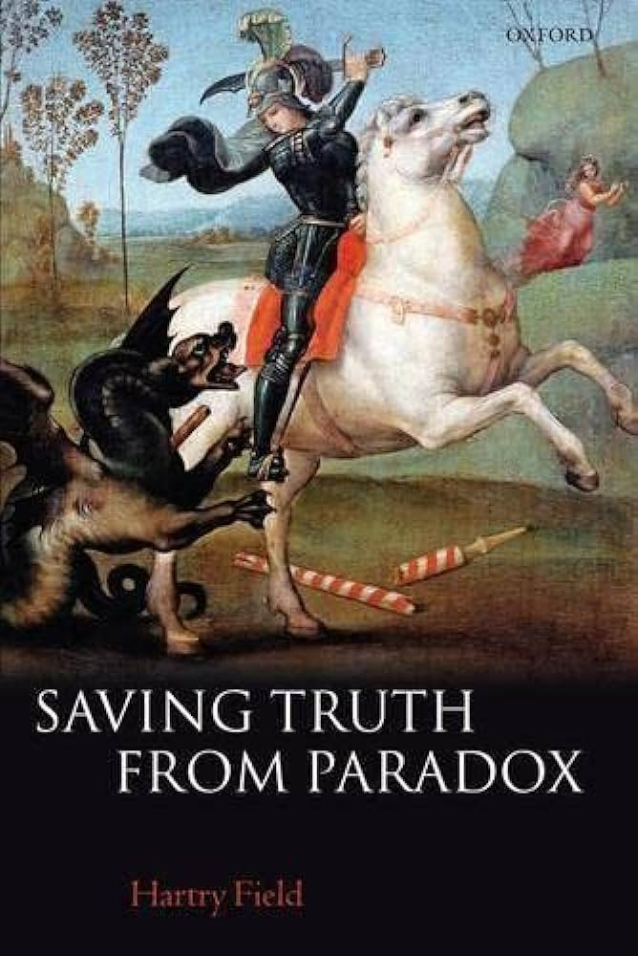
Saving Truth from Paradox
Everything in this part of the paradox has come from Hartry Field’s Saving Truth from Paradox (2008, OUP)
Field goes on to develop an incredibly complex theory of the conditional which is designed to work with a satisfying paracomplete solution to the Liar Paradox
It is controversial whether Field’s solution really works (although everyone agrees it is technically masterful!)
At this point you might start wondering: maybe we’d be better off if we just stopped fighting the Liar Paradox, and accepted that liar sentences are both true and false!
We’ll look at this radical response to the Liar Paradox next week!

Slide 73
For the Next Seminar and Lecture
Seminar Reading
Kripke (1975), ‘Outline of a theory of truth’. The Journal of Philosophy 72, pp.690-716
Lecture Reading
Sainsbury (2009). Paradoxes (CUP), ch.7

