Slide 1
Reason and Argument
Lecture 9: Identity
Robert Trueman
rob.trueman@york.ac.uk
University of York

Slide 2
Reason and Argument
Lecture 9: Identity
Quick Quiz!
Adding Identity to FOL
Counting in FOL
Definite Descriptions

Slide 3
PRACTISE!
Use this symbolisation key:
domain: dogs
$C:$ __₁ chases __₂
$E$: __ is energetic
$P:$ __ is playful
How should we symbolise ‘If every dog is playful, then every dog is energetic’?
1. $∀x\left(Px→Ex\right)$
2. $∀x\left(Px∧Ex\right)$
3. $∀xPx→∀xEx$
3. $∀xPx→∀xEx$

Slide 4
PRACTISE!
Use this symbolisation key:
domain: dogs
$C:$ __₁ chases __₂
$E$: __ is energetic
$P:$ __ is playful
How should we symbolise ‘Every playful dog is an energetic dog’?
1. $∀x\left(Px→Ex\right)$
2. $∀x\left(Px∧Ex\right)$
3. $∀x\left(Px↔Ex\right)$
1. $∀x\left(Px→Ex\right)$

Slide 5
PRACTISE!
Use this symbolisation key:
domain: dogs
$C:$ __₁ chases __₂
$E$: __ is energetic
$P:$ __ is playful
How should we symbolise ‘No dog is playful but not energetic’?
1. $¬∀x\left(Px∧¬Ex\right)$
2. $∀x¬\left(Px∧¬Ex\right)$
3. $¬∃x\left(Px∧¬Ex\right)$
2. $∀x¬\left(Px∧¬Ex\right)$
3. $¬∃x\left(Px∧¬Ex\right)$

Slide 6
PRACTISE!
Use this symbolisation key:
domain: dogs
$C:$ __₁ chases __₂
$E$: __ is energetic
$P:$ __ is playful
How should we symbolise ‘Every playful dog chases a dog who is energetic and playful’?
1. $∀xPx∧∀y∃z\left(Pz∧Cyz\right)$
2. $∀x\left(Px→∃y\left(Py∧Ey∧Cxy\right)\right)$
3. $∀x\left(Px→(∃y\left(Py∧Cxy\right)∧∃y\left(Ey∧Cxy\right)\right)$
2. $∀x\left(Px→∃y\left(Py∧Ey∧Cxy\right)\right)$

Slide 7
Reason and Argument
Lecture 9: Identity
Quick Quiz!
Adding Identity to FOL
Counting in FOL
Definite Descriptions

Slide 12
What went wrong?
When we say something like ‘Rob bores everyone’, we often really mean something like this: ‘Rob bores everyone else’
But if we want to symbolise sentences like that, we need to add one last symbol to First-Order Logic

Slide 13
Introducing identity
We will use ‘=’ as a special two-place predicate
This new predicate will always express identity, and so this will be a (implicit) entry in all our symbolisation keys:
$=$: __₁ is identical to __₂
Importantly, we mean numerical identity, not qualitative identity…

Slide 24
Three different uses of ‘is’
NUMERICAL IDENTITY: Hesperus is Phosphorus
PREDICATION: Hesperus is a planet
EXISTENCE: There is a planet (or even: Hesperus is)

Slide 25
Symbolising our sentence
Rob bores everyone else
Rob bores everyone other than Rob
Rob bores everyone who is not identical to Rob
For all x, it is the case that: if x is not identical to Rob, then Rob bores x
$∀x\left(¬ x=r→Brx\right)$
$∀x\left(x≠r→Brx\right)$

Slide 26
PRACTISE!
domain: people born before 2000ce
$L$: __ is a logician
$R$: __₁ respects __₂
$b$: Bertrand Russell
$g$: Gottlob Frege
Use this key to symbolise the following sentences:
Gottlob respects every other logician
Bertrand respects a logician other than Gottlob
Bertrand respects all logicians other than Gottlob
A logician other than Gottlob respects Bertrand
$∀x\left(\left(¬ x=g∧Lx\right)→Rgx\right)$
$∃x\left(Lx∧¬ x=g∧Rbx\right)$
$∀x\left(\left(Lx∧¬ x=g\right)→Rbx\right)$
$∃x\left(Lx∧¬ x=g∧Rxb\right)$

Slide 27
Reason and Argument
Lecture 9: Identity
Quick Quiz!
Adding Identity to FOL
Counting in FOL
Definite Descriptions

Slide 28
Counting in FOL
Adding the identity symbol gives us the power to count in FOL
This makes FOL much more powerful, since it will allow us to handle some simple arithmetical inferences (as we will see later)

Slide 29
At least…
domain: fruit
$A$: __ is an apple
There is at least one apple
There are at least two apples
There are at least three apples
There are at least n apples
$∃xAx$
$∃x∃y\left(Ax∧Ay\right)$
$∃x∃y∃z\left(¬ x=y∧¬ x=z∧¬ y=z∧Ax∧Ay∧Az\right)$
$∃x_{1}∃x_{2}∃x_{3}{…∃x}_{n}(¬{ x}_{1}=x_{2}∧¬{ x}_{1}=x_{3}∧…∧¬{ x}_{1}=x_{n}∧$
$¬$ $x_{2}=x_{3}∧…∧¬{ x}_{2}=x_{n}∧$
$…∧$
$¬{ x}_{n−1}=x_{n}∧$
$Ax_{1}∧Ax_{2}∧Ax_{3}∧…∧Ax_{n})$
$∃x∃y\left(¬ x=y∧Ax∧Ay\right)$

Slide 30
At most…
At least…
domain: fruit
$A$: __ is an apple
There is at most one apple
There are at most two apples
There are at most n apples
$∃xAx$
$∃x∃y\left(¬ x=y∧Ax∧Ay\right)$
$∃x∃y∃z\left(¬ x=y∧¬ x=z∧¬ y=z∧Ax∧Ay∧Az\right)$
$∃x_{1}∃x_{2}∃x_{3}{…∃x}_{n}(¬{ x}_{1}=x_{2}∧¬{ x}_{1}=x_{3}∧…∧¬{ x}_{1}=x_{n}∧$
$¬$ $x_{2}=x_{3}∧…∧¬{ x}_{2}=x_{n}∧$
$…∧$
$¬{ x}_{n−1}=x_{n}∧$
$Ax_{1}∧Ax_{2}∧Ax_{3}∧…∧Ax_{n})$
$¬∃x∃y\left(¬ x=y∧Ax∧Ay\right)$
$¬∃x∃y∃z\left(¬ x=y∧¬ x=z∧¬ y=z∧Ax∧Ay∧Az\right)$
$¬∃x_{1}∃x_{2}∃x_{3}{…∃x}_{n+1}(¬{ x}_{1}=x_{2}∧¬{ x}_{1}=x_{3}∧…∧¬{ x}_{1}=x_{n+1}∧$
$¬$ $x_{2}=x_{3}∧…∧¬{ x}_{2}=x_{n+1}∧$
$…∧$
$¬{ x}_{n}=x_{n+1}∧$
$Ax_{1}∧Ax_{2}∧Ax_{3}∧…∧Ax_{n+1})$
It is not the case that there are at least two apples
It is not the case that there are at least three apples
It is not the case that there are at least n+1 apples

Slide 31
At most…
domain: fruit
$A$: __ is an apple
There is at most one apple
There are at most two apples
There are at most n apples
$¬∃x∃y\left(¬ x=y∧Ax∧Ay\right)$
$¬∃x∃y∃z\left(¬ x=y∧¬ x=z∧¬ y=z∧Ax∧Ay∧Az\right)$
$¬∃x_{1}∃x_{2}∃x_{3}{…∃x}_{n+1}(¬{ x}_{1}=x_{2}∧¬{ x}_{1}=x_{3}∧…∧¬{ x}_{1}=x_{n+1}∧$
$¬$ $x_{2}=x_{3}∧…∧¬{ x}_{2}=x_{n+1}∧$
$…∧$
$¬{ x}_{n}=x_{n+1}∧$
$Ax_{1}∧Ax_{2}∧Ax_{3}∧…∧Ax_{n+1})$

Slide 32
At most…
domain: fruit
$A$: __ is an apple
There is at most one apple
There are at most two apples
There are at most n apples
$∀x∀y\left(\left(Ax∧Ay\right)→x=y\right)$
$∀x∀y∀z\left(\left(Ax∧Ay∧Az\right)→\left(x=y∨x=z∨y=z\right)\right)$
$∀x_{1}∀x_{2}∀x_{3}…{∀x}_{n+1}\left(\left(Ax_{1}∧Ax_{2}∧Ax_{3}∧…∧Ax_{n+1}\right)→\right.$
$\left(x_{1}=x_{2}∨x_{1}=x_{3}∨…∨x_{1}=x_{n+1}∨\right.$
$x_{2}=x_{3}∨…∨x_{2}=x_{n+1}∨$
$…∨$
$\left.\left.x_{n}=x_{n+1}\right)\right)$

Slide 33
At most…
Exactly…
domain: fruit
$A$: __ is an apple
There is exactly one apple
$∀x∀y\left(\left(Ax∧Ay\right)→x=y\right)$
$∀x∀y∀z\left(\left(Ax∧Ay∧Az\right)→\left(x=y∨x=z∨y=z\right)\right)$
$∀x_{1}∀x_{2}∀x_{3}…{∀x}_{n+1}\left(\left(Ax_{1}∧Ax_{2}∧Ax_{3}∧…∧Ax_{n+1}\right)→\right.$
$\left(x_{1}=x_{2}∨x_{1}=x_{3}∨…∨x_{1}=x_{n+1}∨\right.$
$x_{2}=x_{3}∨…∨x_{2}=x_{n+1}∨$
$…∨$
$\left.\left.x_{n}=x_{n+1}\right)\right)$

Slide 34
Exactly…
domain: fruit
$A$: __ is an apple
There is exactly one apple
$∃xAx∧∀x∀y\left(\left(Ax∧Ay\right)→x=y\right)$
$∃x\left(Ax∧∀y\left(Ay→x=y\right)\right)$
$∃x∀y\left(Ay↔x=y\right)$
This is equivalent to: $∃x∀y\left(\left(x=y→Ay\right)∧\left(Ay→x=y\right)\right)$
The green conjunct is a just a very roundabout way of writing ‘$Ax$’
There is at least one apple, and at most one apple

Slide 35
Exactly…
domain: fruit
$A$: __ is an apple
There are exactly two apples
$∃xAx∧∀x∀y\left(\left(Ax∧Ay\right)→x=y\right)$
$∃x\left(Ax∧∀y\left(Ay→x=y\right)\right)$
$∃x∀y\left(Ay↔x=y\right)$
This is equivalent to: $∃x∀y\left(\left(x=y→Ay\right)∧\left(Ay→x=y\right)\right)$
The green conjunct is a just a very roundabout way of writing ‘$Ax$’

Slide 36
Exactly…
domain: fruit
$A$: __ is an apple
There are exactly two apples
$∃x∃y\left(¬ x=y∧Ax∧Ay\right)∧∀x∀y∀z\left(\left(Ax∧Ay∧Az\right)→\right.$
$\left.\left(x=y∨x=z∨y=z\right)\right)$
$∃x∃y\left(¬ x=y∧Ax∧Ay∧∀z\left(Az→\left(x=z∨y=z\right)\right)\right)$
$∃x∃y\left(¬ x=y∧∀z\left(Az↔\left(x=z∨y=z\right)\right)\right)$
There are at least two apples, and at most two apples

Slide 37
Exactly…
domain: fruit
$A$: __ is an apple
There are exactly n apples
$∃x∃y\left(¬ x=y∧Ax∧Ay\right)∧∀x∀y∀z\left(\left(Ax∧Ay∧Az\right)→\right.$
$\left.\left(x=y∨x=z∨y=z\right)\right)$
$∃x∃y\left(¬ x=y∧Ax∧Ay∧∀z\left(Az→\left(x=z∨y=z\right)\right)\right)$
$∃x∃y\left(¬ x=y∧∀z\left(Az↔\left(x=z∨y=z\right)\right)\right)$
$∃x_{1}∃x_{2}…∃x_{n}\left(¬ x_{1}=x_{2}∧…∧¬ x_{1}=x_{n}∧\left(\left(\right.\right.\right.$
$…∧$
$¬ x_{n−1}=x_{n}∧$
$\left.∀x_{n+1}\left(Ax_{n+1}↔\left(x_{1}=x_{n+1}∨…∨x_{n}=x_{n+1}\right)\right)\right)$

Slide 38
PRACTISE!
domain: people born before 2000ce
$L$: __ is a logician
$R$: __₁ respects __₂
$b$: Bertrand Russell
$g$: Gottlob Frege
Use this key to symbolise the following sentences:
There is exactly one logician
Bertrand respects at least two logicians
Gottlob respects at most one logician
$∃x\left(Lx∧∀y\left(Ly→x=y\right)\right)$
$∃x∃y\left(¬ x=y∧Rbx∧Rby\right)$
$∀x∀y\left(\left(Lx∧Ly∧Rgx∧Rgy\right)→x=y\right)$

Slide 39
Reason and Argument
Lecture 9: Identity
Quick Quiz!
Adding Identity to FOL
Counting in FOL
Definite Descriptions

Slide 40
Definite descriptions versus names
NAMES: ‘Munnery’, ‘Kitson’, ‘Phoebe Waller-Bridge’, ‘Whoopi Goldberg’
DEFINITE DESCRIPTIONS: ‘The first dog Rob adopted’, ‘The writer of Fleabag’, ‘the actor who originally played Guinan’
Definite descriptions pick individuals out by describing them (and nothing else)
Names do not pick individuals out by description; they are just tags that we attach to individuals
Names in FOL do not encode any information about the individuals they pick out

Slide 41
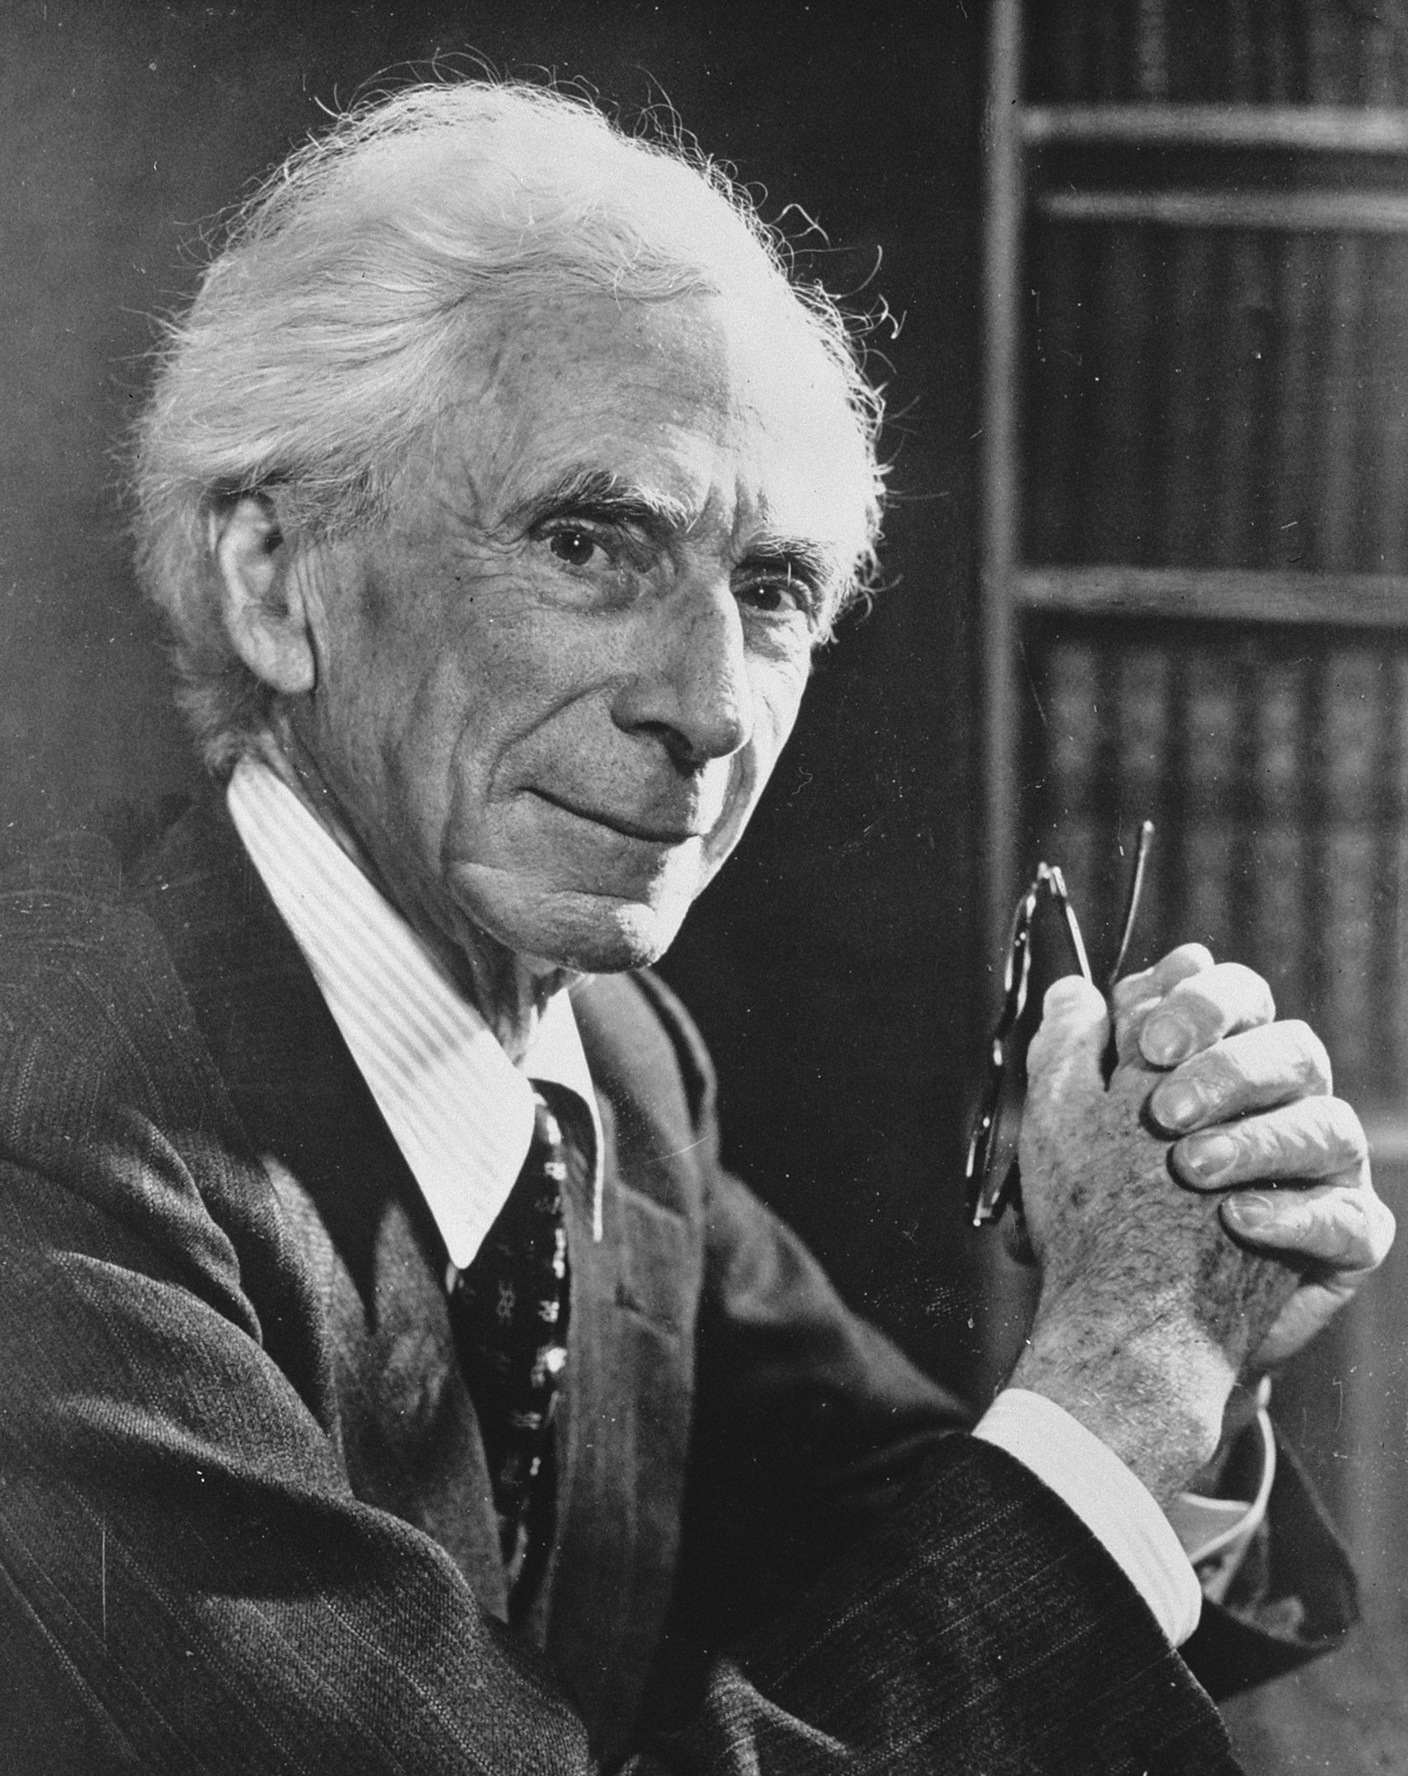
Russell’s Theory of Definite Descriptions
Bertrand Russell came up with a way of handling definite descriptions in FOL, without adding any new resources
He introduced his theory in a classic paper, ‘On denoting’ (Mind, 1905)

Slide 42
Russell’s Theory of Definite Descriptions
Bertrand Russell came up with a way of handling definite descriptions in FOL, without adding any new resources
He introduced his theory in a classic paper, ‘On denoting’ (Mind, 1905)
The king of England is 73 years old
There is at least one king of England, and
There is at most one king of England, and
Every king of England is 73 years old

Slide 43
Russell’s Theory of Definite Descriptions
The king of England is 73 years old
There is at least one king of England, and
There is at most one king of England, and
Every king of England is 73 years old
The writer of Fleabag is very funny
There is at least one writer of Fleabag, and
There is at most one writer of Fleabag, and
Every writer of Fleabag is very funny

Slide 44
Russell’s Theory of Definite Descriptions
The F is G
There is at least one F, and
There is at most one F, and
Every F is G
The writer of Fleabag is very funny
There is at least one writer of Fleabag, and
There is at most one writer of Fleabag, and
Every writer of Fleabag is very funny

Slide 45
Russell’s Theory of Definite Descriptions
The F is G
There is at least one F, and
There is at most one F, and
Every F is G
1. $∃xFx∧$
2. $∀x∀y\left(\left(Fx∧Fy\right)→x=y\right)∧$
3. $∀x\left(Fx→Gx\right)$

Slide 46
Russell’s Theory of Definite Descriptions
The F is G
1. $∃xFx∧$
2. $∀x∀y\left(\left(Fx∧Fy\right)→x=y\right)∧$
3. $∀x\left(Fx→Gx\right)$
There is exactly one F, and it is G

Slide 47
Russell’s Theory of Definite Descriptions
The F is G
There is exactly one F, and it is G
$∃x\left(Fx∧∀y\left(Fy→x=y\right)∧Gx\right)$

Slide 48
Russell’s Theory of Definite Descriptions
The F is G
$∃x\left(Fx∧∀y\left(Fy→x=y\right)∧Gx\right)$
$∃x\left(∀y\left(Fy↔x=y\right)∧Gx\right)$

Slide 49
What if we ignore Russell’s theory...?
Imagine we did try to symbolise ‘the present king of France’ with a name…
domain: people
$B$: __ is bald
$k$: the present king of France
We would symbolise ‘The present king of France is bald’ as ‘$Bk$’
We would symbolise ‘The present king of France isn’t bald’ as ‘$¬Bk$’

Slide 50
Russell’s LEM Puzzle
The Law of the Excluded Middle: $A∨¬A$
LEM is a tautology, and so necessarily true
‘$Bk∨¬Bk$’ is an instance of LEM, but since there is no present king of France, neither disjunct looks true!
BALD | NOT BALD
Patrick Stewart | Brian Blessed
Samuel L. Jackson | Russell Brand
RuPaul (out of drag) | Gerard Butler
… | …

Slide 51
Solving the LEM Puzzle
domain: people
$K$: __ is a present king of France
$B$: __ is bald
The present king of France is bald
$∃x\left(Kx∧∀y\left(Ky→x=y\right)∧Bx\right)$
Either the present king of France is bald, or it is not the case that the present king of France is bald
$∃x\left(Kx∧∀y\left(Ky→x=y\right)∧Bx\right)∨$
$¬$ $∃x\left(Kx∧∀y\left(Ky→x=y\right)∧Bx\right)$
The second disjunct is true: there isn’t a present king of France!

Slide 52
Solving the LEM Puzzle
domain: people
$K$: __ is a present king of France
$B$: __ is bald
The present king of France is bald
$∃x\left(Kx∧∀y\left(Ky→x=y\right)∧Bx\right)$
Either the present king of France is bald, or the present king of France is not bald
$∃x\left(Kx∧∀y\left(Ky→x=y\right)∧Bx\right)∨$
$¬$ $∃x\left(Kx∧∀y\left(Ky→x=y\right)∧Bx\right)$
The second disjunct is true: there isn’t a present king of France!
Either the present king of France is bald, or it is not the case that the present king of France is bald
$∃x\left(Kx∧∀y\left(Ky→x=y\right)∧Bx\right)∨$
$¬$ $∃x\left(Kx∧∀y\left(Ky→x=y\right)∧Bx\right)$
The present king of France is bald or not bald
$∃x\left(Kx∧∀y\left(Ky→x=y\right)∧\left(Bx∨¬Bx\right)\right)$
This sentence is false: there isn’t a present king of France!

Slide 53
Is Russell’s Theory of Definite Descriptions right?
There is a large literature trying to figure out if Russell’s Theory of Definite Descriptions is right
But whatever the final answer, it’s how we’ll handle definite descriptions in FOL
  ✓ It is a viable theory
✓ It doesn’t require us to add any extra resources to FOL
✓ It solves Russell’s LEM Puzzle

Slide 54
For next time…
Read Sections 18 and 19 of forallx
Complete all associated exercises!
Worksheet 5 is now available

