Slide 1
Logic and Paradox
Lecture 8:
The Liar Paradox
Rob Trueman
rob.trueman@york.ac.uk

Slide 2
The Liar Paradox
Introducing the Liar
Aside: satisfaction
Self-reference
The T-Scheme
The strengthened liar
Tarski’s hierarchy
Expressive limitations
Tarski and natural language

Slide 9
An Early Liar Paradox
This was an early version of the Liar Paradox
A Cretans says ‘All Cretans are liars’. If he is telling the truth, then he is lying. If he is lying, then he is telling the truth. Contradiction!
This version of the Liar has a few problems:
It is unnecessarily complicated – lying isn’t just a matter of saying something false, but of intentionally saying something false
The first step in the paradox (if he is telling the truth, then he is lying) is warranted only if calling someone a liar means that they always lie; but then the second step (if he is lying, then he is telling the truth) doesn’t follow, since he could be lying just this once
If some other Cretan isn’t a liar, then the Cretan in our paradox has just said something straightforwardly false!

Slide 10
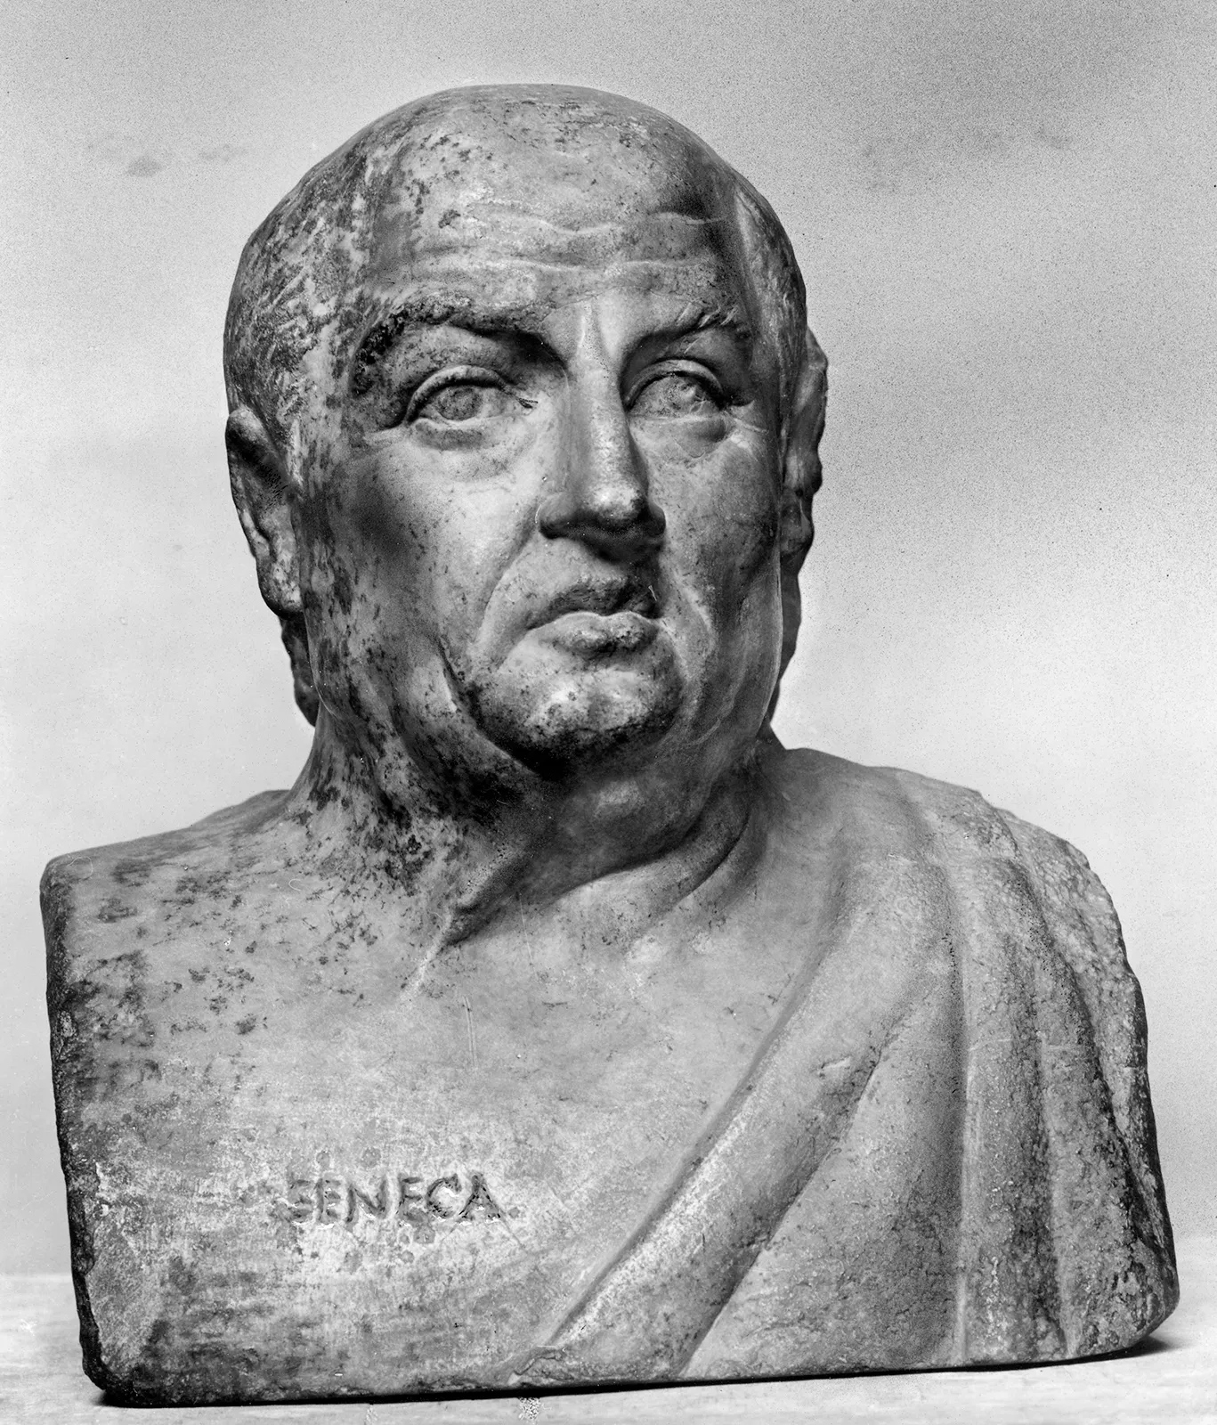
A Modern Liar
Here is a more modern version of the Liar Paradox:
Consider the sentence ‘This sentence is false’
If it is true, then it must be false (since that is what it says)
If it is false, then it must be true (since things are as it says they are)
So it is true and false!
It might be tempting to dismiss this paradox as a silly puzzle or riddle
A Roman philosopher called Seneca once wrote: “Why do you bore me with that which you yourself call the ‘liar fallacy’? […] Not to know [such paradoxes] does no harm, and mastering them does no good.”
However, solving this silly riddle turns out to be very difficult: no solution is ideal, and they all have surprising consequences
Since the 20th Century, the Liar has become the logical paradox to solve

Slide 11
Formulating a Liar Sentence
The Liar Paradox starts with a self-referential liar sentence, which says of itself that it is false
There are a few obvious ways we might try to do that
We could use a sentence that has a demonstrative (e.g. ‘this’) which refers to itself
This sentence is false
We could use a sentence that contains a definite description which happens to apply just to itself
The sixth item on this slide is false
We could use the common convention of labelling sentences to talk about them
$(α)$ $α$ is false

Slide 12
The T-Scheme
The Liar Paradox also relies on an assumption about how truth works
Intuitive: A sentence is true iff things are the way it says they are
‘Snow is white’ is true iff snow is white
‘Socrates was a footballer’ is true iff Socrates was a footballer
‘$2+2=4$’ is true iff $2+2=4$
‘$2+2<2$’ is true iff $2+2<2$
This general pattern is captured by the T-Scheme
(T) ‘$A$’ is true iff $A$
Whenever we substitute the same English sentence for both of the ‘$A$’s, we should end up with an acceptable result

Slide 13
The Liar Paradox
Here is a formalisation of the Liar Paradox
1. $α$ $=$ ‘$α$ is false’ [Liar Sentence]
2. ‘$α$ is false’ is true iff $α$ is false [T-Scheme]
3. $∴$ $α$ is true iff $α$ is false [Substitution of Identicals]
4. $∴α$ is true and $α$ is false [Bivalence: every sentence is true or false]
This argument is classically valid: if we assume bivalence, plugging a liar sentence into the T-Scheme leads to a contradiction
So we have three options:
Reject one of the premises
Revise classical logic
Accept the contradictory conclusion
We will consider (b) and (c) in later lectures, but this week we will focus on (a)

Slide 14
The Liar Paradox
Introducing the Liar
Aside: satisfaction
Self-reference
The T-Scheme
The strengthened liar
Tarski’s hierarchy
Expressive limitations
Tarski and natural language

Slide 15
Introducing Satisfaction
In the literature on the Liar Paradox, philosophers sometimes focus on satisfaction rather than truth
An individual satisfies a formula iff that formula is true of that individual
You satisfy the formula ‘$x$ is a human’
You satisfy the formula ‘$x$ is a human and $x$ is a student’
You do not satisfy the formula ‘$x$ is a dog’, but my two dogs do
Intuitively, satisfaction should obey a scheme just like (T)
(S) $∀y(y \text{satisfies}$ ‘$A(…x…)$’ $↔A(…y…))$
$∀y(y$ satisfies ‘$x$ is a dog’ $↔$ $y$ is a dog$)$
$∀y(y$ satisfies ‘$x$ is a dog $∨$ $x$ is a cat’ $↔$ $(y$ is a dog $∨$ $y$ is a cat$))$
$∀y(y$ satisfies ‘$¬(x$ is a dog $∧$ $x$ is brown)’ $↔$ $¬(y$ is a dog $∧$ $x$ is brown$))$

Slide 16
Grelling’s Paradox
We can generate a version of the Liar Paradox for satisfaction, which is often called Grelling’s Paradox (or the Heterological Paradox)
Consider the formula ‘$x$ does not satisfy $x$’
If we plug this formula into the (S) scheme for satisfaction, we get the following result:
$∀y(y$ satisfies ‘$x$ does not satisfy $x$’ $↔$ $y$ does not satisfy $y)$
This is a universal generalization, so we can let $y$ be anything we can quantify over
So, now let $y$ be the formula ‘$x$ does not satisfy $x$’:
‘$x$ does not satisfy $x$’ satisfies ‘$x$ does not satisfy $x$’ $↔$ ‘$x$ does not satisfy $x$’ does not satisfy ‘$x$ does not satisfy $x$’
‘$x$ does not satisfy $x$’ satisfies itself$↔$ ‘$x$ does not satisfy $x$’ does not satisfy itself
That’s a classical contradiction!

Slide 17
Truth or Satisfaction?
Strictly speaking, we probably should focus on satisfaction rather than truth
Logicians have known for a long time how to define truth in terms of satisfaction, but it is not always possible to define satisfaction in terms of truth
Obvious idea: $y$ satisfies ‘$A(…x…)$’ iff: there is some name for $y$, ‘$c$’, and ‘$A(…c…)$’ is true
But this won’t work if some individuals in your domain don’t have names in your language
However, truth is much easier to think and speak about than satisfaction, and so we will stick with truth and the Liar Paradox

Slide 18
The Liar Paradox
Introducing the Liar
Aside: satisfaction
Self-reference
The T-Scheme
The strengthened liar
Tarski’s hierarchy
Expressive limitations
Tarski and natural language

Slide 19
Problems of Self-Reference
It is natural to think that the Liar Paradox just shows that there cannot be a liar sentence
A liar sentence would be self-referential: it would say of itself that it is false
Self-reference can lead to weird results even when it doesn’t lead to a flat-out contradiction
A truth-teller sentence is a sentence which says of itself that it is true
1. $β$ $=$ ‘$β$ is true’ [Truth-Teller]
2. ‘$β$ is true’ is true iff $β$ is true [T-Scheme]
3. $∴$ $β$ is true iff $β$ is true [Substitution of Identicals]
The conclusion here isn’t a contradiction, it’s a tautology; but that is still mysterious
We rely on the T-Scheme to tell us what it takes for a sentence to be true
But when we apply the T-Scheme to $β$ we just get the trivial tautology
So is $β$ true or false!?

Slide 20
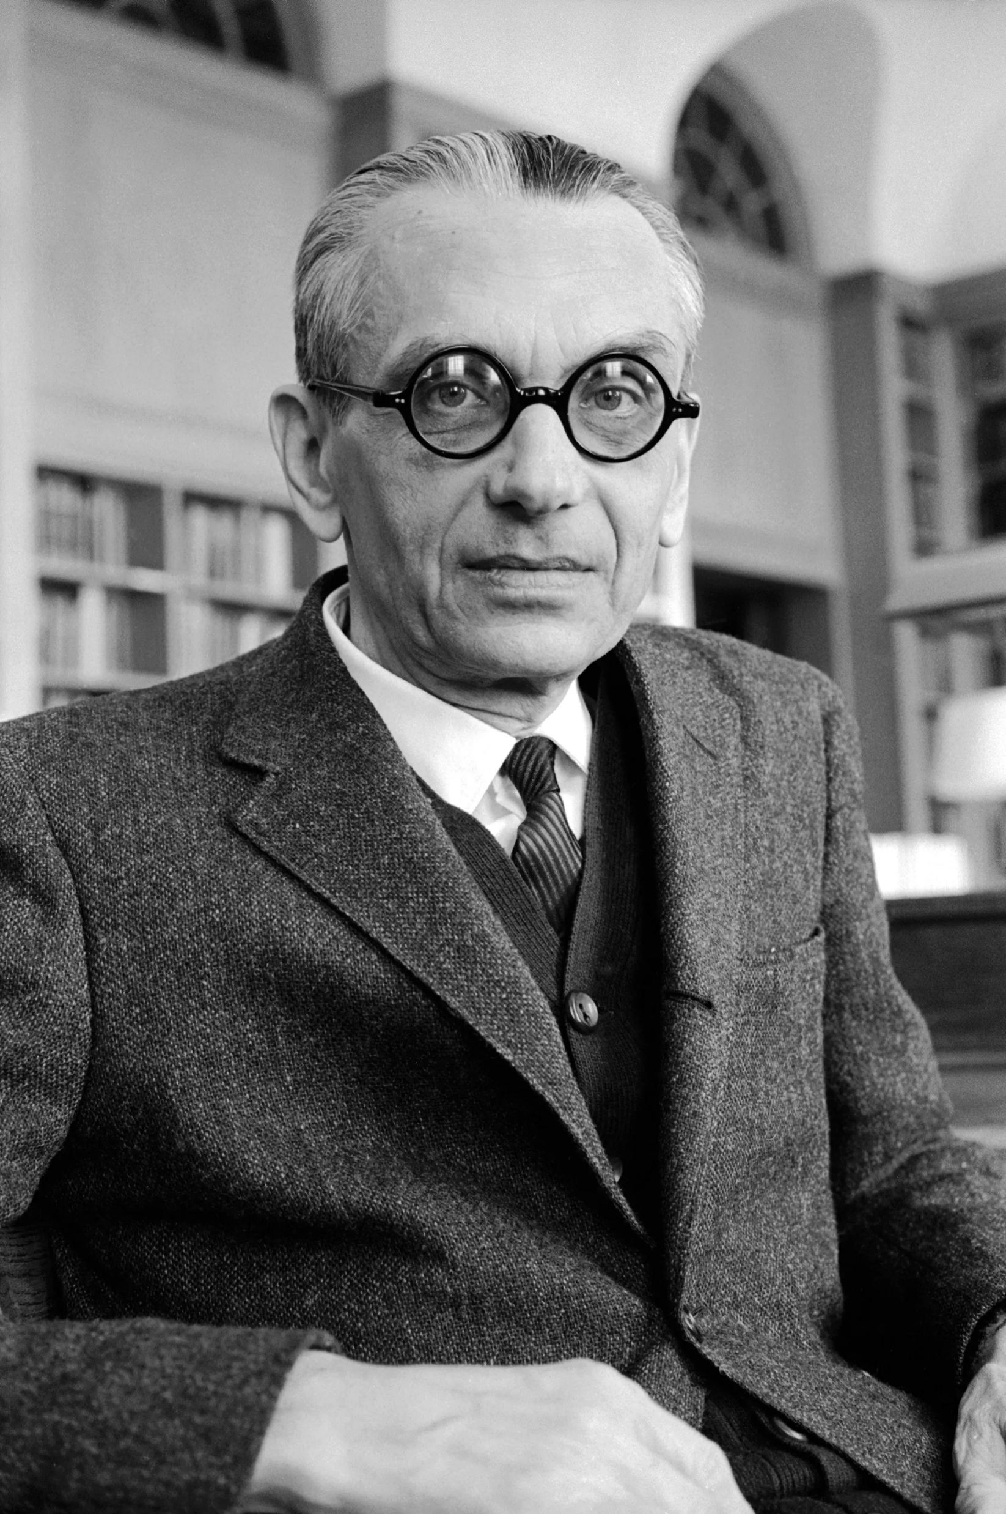
Gödel Codes
Nowadays, almost no one tries to block the Liar Paradox by denying that there could be a liar sentence
This was in large part due to Kurt Gödel, who invented a way of coding up claims about language into arithmetic
The idea of coding information into arithmetic is now very familiar to us today, thanks to the ubiquity of computers
When we code things up in this way, arithmetic allows us to create self-referential sentences, including a liar sentence which (intuitively) says of itself that it is false
So, unless we want to argue with standard arithmetic, we cannot block the Liar Paradox by outlawing self-reference

Slide 21
Contingent Liars
It is also important to remember that there can be liar sentences like this one:
The second sentence on this slide is false
This sentence is a liar, because it says of itself that it is false, but that is purely contingent
If the slide had included one more sentence at the start, then we wouldn’t have had a liar sentence
Sentences like these are known as contingent (or empirical) liars
We cannot impose any formal rules that would prevent the possibility of contingent liars
No formal rule can save you from sheer bad luck!

Slide 22
Circular Liars
You can also come up with variations on the Liar Paradox which involve no self-reference!
1. $γ$ $=$ ‘$δ$ is false’
2. $δ$ = ‘$γ$ is true’
3. ‘$γ$ is true’ is true iff $γ$ is true [T-Scheme]

Slide 23
Circular Liars
You can also come up with variations on the Liar Paradox which involve no self-reference!
1. $γ$ $=$ ‘$δ$ is false’
2. $δ$ = ‘$γ$ is true’
3. ‘$γ$ is true’ is true iff $γ$ is true [T-Scheme]

Slide 24
Circular Liars
You can also come up with variations on the Liar Paradox which involve no self-reference!
1. $γ$ $=$ ‘$δ$ is false’
2. $δ$ = ‘$γ$ is true’
3. ‘$γ$ is true’ is true iff $γ$ is true [T-Scheme]
4. $∴δ$ is true iff $γ$ is true [Substitution of Identicals]
5. ‘$δ$ is false’ is true iff $δ$ is false [T-Scheme]
6. $∴γ$ is true iff $δ$ is false [Substitution of Identicals]
7. $∴δ$ is true iff $δ$ is false [Transitivity of Biconditional]
This version of the Liar Paradox uses circular-reference, but not self-reference!

Slide 25
Circular Liars
You can also come up with variations on the Liar Paradox which involve no self-reference!
1. $γ$ $=$ ‘$δ$ is false’
2. $δ$ = ‘$γ$ is true’
3. ‘$γ$ is true’ is true iff $γ$ is true [T-Scheme]
4. $∴δ$ is true iff $γ$ is true [Substitution of Identicals]
5. ‘$δ$ is false’ is true iff $δ$ is false [T-Scheme]
6. $∴γ$ is true iff $δ$ is false [Substitution of Identicals]
7. $∴δ$ is true iff $δ$ is false [Transitivity of Biconditional]
This version of the Liar Paradox uses circular-reference, but not self-reference!

Slide 26
Circular Liars
You can also come up with variations on the Liar Paradox which involve no self-reference!
1. $γ$ $=$ ‘$δ$ is false’
2. $δ$ = ‘$γ$ is true’
3. ‘$γ$ is true’ is true iff $γ$ is true [T-Scheme]
4. $∴δ$ is true iff $γ$ is true [Substitution of Identicals]
5. ‘$δ$ is false’ is true iff $δ$ is false [T-Scheme]
6. $∴γ$ is true iff $δ$ is false [Substitution of Identicals]
7. $∴δ$ is true iff $δ$ is false [Transitivity of Biconditional]
This version of the Liar Paradox uses circular-reference, but not self-reference!

Slide 27
Circular Liars
You can also come up with variations on the Liar Paradox which involve no self-reference!
1. $γ$ $=$ ‘$δ$ is false’
2. $δ$ = ‘$γ$ is true’
3. ‘$γ$ is true’ is true iff $γ$ is true [T-Scheme]
4. $∴δ$ is true iff $γ$ is true [Substitution of Identicals]
5. ‘$δ$ is false’ is true iff $δ$ is false [T-Scheme]
6. $∴$ $γ$ is true iff $δ$ is false [Substitution of Identicals]
7. $∴δ$ is true iff $δ$ is false [Transitivity of Biconditional]
This version of the Liar Paradox uses circular-reference, but not self-reference!

Slide 28
Circular Liars
You can also come up with variations on the Liar Paradox which involve no self-reference!
1. $γ$ $=$ ‘$δ$ is false’
2. $δ$ = ‘$γ$ is true’
3. ‘$γ$ is true’ is true iff $γ$ is true [T-Scheme]
4. $∴δ$ is true iff $γ$ is true [Substitution of Identicals]
5. ‘$δ$ is false’ is true iff $δ$ is false [T-Scheme]
6. $∴$ $γ$ is true iff $δ$ is false [Substitution of Identicals]
7. $∴δ$ is true iff $δ$ is false [Transitivity of Biconditional]
This version of the Liar Paradox uses circular-reference, but not self-reference!

Slide 29
Circular Liars
You can also come up with variations on the Liar Paradox which involve no self-reference!
1. $γ$ $=$ ‘$δ$ is false’
2. $δ$ = ‘$γ$ is true’
3. ‘$γ$ is true’ is true iff $γ$ is true [T-Scheme]
4. $∴δ$ is true iff $γ$ is true [Substitution of Identicals]
5. ‘$δ$ is false’ is true iff $δ$ is false [T-Scheme]
6. $∴$ $γ$ is true iff $δ$ is false [Substitution of Identicals]
7. $∴δ$ is true iff $δ$ is false [Transitivity of Biconditional]
8. $∴δ$ is true and $δ$ is false [Bivalence]
This version of the Liar Paradox uses circular-reference, but not self-reference!

Slide 30
Yablo’s Paradox
You can even come up with another paradox (Yablo’s Paradox) which doesn’t involve circularity!
Consider an infinite sequence of sentences, like this:
$s_{1}$: for all $m>1$, $s_{m}$ is false
$s_{2}$: for all $m>2$, $s_{m}$ is false
$s_{3}$: for all $m>3$, $s_{m}$ is false
…
The paradox now runs as follows:
1. If $s_{n}$ is true, then $s_{n+1}$ is false
But if $s_{n}$ is true, then $s_{m}$ is false for all $m>n+1$, and so $s_{n+1}$ is true
So $s_{n}$ is false, for all $n$
But in that case, $s_{m}$ is false for all $m>1$, and so $s_{1}$ is true!

Slide 31
The Liar Paradox
Introducing the Liar
Aside: satisfaction
Self-reference
The T-Scheme
The strengthened liar
Tarski’s hierarchy
Expressive limitations
Tarski and natural language

Slide 32
Why Accept the T-Scheme?
The Liar Paradox (and all its variants) rely on the T-Scheme
(T) ‘$A$’ is true iff $A$
Later we will look at a standard solution to the Liar which involves restricting the T-Scheme
But it will be helpful now to look at some reasons for accepting the T-Scheme
Two Types of Motivation
What we want truth to do for us
Philosophical reflection on the very concept of truth

Slide 33
What Does Truth Do?
The T-Scheme might make you think that truth is redundant
(T) ‘$A$’ is true iff $A$
However, not every ascription of truth can be straightforwardly eliminated
Intuitively, the following inference should be valid:
Everything Rob said is true. Rob said ‘logic is fun’. Therefore logic is fun
But this inference relies on the left-to-right direction of (T): If ‘logic is fun’ is true, then logic is fun
Equally, this inference should be valid too
Nothing Rob said is true. Ethics is fun. Therefore Rob didn’t say ‘ethics is fun’
But this inference relies on the right-to-left direction of (T): If ethics is fun, then ‘ethics is fun’ is true

Slide 34
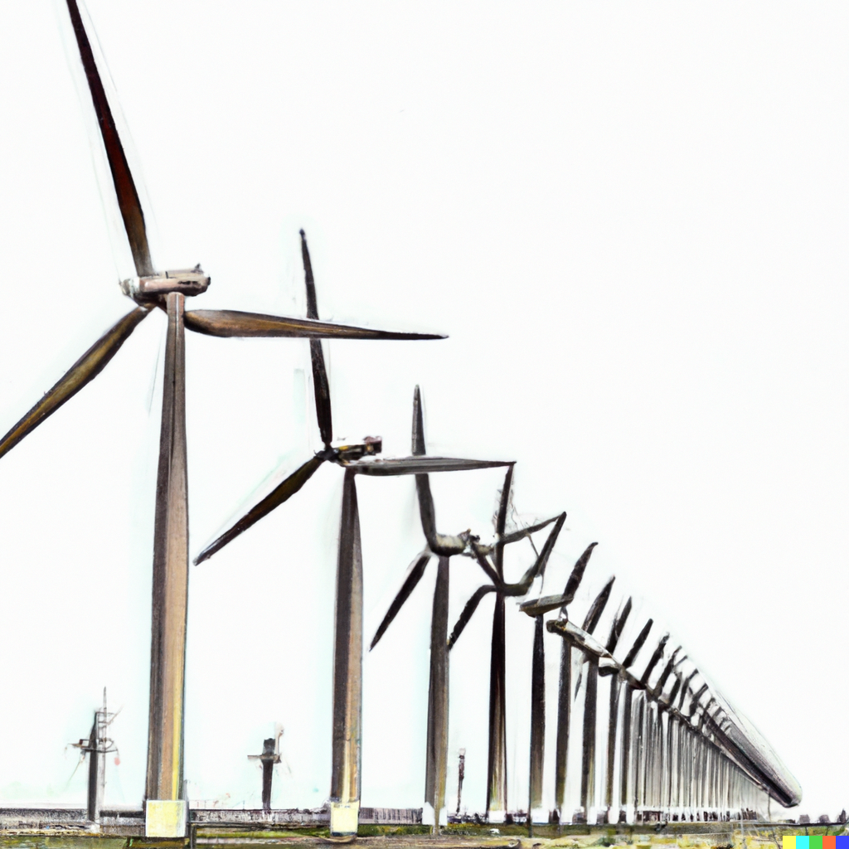
Infinite Conjunctions/Disjunctions
You can think of truth-talk as allowing us to simulate infinite conjunctions/disjunctions
If we could write infinitely long sentences, we could say things like this:
If Rob said ‘snow is white’, then snow is white; and if Rob said ‘2+2=5’, then 2+2=5; and…
Rob said ‘snow is white’ and snow is white; or Rob said ‘2+2=5’ and 2+2=5; or…
We can’t really write infinitely long sentences (we always stop short eventually!), but we can capture their content like this:
Everything Rob said is true
Something Rob said is true
However, we can only use this simulation if we accept the T-Scheme
(T) ‘$A$’ is true iff $A$

Slide 35
Disquotationalism
The T-Scheme also seems to be an important part of the concept of truth
Some philosophers – disquotationalists – even think that the T-Scheme defines, or otherwise fully exhausts, the concept of truth
They think that truth just is a device for disquoting sentences
‘Snow is white’ is true iff snow is white: ‘snow is white’ appears in quotation marks on the left, and outside of them on the right
However, even if you think that disquotationalism goes too far, it still seems right to say that truth just wouldn’t be truth without disquotation

Slide 36
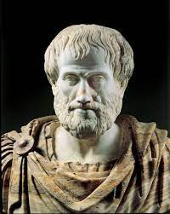
Truth and Meaning
Aristotle’s Dictum: ‘To say of what is that it is not, or of what is not that it is, is false; while to say of what is that it is, or of what is not that it is not, is true’
A modern gloss: $s$ is true iff things are as $s$ says that they are
And the following scheme seems undeniable: ‘$A$’ says that $A$
‘Snow is white’ says that snow is white
‘2+2=5’ says that 2+2=5
‘Logic is fun’ says that logic is fun
If we combine the above definition of truth with the above scheme, we get the T-Scheme
(T) ‘$A$’ is true iff $A$

Slide 37
The Liar Paradox
Introducing the Liar
Aside: satisfaction
Self-reference
The T-Scheme
The strengthened liar
Tarski’s hierarchy
Expressive limitations
Tarski and natural language

Slide 38
Bivalence
The Liar Paradox
1. $α$ $=$ ‘$α$ is false’ [Liar Sentence]
2. ‘$α$ is false’ is true iff $α$ is false [T-Scheme]
3. $∴$ $α$ is true iff $α$ is false [Substitution of Identicals]
4. $∴α$ is true and $α$ is false [Bivalence: every sentence is true or false]
As formulated, the Liar Paradox only leads to a contradiction because we assumed bivalence
If we didn’t assume bivalence, then we could consistently say that the liar sentence is neither true nor false
Many philosophers have thought that this is the key to solving the Liar Paradox
The liar sentence is defective, and fails even to be false

Slide 39
Revenge!
However, now consider a new liar sentence:
$(ε)$ $ε$ is either false or neither true nor false
We can now present a new version of the Liar Paradox
1. $ε$ $=$ ‘$ε$ is either false or neither true nor false’ [New Liar Sentence]
2. ‘$ε$ is either false or neither true nor false’ is true iff
$ε$ is either false or neither true nor false [T-Scheme]
3. $∴$ $ε$ is true iff $ε$ is either false or neither true nor false [Substitution of Identicals]
4. $∴ε$ is true and either false or neither true nor false [Trivalence]
This is known as a revenge paradox: we introduced some new tools to solve the original Liar Paradox; but then we used those very tools to develop a new version of the Liar
One of the big challenges is to come up with a solution to the Liar that is immune to revenge

Slide 40
The Strengthened Liar
A sentence is either false or neither true nor false iff it is not true
This observation has led philosophers to introduce the strengthened liar sentence:
$(λ)$ $λ$ is not true
This leads to an especially resilient version of the Liar Paradox
1. $λ$ $=$ ‘$λ$ is not true’ [Strengthened Liar Sentence]
2. ‘$λ$ is not true’ is true iff $λ$ is not true [T-Scheme]
3. $∴$ $λ$ is true iff $λ$ is not true [Substitution of Identicals]
4. $λ$ is true and $λ$ is not true [Classical Logic]
In what follows, this will be the version of the Liar Paradox that we will focus on

Slide 41
No-Proposition Solutions
One very tempting idea is that $λ$ (i.e. ‘$λ$ is not true) fails to express a proposition
A proposition is supposed to be the truth-evaluable meaning of a sentence
So the idea is that $λ$ is defective because it fails to express a truth-evaluable meaning
If that is right, it surely follows that $λ$ is not true (since it doesn’t express a truth-evaluable proposition)
So if you assert ‘$λ$ does not express a proposition’, you are committed to asserting ‘$λ$ is not true’
But $λ=$ ‘$λ$ is not true’, and so you are committed to asserting the very sentence you said doesn’t express a proposition!

Slide 42
The Liar Paradox
Introducing the Liar
Aside: satisfaction
Self-reference
The T-Scheme
The strengthened liar
Tarski’s hierarchy
Expressive limitations
Tarski and natural language

Slide 43
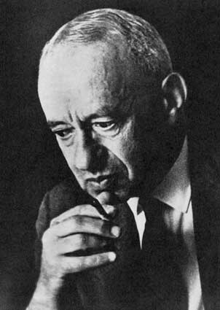
Alfred Tarski
No one did more to bring the Liar Paradox to serious academic attention than Alfred Tarski
He made philosophers realise that the Liar Paradox is not just a frivolous puzzle, but a serious problem in semantics
He also offered a solution to the paradox, which was the standard solution for a long time
Much of his work was formal, but he also wrote an informal, philosophical summary of his work
Tarski (1944), ‘The semantic conception of truth’. Philosophy and Phenomenological Research 4, pp.341-376

Slide 44
Formal Languages Only!
Tarski focussed on the Liar Paradox as it appears in well-behaved formal languages (like FOL)
Tarski did not attempt to solve the Liar Paradox as it appears in natural languages (like English)
According to Tarski, natural languages do not have a specified structure
We cannot lay down clear rules for determining what does and what doesn’t count as a sentence of English
But we can lay down such rules for FOL
Tarski denied that the problem of solving the Liar Paradox is only a rigorous logical problem when we are working with a language with a specified structure
Many philosophers disagree with Tarski, and think that we can’t just ignore the Liar Paradox in natural languages – we will come to that later!

Slide 45
Semantic Closure
A language, L, is semantically closed iff it includes both of the following:
Ways of referring to all the expressions in L (e.g. you can refer to the sentence ‘$Fa$’ with the quote-name ‘ “$Fa$” ’)
A predicate, ‘true’, which obeys the T-Scheme when applied to sentences of L
According to Tarski, the Liar Paradox is just a successful demonstration that no consistent language can meet all of the following conditions:
Obeying classical logic (not necessarily in the sense of being bivalent, but in the sense of permitting all of the inference rules we covered for FOL in Reason & Argument)
Containing the necessary resources to formulate liar sentences like $λ$
Being semantically closed
Tarski solved the Liar Paradox by rejecting (c) across the board: no language can be semantically closed

Slide 46
No Closure
Tarskian Slogan: No language can contain its own truth predicate
If you want to talk about which sentences are (or aren’t) true in language L, you can’t do that in L itself
You need to move to a more powerful language, $L^{+}$, which contains a truth predicate for L (which we can write as ‘true-in-L’)
Although we can use $L^{+}$ to talk about truth-in-L, we can’t use it to talk about truth-in-$L^{+}$
If you want to talk about truth-in-$L^{+}$, you need to move to an even more powerful language, $L^{++}$
Another way to put it: If you want to do the semantics for some object-language, you need to move to a more powerful meta-language

Slide 47
Tarski’s Hierarchy
Tarskian Slogan: No language can contain its own truth predicate
$L_{0}$: includes sentences about the world (e.g. ‘2+2=4’), but none about truth
$L_{1}$: includes all the sentences in $L_{0}$, plus ‘${\text{true}}_{0}$’, which can be applied to the sentences in $L_{0}$
$L_{2}$: includes all the sentences in $L_{1}$, plus ‘${\text{true}}_{1}$’, which can be applied to the sentences in $L_{1}$
…
$$…$$
$$L_{2}$$
$$L_{1}$$
$$L_{0}$$

Slide 48
Back to the T-Scheme
Tarski rejected the T-Scheme as we had formulated it, because we assumed that there was a universal truth-predicate, rather than a hierarchy of language-specific truth-predicates
(T) ‘$A$’ is true $↔$ $A$
However, he insisted that we should accept this reformulated version of the scheme for every sentence in $L_{n}$
($T_{n}$) ‘$A$’ is ${true}_{n}↔A$
TWO IMPORTANT POINTS
Since ($T_{n}$) contains the predicate ‘${true}_{n}$’, it cannot itself be formulated in $L_{n}$; to formulate ($T_{n}$), we must move up to $L_{n+1}$ (or higher)
If ‘$A$’ doesn’t belong to $L_{n}$, then ‘ “$A$” is ${true}_{n}$’ is automatically false, since ‘$A$’ is not true-in-$L_{n}$; so, in general, you shouldn’t assume ($T_{n}$) holds for sentences not in $L_{n}$

Slide 49
Some Examples
($T_{n}$) ‘$A$’ is ${true}_{n}$ $↔$ $A$
Each instance of ($T_{n}$) is formulated in $L_{n+1}$ (and all later languages)
But an instance of ($T_{n}$) is acceptable iff we substitute a sentence from $L_{n}$ for $A$
‘$Fa$’ is ${true}_{0}$ $↔$ $Fa$
This is an acceptable instance of ($T_{0}$), so long as ‘$Fa$’ is a sentence of $L_{0}$
‘ “$Fa$” is ${true}_{0}$’ is ${true}_{1}$ $↔$ ‘$Fa$’ is ${true}_{0}$
This is an acceptable instance of ($T_{1}$), because ‘ “$Fa$” is ${true}_{0}$’ is a sentence of $L_{1}$
‘ “$Fa$” is ${true}_{0}$’ is ${true}_{0}$ $↔$ ‘$Fa$’ is ${true}_{0}$
This is an unacceptable instance of ($T_{0}$), because ‘ “$Fa$” is ${true}_{0}$’ is not a sentence of $L_{0}$
If ‘$Fa$’ is in fact $true_{0}$, we should accept the righthand side but reject the lefthand side, and so we should reject this biconditional

Slide 50
Solving the Liar Paradox
The Liar Paradox starts with a sentence that says of itself that it is not true
$λ$ $=$ ‘$λ$ is not true’
But we are no longer working with a single notion of truth; instead, we will have a different version of $λ$ for each truth-predicate
$λ_{n}$ $=$ ‘$λ_{n}$ is not ${true}_{n}$’
The next step of the Liar Paradox would be to plug some $λ_{n}$ into the corresponding ($T_{n}$)
‘$λ_{n}$ is not ${true}_{n}$’ is ${true}_{n}$ $↔$ $λ_{n}$ is not ${true}_{n}$
But this is an unacceptable instance of ($T_{n}$), because ‘$λ_{n}$ is not ${true}_{n}$’ talks about ${truth}_{n}$, and so can only be formulated in $L_{n+1}$ (and higher) languages!
And no contradiction follows from this instance of ($T_{n+1}$)
‘$λ_{n}$ is not ${true}_{n}$’ is ${true}_{n+1}$ $↔$ $λ_{n}$ is not ${true}_{n}$
In fact, we should accept both sides of this biconditional!

Slide 51
No Cycles!
It is important that we think of our languages as forming a hierarchy of ever more powerful meta-languages
We cannot, for example, allow that there might be two languages, $L_{1}$ and $L_{2}$, such that we can talk about ${truth}_{1}$ in $L_{2}$, and about ${truth}_{2}$ in $L_{1}$
We could then form a version of the circular Liar Paradox as follows:
1. $ζ_{1}$ $=$ ‘$ζ_{2}$ is not ${true}_{2}$’ [$ζ_{1}$ is a sentence in $L_{1}$]
2. $ζ_{2}$ $=$ ‘$ζ_{1}$ is ${true}_{1}$’ [$ζ_{2}$ is a sentence in $L_{2}$]
3. ‘$ζ_{1}$ is ${true}_{1}$’ is ${true}_{2}$ $↔$ $ζ_{1}$ is ${true}_{1}$ [$T_{2}$]
4. $∴ζ_{2}$ is ${true}_{2}$ $↔$ $ζ_{1}$ is ${true}_{1}$ [Substitution of Identicals]
5. ‘$ζ_{2}$ is not ${true}_{2}$’ is ${true}_{1}$ $↔$ $ζ_{2}$ is not ${true}_{2}$ [$T_{1}$]
6. $∴$ $ζ_{1}$ is ${true}_{1}$ $↔$ $ζ_{2}$ is not ${true}_{2}$ [Substitution of Identicals]
7. $∴ζ_{2} \text{is} {true}_{2}$ $↔$ $ζ_{2}$ is not ${true}_{2}$ [Transitivity of Biconditional]
8. $∴ζ_{2} \text{is} {\text{true}}_{2}$ and $ζ_{2}$ is not ${true}_{2}$ [Classical Logic]

Slide 52
The Liar Paradox
Introducing the Liar
Aside: satisfaction
Self-reference
The T-Scheme
The strengthened liar
Tarski’s hierarchy
Expressive limitations
Tarski and natural language

Slide 57
Generalising Across the Hierarchy
Bivalence: Every sentence is true or false
When people assert Bivalence, they do not usually think they are talking about some restricted set of sentences: they think that every sentence is true or false
Likewise, when people reject Bivalence, they are denying that every sentence is true or false
But if Tarski is right, then we can’t take Bivalence as a truly universal generalisation over every sentence
We can assert $Bivalence_{n}$ for language $L_{n}$: every sentence in $L_{n}$ is ${true}_{n}$ or ${false}_{n}$
But $Bivalence_{n}$ itself belongs to $L_{n+1}$, and so doesn’t apply to itself
We can then assert $Bivalence_{n+1}$, but that principle will belong to $L_{n+2}$, and so also won’t apply to itself
…

Slide 58
Expressive Limitations
Most solutions to the Liar Paradox seem to impose expressive limitations
There are apparently intelligible things that we want to say, but which the solution declares inexpressible
It seems like the Liar Paradox may force us to make a choice:
Either accept some expressive limitations…
… or face a contradiction!
Most philosophers choose the expressive limitations, but dialetheists would rather live with contradictions (see Lecture 10!)

Slide 59
Revenge Again
Expressive limitations are closely related to revenge paradoxes
We introduce some new tools to solve the original Liar Paradox; but then we use those very tools to develop a new version of the Liar
We are hit by revenge paradoxes when we try to overcome the expressive limitations imposed by a given solution to the Liar
Suppose we introduce a new ‘${true}_{∞}$’ predicate that can be applied to any sentence that appears anywhere in Tarski’s hierarchy
We could use this new predicate to formulate a version of Bivalence that applies to every sentence: every sentence (anywhere in the hierarchy) is ${true}_{∞}$ or ${false}_{∞}$
But we could also use it to reintroduce the Liar Paradox: $λ$ $=$ ‘$λ$ is not ${true}_{∞}$’
This problem is especially pressing when we seem to need to violate the expressive limitations imposed by a solution in order to express that very solution
If you can’t say that every sentence in Tarski’s hierarchy is true or false, then an important part of that solution is going unsaid

Slide 60
The Liar Paradox
Introducing the Liar
Aside: satisfaction
Self-reference
The T-Scheme
The strengthened liar
Tarski’s hierarchy
Expressive limitations
Tarski and natural language

Slide 61
Going against Tarski’s Wishes…
Tarski did not intend his solution to apply to the Liar Paradox as it appears in natural languages
He thought that natural languages were too messy and ill-defined for there to be any rigorous solutions
However, most philosophers think that we need to solve the Liar for natural languages
Some think that this is the real version of the paradox, and any formal variant is just a simplified model
So, if were to go against Tarski’s wishes, how would his solution work for natural languages like English?

Slide 62
A Hierarchy of English Languages?
If we straightforwardly ported over Tarski’s solution to English, we would need to say that there is a whole hierarchy of English languages
${English}_{0}$: includes sentences about the world, but none about truth
${English}_{1}$: all the sentences in ${English}_{0}$, plus ‘${\text{true}}_{0}$’, which can be applied to the sentences in ${English}_{0}$
${English}_{2}$: all the sentences in ${English}_{1}$, plus ‘${\text{true}}_{1}$’, which can be applied to the sentences in ${English}_{1}$
…
But this is absurd!

Slide 65
More Plausibly…
We can instead think that, although there is a single English language, it contains an infinite hierarchy of truth-predicates
‘${true}_{0}$’ is used to evaluate English sentences that don’t mention truth (or other semantic notions)
‘${true}_{1}$’ is used to evaluate English sentences that mention ${truth}_{0}$, but no higher notion of truth
‘${true}_{2}$’ is used to evaluate English sentences that mention ${truth}_{1}$, but no higher notion of truth
…
Just as in Tarski’s theory, each truth-predicate is governed by a restricted version of the T-Scheme (for any sentence ‘$A$’ that doesn’t mention any notion of truth at or above ${truth}_{n}$)
($T_{n}$) ‘$A$’ is ${true}_{n}$ iff $A$

Slide 66
Back to Truth and Meaning
Aristotle’s Dictum: ‘To say of what is that it is not, or of what is not that it is, is false; while to say of what is that it is, or of what is not that it is not, is true’
A modern gloss: $s$ is true iff things are as $s$ says that they are
A revised gloss: $s$ is ${true}_{n}$ iff things are as $s$ ${says}_{n}$ that they are
We would need to think that different sentences have different kinds of meaning
‘Snow is white’ has one kind of meaning: it ${says}_{0}$ that snow is white
‘ “Snow is white” is ${true}_{0}$’ has another kind of meaning: it ${says}_{1}$ that ‘snow is white’ is ${true}_{0}$
It is up to you whether you think this seems plausible!

Slide 67
Contextualism
We obviously don’t actually use predicates like ‘${true}_{256}$’; we just use the predicate ‘true’
However, we can think of the word ‘true’ as a kind of indexical, whose extension changes in different contexts
Rough idea: a given use of ‘true’ should be interpreted as ‘${true}_{n}$’ where $n$ is as low as it can be while still making good sense of the speaker, given their intentions, purposes, etc
Examples
If someone says ‘ “Snow is white” is true’, we can safely interpret that as ‘ “Snow is white” is $true_{0}$’
But if someone says ‘ “ ‘Snow is white’ is true” is true’, we shouldn’t interpret that as ‘ “ ‘Snow is white’ is ${true}_{0}$” is ${true}_{0}$’, since that is automatically false
We should instead interpret what they said as ‘ “ ‘Snow is white’ is ${true}_{0}$” is ${true}_{1}$’
For more details, see: Burge (1979), ‘Semantical paradox’. The Journal of Philosophy 76, pp.169-198

Slide 70
No Stable Interpretation
The problem case
Fatma: Nothing Simon says is true
Simon: Nothing Fatma says is true
We need to assign indexes on Fatma’s and Simon’s uses of ‘true’; let’s just index Fatma’s as ‘${true}_{n}$’
Presumably Simon meant his assertion to apply to Fatma’s, and so we will need to index Simon’s use of ‘true’ as ‘${true}_{n+1}$’
But now Fatma’s assertion doesn’t apply to Simon’s!
To fix this, Fatma’s use of ‘true’ must be interpreted as ‘${true}_{n+2}$’; but then Simon’s should be interpreted as ‘${true}_{n+3}$’, and round we go again!
Things can get even worse if Simon said ‘Everything Fatma says is true’
Kripke (1975), ‘Outline of a theory of truth’. The Journal of Philosophy 72, pp.690-716

Slide 71
For the Next Seminar and Lecture
Seminar Reading
Mackie (1972). Truth, Probability and Paradox (OUP), ch.6 (feel free to skip Sections 5 and 6)
Lecture Reading
Re-read Sainsbury (2009). Paradoxes (CUP), ch.6 (esp. Section 6.3)

