Slide 1
Reason and Argument
Lecture 7: Introducing First-Order Logic
Robert Trueman
rob.trueman@york.ac.uk
University of York

Slide 2
Reason and Argument
Lecture 7: Introducing First-Order Logic
Splitting the Logical Atom
Names
Predicates
Quantifiers

Slide 12
Introducing First-Order Logic
The basic building blocks of Truth-Functional Logic were atomic sentences
In First-Order Logic (or FOL), we split atomic sentences up into sub-sentential building blocks
FOL has three kinds of sub-sentential building block:
Names
Predicates
Quantifiers

Slide 13
Reason and Argument
Lecture 7: Introducing First-Order Logic
Splitting the Logical Atom
Names
Predicates
Quantifiers

Slide 14
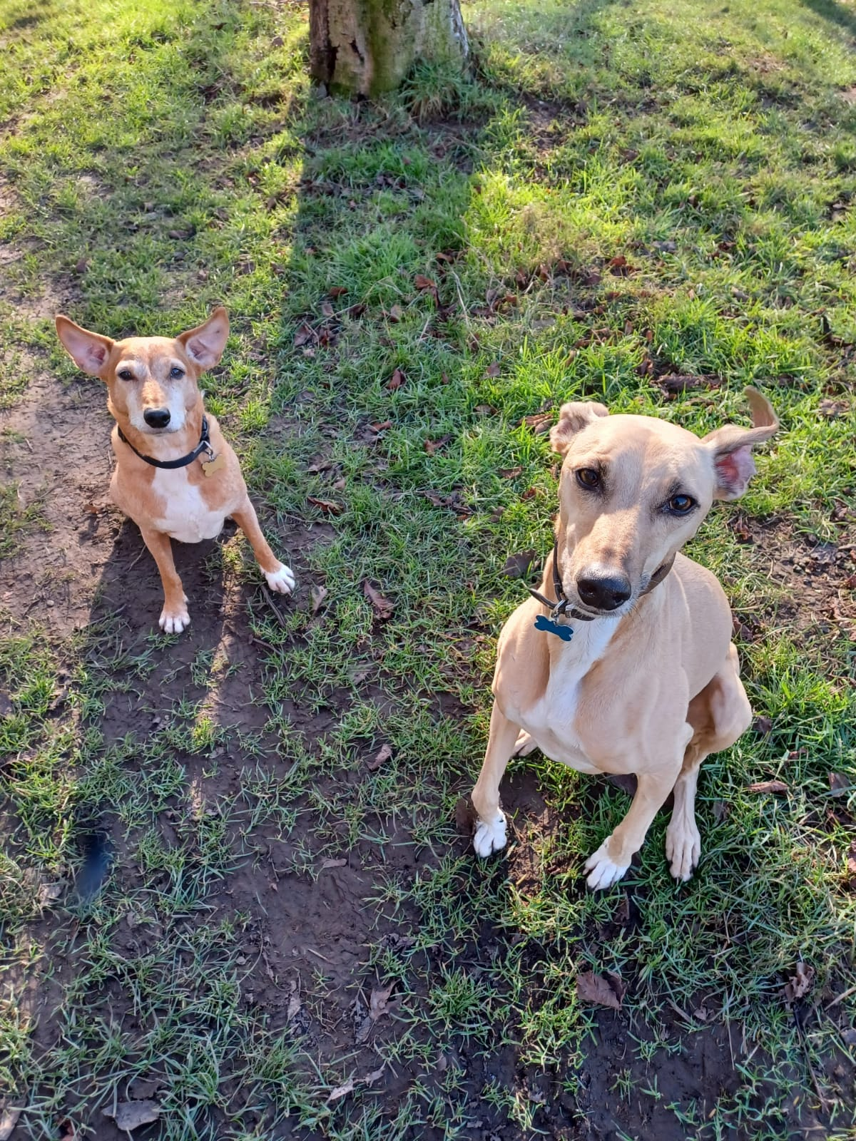
Singular terms
Singular terms are expressions which refer to a specific individual (e.g. a person, animal, place, or thing)
‘Munnery’ is a singular term that refers to this dog
‘Kitson’ is a singular term that refers to this dog

Slide 15
Two kinds of singular term
NAMES: ‘Munnery’, ‘Kitson’, ‘Phoebe Waller-Bridge’, ‘Whoopi Goldberg’
DEFINITE DESCRIPTIONS: ‘The first dog Rob adopted’, ‘The writer of Fleabag’, ‘the actor who originally played Guinan’
Definite descriptions pick individuals out by describing them (and nothing else)
Names do not pick individuals out by description; they are just tags that we attach to individuals
For now, we are going to focus on names (but we’ll come back to definite descriptions in Lecture 9)

Slide 16
Names in FOL
In FOL, we symbolise names with lowercase letters from the start of the alphabet
We’ll also allow ourselves to add numerical subscripts to the names, to make sure we can’t run out
NAMES IN FOL: $a,b,c,…,r$
$a_{1},b_{1},c_{1},…,r_{1}$
$a_{2},b_{2},c_{2},…r_{2}$
$…$

Slide 17
Names on a symbolisation key
We will continue to use symbolisation keys to indicate what we are (temporarily!) using our symbols to symbolise
Our symbolisation keys will tell us what our names refer to, like this:
$g$: Whoopi Goldberg
$k$: Kitson
$m$: Munnery
IMPORTANT: In FOL, every name must refer to one and only one individual
No names that do not really refer to anything!
No names that refer to more than one individual!
But one individual can be referred to by more than one name!

Slide 18
Names on a symbolisation key
We will continue to use symbolisation keys to indicate what we are (temporarily!) using our symbols to symbolise
Our symbolisation keys will tell us what our names refer to, like this:
$g$: Whoopi Goldberg
$k$: Kitson
$m$: Munnery
IMPORTANT: In FOL, every name must refer to one and only one individual
No names that do not really refer to anything!
No names that refer to more than one individual!
But one individual can be referred to by more than one name!
We will continue to use symbolisation keys to indicate what we are (temporarily!) using our symbols to symbolise
Our symbolisation keys will tell us what our names refer to, like this:
$g$: Whoopi Goldberg
$j$: Caryn Elaine Johnson
$m$: Munnery
IMPORTANT: In FOL, every name must refer to one and only one individual
No names that do not really refer to anything!
No names that refer to more than one individual!
But one individual can be referred to by more than one name!
We will continue to use symbolisation keys to indicate what we are (temporarily!) using our symbols to symbolise
Our symbolisation keys will tell us what our names refer to, like this:
$g$: Whoopi Goldberg
$j$: Whoopi Goldberg
$m$: Munnery
IMPORTANT: In FOL, every name must refer to one and only one individual
No names that do not really refer to anything!
No names that refer to more than one individual!
But one individual can be referred to by more than one name!

Slide 19
Reason and Argument
Lecture 7: Introducing First-Order Logic
Splitting the Logical Atom
Names
Predicates
Quantifiers

Slide 20
Saying things of individuals
Predicates are expressions which say things of individuals
‘__ is a dog’ says of an individual that they are a dog
‘__ is an actor’ says of an individual that they are an actor
‘__ loves logic’ says of an individual that they love logic
We use names to pick out individuals, and predicates to say things about them
In ‘Whoopi Goldberg is an actor’, we use ‘Whoopi Goldberg’ to pick out Whoopi Goldberg, and ‘__ is an actor’ to say of her that she is an actor

Slide 21
Predicate = Sentence − Name
In English, you can make a predicate by taking a sentence, and removing a name
Here are some predicates you can form by removing names from ‘Munnery and Kitson pushed Rob off the sofa’:
‘__ and Kitson pushed Rob off the sofa’
‘Munnery and __ pushed Rob off the sofa’
‘Munnery and Kitson pushed __ off the sofa’
If you plug a name into a predicate, you get a sentence

Slide 22
Predicate = Sentence − Name
In English, you can make a predicate by taking a sentence, and removing a name
Here are some predicates you can form by removing names from ‘Munnery and Kitson pushed Rob off the sofa’:
‘__ and Kitson pushed Rob off the sofa’
‘Munnery and __ pushed Rob off the sofa’
‘Munnery and Kitson pushed __ off the sofa’
If you plug a name into a predicate, you get a sentence
In English, you can make a predicate by taking a sentence, and removing a name
Here are some predicates you can form by removing names from ‘Munnery and Kitson pushed Rob off the sofa’:
‘Sharon and Kitson pushed Rob off the sofa’
‘Munnery and __ pushed Rob off the sofa’
‘Munnery and Kitson pushed __ off the sofa’
If you plug a name into a predicate, you get a sentence

Slide 23
Predicate = Sentence − Name
In English, you can make a predicate by taking a sentence, and removing a name
Here are some predicates you can form by removing names from ‘Munnery and Kitson pushed Rob off the sofa’:
‘Sharon and Kitson pushed Rob off the sofa’
‘Munnery and __ pushed Rob off the sofa’
‘Munnery and Kitson pushed __ off the sofa’
If you plug a name into a predicate, you get a sentence
In English, you can make a predicate by taking a sentence, and removing a name
Here are some predicates you can form by removing names from ‘Munnery and Kitson pushed Rob off the sofa’:
‘__ and Kitson pushed Rob off the sofa’
‘Munnery and Sharon pushed Rob off the sofa’
‘Munnery and Kitson pushed __ off the sofa’
If you plug a name into a predicate, you get a sentence

Slide 24
Predicate = Sentence − Name
In English, you can make a predicate by taking a sentence, and removing a name
Here are some predicates you can form by removing names from ‘Munnery and Kitson pushed Rob off the sofa’:
‘__ and Kitson pushed Rob off the sofa’
‘Munnery and Sharon pushed Rob off the sofa’
‘Munnery and Kitson pushed __ off the sofa’
If you plug a name into a predicate, you get a sentence
In English, you can make a predicate by taking a sentence, and removing a name
Here are some predicates you can form by removing names from ‘Munnery and Kitson pushed Rob off the sofa’:
‘__ and Kitson pushed Rob off the sofa’
‘Munnery and __ pushed Rob off the sofa’
‘Munnery and Kitson pushed Sharon off the sofa’
If you plug a name into a predicate, you get a sentence

Slide 25
Predicates in FOL
In FOL, we symbolise predicates with uppercase letters
We’ll also allow ourselves to add numerical subscripts to the predicates, to make sure we can’t run out
PREDICATES IN FOL: $A,B,C,…,Z$
$A_{1},B_{1},C_{1},…,Z_{1}$
$A_{2},B_{2},C_{2},…Z_{2}$
$…$

Slide 26
Predicates on a symbolisation key
We’ll add predicates to our symbolisation keys like this:
$D$: __ is a dog
$L$: __ loves dogs
$g$: Whoopi Goldberg
$k$: Kitson
$m$: Munnery
We can make atomic sentences in FOL by writing a predicate followed by a name
‘$Lg$’ symbolises ‘Whoopi Goldberg loves dogs’
‘$Dk$’ symbolises ‘Kitson is a dog’

Slide 27
Predicates on a symbolisation key
We’ll add predicates to our symbolisation keys like this:
$D$: __ is a dog
$L$: __ loves dogs
$g$: Whoopi Goldberg
$k$: Kitson
$m$: Munnery
We can make atomic sentences in FOL by writing a predicate followed by a name
‘$Lg$’ symbolises ‘Whoopi Goldberg loves dogs’
‘$Dk$’ symbolises ‘Kitson is a dog’
We’ll add predicates to our symbolisation keys like this:
$D$: __ is a dog
$L$: __ loves dogs
$g$: Whoopi Goldberg
$k$: Kitson
$m$: Munnery
We can also combine atomic sentences with truth-functional connectives
‘$¬Dg∧Lg$’ symbolises ‘Whoopi is not a dog but she loves dogs’
‘$Lg↔\left(Dk∧Dm\right)$’ symbolises ‘Whoopi loves dogs iff Kitson and Munnery are dogs’

Slide 28
PRACTISE!
Use this symbolisation key:
$G:$ __ is grumpy
$H:$ __ is hungry
$k:$ Kitson
$m:$ Munnery
How should we symbolise ‘Munnery is grumpy if he’s hungry’?
1. $Hm→Gm$
2. $Hk→Gk$
3. $Gm→Hm$
1. $Hm→Gm$

Slide 29
PRACTISE!
Use this symbolisation key:
$G:$ __ is grumpy
$H:$ __ is hungry
$k:$ Kitson
$m:$ Munnery
How should we symbolise ‘Kitson is neither hungry nor grumpy’?
1. $¬Hk∧¬Gk$
3. $¬\left(Hk∨Gk\right)$
1. $¬Hk∧¬Gk$
2. $Hk∨Gk$
3. $¬\left(Hk∨Gk\right)$

Slide 30
PRACTISE!
Use this symbolisation key:
$D:$ __ is a dog
$Y:$ __ is yellow
$k:$ Kitson
$m:$ Munnery
How should we symbolise ‘Kitson is a yellow dog’?
1. $Dm∨Yk$
2. $Dk↔Yk$
3. $Yk∧Dk$
3. $Yk∧Dk$

Slide 31
PRACTISE!
Use this symbolisation key:
$D:$ __ is a dog
$S:$ __ is small
$k:$ Kitson
$m:$ Munnery
How should we symbolise ‘Munnery is a small dog’?
1. $Dk∨Sm$
2. $Dm↔Sm$
3. $Sm∧Dm$
—
3. $Sm∧Dm$

Slide 32
Careful with complex adjectives!
1. Munnery is a small dog
2. Munnery is a terrier-cross
3. Munnery is a small terrier-cross
Sentence 3 is not logically implied by sentences 1 and 2
But suppose we tried to symbolise them like this…
Sentence 3′ is logically implied by sentences 1′ and 2′
1′. $Sm∧Dm$
2′. $Tm$
3′. $Sm∧Tm$

Slide 33
Careful with complex adjectives!
REMEMBER: You should only symbolise a sentence as $A∧B$ if you can paraphrase it as ‘It is the case that both A and B’
You can paraphrase ‘Kitson is a yellow dog’ as ‘It is the case that both Kitson is yellow and Kitson is a dog’, so you can symbolise it as ‘$Yk∧Dk$’
You can’t paraphrase ‘Munnery is a small dog’ as ‘It is the case that both Munnery is small and Munnery is a dog’, so you can’t symbolise it as ‘$Sm∧Dm$’

Slide 34
Reason and Argument
Lecture 7: Introducing First-Order Logic
Splitting the Logical Atom
Names
Predicates
Quantifiers

Slide 35
Quantifiers in English
Quantifiers are expressions which generalise over individuals
In English, we use words like ‘everyone’, ‘everything’, ‘someone’ and ‘something’ as quantifiers
Grammatically, we put these English quantifiers where names go
‘Whoopi loves dogs’
‘Everyone loves dogs’
‘Someone loves dogs’
But in First-Order Logic, quantifiers work a bit differently…

Slide 36
The universal quantifier
We symbolise ‘Everyone loves dogs’ as ‘$∀xLx$’
We call ‘$∀$’ the universal quantifier
The universal quantifier must be followed by a variable, which is a lowercase letter from the end of the alphabet
$s,t,…,z, s_{1},t_{1},…,z_{1}, s_{2},…$
It doesn’t matter which variable you pick, it is just a placeholder for a name (so ‘$∀yLy$’ is equivalent to ‘$∀xLx$’)
You can re-read ‘$∀xLx$’ back into (something like) English as ‘For all x, it is the case that: x loves dogs’

Slide 37
The existential quantifier
We symbolise ‘Someone loves dogs’ as ‘$∃xLx$’
We call ‘$∃$’ the existential quantifier
The existential quantifier must also be followed by a variable, which is again just a placeholder (so ‘$∃yLy$’ is equivalent to ‘$∃xLx$’)
You can re-read ‘$∃xLx$’ back into (something like) English as ‘There is some x, such that: x loves dogs’

Slide 38
Quantifiers in FOL
The universal rule: A sentence can be symbolised as $∀xAx$ iff it can be paraphrased in English as ‘For all x, it is the case that: Ax’
‘No one loves dogs’ can be paraphrased as ‘For all x, it is the case that: x does not love dogs’
So ‘No one loves dogs’ can be symbolised as ‘$∀x¬Lx$’
The existential rule: A sentence can be symbolised as $∃xAx$ iff it can be paraphrased in English as ‘There is an x, such that: Ax’
‘Someone doesn’t love dogs’ can be paraphrased as ‘There is an x, such that: x does not love dogs’
So ‘Someone doesn’t love dogs’ can be symbolised as ‘$∃x¬Lx$’

Slide 44
Domains on a symbolisation key
The domain is the collection of individuals we are talking about
We add domains to our symbolisation key like this:
domain: all the students taking R&A in Autumn 2022
$L$: __ loves dogs
Our quantifiers only generalise over the individuals in our domain
$∀xAx$ symbolises ‘For all x in the domain, it is the case that: Ax’
$∃xAx$ symbolises ‘There is some x in the domain, such that: Ax’
So on this domain, ‘$∀xLx$’ symbolises ‘Everyone who is taking R&A in Autumn 2022 loves dogs’

Slide 45
Some important rules
Our domains are never allowed to be empty: there must be at least one individual in our domain
We also insist that our names always refer to individuals in our domains
We need these rules to make sure that our quantifiers and our names work together logically in the way that they should
For example, if ‘$a$’ referred to something that wasn’t in the domain, then ‘$Fa$’ wouldn’t logically imply ‘$∃xFx$’

Slide 46
PRACTISE!
Use this symbolisation key:
domain: dogs
$F:$ __ is friendly
$G:$ __ is grumpy
$k:$ Kitson
$m:$ Munnery
How should we symbolise ‘There is a grumpy dog’?
1. $Gk$
2. $∃xGx$
3. $∃xFx$
2. $∃xGx$

Slide 47
PRACTISE!
Use this symbolisation key:
domain: dogs
$F:$ __ is friendly
$G:$ __ is grumpy
$k:$ Kitson
$m:$ Munnery
How should we symbolise ‘If all dogs are friendly, then Munnery and Kitson are friendly’?
1. $∃xFx→\left(Fm∧Fk\right)$
2. $∃xFx∨\left(Fm∧Fk\right)$
3. $∀xFx→\left(Fm∧Fk\right)$
3. $∀xFx→\left(Fm∧Fk\right)$

Slide 48
For next time…
Read Section 15 of forallx
Complete all associated exercises!
Worksheet 4 is now available

