Slide 1
Logic and Paradox
Lecture 4:
Supervaluationism
Rob Trueman
rob.trueman@york.ac.uk

Slide 2
Supervaluationism
Recap
The basic idea
Supertruth
The Sorites Paradox
Validity
Introducing ‘definitely’
Higher-Order Vagueness

Slide 8
A Paradox about Vagueness
Sorites paradoxes come up whenever we use vague concepts
Intuitively: A vague concept admits borderline cases
There are some things that the vague concept definitely applies to
There are some things that the vague concept definitely doesn’t apply to
But there are also borderline cases that the concept neither definitely applies to nor definitely doesn’t apply to
Baby is a vague concept
A newborn is definitely a baby; a 37 year old is definitely not a baby; but a 12 month old is neither definitely a baby nor definitely not a baby
Bald is a vague concept
Someone with no hair is definitely bald; someone with 150,000 hairs is definitely not bald; someone with 20,000 hairs is neither definitely bald nor definitely not bald

Slide 9
Paradoxes of Tolerance
Sorites paradoxes are often formulated as paradoxes of Tolerance
1. A person with no hair is bald
2. One hair never makes the difference between being bald and not (Tolerance)
3. So even someone with 150,000 hairs is bald
It might be tempting to say that these paradoxes just show us that Tolerance is false
Maybe it’s just hasty overgeneralisations?
But there is another way of presenting the sorites paradoxes…
1. $B\left(0\right)$
2. $∀n\left(B\left(n\right)→B\left(n+1\right)\right)$
3. $∴B\left(150,000\right)$

Slide 10
An Unquantified Formulation
Rather than formulating a sorites with a quantified premise, we can just use a long list of conditionals:
1. $B\left(0\right)$
2. $B\left(0\right)→B\left(1\right)$
3. $B\left(1\right)→B\left(2\right)$
… …
150,001. $B\left(149,999\right)→B\left(150,000\right)$
150,002. $∴B\left(150,000\right)$
It is very hard to deny the conditional premises
The early conditionals obviously look true, but so do the later ones: someone with 149,999 hairs isn’t bald, but if they were, so would someone with 150,000 hairs
If you reject any premise you are (classically) committed to a particular sharp cut-off: $¬\left(B\left(n\right)→B\left(n+1\right)\right)⊢B\left(n\right)∧¬B\left(n+1\right)$

Slide 11
An Unquantified Formulation
Rather than formulating a sorites with a quantified premise, we can just use a long list of conditionals:
1. $B\left(0\right)$
2. $B\left(0\right)→B\left(1\right)$
3. $B\left(1\right)→B\left(2\right)$
… …
150,001. $B\left(149,999\right)→B\left(150,000\right)$
150,002. $∴B\left(150,000\right)$
It is very hard to deny the conditional premises
The early conditionals obviously look true, but so do the later ones: someone with 149,999 hairs isn’t bald, but if they were, so would someone with 150,000 hairs
If you reject any premise you are (classically) committed to a particular sharp cut-off: $¬\left(B\left(n\right)→B\left(n+1\right)\right)⊢B\left(n\right)∧¬B\left(n+1\right)$
It is very hard to reject the reasoning
We are only using one inference – modus ponens – over and over again: $P,P→Q⊢Q$
Modus ponens is obviously valid, and how could re-applying a valid rule lots of times suddenly make it invalid?

Slide 12
Many-Valued Logics
It is very tempting to say that accommodating vagueness requires rejecting Bivalence (every sentence is true or false)
Three-valued logic introduces a new ‘neither true nor false’ value, and continuum-valued logic has a whole continuum of intermediate truth-values
Two problems
Higher-order vagueness: Intuitively, it should sometimes be vague whether someone is definitely tall, but many-valued logics have no obvious way of allowing that
Truth-functionality: Many-valued logics are usually truth-functional, but that leads to some odd results (e.g. some contradictions get truth-value 0.5 instead of 0)

Slide 13
Supervaluationism
Recap
The basic idea
Supertruth
The Sorites Paradox
Validity
Introducing ‘definitely’
Higher-Order Vagueness

Slide 14
Artificial Precision
Suppose that everyone with no hair is definitely bald, everyone with three or more hairs is definitely not bald, and everyone else is borderline
We could introduce new artificially precise concepts of baldness
BALD
NOT BALD
We could stipulate that someone is bald iff they have no hair…

Slide 15
Artificial Precision
Suppose that everyone with no hair is definitely bald, everyone with three or more hairs is definitely not bald, and everyone else is borderline
We could introduce new artificially precise concepts of baldness
BALD
NOT BALD
We could stipulate that someone is bald iff they have no hair…
… or iff they have one or fewer hairs

Slide 16
Artificial Precision
Suppose that everyone with no hair is definitely bald, everyone with three or more hairs is definitely not bald, and everyone else is borderline
We could introduce new artificially precise concepts of baldness
BALD
NOT BALD
We could stipulate that someone is bald iff they have no hair…
… or iff they have one or fewer hairs
… or iff they have two or fewer hairs

Slide 17
Artificial Precision
Suppose that everyone with no hair is definitely bald, everyone with three or more hairs is definitely not bald, and everyone else is borderline
We could introduce new artificially precise concepts of baldness
BALD
NOT BALD
We could stipulate that someone is bald iff they have no hair…
… or iff they have one or fewer hairs
… or iff they have two or fewer hairs
No one of these precise concepts accurately models our concept of baldness, but maybe we can somehow use all of them together as our model

Slide 18
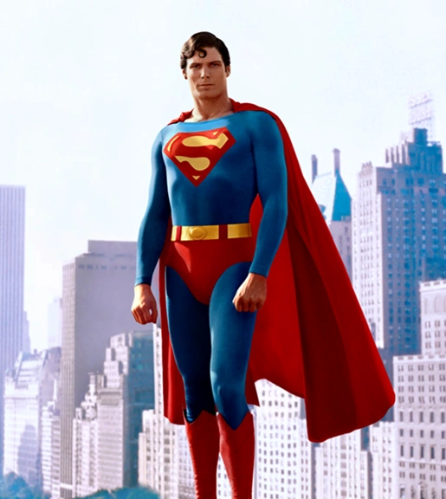
Supervaluationism: The Basic Idea
Supertruth
A sentence is supertrue iff it stays true no matter how we precisify our vague concepts
A sentence is superfalse iff it stays false no matter how we precisify our vague concepts
Supervaluationism
truth = supertruth
falsehood = superfalsehood
SUPERVALUATION MAN

Slide 19
Not Bivalent
BALD
NOT BALD
Simon
Suppose that Simon has just one hair
It is not supertrue that Simon is bald, because on some precisifications he isn’t
It is not superfalse that Simon is bald, because on some precisifications he is
So, according to supervaluationism, ‘Simon is bald’ is neither true nor false
Supervaluationism rejects bivalence, and is a type of three-valued semantics

Slide 20
Not Bivalent
Not Truth-Functional
BALD
NOT BALD
Simon
Daniel
Suppose that Simon has just one hair
It is not supertrue that Simon is bald, because on some precisifications he isn’t
It is not superfalse that Simon is bald, because on some precisifications he is
So, according to supervaluationism, ‘Simon is bald’ is neither true nor false
Supervaluationism rejects bivalence, and is a type of three-valued semantics
Supervaluationism is not truth-functional
Suppose Daniel has just two hairs
‘Simon is bald’ and ‘Daniel is bald’ are both neither supertrue nor superfalse
‘Simon is bald $→$ Daniel is bald’ is neither supertrue nor superfalse
‘Daniel is bald $→$ Simon is bald’ is supertrue

Slide 21
Not Truth-Functional
BALD
NOT BALD
Simon
Daniel
Supervaluationism is not truth-functional
Suppose Daniel has just two hairs
‘Simon is bald’ and ‘Daniel is bald’ are both neither supertrue nor superfalse
‘Simon is bald $→$ Daniel is bald’ is neither supertrue nor superfalse
‘Daniel is bald $→$ Simon is bald’ is supertrue

Slide 22
Semantic Indecision
Philosophers often motivate supervaluationism with a philosophical picture of vagueness
The way we use ‘bald’ makes it right to call some people ‘bald’ and some people ‘not bald’
But the way we use ‘bald’ doesn’t fix an answer in all cases – sometimes, our usage just remains silent about whether or not to classify someone as bald
Vagueness is a result of our semantic indecision
According to this picture, vagueness isn’t so different from ambiguity after all
We might think of our use of ‘bald’ as ambiguous between all of its precisifications
However, vagueness would still be a special kind of ambiguity
As we will see, vagueness is systematic in a way that ordinary ambiguity isn’t
And we will need to find a way of dealing with higher-order vagueness, which is not an issue for ordinary ambiguity

Slide 23
The Supervaluationists
Supervaluationism is one of the two most popular contemporary theories of vagueness
The other is epistemicism, which we’ll look at next week
It was introduced as a theory of vagueness by Kit Fine
Fine (1975), ‘Vagueness, truth and logic’. Synthese 30, pp.265-300
But supervaluationism has been developed most fully by Rosanna Keefe
Keefe (2000), Theories of Vagueness (CUP), esp. chs 7 & 8

Slide 24
Supervaluationism
Recap
The basic idea
Supertruth
The Sorites Paradox
Validity
Introducing ‘definitely’
Higher-Order Vagueness

Slide 25
What is a Precisification?
A precisification of a predicate is just a set individuals
A predicate is true of an individual relative to a precisification iff that individual is a member of that precisification
A predicate is false of an individual relative to a precisification iff that individual is not a member of that precisification
So defined, any set will do as a precisification for any predicate, no matter how silly the results
You could use a set of people with thick heads of hair as a precisification of ‘bald’, if you wanted
We need to filter these silly precisifications out: we want to focus on admissible precisifications

Slide 26
Admissible Precisifications
If $p$ is an admissible precisification of ‘bald’, then:
If $x$ is definitely bald, then $x∈p$
If $x$ is definitely not bald, then $x∉p$
If $x∈p$ and $y$ has less hair than $x$, then $y∈p$
If $x∉p$ and $y$ has more hair than $x$, then $y∉p$
However, there is more to being an admissible precisification than these basic rules…
We need to think about how different vague predicates interact
If $p$ is an admissible precisification of ‘$F$’, then:
If $x$ is definitely $F$, then $x∈p$
If $x$ is definitely not $F$, then $x∉p$
If $x∈p$ and $y$ is more $F$ than $x$, then $y∈p$
If $x∉p$ and $y$ is less $F$ than $x$, then $y∉p$

Slide 27
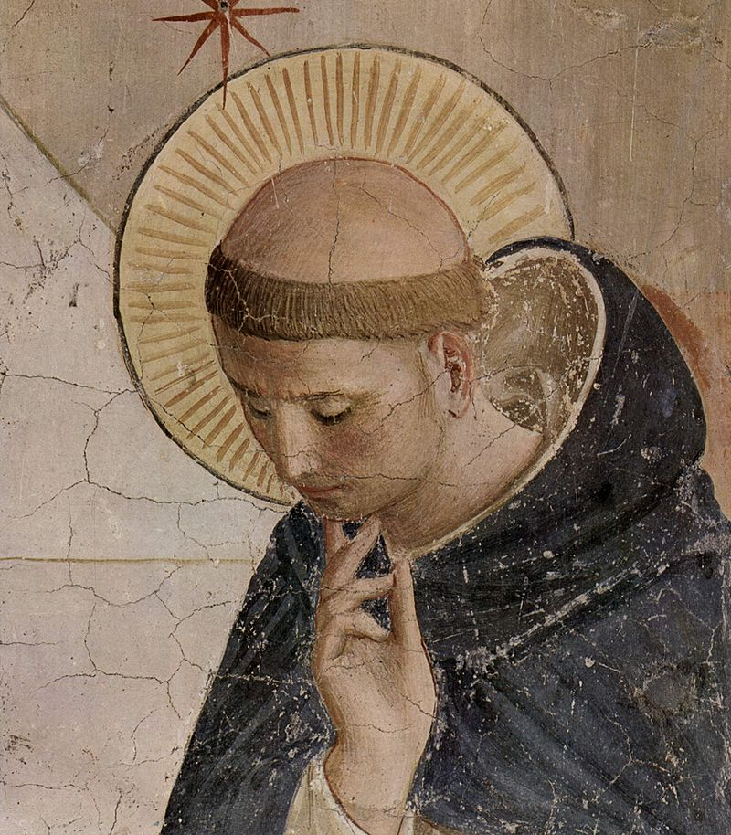
Penumbral Connections
There is no sharp cut-off between someone who is bald and someone who has a tonsure
One hair on the side of your head never makes the difference between being bald and having a tonsure
However, being bald is logically incompatible with having a tonsure: no one can be both!
Fine calls logical relations between vague concepts penumbral connections
Because of the penumbral connection between ‘bald’ and ‘has tonsure’, we cannot define what it is for a preicisification to be admissible for ‘bald’ on its own
Instead, we have to talk about whether a pair of precisifications are admissible for ‘bald’ and ‘has a tonsure’
If $p_{1}$ and $p_{2}$ are admissible precisifications for ‘bald’ and ‘has a tonsure’ respectively, then there is no $x$ s.t. $x∈p_{1}$ and $x∈p_{2}$

Slide 28
Complete Precisifications
There are all sorts of penumbral connections between all sorts of vague predicates
Nothing can be scarlet without being red; no one can be a human without being a mammal; no one can be a baby and morally responsible…
Since penumbral connections spread throughout our language, we can only really say that a complete precisification of the entire language is (or is not) admissible
A complete precisification of a language provides a precisification of every predicate in that language
Moreover, since penumbral connections are often determined by what the predicates mean, we cannot give a purely formal account of what it is for a complete precisification to be admissible
For the purposes of laying out supervaluationism as a theory, we will just treat ‘admissible’ as an undefined primitive
When applying supervaluationism, you need to rely on your own understanding of the language to tell whether a given precisification is admissible

Slide 29
Bivalence versus LEM
A sentence is supertrue iff it is true on every admissible precisification of the language
A sentence is superfalse iff it is false on every admissible precisification of the language
Supervaluationism: truth = supertruth; falsehood = superfalsehood
BALD
NOT BALD
Simon
BALD OR NOT BALD
Supervaluationism rejects bivalence, since a sentence can be neither supertrue nor superfalse
Importantly, however, supervaluationism does not reject the Law of the Excluded Middle (LEM): $A∨¬A$

Slide 30
Bivalence versus LEM
A sentence is supertrue iff it is true on every admissible precisification of the language
A sentence is superfalse iff it is false on every admissible precisification of the language
Supervaluationism: truth = supertruth; falsehood = superfalsehood
BALD
NOT BALD
Simon
BALD OR NOT BALD
Supervaluationism rejects bivalence, since a sentence can be neither supertrue nor superfalse
Importantly, however, supervaluationism does not reject the Law of the Excluded Middle (LEM): $A∨¬A$
No matter where we draw the cut-off, ‘Simon is bald or not bald’ always comes out true!

Slide 31
Disjunctions are Weird!
‘Simon is bald or Simon is not bald’ is supertrue even though neither ‘Simon is bald’ nor ‘Simon is not bald’ is supertrue
So according to supervaluationism, a disjunction can be true even if it has not true disjuncts!
Some people think that this is a serious cost of supervaluationism…
…but other people think it’s one of supervaluationism’s most attractive features
Either way, it is a very important feature of supervaluationism that will come up again later

Slide 32
Supervaluationism
Recap
The basic idea
Supertruth
The Sorites Paradox
Validity
Introducing ‘definitely’
Higher-Order Vagueness

Slide 33
A Premise-Flawed Paradox
Let’s start with the unquantified form of sorites:
1. $B\left(0\right)$
2. $B\left(0\right)→B\left(1\right)$
3. $B\left(1\right)→B\left(2\right)$
… …
150,001. $B\left(149,999\right)→B\left(150,000\right)$
150,002. $∴B\left(150,000\right)$
As we will see later, supervaluationists accept that this reasoning is valid
However, they think that at least one of the conditional premises is untrue (false on at least one precisification)
BALD
NOT BALD

Slide 34
A Premise-Flawed Paradox
Let’s start with the unquantified form of sorites:
1. $B\left(0\right)$
2. $B\left(0\right)→B\left(1\right)$
3. $B\left(1\right)→B\left(2\right)$
… …
150,001. $B\left(149,999\right)→B\left(150,000\right)$
150,002. $∴B\left(150,000\right)$
As we will see later, supervaluationists accept that this reasoning is valid
However, they think that at least one of the conditional premises is untrue (false on at least one precisification)
But they do not think that there is a sharp cut-off for ‘bald’, because no conditional premise is false (false on every precisification)
BALD
NOT BALD

Slide 35
Sharp Cut-Offs Strike Back?
Now let’s consider a quantified version of the sorites paradox
1. $B\left(0\right)$
2. $∀n\left(B\left(n\right)→B\left(n+1\right)\right)$
3. $∴B\left(150,000\right)$
Again, supervaluationists say that the second premise is untrue
BALD
NOT BALD
But more than that, they think the second premise is false!
No matter where we draw the cut-off, premise 2 always comes out false
Equivalently: no matter where we draw the cut-off, ‘$∃n\left(B\left(n\right)∧¬B\left(n+1\right)\right)$’ comes out true
So does that mean that supervaluationists are committed to a sharp cut-off for ‘bald’ after all?

Slide 36
Existential Generalisations are Weird
Existential generalisations are a lot like infinite disjunctions
$∃n\left(B\left(n\right)∧¬B\left(n+1\right)\right)⇒$
$$\left(B\left(0\right)∧¬B\left(1\right)\right)∨\left(B\left(1\right)∧¬B\left(2\right)\right)…$$
We’ve already seen that supervaluationists say that a disjunction can be true even if it has no true disjuncts
BALD
NOT BALD
They also say that an existential generalisation can be true even if it has no true instance
‘$∃n\left(B\left(n\right)∧¬B\left(n+1\right)\right)$’ is true, because it’s true on every precisification
But no instance of the form ‘$B\left(n\right)∧¬B(n+1)$’ is true, because there’s always some precisification which makes it false
‘$∃n\left(B\left(n\right)∧¬B\left(n+1\right)\right)$’ is made true by different instances on different precisifications

Slide 37
So Are There Sharp Cut-Offs Then!?
Some supervaluationists (e.g. Keefe) claim that they aren’t committed to a sharp cut-off for ‘bald’, because they don’t think any instance of ‘$B\left(n\right)∧¬B\left(n+1\right)$’ is true
A sharp cut-off would be a point in a sorites series where we would rightly call one person ‘bald’ and the next person ‘not bald’
Keefe (2000), Theories of Vagueness (CUP), pp.184-5
Some critics (e.g. Williamson) disagree
Either the supervaluationists have accurately modelled the behaviour of the existential quantifier, or they haven’t
If they haven’t, then they haven’t actually addressed the sorites paradoxes yet
If they have, then when they say that ‘$∃n\left(B\left(n\right)∧¬B\left(n+1\right)\right)$’ is true, they are literally just saying that ‘bald’ has a sharp cut-off!
Williamson (1994), Vagueness (Routledge), pp.153-4

Slide 38
Supervaluationism
Recap
The basic idea
Supertruth
The Sorites Paradox
Validity
Introducing ‘definitely’
Higher-Order Vagueness

Slide 39
Classical Logic?
Supervaluationists reject bivalence, but they retain the classical Law of the Excluded Middle: $A∨¬A$
Supervaluationists often claim that they retain all of classical logic!
Roughly: classical logic is what you learned in R&A
This is usually offered as one of supervaluationism’s major selling points
Classical logic behaves (mostly) intuitively
Classical logic is powerful and simple to use
Mathematicians, scientists, etc., all tend to use classical logic
However, things aren’t quite that simple…

Slide 40
Introducing Global Validity
A valid argument is an argument which necessarily preserves truth
It is impossible for the premises all to be true and for the conclusion not to be true
Supervaluationism: truth = supertruth
So, for a supervaluationist, a valid argument should be one which necessarily preserves supertruth
It is impossible for all of the premises to be supertrue and for the conclusion not to be supertrue
It is impossible for all of the premises to be true on every precisification, and for the conclusion to be false on some precisification
This is known as global validity

Slide 41
Global Validity and Interpretations
In a classical setting, we can explicate validity in terms of interpretations
$A_{1},…,A_{n}⊨_{C}B$iff there is no interpretation in which $A_{1},…,A_{n}$are all true and $B$ is not true
Let a supervaluationist interpretation be a set of complete precisifications
Every sentence of the language gets a truth-value relative to a complete precisfication, according to the usual classical rules (see forallx!)
A sentence is supertrue on a supervaluationist interpretation iff it is true relative to every complete precisification in that interpretation
We can now define global validity in terms of supervaluationist interpretations
$A_{1},…,A_{n}⊨_{G}B$ iff there is no supervaluationist interpretation in which $A_{1},…,A_{n}$ are all supertrue, and $B$ is not supertrue
$A_{1},…,A_{n}⊨_{G}B$ iff there is no supervaluationist interpretation in which $A_{1},…,A_{n}$ are all true relative to every precisification, and $B$ is false relative to some precisification

Slide 42
The Classical Result
If we restrict ourselves to the language of FOL (see forallx!), then it is fairly easy to establish this important result:
$A_{1},…,A_{n}⊨_{C}B$ iff $A_{1},…,A_{n}⊨_{G}B$
For a proof, see: Cobreros and Tranchini (2019), ‘Supervaluationism, subvaluationism and the Sorites Paradox’ in The Sorites Paradox (CUP), pp.40-3
This is what supervaluationists have in mind when they say that they retain all of classical logic
Also note that this result tells us that, according to supervaluationism, the sorites paradoxes are valid, since they are obviously classically valid

Slide 43
Multiple-Conclusion Logic
According to the standard definitions, an argument can have many premises but only one conclusion
However, we can adopt a multiple-conclusion logic, which allows us to have many premises and many conclusions
Intuitive Idea: An argument is valid iff it is impossible for all of its premises to be true and for all of its conclusions not to be true
Classical Validity: $A_{1},…,A_{n}⊨_{C}B_{1},…,B_{n}$ iff there is no interpretation in which all of $A_{1},…,A_{n}$ are true, and none of $B_{1},…,B_{n}$ is true
Global Validity: $A_{1},…,A_{n}⊨_{G}B_{1},…,B_{n}$ iff there is no interpretation in which all of $A_{1},…,A_{n}$ are supertrue, and none of $B_{1},…,B_{n}$ is supertrue
Global Validity: $A_{1},…,A_{n}⊨_{G}B_{1},…,B_{n}$ iff there is no interpretation in which all of $A_{1},…,A_{n}$ are true relative to every precisification, and each of $B_{1},…,B_{n}$ is false relative to some precisification

Slide 44
Classical Logic Lost…
In a multiple-conclusion logic, classical validity and global validity yield different results
$A∨B⊭_{C}A$ and $A∨B⊭_{C}B$, but $A∨B⊨_{C}A,B$
There is no classical interpretation in which ‘$A∨B$’ is true but neither ‘$A$’ nor ‘$B$’ is true
However, $A∨B⊭_{G}A,B$
We have already seen that a disjunction can be supertrue even if neither disjunct is supertrue
Three Options
Accept that supervaluationists do not retain all of classical logic
Reject (or otherwise downplay) multiple-conclusion logic
Reject global validity, and come up with a new supervaluationist definition of validity

Slide 45
Local Validity
Global Validity: $A_{1},…,A_{n}⊨_{G}B_{1},…,B_{n}$ iff there is no interpretation in which all of $A_{1},…,A_{n}$ are true relative to every precisification, and each of $B_{1},…,B_{n}$ is false relative to some precisification
Local Validity: $A_{1},…,A_{n}⊨_{L}B_{1},…,B_{n}$ iff there is no precisification in any interpretation relative to which $A_{1},…,A_{n}$ are all true, but none of $B_{1},…,B_{n}$ is true
When we ask whether an argument is globally valid, we assess the premises and conclusions for supertruth (truth relative to all precisifications)
When we ask whether an argument is locally valid, we assess the truth-values of the premises and the conclusions relative to each precisification, one at a time
Good news: $A∨B⊨_{L}A,B$

Slide 46
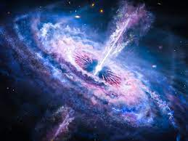
Global or Local?
Supervaluationists tend to prefer global validity
Validity is meant to be the necessary preservation of truth. According to supervaluationism, truth = supertruth. So global validity is the right notion of validity for supervaluationism
Compare supervaluationism to modal logic, the logic of necessity ($□$)
A modal interpretation is a set of worlds; each world settles all of the non-modal facts; $□A$ is true iff $A$ is true at every world
$A_{1},…,A_{n}⊨_{□}B_{1},…,B_{n}$ iff there is no world in any interpretation relative to which $A_{1},…,A_{n}$ are all true, but none of $B_{1},…,B_{n}$ is true
This definition of modal validity is motivated because we live in one of the worlds – whichever world we are in, we know that modal validity will preserve truth there
But we don’t live in any one of the precisifications: none of them accurately models our vague language!

Slide 47
Supervaluationism
Recap
The basic idea
Supertruth
The Sorites Paradox
Validity
Introducing ‘definitely’
Higher-Order Vagueness

Slide 51
Definitely
When defining vagueness, we helped ourselves to the idea of definitely
‘Bald’ is vague because there are people who are definitely bald, people who are definitely not bald, and people who are neither
It seems, then, that no theory of vagueness would be complete without an account of definitely
Supervaluationists have an obvious way of defining a ‘definitely’ operator:
$DA$ is true relative to a precisification in a given interpretation iff $A$ is true relative to every precisification in that interpretation
(This operator works a lot like $□A$ in modal logic)
In general, $DA$ is supertrue iff $A$ is supertrue
What’s the point of that!?
Crucially, $DA$ is superfalse iff $A$ is not supertrue

Slide 52
Definite Bivalence
BALD
NOT BALD
Simon
Joe
Suppose that Joe has a thick head of hair
There is no admissible interpretation relative to which he is bald
So ‘$D$(Joe is not bald)’ is true relative to every precisification (supertrue)
But if Simon only has one hair, then there are precisifications relative to which he is bald
So ‘$D$(Simon is not bald)’ is false relative to every precisification (superfalse)

Slide 53
No Definite Cut-Offs
We saw earlier that supervaluationists are forced to say that ‘$∃n\left(B(n)∧¬B\left(n+1\right)\right)$’ is supertrue
This looks dangerously like they’re saying that there is a sharp cut-off for ‘bald’
But note that supervaluationists think that this is superfalse: $∃n\left(DB\left(n\right)∧D¬B\left(n+1\right)\right)$
On each precisification, there is a cut-off between bald people and not-bald people
But that cut-off moves from precisification to precisification
So there is no sharp cut-off between definitely bald people and definitely not bald people

Slide 54
Definitely Weird
This is supertrue: $D∃n\left(\left(Bn∧¬DBn\right)∨\left(¬Bn∧¬D¬Bn\right)\right)$
On each precisification, we either classify some borderline $n$ as $Bn$, or we classify some borderline $n$ as $¬Bn$
But this is weird!
What is involved in being bald but not being definitely bald?
BALD
NOT BALD
What is involved in being not bald but not being definitely not bald?
Note that we wouldn’t get this result on the many-valued approaches discussed last week
Does it help that there is no supertrue instance of ‘$\left(Bn∧¬DBn\right)∨\left(¬Bn∧¬D¬Bn\right)$’?

Slide 55
Non-Classical Again
Important Observation 1: $A⊨_{G}DA$
If $A$ is supertrue in an interpretation, then $DA$ is supertrue in that interpretation too
Important Observation 2: $⊭_{G}A→DA$
We have already seen that relative to some precisifications, some borderline $n$ gets classified as $Bn$
However, classical logic obeys conditional proof: if $A⊨_{C}B$ then $⊨_{C}A→B$
If we want to preserve classical logic, we could try going local again, since $A⊭_{L}DA$
However, we have already seen that there is good reason to think that supervaluationists should work with global validity

Slide 56
Supervaluationism
Recap
The basic idea
Supertruth
The Sorites Paradox
Validity
Introducing ‘definitely’
Higher-Order Vagueness

Slide 57
Higher-Order Vagueness
Admissible precisifications must count every definitely bald person as bald
But who is definitely bald?
There is no sharp cut-off between being definitely bald and being not definitely bald
The predicate ‘definitely bald’ is just as vague as ‘bald’
We can run a sorites paradox for ‘definitely bald’: one hair never makes the difference between being definitely bald and not
This is a return of the problem of higher-order vagueness

Slide 58
‘Admissible’ is Vague
It is vague whether a precisification is admissible
This is a problem if you wanted supervaluationism to be a non-vague semantics for vague languages
However, if we take vagueness seriously at all, we would probably expect that the semantics for vague languages would have to be vague too
Supervaluationism can still solve the sorites paradoxes, even if it is vague whether a precisification is admissible
On every admissible precisification of ‘admissible’, there are admissible precisifications of ‘bald’ which draw the cut-off at different places
So on every admissible precisification of ‘admissible’, some instance of ‘$B\left(n\right)∧¬B\left(n+1\right)$’ is neither supertrue nor superfalse

Slide 59
Higher-Order Vagueness Again
If ‘definitely bald’ is vague, then there should be some $n$ such that $¬DDBn$ and $¬D¬DBn$
However, on the supervaluationist semantics for the ‘definitely’ operator we gave earlier, $⊨_{G}DA→DDA$ and $⊨_{G}¬DA→D¬DA$
Imagine that precisifications are admissible or not relative to other precisifications
Example: $p_{1}$ is admissible relative to $p_{2}$ only if $p_{1}$ draws the cut-off for ‘baldness’ within 10 hairs of $p_{1}$
We can now tweak the semantics for ‘$D$’:
$$A$$
$DA$ is true relative to a given precisification iff $A$ is true relative to every precisification admissible relative to the first
In this tweaked semantics, $⊭_{G}DA→DDA$
Williamson (1999), ‘On the structure of higher-order vagueness’, Mind 108, pp.127-43
$$¬A$$
$$A$$

Slide 60
Super-Definite
Suppose we introduced a new ‘super-definitely’ operator:
$D^{∗}A$ is true relative to a precisification iff $A, DA, DDA, DDDA, DDDDA…$ are all true relative to that precisification
Even on the tweaked semantics, $⊨_{G}D^{∗}A→D^{∗}D^{∗}A$!
No one is sure how to respond to super-definiteness!
See the Bonus Reading!!!

Slide 61
For the Next Seminar and Lecture
Seminar Reading
Keefe (2008), ‘Vagueness: supervaluationism’. Philosophy Compass 3, pp.315-24
Williamson (1994), Vagueness (Routledge), ch.5
Lecture Reading
Sainsbury (2009). Paradoxes (CUP), ch.3 (Section 3.4)

