Slide 1
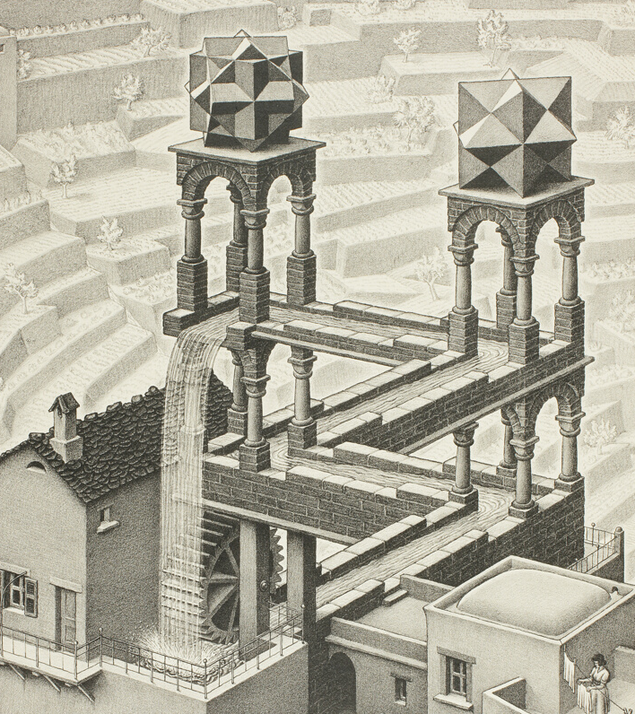
Logic and Paradox
Lecture 3:
Introducing the Sorites
Rob Trueman
rob.trueman@york.ac.uk

Slide 2
Introducing the Sorites
Some sorites paradoxes
What is vagueness?
Formalising sorites paradoxes
Nihilism
Three-valued semantics
Continuum-valued semantics
Higher-order vagueness
Truth-functionality

Slide 12
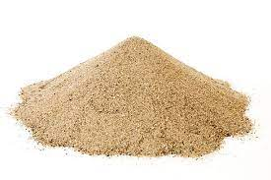
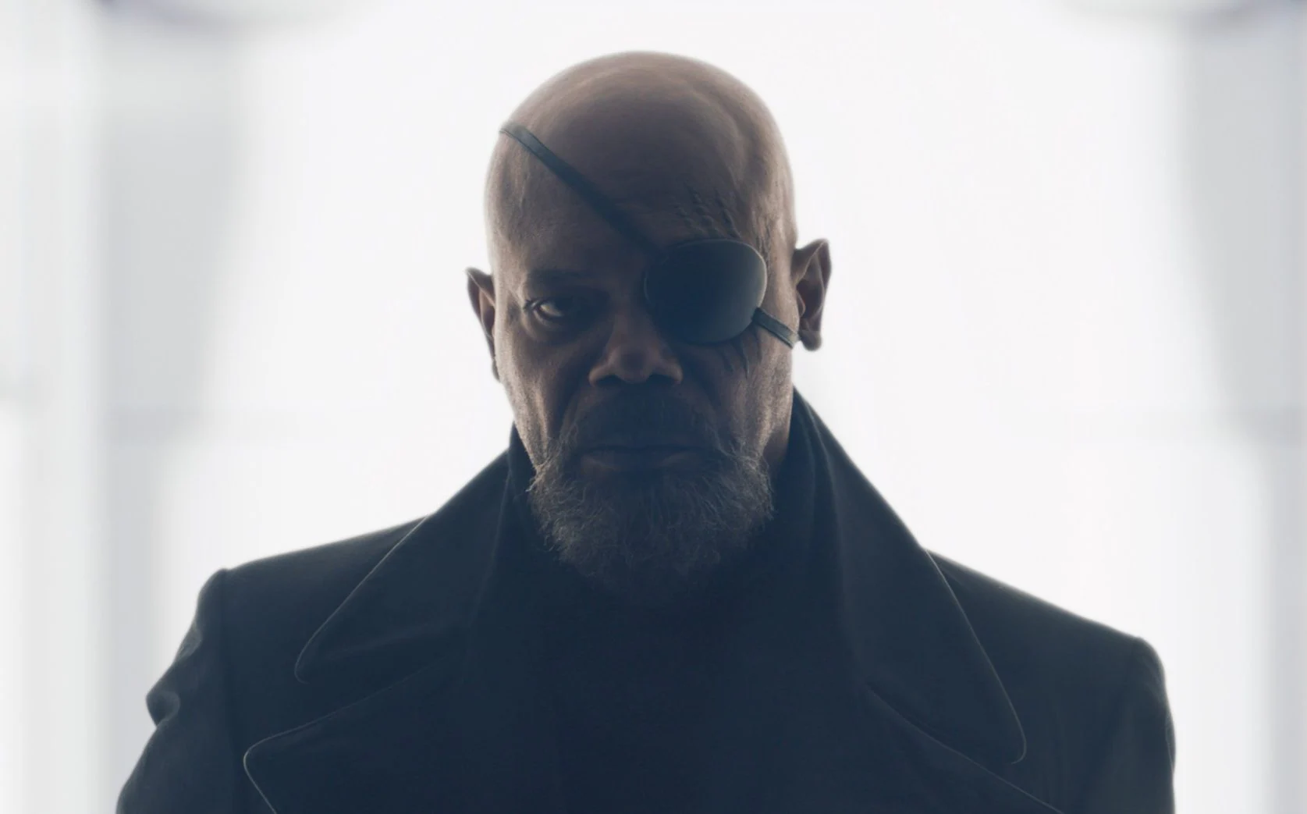
Two More Paradoxes
The Heap
One grain of sand doesn’t make a heap
Adding one grain of sand to something which isn’t a heap never makes a heap
So no matter how many grains of sand you have, it isn’t a heap
The Bald Man
A person with no hair is bald
One hair is never the difference between being bald and not
So everyone is bald, no matter how many hairs they have
These paradoxes are both attributed to an ancient Greek philosopher called Eubulides (who also introduced the Liar!)
They clearly have the same form, and nowadays there are all known as sorites paradoxes (from ‘soros’, the ancient Greek word for heap)

Slide 13
Loads More Paradoxes…
Tall
Someone whose height is less than 1m is not tall
One millimetre never makes the difference between being tall and not
So no one is tall, no matter their height
Hot
A cup of coffee that is 10ºC is not hot
A tenth of a degree never makes the difference between being hot and not
So no cup of coffee is hot, no matter its temperature
Safe
10km/hr is a safe driving speed in residential areas
0.001km/hr never makes the difference between a safe speed and unsafe one
So every driving speed is safe in residential areas

Slide 14
Introducing the Sorites
Some sorites paradoxes
What is vagueness?
Formalising sorites paradoxes
Nihilism
Three-valued semantics
Continuum-valued semantics
Higher-order vagueness
Truth-functionality

Slide 15
A Paradox about Vagueness
Sorites paradoxes come up whenever we use vague concepts
Intuitively: A vague concept admits borderline cases
There are some things that the vague concept definitely applies to
There are some things that the vague concept definitely doesn’t apply to
But there are also borderline cases that the concept neither definitely applies to nor definitely doesn’t apply to
Baby is a vague concept
A newborn is definitely a baby; a 37 year old is definitely not a baby; but a 12 month old is neither definitely a baby nor definitely not a baby
Bald is a vague concept
Someone with no hair is definitely bald; someone with 150,000 hairs is definitely not bald; someone with 20,000 hairs is neither definitely bald nor definitely not bald

Slide 16
Vagueness versus Contingent Ignorance
We do not know the shortest height that still counts as tall
However, this is not ordinary contingent ignorance
I happen not to know the height (to the nearest centimetre) of the tallest person in this room, but I could find it out!
There’s nothing I could do to find out the shortest height that still counts as tall
Many philosophers make the stronger claim that we’re not really dealing with any kind of ignorance at all
There is no fact that we are ignorant about; there’s just not fact at all about the shortest height that counts as tall
There are some philosophers (the epistemicists) who think that vagueness is a kind of ignorance, but not contingent
Epistemicists think that it is impossible for us to know the shortest height that still counts as tall!

Slide 17
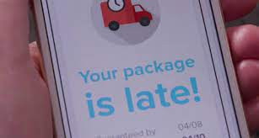
Vagueness versus Generality
In ordinary language, we often treat certain kinds of generality as varieties of vagueness
‘The package will be delivered between 9am and 5pm (inclusive). I hate it when they’re so vague!’
That’s not what philosophers mean by ‘vagueness’!
‘The package will be delivered between 9am and 5pm (inclusive)’ is a generalisation, but isn’t vague
It is definitely true if the package is delivered sometime between 9am and 5pm (inclusive), and definitely false otherwise
There is no borderline, where it is neither definitely true nor definitely false
Not all general claims are vague, but some particular claims are
If John has 20,000 hairs, then ‘John is bald’ is particular but vague

Slide 18
Vagueness versus Margins of Error
When making any kind of measurement, there is always a margin of error
We know that the true value lies within some range centred on the measured value, but not exactly where
Measurements that come with a margin of error are not automatically vague
A margin of error is really just a generalisation
The measurement is definitely correct if the true value lies somewhere in this margin, and definitely incorrect otherwise
There need not be any borderline, where the measurement is neither definitely correct nor definitely incorrect

Slide 19
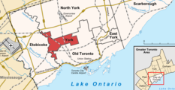
Vagueness versus Ambiguity
In ordinary language, we also describe ambiguity as a kind of vagueness
‘She said she lived in York, but that’s a bit vague: York in England, or York in Canada?’
When someone says something ambiguous, there are multiple ways of interpreting what they said
What they said might be true on some interpretations, false on others
Vagueness occurs within one interpretation
Let’s disambiguate ‘baby’: a baby is an infant human
There are still borderline cases where ‘baby’ does not definitely apply nor definitely not apply
(Having said that, next week we will look at a theory of vagueness– supervaluationism – which draws important connections between vagueness and ambiguity!)

Slide 20
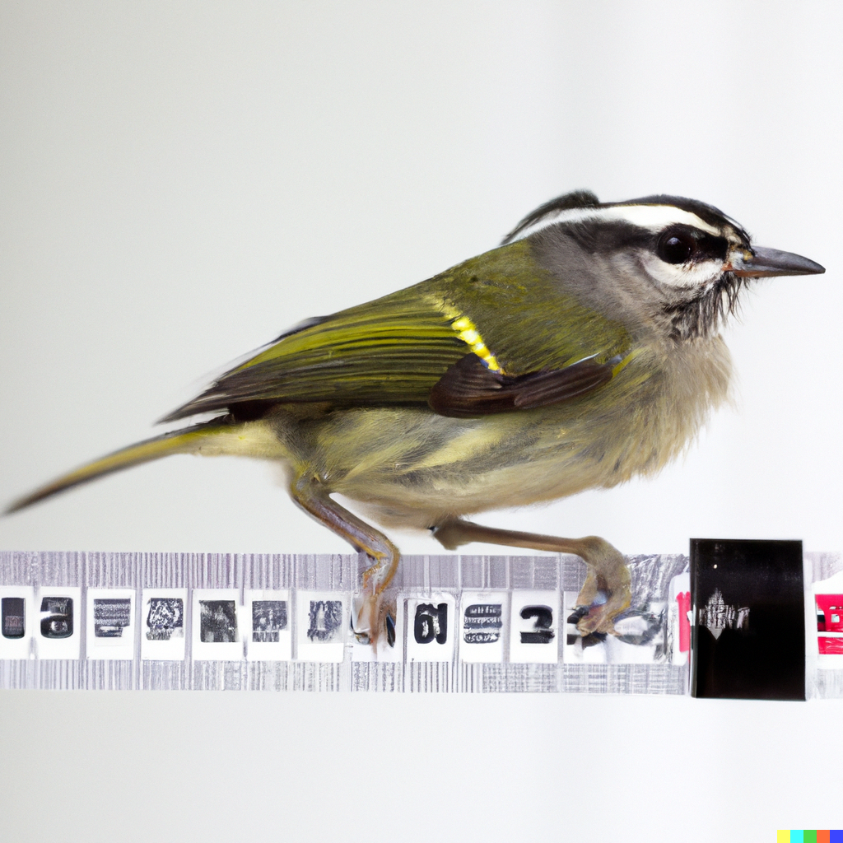
Vagueness versus Relativity
It is also important to distinguish vagueness from relativity
Is Marcus Rashford (1.8m) tall?
He is tall for a biped (most bipeds are birds), but he isn’t tall for a footballer (average height 1.82m)
Whether a person counts as tall partly depends on the comparison class we are working with (and lots of our concepts are like that)
But this relativity is not the same as vagueness!
Let’s fix our comparison class: we are interested in tall for a footballer
This is still a vague concept: a 1.85m tall footballer might still be a borderline case of someone who is tall for a footballer
There are other types of relativity too, but vagueness survives even when we eliminate them all

Slide 21
No Sharp Boundaries?
If vague concepts admit borderline cases, then it is natural to think of them as lacking sharp boundaries
Return to our sorites series, where each person is one second older than the last
‘Baby’ lacks sharp boundaries: we can’t find a cut-off, where one person is a baby and the next person isn’t
$$¬∃n\left(B\left(n\right)∧¬B\left(n+1\right)\right)$$
$$¬∃r\left(T\left(r\right)∧¬T\left(r−0.001\right)\right)$$
We can construct similar sorites series for other vague concepts, and none of them will have a cut-off
Or at least, this seems intuitive: some theories of vagueness – e.g. epistemicism – say otherwise!

Slide 22
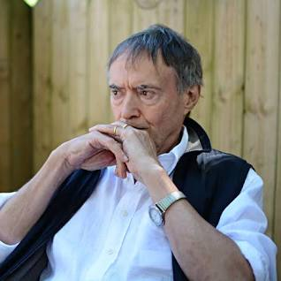
Tolerance Principles
No Sharp Boundaries: $¬∃n\left(Fn∧¬F\left(n+1\right)\right)$
Tolerance Principle: $∀n\left(Fn→F\left(n+1\right)\right)$
“In these examples we encounter the feature of a certain tolerance in the concepts involved, a notion of degree of change too small to make any difference, as it were. There are degrees of change in point of size, maturity [etc.] which are insufficient to alter the justice with which some specific predicate of size, maturity [etc.] is applied.”
Wright (1975), ‘On the coherence of vague predicates’. Synthese 30, p.333
In Classical Logic, No Sharp Boundaries is equivalent to the Tolerance Principle
However, some people think we need to change our logic to accommodate vagueness, and so it is useful to see that Tolerance has its own motivation

Slide 23
Introducing the Sorites
Some sorites paradoxes
What is vagueness?
Formalising sorites paradoxes
Nihilism
Three-valued semantics
Continuum-valued semantics
Higher-order vagueness
Truth-functionality

Slide 24
Sorites Forwards and Backwards
Forwards
A person with no hair is bald
Adding one hair never makes the difference between being bald and not
So even a person with 150,000 hairs is bald
Backwards
A person with 150,000 hairs isn’t bald
Removing one hair never makes the difference between not being bald and being bald
So even a person with no hair isn’t bald
Forwards
One grain of sand isn’t a heap
Adding one grain of sand to something which isn’t a heap never makes a heap
So even 10,000 grains of sand isn’t a heap
Backwards
10,000 grains of sand is a heap
Removing one grain of sand from a heap never destroys the heap
So even one grain of sand is a heap!

Slide 25
Paradoxes of Tolerance
Sorites paradoxes are often formulated as paradoxes of Tolerance
1. A person with no hair is bald
2. One hair never makes the difference between being bald and not
3. So even someone with 150,000 hairs is bald
It might be tempting to say that these paradoxes just show us that Tolerance is false
Maybe it’s just hasty overgeneralisations?
But there is another way of presenting the sorites paradoxes…
1. $B\left(0\right)$
2. $∀n\left(B\left(n\right)→B\left(n+1\right)\right)$
3. $∴B\left(150,000\right)$

Slide 26
An Unquantified Formulation
Rather than formulating a sorites with a quantified premise, we can just use a long list of conditionals:
1. $B\left(0\right)$
2. $B\left(0\right)→B\left(1\right)$
3. $B\left(1\right)→B\left(2\right)$
… …
150,001. $B\left(149,999\right)→B\left(150,000\right)$
150,002. $∴B\left(150,000\right)$
It is very hard to deny the conditional premises
The early conditionals obviously look true, but so do the later ones: someone with 149,999 hairs isn’t bald, but if they were, so would someone with 150,000 hairs
If you reject any premise you are (classically) committed to a particular sharp cut-off: $¬\left(B\left(n\right)→B\left(n+1\right)\right)⊢B\left(n\right)∧¬B\left(n+1\right)$

Slide 27
An Unquantified Formulation
Rather than formulating a sorites with a quantified premise, we can just use a long list of conditionals:
1. $B\left(0\right)$
2. $B\left(0\right)→B\left(1\right)$
3. $B\left(1\right)→B\left(2\right)$
… …
150,001. $B\left(149,999\right)→B\left(150,000\right)$
150,002. $∴B\left(150,000\right)$
It is very hard to deny the conditional premises
The early conditionals obviously look true, but so do the later ones: someone with 149,999 hairs isn’t bald, but if they were, so would someone with 150,000 hairs
If you reject any premise you are (classically) committed to a particular sharp cut-off: $¬\left(B\left(n\right)→B\left(n+1\right)\right)⊢B\left(n\right)∧¬B\left(n+1\right)$
It is very hard to reject the reasoning
We are only using one inference – modus ponens – over and over again: $P,P→Q⊢Q$
Modus ponens is obviously valid, and how could re-applying a valid rule lots of times suddenly make it invalid?

Slide 28
Paradoxes of Sharp Cut-Offs
You can also present sorites directly as paradoxes of sharp cut-offs
1. $B\left(0\right)$
2. $¬\left(B\left(0\right)∧¬B\left(1\right)\right)$
3. $¬\left(B\left(1\right)∧¬B\left(2\right)\right)$
… …
150,001. $¬\left(B\left(149,999\right)∧¬B\left(150,000\right)\right)$
150,002. $∴B\left(150,000\right)$
It is still hard to deny the premises or reject the reasoning!
We are relying on the following rule: $P,¬\left(P∧¬Q\right)⊢Q$
This rule can be derived from Conjunction Introduction, Negation Introduction and Double-Negation Elimination
1. $B\left(0\right)$
2. $¬∃n\left(B\left(n\right)∧¬B\left(n+1\right)\right)$
3. $∴B\left(150,000\right)$

Slide 29
Introducing the Sorites
Some sorites paradoxes
What is vagueness?
Formalising sorites paradoxes
Nihilism
Three-valued semantics
Continuum-valued semantics
Higher-order vagueness
Truth-functionality

Slide 32
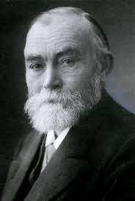
Frege against Vague Concepts
“Figuratively, we can also express it like this: a concept must have sharp boundaries. If one pictures a concept […] as a region in a plane then [… a] concept without sharp boundaries would correspond to a region that would not have a sharp borderline everywhere but would, in places, be completely blurred, merging with its surroundings. This would not really be a region at all; and, correspondingly, a concept without sharp definition is wrongly called a concept. Logic cannot recognise such concept-like constructions as concepts; it is impossible to formulate exact laws concerning them.”
Frege (1903), Grundgesetze der Artihmetik, vol 2 (Pohle), Section 56

Slide 33
Varieties of Nihilism
Call the idea that vague predicates are somehow defective nihilism
Frege was an extreme kind of nihilist: he thought that vague predicates were meaningless (or at least that they didn’t have the right kind of meanings to use in logical reasoning)
Unger is a less extreme nihilist: he thinks that the sorites ‘paradoxes’ are really just proofs that vague predicates are all empty (i.e. false of everything)
Seminar reading: Unger (1979), ‘There are no ordinary things’. Synthese 41, pp.117-54
Backwards
A person with 150,000 hairs isn’t bald
Removing one hair never makes the difference between not being bald and being bald
So even a person with no hair isn’t bald
Forwards
A person with no hair is bald
Adding one hair never makes the difference between being bald and not
So even a person with 150,000 hairs is bald
A person with no hair is bald ✗
So even a person with no hair isn’t bald ✓

Slide 34
Eliminating Vagueness?
According to nihilism, if we want to truly describe the world, we need to eliminate vagueness from our language
But many of the terms in our language are vague
Examples: ‘baby’, ‘heap’, ‘bald’, ‘tall’, ‘clever’, ‘kind’, ‘cruel’, ‘York’, ‘Asia’, ‘ocean’, ‘mountain’, ‘table’, ‘dog’, ‘human’
Is it even clear that we could speak in entirely non-vague terms?
Given the kind of creatures that we are, could we really speak a language where we don’t talk about places, animals, character traits…?
Are we certain that the world itself can be described in entirely non-vague terms?
Even if we could eliminate vagueness, should we? Or would we lose out on something important?

Slide 35
Two Important Roles for Vagueness
Morality
Classifications like ‘baby’ (‘adult’, ‘person’, etc.) have moral significance: we have many special moral duties towards babies, and unlike other people, babies have no moral responsibilities
There is no sharp cut-off, where these duties suddenly disappear: you stop being a baby only when you undergo certain morally relevant changes; but these changes can never happen in a second!
(We do sometimes draw artificial sharp cut-offs for particular purposes, but we know they are arbitrary!)
Casual Observation
We need categories for classifying objects on the basis of casual observation (e.g. ‘tall’, ‘fast’, ‘hot’, …)
But we can’t know the precise height, or the precise speed (etc.) of an object on the basis of causal observation
Wright (1975), ‘On the coherence of vague predicates’. Synthese 30, pp.325-65

Slide 36
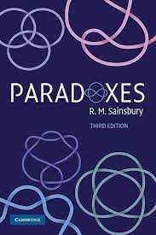
Sainsbury on Casual Observation
We might not be able to know someone’s exact height by observation, but remember that generalisations are not automatically vague!
We can often tell by looking that someone is shorter than 6ft, for example
So, we don’t need to use vague language just to let us know things on the basis of casual observation
Sainsbury (2009), Paradoxes (CUP, 3rd ed), pp.45-6

Slide 37
Casual Observation and Appearances
Sometimes we use language which explicitly describes how things appear to casual observation
Examples: ‘The ball looks red’, ‘Marcus looks shorter than 1.85m’, ‘The bag feels like it’s less than a kilo’, ‘The car sounds more than a mile away’…
This kind of language seems inherently vague
If two people differ in height by just one millimetre, then they will be indistinguishable to casual observation
So if someone who is $n$ metres tall looks shorter than 1.85 metres on casual observation, then so should someone who is $n.001$ metres tall
This is a Tolerance Principle, and so we have another sorties paradox
If this is right, then we cannot dodge sorites paradoxes by eliminating vagueness, unless we are willing to give up on being able to describe how things appear

Slide 38
Introducing the Sorites
Some sorites paradoxes
What is vagueness?
Formalising sorites paradoxes
Nihilism
Three-valued semantics
Continuum-valued semantics
Higher-order vagueness
Truth-functionality

Slide 39
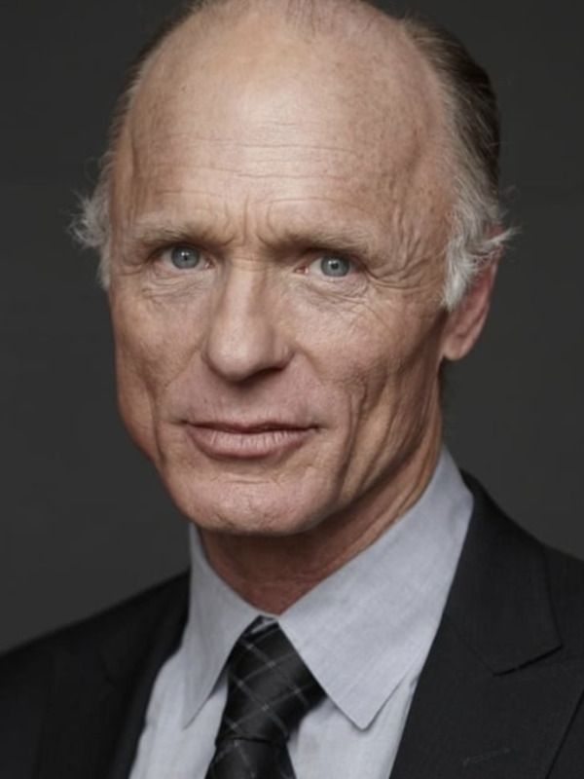
The Law of the Excluded Middle
Imagine that Ed is a borderline case of bald
It is tempting to say that Ed is neither bald nor not-bald: $¬\left(Be∨¬Be\right)$
This is a violation of the Law of the Excluded Middle (LEM): $A∨¬A$
LEM is a law of classical logic, and so maybe classical logic is inadequate for vagueness?
Maybe the sorites is fallacious, because it relies on classical inferences that are inappropriate for vagueness?

Slide 40
LEM and Bivalence
It is important to distinguish LEM from bivalence: Every sentence is either true or false
LEM is an object-language scheme
Bivalence is a meta-linguistic generalisation about truth and falsehood
However, in a classical setting, we take LEM to be a logical law because we assume bivalence
$$A$$ | $$A ∨ ¬ A$$
T | T T F T
F | F T T F
One natural thought would be to dodge LEM by rejecting Bivalence: some sentences are neither true nor false!

Slide 41
Negation
$$A$$ | $$¬A$$
T | F
N
F | T

Slide 42
Negation
External Negation
$$A$$ | $$¬A$$
T | F
N | T
F | T
This is no good for our purposes!
We wanted to move over to a three-valued logic to avoid LEM – $A∨¬A$ – but this truth-table vindicates it
Either $A$ is T, or it is N or F
If $A$ is T, then $A∨¬A$ is T
If $A$ is N or F, then $¬A$ is T, and so $A∨¬A$ is still T

Slide 43
External Negation
Internal Negation
$$A$$ | $$¬A$$
T | F
N | N
F | T
$$A$$ | $$¬A$$
T | F
N | T
F | T

Slide 44
Internal Negation
Strong Kleene Truth-Tables
$$A$$ | $$¬A$$
T | F
N | N
F | T
$$A$$ | $$B$$ | $$A∨B$$
T | T | T
T | N
T | F | T
N | T
N | N
N | F
F | T | T
F | N
F | F | F

Slide 45
Strong Kleene Truth-Tables
$$A$$ | $$¬A$$
T | F
N | N
F | T
$$A$$ | $$B$$ | $$A∨B$$
T | T | T
T | N
T | F | T
N | T
N | N | N
N | F
F | T | T
F | N
F | F | F

Slide 46
Strong Kleene Truth-Tables
$$A$$ | $$¬A$$
T | F
N | N
F | T
$$A$$ | $$B$$ | $$A∨B$$
T | T | T
T | N | T
T | F | T
N | T | T
N | N | N
N | F
F | T | T
F | N
F | F | F

Slide 47
Strong Kleene Truth-Tables
$$A$$ | $$¬A$$
T | F
N | N
F | T
$$A$$ | $$B$$ | $$A∨B$$
T | T | T
T | N | T
T | F | T
N | T | T
N | N | N
N | F | N
F | T | T
F | N | N
F | F | F
$$A$$ | $$B$$ | $$A∧B$$
T | T | T
T | N
T | F | F
N | T
N | N
N | F
F | T | F
F | N
F | F | F

Slide 48
Strong Kleene Truth-Tables
$$A$$ | $$¬A$$
T | F
N | N
F | T
$$A$$ | $$B$$ | $$A∨B$$
T | T | T
T | N | T
T | F | T
N | T | T
N | N | N
N | F | N
F | T | T
F | N | N
F | F | F
$$A$$ | $$B$$ | $$A∧B$$
T | T | T
T | N
T | F | F
N | T
N | N | N
N | F
F | T | F
F | N
F | F | F

Slide 49
Strong Kleene Truth-Tables
$$A$$ | $$¬A$$
T | F
N | N
F | T
$$A$$ | $$B$$ | $$A∨B$$
T | T | T
T | N | T
T | F | T
N | T | T
N | N | N
N | F | N
F | T | T
F | N | N
F | F | F
$$A$$ | $$B$$ | $$A∧B$$
T | T | T
T | N
T | F | F
N | T
N | N | N
N | F | F
F | T | F
F | N | F
F | F | F

Slide 50
Strong Kleene Truth-Tables
$$A$$ | $$¬A$$
T | F
N | N
F | T
$$A$$ | $$B$$ | $$A∨B$$
T | T | T
T | N | T
T | F | T
N | T | T
N | N | N
N | F | N
F | T | T
F | N | N
F | F | F
$$A$$ | $$B$$ | $$A∧B$$
T | T | T
T | N | N
T | F | F
N | T | N
N | N | N
N | F | F
F | T | F
F | N | F
F | F | F
$$A$$ | $$B$$ | $$A→B$$
T | T | T
T | N
T | F | F
N | T
N | N
N | F
F | T | T
F | N
F | F | T

Slide 51
Strong Kleene Truth-Tables
$$A$$ | $$¬A$$
T | F
N | N
F | T
$$A$$ | $$B$$ | $$A∨B$$
T | T | T
T | N | T
T | F | T
N | T | T
N | N | N
N | F | N
F | T | T
F | N | N
F | F | F
$$A$$ | $$B$$ | $$A∧B$$
T | T | T
T | N | N
T | F | F
N | T | N
N | N | N
N | F | F
F | T | F
F | N | F
F | F | F
$$A$$ | $$B$$ | $$A→B$$
T | T | T
T | N
T | F | F
N | T
N | N
N | F
F | T | T
F | N | T
F | F | T

Slide 52
Strong Kleene Truth-Tables
$$A$$ | $$¬A$$
T | F
N | N
F | T
$$A$$ | $$B$$ | $$A∨B$$
T | T | T
T | N | T
T | F | T
N | T | T
N | N | N
N | F | N
F | T | T
F | N | N
F | F | F
$$A$$ | $$B$$ | $$A∧B$$
T | T | T
T | N | N
T | F | F
N | T | N
N | N | N
N | F | F
F | T | F
F | N | F
F | F | F
$$A$$ | $$B$$ | $$A→B$$
T | T | T
T | N | N
T | F | F
N | T | N
N | N | N
N | F | N
F | T | T
F | N | T
F | F | T

Slide 53
Strong Kleene Truth-Tables
Weak Kleene Truth-Tables
$$A$$ | $$¬A$$
T | F
N | N
F | T
$$A$$ | $$B$$ | $$A→B$$
T | T | T
T | N | N
T | F | F
N | T | N
N | N | N
N | F | N
F | T | T
F | N | T
F | F | T
$$A$$ | $$B$$ | $$A∨B$$
T | T | T
T | N | T
T | F | T
N | T | T
N | N | N
N | F | N
F | T | T
F | N | N
F | F | F
$$A$$ | $$B$$ | $$A→B$$
T | T | T
T | N | N
T | F | F
N | T | N
N | N | N
N | F | N
F | T | T
F | N | N
F | F | T
$$A$$ | $$B$$ | $$A∨B$$
T | T | T
T | N | N
T | F | T
N | T | N
N | N | N
N | F | N
F | T | T
F | N | N
F | F | F
$$A$$ | $$B$$ | $$A∧B$$
T | T | T
T | N | N
T | F | F
N | T | N
N | N | N
N | F | F
F | T | F
F | N | F
F | F | F
$$A$$ | $$B$$ | $$A∧B$$
T | T | T
T | N | N
T | F | F
N | T | N
N | N | N
N | F | N
F | T | F
F | N | N
F | F | F

Slide 54
Weak Kleene Truth-Tables
Strong Kleene Truth-Tables
$$A$$ | $$¬A$$
T | F
N | N
F | T
$$A$$ | $$B$$ | $$A→B$$
T | T | T
T | N | N
T | F | F
N | T | N
N | N | N
N | F | N
F | T | T
F | N | N
F | F | T
$$A$$ | $$B$$ | $$A∨B$$
T | T | T
T | N | N
T | F | T
N | T | N
N | N | N
N | F | N
F | T | T
F | N | N
F | F | F
$$A$$ | $$B$$ | $$A→B$$
T | T | T
T | N | N
T | F | F
N | T | N
N | N | N
N | F | N
F | T | T
F | N | T
F | F | T
$$A$$ | $$B$$ | $$A∨B$$
T | T | T
T | N | T
T | F | T
N | T | T
N | N | N
N | F | N
F | T | T
F | N | N
F | F | F
$$A$$ | $$B$$ | $$A∧B$$
T | T | T
T | N | N
T | F | F
N | T | N
N | N | N
N | F | N
F | T | F
F | N | N
F | F | F
$$A$$ | $$B$$ | $$A∧B$$
T | T | T
T | N | N
T | F | F
N | T | N
N | N | N
N | F | F
F | T | F
F | N | F
F | F | F

Slide 55
Strong Kleene Truth-Tables
Łukasiewicz Truth-Tables
$$A$$ | $$¬A$$
T | F
N | N
F | T
$$A$$ | $$B$$ | $$A→B$$
T | T | T
T | N | N
T | F | F
N | T | N
N | N | T
N | F | N
F | T | T
F | N | T
F | F | T
$$A$$ | $$B$$ | $$A∨B$$
T | T | T
T | N | T
T | F | T
N | T | T
N | N | N
N | F | N
F | T | T
F | N | N
F | F | F
$$A$$ | $$B$$ | $$A∧B$$
T | T | T
T | N | N
T | F | F
N | T | N
N | N | N
N | F | F
F | T | F
F | N | F
F | F | F
$$A$$ | $$B$$ | $$A→B$$
T | T | T
T | N | N
T | F | F
N | T | N
N | N | N
N | F | N
F | T | T
F | N | T
F | F | T

Slide 56
Solving the Sorites
Some people are bald, some people are not bald, and in between there are people who are neither
Let’s imagine that the largest number of hairs you can have and still be bald is 5,000
‘$B\left(5,000\right)$’ is T, but ‘$B\left(5,001\right)$’ is N
It follows that ‘$B\left(5,000\right)→B\left(5,001\right)$’ is N
Both the Kleene and Łukasiewicz truth-tables agree that when the antecedent is T and the consequent is N, the conditional is N
They then disagree about what to do with conditionals where both sides are N – e.g. ‘$B\left(5,001\right)→B\left(5,002\right)$’ – but that doesn’t matter right now
So the sorites is premise-flawed, since it has a premise which isn’t true!
$$A$$ | $$B$$ | $$A→B$$
T | T | T
T | N | N
T | F | F
N | T | N
N | N | N/T
N | F | N
F | T | T
F | N | T
F | F | T

Slide 57
Introducing the Sorites
Some sorites paradoxes
What is vagueness?
Formalising sorites paradoxes
Nihilism
Three-valued semantics
Continuum-valued semantics
Higher-order vagueness
Truth-functionality

Slide 58
Closer to the Truth
Imagine that 1.751m and 1.752m are both borderline heights for being bald
In the three-valued setting, ‘$T\left(1.751\right)$’ and ‘$T\left(1.752\right)$’ both get the same truth-value: N
But isn’t there a clear sense in which ‘$T\left(1.752\right)$’ is closer to being true than ‘$T\left(1.751\right)$’?
If we want to capture that, we’ll need more than just three truth-values…

Slide 59
Continuum-Valued Semantics
In a continuum-valued semantics, we use all of the real numbers from 0 to 1 – the continuum [0,1] – as our values
1 represents absolute truth; 0 represents absolute falsehood
The values in between represent being more or less true(/false), depending on how close they are to 1(/0)

Slide 60
The Connectives
$\left[P\right]=0.4, \left[Q\right]=0.5$
$\left[¬P\right]=1−0.4=0.6$
$\left[¬Q\right]=1−0.5=0.5=\left[Q\right]$
$\left[P∧Q\right]=min⁡(0.4, 0.5)=0.4$
$\left[¬P∨Q\right]=\max\left(0.6, 0.5\right)=0.6$
$\left[P→Q\right]=1$
$\left[¬P→Q\right]=1−0.6+0.5=0.9$
$\left[¬A\right]=1−\left[A\right]$
$\left[A∧B\right]=\min\left(\left[A\right],\left[B\right]\right)$
$\left[A∨B\right]=max\left(\left[A\right],\left[B\right]\right)$
$\left[A→B\right]=$ $1$ if $\left[A\right]≤\left[B\right]$
$1−\left[A\right]+\left[B\right]$ otherwise

Slide 61
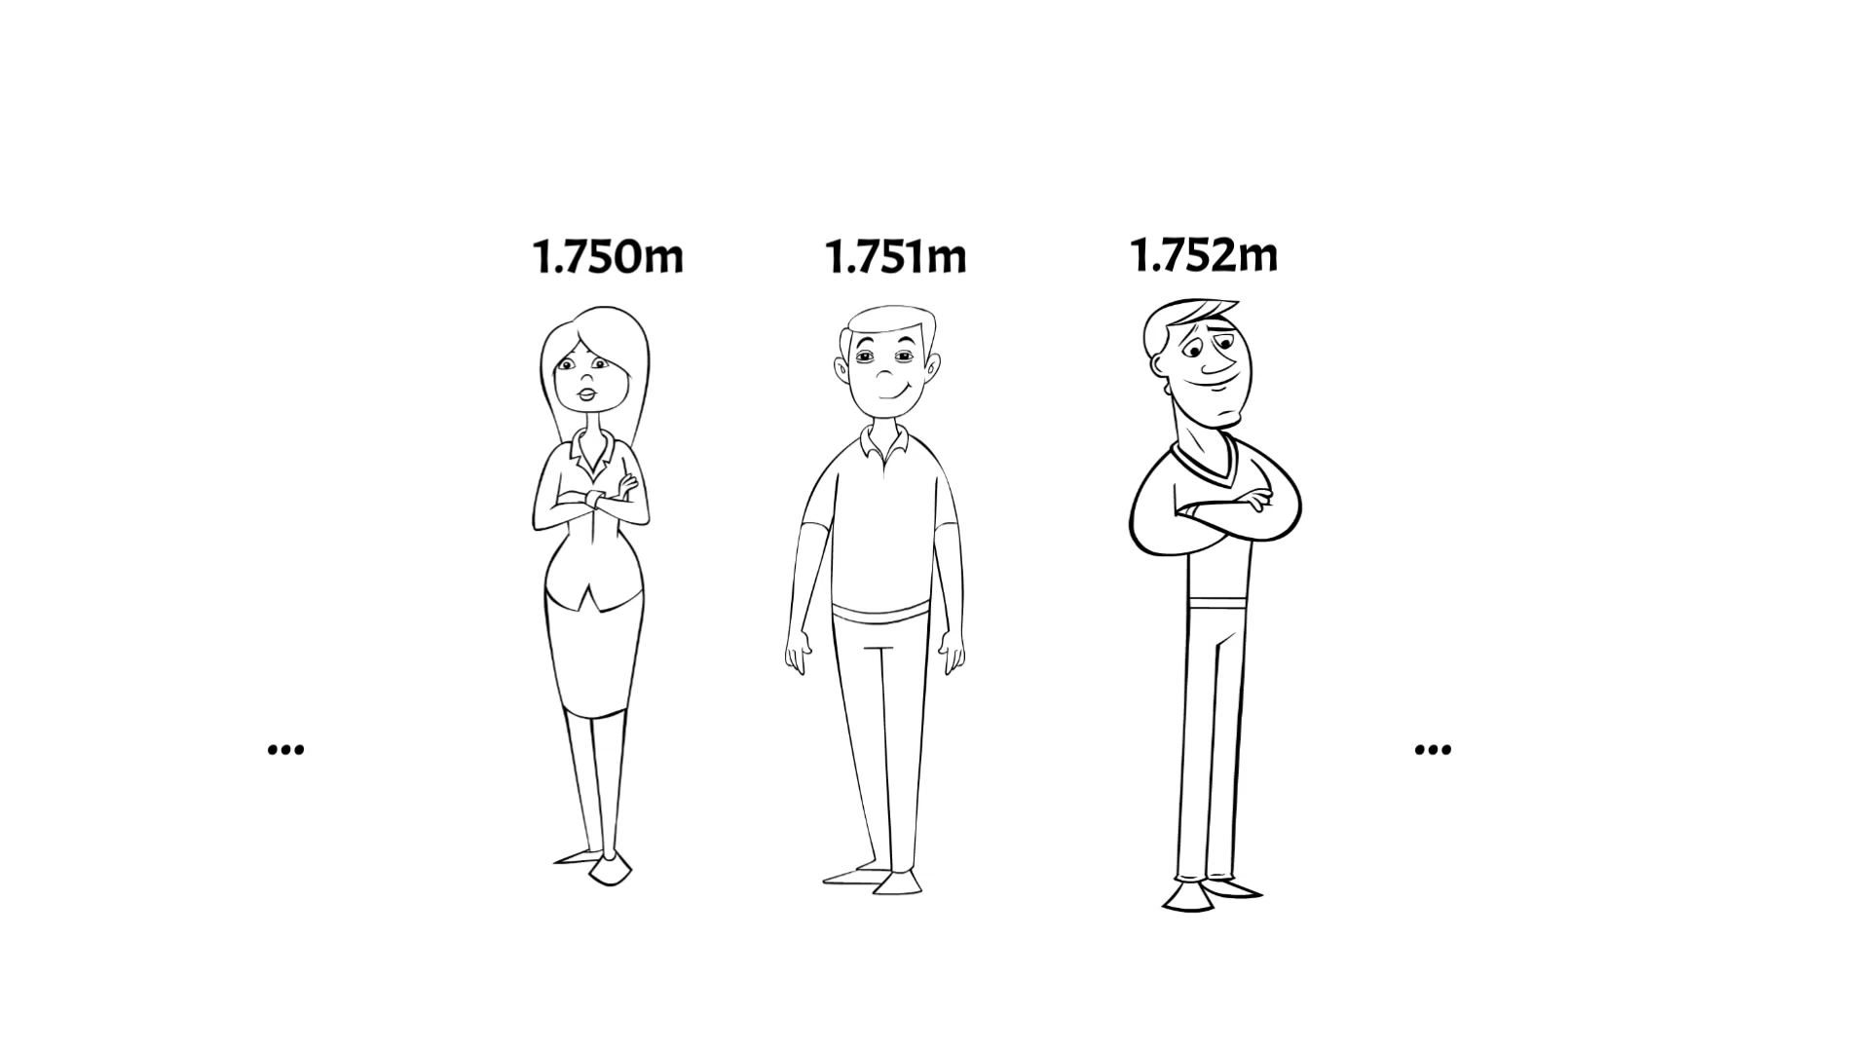
Solving the Sorites Again
Suppose $\left[T\left(1.751\right)\right]=0.8$ and $\left[T\left(1.752\right)\right]=0.85$
$\left[T\left(1.752\right)→T\left(1.751\right)\right]=1−0.85+0.8=0.95$
So many of the conditional premises are less than absolutely true ($≤1)$
Does that mean that sorites paradoxes are premise-flawed?
Yes if you should reject everything other than absolute truth; but no if you should still accept sentences that are true enough

Slide 62
Validity
In classical logic, and argument is valid iff there is no valuation on which each premise is true, and the conclusion is false
How should we generalise this in our continuum-valued setting?
An argument is valid iff there is no valuation on which each premise is absolutely true ($=1$), and the conclusion isn’t ($<1$)
An argument is valid iff there is no valuation on which the conclusion is less true than the least true premise
Option 1 is appropriate if we think that we should reject everything other than absolute truth
Option 2 is appropriate if we think that we should still assert things that are true enough
We need a notion of validity that tells us how to infer things from not-quite-true sentences

Slide 63
A Fallacious Paradox!
An argument is valid iff there is no valuation on which the conclusion is less true than the least true premise
The only rule of inference you need to run a sorites paradox is modus ponens:
$A, A→B⊢B$
But on this definition of validity, modus ponens is invalid!
1. $T\left(1.752\right)$
2. $T\left(1.752\right)→T\left(1.751\right)$
3. $T\left(1.751\right)$
This does block the paradox, but can we really reject modus ponens?
(But you can still use modus ponens when dealing only with absolute truth ($=1$) and absolute falsehood ($=0$), for whatever that’s worth…)

Slide 64
A Fallacious Paradox!
An argument is valid iff there is no valuation on which the conclusion is less true than the least true premise
The only rule of inference you need to run a sorites paradox is modus ponens:
$A, A→B⊢B$
But on this definition of validity, modus ponens is invalid!
1. $\left[T\left(1.752\right)\right]=0.85$
2. $T\left(1.752\right)→T\left(1.751\right)$
3. $T\left(1.751\right)$
This does block the paradox, but can we really reject modus ponens?
(But you can still use modus ponens when dealing only with absolute truth ($=1$) and absolute falsehood ($=0$), for whatever that’s worth…)

Slide 65
A Fallacious Paradox!
An argument is valid iff there is no valuation on which the conclusion is less true than the least true premise
The only rule of inference you need to run a sorites paradox is modus ponens:
$A, A→B⊢B$
But on this definition of validity, modus ponens is invalid!
1. $\left[T\left(1.752\right)\right]=0.85$
2. $T\left(1.752\right)→T\left(1.751\right)$
3. $\left[T\left(1.751\right)\right]=0.8$
This does block the paradox, but can we really reject modus ponens?
(But you can still use modus ponens when dealing only with absolute truth ($=1$) and absolute falsehood ($=0$), for whatever that’s worth…)

Slide 66
A Fallacious Paradox!
An argument is valid iff there is no valuation on which the conclusion is less true than the least true premise
The only rule of inference you need to run a sorites paradox is modus ponens:
$A, A→B⊢B$
But on this definition of validity, modus ponens is invalid!
1. $\left[T\left(1.752\right)\right]=0.85$
2. $\left[T\left(1.752\right)→T\left(1.751\right)\right]=1−0.85+0.8=0.95$
3. $\left[T\left(1.751\right)\right]=0.8$
This does block the paradox, but can we really reject modus ponens?
(But you can still use modus ponens when dealing only with absolute truth ($=1$) and absolute falsehood ($=0$), for whatever that’s worth…)

Slide 67
Introducing the Sorites
Some sorites paradoxes
What is vagueness?
Formalising sorites paradoxes
Nihilism
Three-valued semantics
Continuum-valued semantics
Higher-order vagueness
Truth-functionality

Slide 68
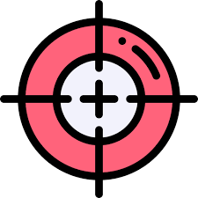
Overly Precise?
It is commonly objected that the continuum-valued semantics makes vagueness itself too precise
Each sentence has to have a particular real number as its truth-value
But isn’t it incredible that the truth-value of ‘Ed is bald’ should be (e.g.) 0.837473802, not 0.8374738021?
Some continuum-value theorists try to dodge this objection by saying that their semantics merely models vagueness, and we shouldn’t over-interpret their values, but it isn’t entirely clear what this amounts to
(But this isn’t a problem for the three-valued semantics, where every sentence is just true, false, or neither)

Slide 69
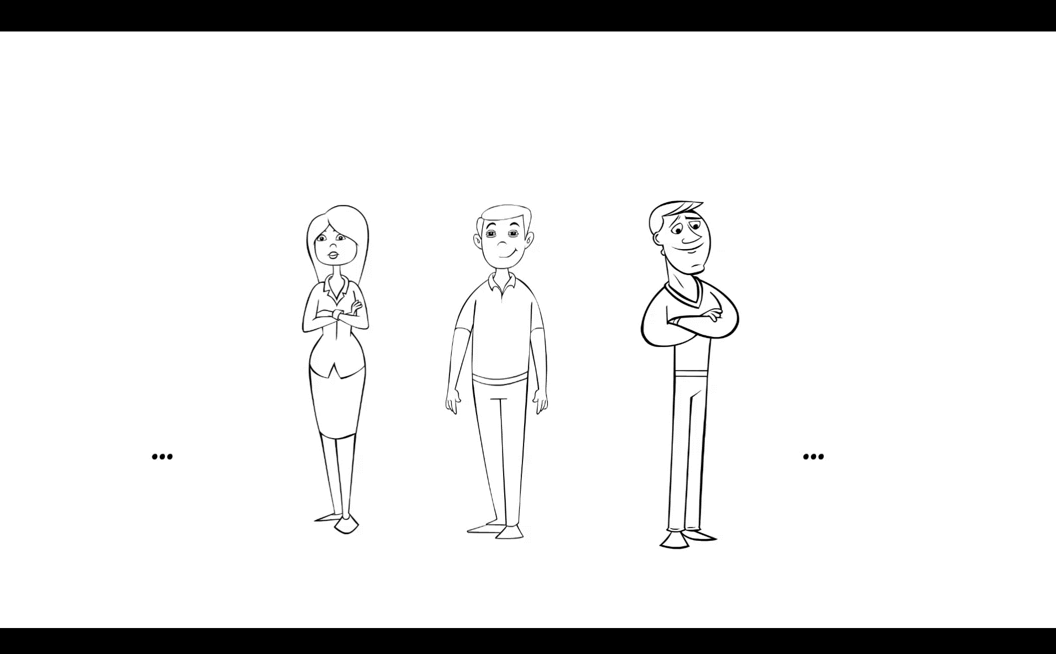
Sharp Cut-Offs?
Three-valued and continuum-valued semantics are motivated by the desire to avoid sharp cut-offs in sorites series
Between the people who are absolutely tall and the people who are absolutely not, there’s a buffer of people who aren’t absolutely either
But now we’ve just multiplied the sharp cut-offs!
There’s one sharp cut-off between people it is absolutely true to call tall, and the people it is neither absolutely true nor absolutely false to call tall…
…and there’s another cut-off between people it is absolutely false to call tall, and the people it is neither absolutely true nor absolutely false to call tall

Slide 70
Higher-Order Vagueness
In a many-valued setting, we can define what we mean by definitely:
$\left[DA\right]=$ $1$ if $\left[A\right]=1$
$0$ otherwise
Intuitively, definitely bald is just as vague as bald, and just as vulnerable to sorites paradox
Someone with no hair is definitely bald
One hair never makes the difference between being definitely bald and not being definitely bald
So everyone is definitely bald, no matter how many hairs they have
But $\left[D∃n\left(DBn∧¬DB\left(n+0.001\right)\right)\right]=1$!
Equally, $DA$ can never itself be vague: $DA⊨DDA$ and $¬DA⊨D¬DA$
Finding a way of accommodating the vagueness of definitely is known as the problem of higher-order vagueness, and it will come up a lot of times!

Slide 71
Introducing the Sorites
Some sorites paradoxes
What is vagueness?
Formalising sorites paradoxes
Nihilism
Three-valued semantics
Continuum-valued semantics
Higher-order vagueness
Truth-functionality

Slide 72
The Wrong Truth-Value
Suppose that Ed is an exact borderline case of being bald: $\left[Be\right]=0.5$
(We can either think of 0.5 as one of the continuum values, or we can think of it as a numerical representation of N in the three-valued setting)
In both the three-valued and continuum-valued semantics, it follows that $\left[¬Be\right]=0.5$
Since $\left[Be\right]=\left[¬Be\right]=0.5$, it follows in both systems that $\left[Be∧¬Be\right]=0.5$
But ‘$Be∧¬Be$’ is a contradiction, and so shouldn’t it be absolutely false ($=0$)?

Slide 75
Truth-Functionality
In classical logic, negation, conjunction and disjunction are truth-functional
The truth-value of a negation/conjunction/disjunction is a function of the truth-values of its immediate constituents
It is natural to want to preserve this in our new many-valued settings
As soon as you start drawing truth-tables – as we did in the three-valued setting – you are defining functions from truth-values to truth-values
And our continuum-valued semantics was truth-functional too
But once you decide to make your theory truth-functional, there is no good way of avoiding the strange results of the three-valued or continuum-valued semantics!

Slide 76
Negation
The continuum-valued clause for negation: $\left[¬A\right]=1−\left[A\right]$
This is really just a generalisation of what happens in classical two-valued semantics
Suppose 1 and 0 are the only two truth-values (representing true and false, respectively)
Then what the above clause tells you is that $\left[¬A\right]=1$ iff $\left[A\right]=0$, and $\left[¬A\right]=0$ iff $\left[A\right]=1$
If we add in 0.5 for neither, then we get our three-valued clause: $\left[¬A\right]=1$ iff $\left[A\right]=0$, $\left[¬A\right]=0$ iff $\left[A\right]=1$, and $\left[¬A\right]=0.5$ iff $\left[A\right]=0.5$
It is extremely intuitive: $¬A$ should be exactly as close to 0 as $A$ is to 1
And it secures this attractive result: $\left[¬¬A\right]=\left[A\right]$

Slide 77
Conjunction
These seem like a very important rule for conjunction:
$\left[A∧A\right]=\left[A\right]=\left[A∨A\right]$
Now let $\left[Be\right]=0.5$
$\left[Be\right]=\left[¬Be\right]=0.5$
$\left[Be\right]=\left[Be∧Be\right]=0.5$
Therefore $\left[Be∧¬Be\right]=0.5$
The last step is justified if conjunction is truth-functional: ‘$Be$’ and ‘$¬Be$’ have the same truth-value, and so must be treated the same way
These results are widely discussed, see for example Keefe (2000), Theories of Vagueness (CUP), pp.96-100

Slide 78
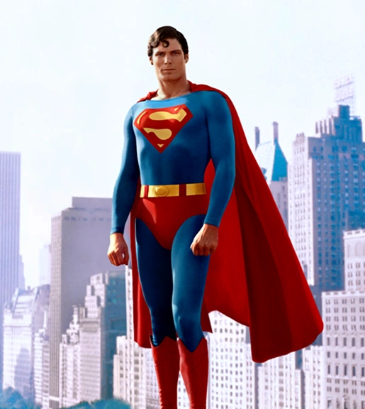
Non-Truth-Functional
Can we give up on truth-functionality?
YES! Next week we will look at a non-truth-functional approach to vagueness called supervaluationism
(But, if you want something non-truth-functional that’s a bit closer to what we looked at this week, why not try Edgington’s ‘Vagueness by degrees’ on the reading list?)
SUPERVALUATION MAN

Slide 79
For the Next Seminar and Lecture
Seminar Reading
Unger (1979), ‘There are no ordinary things’. Synthese 41, pp.117-54
Lecture Reading
Sainsbury (2009). Paradoxes (CUP), ch.3 (Section 3.5)

