Slide 1
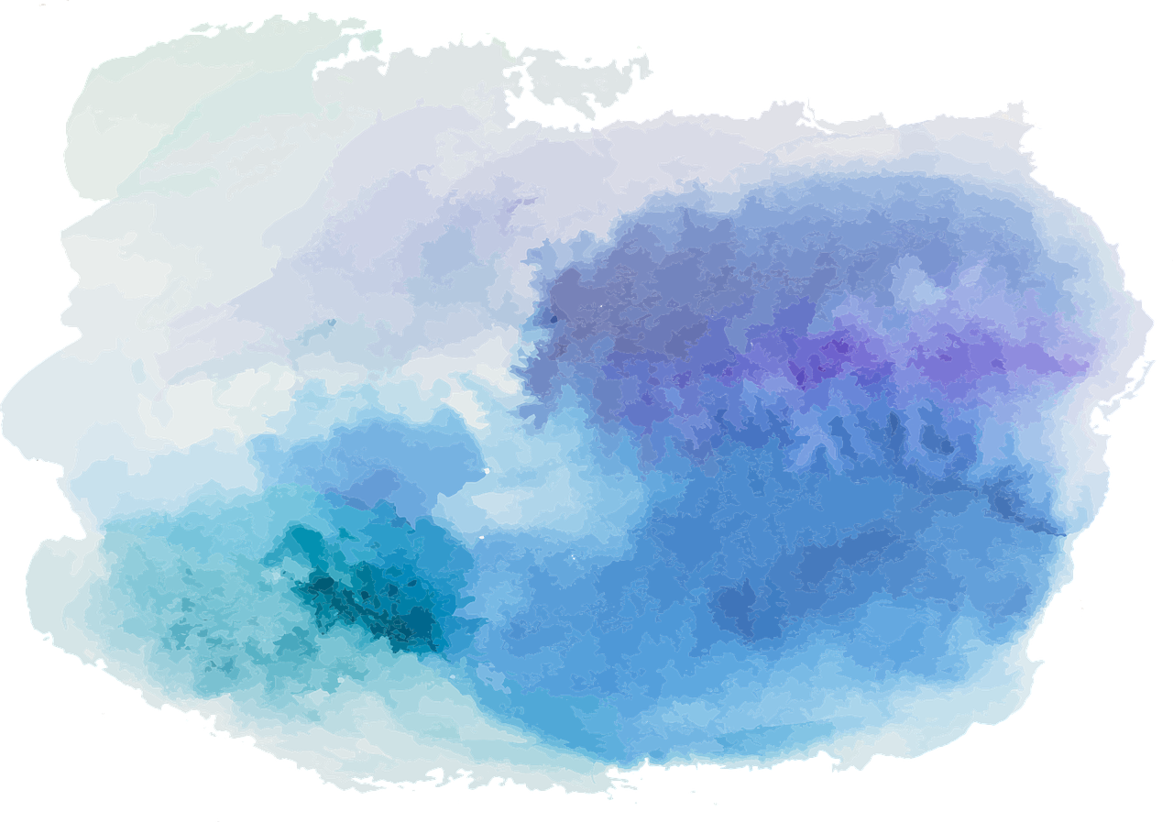
Reason and Argument
Lecture 3: Introducing Truth-Functional Logic
Robert Trueman
rob.trueman@york.ac.uk
University of York

Slide 2
Reason and Argument
Lecture 3: Introducing Truth-Functional Logic
The Atoms of TFL
Negation
Conjunction
Disjunction
The Conditional
The Biconditional
Putting It All Together!

Slide 3
Re-cap: formal validity
An argument is valid if and only if it is impossible for all of its premises to be true and its conclusion to be false
Some (but not all!) arguments are valid in virtue of their form
It’s raining outside
If it’s raining outside, then Simon is miserable
So Simon is miserable
A
If A, then B
So B
Dave is either in his office or in the pub
Dave is not in the pub
So Dave is in his office
A or B
Not-B
So A
A form of argument is valid if and only every argument with that form is valid
The job for a formal logician is to systematically map the valid forms

Slide 4
Our first formal language: Truth-Functional Logic
We will invent a new formal language, which obeys clear and strict rules
This language will allow us to symbolise a wide variety of arguments from ordinary English (and other ‘natural languages’) in a way that displays their form
Then (in future lectures) we will introduce a way of telling which of these forms are valid
This new language is called Truth-Functional Logic (or TFL), for reasons which will become clear later on

Slide 8
Atomic sentences
The basic building blocks of TFL are atomic sentences (or atoms, for short)
The atoms of TFL are just capital letters (with subscripts, if we like):
$A, B, C,…,Z$
$A_{1},…,Z_{1},A_{2},…,Z_{2},…$
Every sentence of TFL is either an atom, or built by combining atoms according to some pre-specified rules

Slide 9
Symbolisation keys
We can use atoms to symbolise any natural-language sentence we like
We indicate what we are using an atom to symbolise with a symbolisation key
$A:$ Dave is in his office
$B:$ Dave is in the pub
$A:$ It is raining outside
$B:$ Simon is miserable
When we lay down a symbolisation key, we are not fixing the meanings of the atoms once and for all
We are just indicating what we are using the atoms to symbolise for now

Slide 10
Atoms are structureless
We can use an atom to symoblise any natural-language sentence we like
However, TFL does not discern any structure within atoms
When we choose to symbolise a sentence with an atom, we are choosing to ignore all of the structure in that sentence
So there is nothing wrong with this symbolisation key:
$A:$ Simon is miserable
$B:$ Simon is happy
We just have to remember that, as far as TFL is concerned, there are no structural relations between the atoms ‘$A$’ and ‘$B$’

Slide 11
Reason and Argument
Lecture 3: Introducing Truth-Functional Logic
The Atoms of TFL
Negation
Conjunction
Disjunction
The Conditional
The Biconditional
Putting It All Together!

Slide 12
Introducing negation
Suppose we wanted to symbolise this sentence:
It is not the case that logic is boring
We can start by laying down this symbolisation key:
$B:$ Logic is boring
We will then symbolise ‘It is not the case that logic is boring’ as ‘$¬B$’
This new symbol, ‘$¬$’, expresses negation

Slide 13
Negation and paraphrase
The negation rule: A sentence can be symbolised as $¬A$ if and only if it can be paraphrased in English as ‘It is not the case that…’
We call $¬A$ the negation of $A$
‘Logic is not boring’ can be paraphrased as ‘It is not the case that logic is boring’
So, if we symbolise ‘Logic is boring’ as ‘$B$’, we can symbolise ‘Logic is not boring’ as ‘$¬B$’

Slide 14
Negation and paraphrase
Imagine we symbolise ‘Some Philosophy modules are fun’ as ‘$P$’
Can we now symbolise ‘Some Philosophy modules are not fun’ as ‘$¬P$’?
No! Paraphrases should be true in exactly the same possible worlds as each other, but…
‘Some philosophy modules are not fun’ is true in worlds where all but one of the Philosophy modules are fun
‘It is not the case that some Philosophy modules are fun’ is only true in worlds where no Philosophy modules are fun

Slide 15
Trust your own linguistic judgment!
There is no fail-proof method of figuring out whether an English sentence can be paraphrased as ‘It is not the case that…’
In the end, you will have to rely on your own judgment as someone who understands English sentences
But if you conclude that a sentence can be paraphrased as ‘It is not the case that…’, then you can symbolise it in TFL as $¬A$

Slide 16
Reason and Argument
Lecture 3: Introducing Truth-Functional Logic
The Atoms of TFL
Negation
Conjunction
Disjunction
The Conditional
The Biconditional
Putting It All Together!

Slide 17
Introducing conjunction
Suppose we wanted to symbolise this sentence:
Logic is fun and logic is useful
We could start by laying down this symbolisation key:
$F:$ Logic is fun
$U:$ Logic is useful
We can then symbolise ‘Logic is fun and logic is useful’ as ‘$\left(F∧U\right)$’
This new symbol, ‘$∧$’, expresses conjunction

Slide 18
Conjunction and paraphrase
The conjunction rule: A sentence can be symbolised as $\left(A∧B\right)$ if and only if it can be paraphrased in English as ‘… and …’
We call $\left(A∧B\right)$ the conjunction of $A$ and $B$; and we call $A$ and $B$ the conjuncts of $\left(A∧B\right)$
‘Logic is fun and useful’ can be paraphrased as ‘Logic is fun and logic is useful’
So we can symbolise ‘Logic is fun and useful’ as ‘$\left(F∧U\right)$’
We can also symbolise ‘Logic is fun but useful’ and ‘Although logic is fun, it is useful’ as ‘$\left(F∧U\right)$’

Slide 22
Clarifying the conjunction rule
Sometimes we use ‘and’ to mean ‘and then’, or ‘and so’
‘Brian woke up and then went to work’ versus ‘Brian went to work and then woke up’
‘We had an argument and so we were late for dinner’ versus ‘We were late for dinner and so we had an argument’
But ‘$∧$’ just expresses the bare ‘and’
$\left(A∧B\right)$ is true if and only if $A$ and $B$ are both true
You can think of it as symbolising ‘It is the case that both … and …’
It makes no suggestion about the relation between any events

Slide 23
What’s with the brackets?
Consider these two sentences:
It is not the case that the pizza is both good for you and delicious
The pizza is not good for you, but it is delicious
If we symbolise ‘the pizza is good for you’ as ‘$G$’, and ‘the pizza is delicious’ as ‘$D$’, we can symbolise sentences 1 and 2 like this:
1′. $¬\left(G∧D\right)$
2′. $\left(¬G∧D\right)$
The brackets let us clearly indicate which sentences are being conjoined, and which are being negated

Slide 24
Reason and Argument
Lecture 3: Introducing Truth-Functional Logic
The Atoms of TFL
Negation
Conjunction
Disjunction
The Conditional
The Biconditional
Putting It All Together!

Slide 25
Introducing disjunction
Suppose we wanted to symbolise this sentence:
Logic is fun or logic is easy
We could start by laying down this symbolisation key:
$E:$ Logic is easy
$F:$ Logic is fun
We can then symbolise ‘Logic is fun or logic is easy’ as ‘$\left(F∨E\right)$’
This new symbol, ‘$∨$’, expresses disjunction

Slide 26
Disjunction and paraphrase
The disjunction rule: A sentence can be symbolised as $\left(A∨B\right)$ if and only if it can be paraphrased in English as ‘… or … (or both)’
We call $\left(A∨B\right)$ the disjunction of $A$ and $B$; and we call $A$ and $B$ the disjuncts of $\left(A∨B\right)$
‘Logic is fun or easy’ can be paraphrased as ‘Logic is fun or logic is easy (or both)’
So we can symbolise ‘Logic is fun or easy’ as ‘$\left(F∨E\right)$’

Slide 27
Distinguishing disjunctions
$\left(A∨B\right)$ expresses an inclusive disjunction
It is true if $A$ is true, or $B$ is true, or both of them are true
We sometimes use ‘or’ in English to express an inclusive disjunction
‘Either I wake up now, or I’ll be late for my lecture’
But we also sometimes use it to express an exclusive disjunction, which is only true if one but not both of the disjuncts is true
‘You will either have the meat dish, or the vegan dish’
Logicians usually take the inclusive disjunction as basic, and then define the exclusive disjunction like this: $\left(\left(A∨B\right)∧¬\left(A∧B\right)\right)$

Slide 28
Brackets again
Consider these three sentences:
Either the pizza isn’t hot, or it doesn’t have the right toppings
The pizza is neither hot, nor does it have the right toppings
The pizza is either hot, or it has the right toppings, but not both
If we symbolise ‘the pizza is hot’ as ‘$H$’, and ‘the pizza has the right toppings’ as ‘$T$’, we can symbolise sentences 1-3 like this:
1′. $\left(¬H∨¬T\right)$
2′. $¬\left(H∨T\right)$
3′. $\left(\left(H∨T\right)∧¬\left(H∧T\right)\right)$

Slide 29
Reason and Argument
Lecture 3: Introducing Truth-Functional Logic
The Atoms of TFL
Negation
Conjunction
Disjunction
The Conditional
The Biconditional
Putting It All Together!

Slide 30
Introducing the material conditional
Suppose we wanted to symbolise these sentences:
If logic is interesting then it is fun
If logic is fun then it is interesting
We could start by laying down this symbolisation key:
$F:$ Logic is fun
$I:$ Logic is interesting
We can then symbolise sentence 1 as ‘$\left(I→F\right)$’
And we can symbolise sentence 2 as ‘$\left(F→I\right)$’
This new symbol, ‘$→$’, expresses the conditional

Slide 31
Order matters!
The conditional rule: A sentence can be symbolised as $\left(A→B\right)$ if and only if it can be paraphrased in English as ‘If A, then B’
We call $A$ the antecedent of $\left(A→B\right)$, and $B$ the consequent
When it comes to conditionals, the order really matters!!!
There is a huge difference between ‘If A, then B’, and ‘If B, then A’
If you eat the whole pizza, then you’ll feel sick
If you feel sick, then you’ll eat the whole pizza
So, when symbolising a sentence as $\left(A→B\right)$, you must carefully pick which sentence is the antecedent, and which is the consequent

Slide 32
Which way round?
For logic to be fun, it is sufficient that it be interesting
$\left(F→I\right)$ or $\left(I→F\right)?$
For logic to be fun, it is sufficient that it be interesting
$\left(F→I\right)$ or $\left(I→F\right)$
For logic to be fun, it is necessary that it be interesting
$\left(F→I\right)$ or $\left(I→F\right)?$
For logic to be fun, it is necessary that it be interesting
$$\left(F→I\right)$$
Logic is fun, if it is interesting
$\left(F→I\right)$ or $\left(I→F\right)$
Logic is fun only if it is interesting
$\left(F→I\right)$ or $\left(I→F\right)?$
Logic is fun, if it is interesting
$\left(F→I\right)$ or $\left(I→F\right)?$
Logic is fun only if it is interesting
$$\left(F→I\right)$$

Slide 33
Conditionals and paraphrase
All of the following can be symbolised as $\left(A→B\right):$
If A, then B
A only if B
B, if A
For it to be the case that B, it is sufficient that it be the case that A
For it to be the case that A, it is necessary that it be the case that B
Because of the last two, logicians say that $\left(A→B\right)$ gives a sufficient condition for $B$, and a necessary condition for $A$

Slide 34
Reason and Argument
Lecture 3: Introducing Truth-Functional Logic
The Atoms of TFL
Negation
Conjunction
Disjunction
The Conditional
The Biconditional
Putting It All Together!

Slide 35
Introducing the biconditional
Suppose we wanted to symbolise this sentence:
Logic is fun if and only if it is challenging
We could start by laying down this symbolisation key:
$C:$ Logic is challenging
$F:$ Logic is fun
We can then symbolise ‘Logic is fun if and only if it is challenging’ as ‘$\left(F↔C\right)$’
This new symbol, ‘$↔$’, expresses the biconditional

Slide 36
The biconditional: a handy time-saver
The biconditional rule: A sentence can be symbolised as $\left(A↔B\right)$ if and only if it can be paraphrased in English as ‘… if and only if…’
We don’t really need to add a new connective for the biconditional
‘A only if B’: $\left(A→B\right)$
‘A if B’: $\left(B→A\right)$
‘A if and only if B’: $\left(\left(A→B\right)∧\left(B→A\right)\right)$
However, logicians use ‘if and only if’ a lot, so it is helpful for it to have its own symbol
In fact, even in informal contexts, logicians (and philosophers) abbreviate ‘if and only if’ as ‘iff’

Slide 37
An important life lesson!
Very often, when someone uses a conditional, they really mean the biconditional
Imagine a parent says this to their child: ‘If you don’t clean your room, you can’t go out with your friends’
Now imagine how annoyed the child would be if they cleaned their room, but still weren’t allowed out!
Philosophers are sometimes more careful, and frequently use ‘iff’, but still watch out!
(And feel free to use ‘iff’ in your own essays!!!)

Slide 38
Reason and Argument
Lecture 3: Introducing Truth-Functional Logic
The Atoms of TFL
Negation
Conjunction
Disjunction
The Conditional
The Biconditional
Putting It All Together!

Slide 39
Summary
Connective | Symbolisation | Plain English
Negation | $$¬A$$ | It is not the case that A
Conjunction | $$\left(A∧B\right)$$ | A and B
Disjunction | $$\left(A∨B\right)$$ | A or B (or both)
Conditional | $$\left(A→B\right)$$ | If A, then B A only if B B, if A A is sufficient for B B is necessary for A
Biconditional | $$\left(A↔B\right)$$ | A if and only if B A iff B If A then B, and if B then A

Slide 40
PRACTISE!
Use this symbolisation key:
$I:$ Iron Man is smarter than Batman
$S:$ Superman is stronger than Thor
$W:$ Wonder Woman is braver than Captain America
How should we symbolise ‘Iron Man isn’t stronger than Batman’?
1. $I$
2. $¬I$
3. $S$
2. $¬I$

Slide 41
PRACTISE!
Use this symbolisation key:
$I:$ Iron Man is smarter than Batman
$S:$ Superman is stronger than Thor
$W:$ Wonder Woman is braver than Captain America
How should we symbolise ‘Iron Man isn’t stronger than Batman’?
Use this symbolisation key:
$I:$ Iron Man is smarter than Batman
$S:$ Superman is stronger than Thor
$W:$ Wonder Woman is braver than Captain America
How should we symbolise ‘Wonder Woman is braver than Captain America, but Superman isn’t stronger than Thor’?
1. $\left(W∧¬S\right)$
2. $\left(¬W∧¬S\right)$
3. $¬\left(W∧S\right)$
1. $\left(W∧¬S\right)$
2. $¬I$

Slide 42
PRACTISE!
Use this symbolisation key:
$I:$ Iron Man is smarter than Batman
$S:$ Superman is stronger than Thor
$W:$ Wonder Woman is braver than Captain America
How should we symbolise ‘Superman is stronger than Thor, only if Wonder Woman is braver than Captain America but Iron Man isn’t smarter than Batman’?
Use this symbolisation key:
$I:$ Iron Man is smarter than Batman
$S:$ Superman is stronger than Thor
$W:$ Wonder Woman is braver than Captain America
How should we symbolise ‘Wonder Woman is braver than Captain America, but Superman isn’t stronger than Thor’?
1. $\left(W∧¬S\right)$
1. $\left(S↔\left(W∧I\right)\right)$
2. $\left(S→\left(W∧¬I\right)\right)$
3. $\left(\left(W∧¬I\right)→S\right)$
2. $\left(S→\left(W∧¬I\right)\right)$

Slide 43
PRACTISE!
Use this symbolisation key:
$I:$ Iron Man is smarter than Batman
$S:$ Superman is stronger than Thor
$W:$ Wonder Woman is braver than Captain America
How should we symbolise ‘Iron Man is smarter than Batman iff either Wonder Woman is braver than Captain America, or Superman isn’t stronger than Thor, but not both’
Use this symbolisation key:
$I:$ Iron Man is smarter than Batman
$S:$ Superman is stronger than Thor
$W:$ Wonder Woman is braver than Captain America
How should we symbolise ‘Superman is stronger than Thor, only if Wonder Woman is braver than Captain America but Iron Man isn’t smarter than Batman’?
1. $\left(I↔\left(W∨S\right)\right)$
2. $\left(¬W↔\left(\left(S∨B\right)∧¬\left(S∧B\right)\right)\right)$
3. $\left(I↔\left(\left(W∨S\right)∧¬\left(W∧S\right)\right)\right)$
2. $\left(S→\left(W∧¬I\right)\right)$
3. $\left(I↔\left(\left(W∨S\right)∧¬\left(W∧S\right)\right)\right)$

Slide 44
For next time…
Read Sections 6 and 7 of forallx
Complete all associated exercises!
Worksheet 2 is now available

