Slide 1
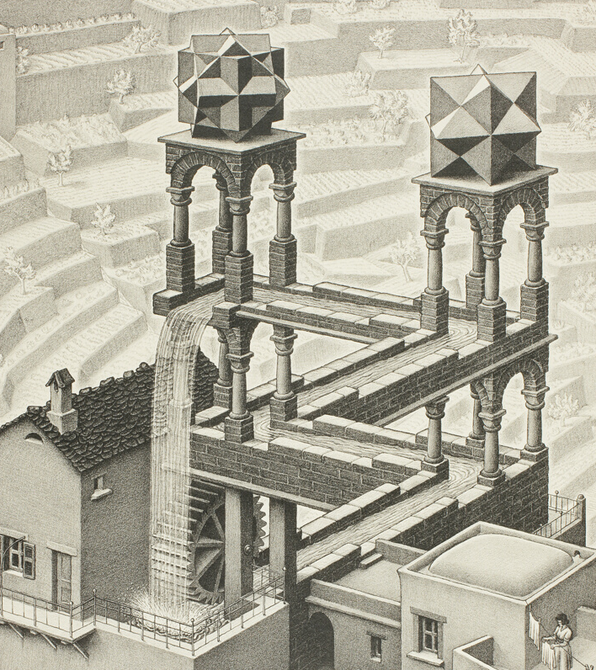
Logic and Paradox
Lecture 2:
Zeno’s Paradoxes
Rob Trueman
rob.trueman@york.ac.uk

Slide 2
Zeno’s Paradoxes
Zeno of Elea
Achilles and the Tortoise
The Racetrack
Are space and time discrete?
The Arrow
Potential vs actual infinity

Slide 3
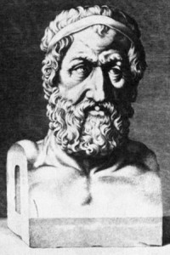
Zeno of Elea
Born c. 490BCE
Plato’s Parmenides begins with Socrates going to hear Zeno read from his book of paradoxes
As Parmenides’ disciple, Zeno wanted to show that, despite appearances to the contrary, the world was one unchanging whole
His paradoxes were designed to reveal the incoherence in the ordinary view of the world as made up of many changing parts
None of Zeno’s writings survive
We know about his paradoxes via the discussions of later philosophers, most notably Aristotle

Slide 4
Zeno’s Paradoxes
Zeno devised four paradoxes to show that motion is impossible
Achilles and the Tortoise (aka the Achilles)
The Racetrack (aka the Dichotomy)
The Arrow
The Stadium
We will look at the first three (the Stadium is pretty weird…)
Why bother? We know the arguments must be wrong!
It’s one thing to know that the conclusion is wrong, but it is another thing to figure out what’s wrong with Zeno’s arguments!
Whenever a philosopher thinks they have gotten to the bottom of Zeno’s paradoxes, new puzzles always seem to turn up!

Slide 5
Zeno’s Paradoxes
Zeno of Elea
Achilles and the Tortoise
The Racetrack
Are space and time discrete?
The Arrow
Potential vs actual infinity

Slide 6
Achilles and the Tortoise
Achilles and a tortoise decide to have a race

Slide 7
Achilles and the Tortoise
0m
100m
Achilles and a tortoise decide to have a race
Achilles is 10 times faster than the tortoise, and so the tortoise is given a 100m headstart

Slide 8
Achilles and the Tortoise
0m
100m
100m
110m
Achilles is 10 times faster than the tortoise, and so the tortoise is given a 100m headstart
Achilles quickly covers the 100m, but in that time the tortoise trudges on another 10m

Slide 9
Achilles and the Tortoise
100m
110m
110m
111m
Achilles quickly covers the 100m, but in that time the tortoise trudges on another 10m
Achilles quickly covers that 10m, but in that time the tortoise trudges on another 1m

Slide 10
Achilles and the Tortoise
110m
111m
111m
111.1m
Achilles quickly covers that 10m, but in that time the tortoise trudges on another 1m
Achilles quickly covers that 1m, but in that time the tortoise trudges on another 0.1m

Slide 11
Achilles and the Tortoise
111m
111.1m
Achilles quickly covers that 1m, but in that time the tortoise trudges on another 0.1m
And on it goes: in the time it takes for Achilles to close the gap, the tortoise moves on a little bit

Slide 12
Achilles and the Tortoise
111m
111.1m
And on it goes: in the time it takes for Achilles to close the gap, the tortoise moves on a little bit
So Achilles can never catch-up with the tortoise!

Slide 13
An Infinite Sum
To catch the tortoise, Achilles must first run 100m, then 10m, then 1m, then 0.1m, then…
We can represent Achilles’ task with an infinite sum: $100+10+1+0.1+0.01+…$
Intuitively, infinite sums can look pretty dodgy
Maybe they don’t make any sense?
Maybe they do, but they always add up to infinity? There are infinitely many terms, after all!
However, modern mathematics gives us a way of understanding infinite sums, and they don’t always equal infinity!

Slide 14
A Simple Example
$1/2+1/4+1/8+1/{16}+1/{32}+…=1$
$$1$$

Slide 15
A Simple Example
$1/2+1/4+1/8+1/{16}+1/{32}+…=1$
$$1/2$$
$$1$$

Slide 16
A Simple Example
$1/2+1/4+1/8+1/{16}+1/{32}+…=1$
$$1/4$$
$$1/2$$
$$1$$

Slide 17
A Simple Example
$1/2+1/4+1/8+1/{16}+1/{32}+…=1$
$$1/4$$
$$1/2$$
$$1/8$$
$$1$$

Slide 18
A Simple Example
$1/2+1/4+1/8+1/{16}+1/{32}+…=1$
$$1/4$$
$$1/2$$
$$1/8$$
$$1/{16}$$
$$1$$

Slide 19
A Simple Example
$1/2+1/4+1/8+1/{16}+1/{32}+…=1$
$$1/4$$
$$1/2$$
$$1/{32}$$
$$…$$
$$1/8$$
$$1/{16}$$
$$1$$

Slide 20
How to Calculate an Infinite Sum
To calculate an infinite sum, you start with all of the finite partial sums
SIMPLE EXAMPLE: $1/2+1/4+1/8+1/{16}+1/{32}+…=1$
$1/2+1/4=3/4$
$1/2+1/4+1/8=7/8$
$1/2+1/4+1/8+1/{16}={15}/{16}$
$1/2+1/4+1/8+1/{16}+…+1/{2^{n}}={2^{n}−1}/{2^{n}}$
Sometimes, the partial sums converge (roughly: get as close as you like) to a single value; in this case, we say the infinite sum equals the value that the partial sums converge to
Three possibilities:
The infinite series converges to a finite value: $1/2+1/4+1/8+1/{16}+1/{32}+…=1$
The infinite series explodes to infinity: $1/2+1/3+1/4+1/5+…=∞$
The infinite series bounces around: $1−1+1−1+1−…$ has no sum

Slide 21
Back to Achilles and the Tortoise
To catch the tortoise, Achilles must first run 100m, then 10m, then 1m, then 0.1m, then…
We can represent Achilles’ task with an infinite sum: $100+10+1+0.1+0.01+…$
$100+10=110$
$100+10+1=111$
$100+10+1+0.1=111.1$
$100+10+1+0.1+0.01=111.11$
$100+10+1+0.1+0.01+…=111.\dot{1}=111\frac{1}{9}$
So Achilles will catch the tortoise at $111\frac{1}{9}m$!

Slide 22
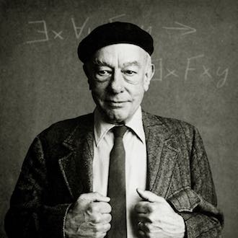
Paradox Solved!
“the fallacy that emerges is the mistaken notion that any infinite succession of lengths has to add up to an infinite length. Actually when an infinite succession of lengths is so chosen that the succeeding lengths become shorter and shorter, the whole length may be either finite or infinite. It is a question of a convergent series.”
Quine (1976), ‘The ways of paradox’. The Ways of Paradox and Other Essays (HUP), pp.3-4
(modified to deal with lengths rather than times)

Slide 25
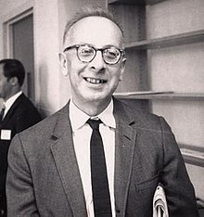
The Paradox Strikes Back!
“Let us be clear about what is meant by the assertion that the sum of the infinite series $100+10+1+1/{10}+1/{100}+…$ is $111\frac{1}{9}$. It does not mean, as the naïve might suppose, that mathematicians have succeeded in adding together an infinite number of terms. As Frege pointed out in a similar connection, this remarkable feat would require an infinite supply of paper, an infinite quantity of ink, and an infinite amount of time…

Slide 26
The Paradox Strikes Back!
“Let us be clear about what is meant by the assertion that the sum of the infinite series $100+10+1+1/{10}+1/{100}+…$ is $111\frac{1}{9}$. It does not mean, as the naïve might suppose, that mathematicians have succeeded in adding together an infinite number of terms. As Frege pointed out in a similar connection, this remarkable feat would require an infinite supply of paper, an infinite quantity of ink, and an infinite amount of time…
“To say that the sum of the series is $111\frac{1}{9}$ is to say that if enough terms of the series are taken, the difference between the sum of that finite number of terms and the number $111\frac{1}{9}$ becomes, and stays, as small as we please…

Slide 27
The Paradox Strikes Back!
“Now let us apply this to the race. The series of distances traversed by Achilles is convergent. This means that if Achilles takes enough steps whose sizes are given by the series 100 yards, 10 yards, 1 yard, 1/10 yard, etc. the distance still to go to the meeting point eventually becomes, and stays, as small as we please…
“To say that the sum of the series is $111\frac{1}{9}$ is to say that if enough terms of the series are taken, the difference between the sum of that finite number of terms and the number $111\frac{1}{9}$ becomes, and stays, as small as we please…

Slide 28
The Paradox Strikes Back!
“But the distance, however much reduced, still remains to be covered; and after each step there are infinitely many steps still to be taken. The logical difficulty is that Achilles seems called upon to perform an infinite series of tasks; and it does not help to be told that the tasks become easier and easier, or need progressively less and less time in the doing. Achilles may get nearer to the place and time of the rendezvous, but his task remains just as hard, for he still has to perform what seems to be logically impossible.”
Black (1951), ‘Achilles and the tortoise’. Analysis 11, pp.93-4
“Now let us apply this to the race. The series of distances traversed by Achilles is convergent. This means that if Achilles takes enough steps whose sizes are given by the series 100 yards, 10 yards, 1 yard, 1/10 yard, etc. the distance still to go to the meeting point eventually becomes, and stays, as small as we please…

Slide 29
Back Where We Started
To say that $100+10+1+0.1+0.01+…=111\frac{1}{9}$ is just to say that the partial sums get closer and closer to $111\frac{1}{9}$
But we already knew that Achilles would get closer and closer to the tortoise – Zeno never denied that
Zeno denied that Achilles would ever actually catch up with the tortoise!
Zeno had another paradox that illustrated the problem more simply: the Racetrack
111m
111.1m

Slide 30
Zeno’s Paradoxes
Zeno of Elea
Achilles and the Tortoise
The Racetrack
Are space and time discrete?
The Arrow
Potential vs actual infinity

Slide 31
The Racetrack
Achilles wants to run along a racetrack

Slide 32
The Racetrack
$$Z_{0}$$
$$Z^{∗}$$
Achilles wants to run along a racetrack
Call his starting point $Z_{0}$, and his end point $Z^{∗}$

Slide 33
The Racetrack
$$Z_{0}$$
$$Z_{1}$$
$$Z^{∗}$$
Call his starting point $Z_{0}$, and his end point $Z^{∗}$
To get from $Z_{0}$ to $Z^{∗}$, Achilles must first pass the midway point, call it $Z_{1}$

Slide 34
The Racetrack
$$Z_{0}$$
$$Z_{1}$$
$$Z_{2}$$
$$Z^{∗}$$
To get from $Z_{0}$ to $Z^{∗}$, Achilles must first pass the midway point, call it $Z_{1}$
To get from $Z_{1}$ to $Z^{∗}$, Achilles must first pass the new midway point, call it $Z_{2}$

Slide 35
The Racetrack
$$Z_{0}$$
$$Z_{1}$$
$$Z_{2}$$
$$Z_{3}$$
$$Z^{∗}$$
To get from $Z_{1}$ to $Z^{∗}$, Achilles must first pass the new midway point, call it $Z_{2}$
To get from $Z_{2}$ to $Z^{∗}$, Achilles must first pass the new midway point, call it $Z_{3}$

Slide 36
The Racetrack
$$Z_{0}$$
$$Z_{1}$$
$$Z_{2}$$
$$Z_{3}$$
$$Z^{∗}$$
To get from $Z_{2}$ to $Z^{∗}$, Achilles must first pass the new midway point, call it $Z_{3}$
And on it goes: to get from his current position to $Z^{∗}$, Achilles must pass a new midpoint

Slide 37
The Racetrack
$$Z_{0}$$
$$Z_{1}$$
$$Z_{2}$$
$$Z_{3}$$
$$Z^{∗}$$
And on it goes: to get from his current position to $Z^{∗}$, Achilles must pass a new midpoint
But Achilles can’t do infinitely many things in a finite period of time

Slide 38
The Racetrack
$$Z_{0}$$
$$Z_{1}$$
$$Z_{2}$$
$$Z_{3}$$
$$Z^{∗}$$
But Achilles can’t do infinitely many things in a finite period of time
So Achilles can never reach $Z^{∗}$!

Slide 39
The Racetrack in Brief
In order to move from one point to another, you have to complete infinitely many tasks in a finite period of time – you need to pass infinitely many points between the start and end
It is impossible to complete infinitely many tasks in a finite period of time
Therefore, it is impossible to move from one point to another
Terminology: an infinite series of tasks is called a supertask

Slide 40
The Racetrack in Brief
In order to move from one point to another, you have to complete a supertask in a finite period of time – you need to pass infinitely many points between the start and end
It is impossible to complete a supertask in a finite period of time
Therefore, it is impossible to move from one point to another
Terminology: an infinite series of tasks is called a supertask
In order to move from one point to another, you have to complete infinitely many tasks in a finite period of time – you need to pass infinitely many points between the start and end
It is impossible to complete infinitely many tasks in a finite period of time

Slide 41
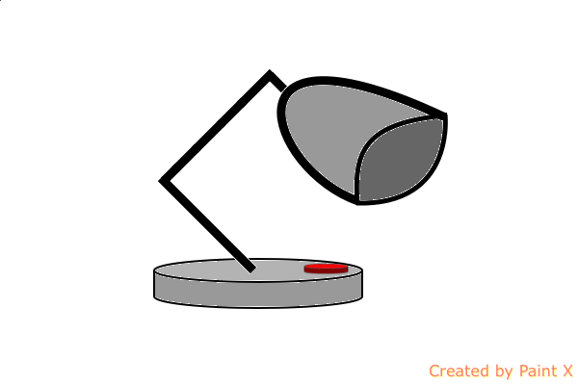
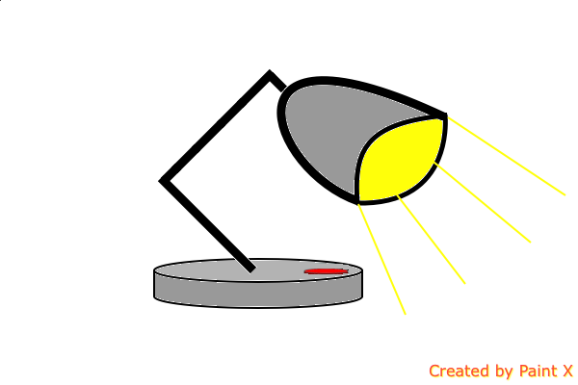
Thomson’s Lamp
Is it really impossible to complete a supertask in a finite period of time?
Thomson presented a famous thought experiment to show that at least some types of supertask are impossible
Thomson (1954), ‘Tasks and Supertasks’. Analysis 15, pp.1-13
Imagine a desk lamp which you can turn on or off by pushing a button

Slide 42
Thomson’s Lamp
You play a game for two minutes:
You wait a minute, and turn it on
Then you wait 30 seconds, and turn it off
Then you wait 15 seconds and turn it on
Then you wait 7.5 seconds and turn it off
You keep doing this, always halving the waiting time
After 2 minutes of this, the button will have been pushed infinitely many times. Will the lamp be on or off?
It can’t be off, because you never turned it off without turning it on again
It can’t be on, because you never turned it on without turning it off again
But that’s impossible: it must be on or off!
X

Slide 43
What did Thomson Think?
In order to move from one point to another, you have to complete a supertask in a finite period of time – you need to pass infinitely many points between the start and end
It is impossible to complete a supertask in a finite period of time
Therefore, it is impossible to move from one point to another
Thomson thought that his Lamp demonstrated that some types of supertask are impossible
However, he thought that there were different types of supertask
According to Thomson, moving does involve completing a supertask, but not of a problematic type
In other words, he thought that the Racetrack trades on an ambiguity in ‘supertask’
But it is not clear (to me at least!) exactly how Thomson distinguishes between possible and impossible supertasks

Slide 44
Is Thomson’s Lamp Really Impossible?
According to Benacerraf, Thomson’s Lamp doesn’t even manage to show that any supertasks are impossible!
Benacerraf (1962), ‘Tasks, super-tasks, and the modern Eleatics’. The Journal of Philosophy 59, pp.765-84
The story of Thomson’s Lamp contains enough information to tell us whether the lamp was on or off at any time before the 2 minutes are up
But the story just doesn’t tell us anything about what happens once the 2 minutes are up!
The story isn’t inconsistent, just incomplete
We could consistently extend the story by adding, ‘…and once the 2 minutes were up, the lamp was on!’
But we could also consistently extend I by adding, ‘…and once the 2 minutes were up, the lamp was off!’

Slide 45
Why is the Lamp On/Off
What explains why the lamp is on/off after 2 minutes?
We usually expect the state of the lamp at one moment to be determined by its earlier states (plus its local environment)
But Benacerraf’s point was that our 2-minute game doesn’t determine the state of the lamp at 2 minutes
But is it a logical law, or just a physical law (or neither) that the state of the lamp is determined by its earlier states?
If it’s just a physical law, then at most Thomson’s thought experiment shows that his lamp is physically impossible – and we knew that anyway!
But Thomson wanted to show that his lamp was logically impossible
Question: if the state of the lamp at 2 minutes is not determined by the earlier states of the lamp, what makes us say that it is the same lamp at all?

Slide 46
Zeno’s Paradoxes
Zeno of Elea
Achilles and the Tortoise
The Racetrack
Are space and time discrete?
The Arrow
Potential vs actual infinity

Slide 51
Physics versus Mathematics
We are free to stipulate that an idealised mathematical space is infinitely divisible, if we like
But we aren’t free to make stipulations about whether physical space is infinitely divisible
Physical space (and physical time) exists independently of us, and its our job to figure out how it’s structured!
It might be that physical space/time is infinitely divisible, but it might also be discrete
In other words: physical space might be made up of indivisible chunks of distance
Although each chunk would be tiny, they would still have some finite length
If physical space is discrete, then the Racetrack (and Achilles and the Tortoise) is solved
Achilles will not have to pass infinitely points, just finitely many chunks of distance

Slide 52
Black on Infinite Divisibility
“If it were really necessary for [Achilles] to perform an infinite number of tasks […] it would indeed be logically impossible for him to pass the tortoise. But the things he really does are finite in number; a finite number of steps, heart beats, deep breaths, cries of defiance, and so on. The track on which he runs has a finite number of pebbles, grains of earth, and blades of grass, each of which in turn has a finite, though enormous number of atoms. For all of these are things that have a beginning and end in space or time.

Slide 53
Black on Infinite Divisibility
“But if anyone says we must imagine that the atoms themselves occupy space and so are divisible ‘in thought’, he is no longer talking about spatio-temporal things. To divide a thing ‘in thought’ is merely to halve the numerical interval which we have assigned to it. Or else it is to suppose what is in fact physically impossible beyond a certain point, the actual separation of physical things into discrete parts.”
Black (1951), ‘Achilles and the tortoise’. Analysis 11, pp.100-1
“If it were really necessary for [Achilles] to perform an infinite number of tasks […] it would indeed be logically impossible for him to pass the tortoise. But the things he really does are finite in number; a finite number of steps, hear beats, deep breaths, cries of defiance, and so on. The track on which he runs has a finite number of pebbles, grains of earth, and blades of grass, each of which in turn has a finite, though enormous number of atoms. For all of these are things that have a beginning and end in space or time.

Slide 54
A Heterodox Idea!
Importantly, standard physics assumes that space/time is infinitely divisible
In fact, physicists usually assume that space/time are made up of an infinite continuum of points
These points have no length/duration
It is sometimes said that Quantum Mechanics teaches that space/time is discrete
In particular, it is sometimes suggested that the smallest units of space and time are things called the planck length and planck time
However, standard Quantum Mechanics is not a theory of spacetime at all!
General Relativity is our best theory of spacetime, and it takes spacetime to be an infinite continuum of points
There are theories that try to marry Quantum Mechanics with General Relativity, and which treat space/time as discrete, but they are controversial!

Slide 55
Zeno’s Paradoxes
Zeno of Elea
Achilles and the Tortoise
The Racetrack
Are space and time discrete?
The Arrow
Potential vs actual infinity

Slide 56
The Arrow
The Arrow Paradox appears to be designed to target people who think that time is made up of indivisible moments
It doesn’t seem to matter whether you think that these moments are durationless points, or have their own finite duration
So the Arrow appears to target the standard contemporary view of time, and the idea that time is discrete

Slide 57
The Arrow
Consider an arrow mid-flight, at some indivisible moment
The Arrow cannot be moving during that moment
If it did, then it would be at different locations at the start and end of the moment
In that case, this moment can be divided after all!
This point generalises: the arrow cannot move during any indivisible moment
But time is just a series of indivisible moments
So the arrow cannot move at all!
The Arrow Paradox appears to be designed to target people who think that time is made up of indivisible moments
It doesn’t seem to matter whether you think that these moments are durationless points, or have their own finite duration
So the Arrow appears to target the standard contemporary view of time, and the idea that time is discrete

Slide 58
An Easy Solution?
It seems right to say that nothing can move within an indivisible moment
But it doesn’t follow that nothing can move across many indivisible moments
To think otherwise appears to be an instance of the Fallacy of Composition: assuming that the properties of parts are also properties of wholes
Example: Human cells can’t run marathons. Therefore human bodies can’t run marathons
An arrow doesn’t need to move within a moment to move across many moments
Arrows move by occupying different locations at different moments
We can then introduce a sense in which things can be moving at a moment
$x$ is moving at a moment $m$ iff $m$ belongs to a series of moments across which $x$ is moving

Slide 59
Is That Really Movement?
We usually think of movement as a kind of change
But on this picture of movement, nothing seems to change
Each moment is like a frame of a film: static and unchanging
Change seems to be an illusion that is only generated when we shift our attention from one moment to another
Bergson (1911), ‘The cinematographic view of becoming’. Reprinted in Zeno’s Paradoxes (Hackett Publishing Company), pp.59-66

Slide 60
The Return of the Paradox
Movement is a kind of change
If time is made up of indivisible moments, then change is impossible
So if time is made up of indivisible moments, then movement is impossible
The argument is obviously valid
You could try rejecting Premise 1, but that seems pointless
The conclusion that change is impossible would still be radical enough!
So if you want to avoid the conclusion, you need to reject Premise 2
There is an ongoing debate in the philosophy of time about what should count as change
See McTaggart (1908), ‘The unreality of time’. Mind 68, pp.457-74
McTaggart’s argument is a classic, but very controversial

Slide 61
Zeno’s Paradoxes
Zeno of Elea
Achilles and the Tortoise
The Racetrack
Are space and time discrete?
The Arrow
Potential vs actual infinity

Slide 67
Two Senses of ‘Infinitely Divisible’
We can distinguish two senses in which space(/time) is infinitely divisible
Strong: Space can be divided into infinitely many parts
Weak: No matter how many finite parts we have divided space into, we can always divide it further
So far, we have always taken ‘infinitely divisible’ in the strong sense
One way of thinking that space is infinitely divisible in this sense is to think of it as a continuum of lengthless points, but that’s not the only way
If you think that 1 meter can be completely divided into $1/2m,1/4m,1/8m,$ etc, then you also think that space is infinitely divisible in the strong sense (even if you don’t believe in points!)
Maybe the lesson of Zeno’s Paradox is to treat space as infinitely divisible only in the weak sense?

Slide 68
No Finite Limit
The idea is that space cannot be divided into infinitely many parts, but there’s no finite limit to how finely you can divide space
You can divide space into lengths that are as small as you like
You can’t divide space into infinitely many points
You can’t divide space into an infinite series of shrinking lengths (e.g. $1/2m,1/4m,1/8m,$ etc)
Space permits an infinite range of possible divisions, but not the possibility of infinite divisions
Question: What is to stop us from completing all of the possible divisions that space permits?

Slide 69
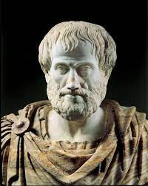
Potential versus Actual Infinity
Aristotle introduced a distinction between potential and actual infinity
A category is actually infinite iff it contains infinitely many things
A category is potentially infinite iff every finite collection of things in that category can be extended with new members
According to Aristotle, actual infinity is conceptually incoherent
Actual infinity leads to a variety of paradoxes, including Zeno’s!
Aristotle claimed that the only good notion of infinity is potential infinity
If Aristotle is right, then it only makes sense to suppose that space is infinitely divisible in the weak sense

Slide 70
The Racetrack Solved!
It is incoherent to describe Achilles as needing to pass infinitely many points
That would only make sense if space were infinitely divisible in the strong sense
If space is only infinitely divisible in the weak sense, then we can still divide Achilles journey up into lengths that are as small as we like…
…but there are always only finitely many of them!

Slide 71
Thomson’s Lamp Solved!
If time is only infinitely divisible in the weak sense, then Thomson’s instructions are incoherent
You’re meant to press the button after 1 minute, then 30 seconds, then 15 seconds, then 7.5 seconds, then…
But you could only carry on doing that forever if time were infinitely divisible in the strong sense
You can still follow Thomson’s instructions for any finite number of button-presses you like…
…but you can’t keep it up for the full 2 minutes!

Slide 72
The Arrow Solved!
If time is infinitely divisible in the weak sense, then it is not made up of indivisible moments
Every finite moment can be further divided…
…and you can’t infinitely divide time into durationless points
Since every moment always has some finite duration, the arrow can be moving within a moment!

Slide 73
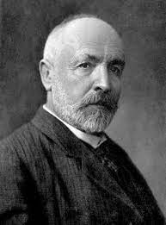
The Catch
Aristotle’s doctrine that potential infinity is the only coherent notion of infinity was more-or-less orthodoxy for two thousand years
But mathematicians rehabilitated actual infinity in the 19th Century
Most notably, Cantor developed a rigorous mathematical theory of the actually infinite, which pretty much every mathematician has accepted since
(We’ll talk more about Cantor’s work in the Bonus Lecture in Week 7)
Moreover, Cantor’s ‘transfinite arithmetic’ is not just pure mathematics, but is an integral part of modern physics

Slide 74
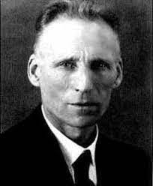
Intuitionism
It is worth noting that some real mathematicians still rejected actual infinity, even after Cantor
Brouwer introduced an alternative intuitionist (aka constructivist) mathematics, that only permitted potential infinity
Intuitionist mathematics can be as elegant and beautiful as standard maths, and may even be all we need for physics
However, intuitionism is very much a minority view amongst mathematicians!

Slide 75
For the Next Seminar and Lecture
Seminar Reading
Thomson (1954), ‘Tasks and super-tasks’. Analysis 15, pp.1-13
Benacerraf (1962), ‘Tasks, super-tasks, and the modern Eleatics’. The Journal of Philosophy, pp.765-84
Lecture Reading
Sainsbury (2009). Paradoxes (CUP), ch.3 (Sections 3.1-3 & 3.6)

