Slide 1
Reason and Argument
Lecture 2: Validity (and other key concepts)
Robert Trueman
rob.trueman@york.ac.uk
University of York

Slide 2
Reason and Argument
Lecture 2: Validity (and other key concepts)
Validity
Other Key Concepts
Possible Worlds
Explosion
Formal Validity

Slide 3
Re-cap: arguments
An argument is a collection of sentences: one sentence is designated as the conclusion; all the rest are premises
The conclusion is meant to follow from the premises
But what does ‘follow from’ really mean!?

Slide 10
Two arguments
Sharon studies archaeology
If Sharon studies archaeology, then she tells Rob a lot about old pots
So Sharon tells Rob a lot about old pots
You have been reading forallx
So you are studying R&A
The premise makes it likely that the conclusion is true
The premises guarantee that the conclusion is true

Slide 11
Two arguments
Sharon studies archaeology
If Sharon studies archaeology, then she tells Rob a lot about old pots
So Sharon tells Rob a lot about old pots
You have been reading forallx
So you are studying R&A
The premise makes it likely that the conclusion is true
The premises guarantee that the conclusion is true
The argument is valid

Slide 12
Validity
An argument is valid if and only if it is impossible for all of the premises to be true and the conclusion to be false
(An argument is invalid if and only if it is not valid)
By ‘impossible’, we mean absolutely 100% definitely impossible
It is practically impossible for you to get to Paris in 2 minutes; but it is not absolutely impossible
Validity is the gold standard for arguments
If the premises of a valid argument are true, then the conclusion must be true too

Slide 13
Valid or Invalid?
You are taking Reason & Argument
Everyone who takes Reason & Argument loves logic
Therefore, you love logic
VALID!
It is impossible for the premises to be true and the conclusion to be false

Slide 14
Valid or Invalid?
Some dogs are cute
Munnery is my dog
Therefore, Munnery is cute
You are taking Reason & Argument
Everyone who takes Reason & Argument loves logic
Therefore, you love logic
INVALID!
VALID!
An argument can be invalid even if it has true premises and a true conclusion
It is impossible for the premises to be true and the conclusion to be false

Slide 15
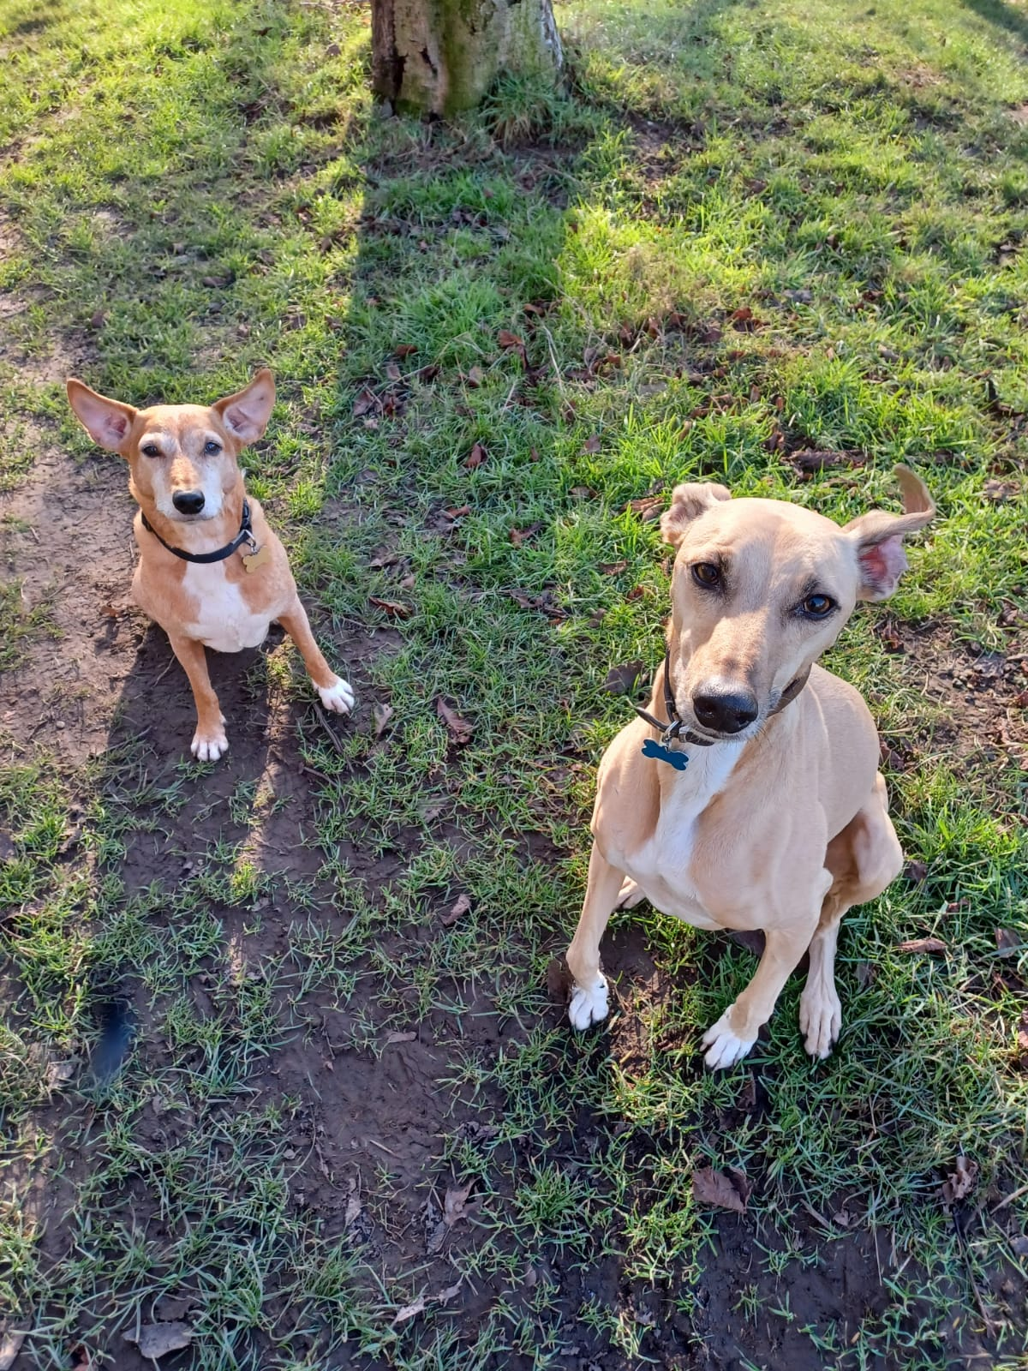

Slide 16
Valid or Invalid?
Some dogs are cute
Munnery is my dog
Therefore, Munnery is cute
All cats have five legs
Munnery is a cat
Therefore, Munnery has five legs
INVALID!
VALID!
An argument can be valid even if it has false premises and a false conclusion
What matters is that the premises couldn’t be true without the conclusion being true too
An argument can be invalid even if it has true premises and a true conclusion
What matters is whether it is possible for the premises to be true when the conclusion is false

Slide 17
Valid or Invalid?
Every cat lives at Rob’s house
Munnery is a cat
Therefore, Munnery lives at Rob’s house
All cats have five legs
Munnery is a cat
Therefore, Munnery has five legs
VALID!
VALID!
An argument can be valid even if it has false premises and a false conclusion
What matters is that the premises couldn’t be true without the conclusion being true too
A valid argument can have false premises and a true conclusion
What matters is that if the premises were true, then the conclusion would have to be true too

Slide 18
Soundness
An argument is sound if and only if it is valid and its premises are true
You are taking R&A. Everyone who takes R&A is a York student. Therefore, you are a York student
Sound arguments are even better than valid ones
If an argument is valid, then its conclusion must be true if its premises are true
If an argument is sound, then its conclusion must be true
However, it isn’t usually the job of logic to tell us whether some premises are true!

Slide 19
Reason and Argument
Lecture 2: Validity (and other key concepts)
Validity
Other Key Concepts
Possible Worlds
Explosion
Formal Validity

Slide 20
Consistency
A collection of sentences are jointly consistent if and only if it is possible for them all to be true together
(A collection of sentences are jointly inconsistent if and only if they are not jointly consistent)
JOINTLY CONSISTENT: Rob is over 6ft tall; Tom is under 5ft tall
A collection of sentences can be jointly consistent even if some (or all) of them are false!
JOINTLY INCONSISTENT: Rob is over 6ft tall; Rob is under 5ft tall

Slide 21
Consistent or inconsistent?
Rob is either 6ft tall or younger than 35
Rob is not 6ft tall
Rob is not younger than 35
INCONSISTENT!
Any two sentences in this collection are jointly consistent, but they cannot all be true together

Slide 22
Consistent or inconsistent?
Rob is either 6ft tall or younger than 35
Rob is not 6ft tall
Rob is not younger than 35
Rob is not 6ft tall
All ravens are black
Snowy is a white raven
INCONSISTENT!
INCONSISTENT!
Any two sentences in this collection are jointly consistent, but they cannot all be true together
Adding a sentence to a jointly inconsistent collection of sentences yields another jointly inconsistent collection of sentences

Slide 23
Consistent or inconsistent?
CONSISTENT
Rob is not 6ft tall
More than 1,000 people live in York
Everyone in Paris is in France
Rob is not 6ft tall
All ravens are black
Snowy is a white raven
INCONSISTENT!
True sentences are always consistent with each other
Adding a sentence to a jointly inconsistent collection of sentences yields another jointly inconsistent collection of sentences

Slide 24
Necessity
A sentence is necessarily false if and only if it is impossible for it to be true
EXAMPLES: 2+2=5; Something is red all over and not red all over; Something is red all over and green all over
A sentence is necessarily true if and only if it is impossible for it to be false
EXAMPLES: 2+2=4; Everything is either red all over or not red all over; Nothing is red all over and green all over
A sentence is contingent if and only if it is neither necessarily true nor necessarily false

Slide 25
A Question
Q: Can a jointly consistent set of sentences include a necessary falsehood?
A: No; it is impossible for necessary falsehood to be true, and so it is impossible for it to be true together with some other sentences

Slide 26
Reason and Argument
Lecture 2: Validity (and other key concepts)
Validity
Other Key Concepts
Possible Worlds
Explosion
Formal Validity

Slide 30
Possible worlds
THE BIG IDEA: for each way the world could be, there is a possible world which is that way
ANOTHER EXAMPLE: You could have studied engineering rather than philosophy; so there is a possible world where you do study engineering

Slide 31
Redefining our key concepts
A sentence is necessarily true if and only if it is true in every possible world
A sentence is necessarily false if and only if it is false in every possible world
A sentence is contingent if and only if it is true in some possible world and false in others
A collection of sentences are jointly consistent if and only if they are all true together in some possible world
An argument is valid if and only if there is no possible world in which all of the premises are true and the conclusion is false

Slide 32
The metaphysics of possible worlds
WHAT IS A POSSIBLE WORLD???
Some philosophers think that, if we want to talk about possible worlds, then we need to develop a metaphysical theory of them
Others think that we can treat possible worlds as a useful fiction
Compare the way that physicists use frictionless planes as useful fictions
We can save all of this for the Second-Year Metaphysics module!

Slide 33
Reason and Argument
Lecture 2: Validity (and other key concepts)
Validity
Other Key Concepts
Possible Worlds
Explosion
Formal Validity

Slide 40
How Explosion works
Rob is under 35 years old
Rob is over 35 years old
Therefore, all dogs are maths professors
INCONSISTENT
It is impossible for both premises to be true
VALID
It is impossible for both premises to be true and the conclusion to be false

Slide 41
How Explosion works
Rob is under 35 years old
Rob is over 35 years old
Therefore, all dogs are maths professors
INCONSISTENT
There is no possible world in which both premises are true
INCONSISTENT
It is impossible for both premises to be true
VALID
It is impossible for both premises to be true and the conclusion to be false
VALID
There is no possible world in which both premises are true and the conclusion is false

Slide 42
How Explosion works
Rob is under 35 years old
Rob is over 35 years old
Therefore, all cats are historians
Rob is under 35 years old
Rob is over 35 years old
Therefore, all dogs are maths professors
INCONSISTENT
There is no possible world in which both premises are true
VALID
There is no possible world in which both premises are true and the conclusion is false

Slide 43
How Explosion works
Rob is under 35 years old
Rob is over 35 years old
Therefore, Paris is in Britain
Rob is under 35 years old
Rob is over 35 years old
Therefore, all cats are historians
INCONSISTENT
There is no possible world in which both premises are true
VALID
There is no possible world in which both premises are true and the conclusion is false

Slide 44
How Explosion works
Rob is under 35 years old
Rob is over 35 years old
Therefore, Paris is not in Britain
Rob is under 35 years old
Rob is over 35 years old
Therefore, Paris is in Britain
INCONSISTENT
There is no possible world in which both premises are true
VALID
There is no possible world in which both premises are true and the conclusion is false

Slide 45
How Explosion works
Any argument with inconsistent premises is automatically valid, no matter what the conclusion!
An argument is valid if it is impossible for all of its premises to be true and its conclusion to be false
If the an argument has inconsistent premises, then it is impossible for all of its premises to be true
So if an argument has inconsistent premises, then it is impossible for all of its premises to be true and its conclusion to be false

Slide 46
How Explosion works
Any argument with inconsistent premises is automatically valid, no matter what the conclusion!
An argument is valid if it is impossible for all of its premises to be true and its conclusion to be false
If the an argument has inconsistent premises, then it is impossible for all of its premises to be true
So if an argument has inconsistent premises, then it is impossible for all of its premises to be true and its conclusion to be false
Any argument with inconsistent premises is automatically valid, no matter what the conclusion!
An argument is valid if there is no possible world in which all of its premises are true and its conclusion is false
If the an argument has inconsistent premises, then there is no possible world in which all of its premises are true
So if an argument has inconsistent premises, then there is no possible world in which all of its premises are true and its conclusion is false

Slide 47
Can we avoid Explosion?
You could try to avoid Explosion by revising our definition of validity
Conceptions of validity which avoid Explosion are called paraconsistent
We won’t try to do that here: paraconsistent systems are very complicated, and they are always strange in their own ways

Slide 48
Can we live with Explosion?
Explosion is a counter-intuitive result, but it only concerns one fringe case: arguments with inconsistent premises
Our definition of validity works just fine in all other cases
This is not an uncommon situation
Validity is our theoretical development of the idea of a conclusion following from some premises
Validity is a rigorous, clear and theoretically useful notion
But those benefits come at a cost: it has some counter-intuitive consequences

Slide 49
Can we love Explosion?
Why is it so bad to have inconsistent beliefs?
Partly because, if you have inconsistent beliefs, then at least one of your beliefs must be false
But we have lots of false beliefs, and inconsistent beliefs seem worse than that
Imagine that Abdul believes that water boils at 50ºC, but Tracy believes both that water boils at 50ºC and that water does not boil at 50ºC
Surely Tracy’s mistake is bigger than Abdul’s!

Slide 50
Can we love Explosion?
You should believe anything that validly follows from what you already believe
Everything validly follows from inconsistent beliefs
So if you have inconsistent beliefs, you should believe everything!

Slide 51
Reason and Argument
Lecture 2: Validity (and other key concepts)
Validity
Other Key Concepts
Possible Worlds
Explosion
Formal Validity

Slide 52
A form of argument
ARGUMENT 1
Sharon studies archaeology
If Sharon studies archaeology, then she tells Rob a lot about old pots
So Sharon tells Rob a lot about old pots

Slide 53
A form of argument
ARGUMENT 2
It’s raining outside
If it’s raining outside, then Simon is miserable
So Simon is miserable
ARGUMENT 1
Sharon studies archaeology
If Sharon studies archaeology, then she tells Rob a lot about old pots
So Sharon tells Rob a lot about old pots

Slide 54
A form of argument
ARGUMENT 2
It’s raining outside
If it’s raining outside, then Simon is miserable
So Simon is miserable
ARGUMENT FORM
1. A
2. If A then B
3. So B
Every argument of this form will be valid!

Slide 55
Another form of argument
ARGUMENT 1
Iayla is either happy or sad
Iayla is not sad
So Iayla is happy

Slide 56
Another form of argument
ARGUMENT 1
Iayla is either happy or sad
Iayla is not sad
So Iayla is happy
ARGUMENT 2
Dave is in either his office or the pub
Dave is not in the pub
So Dave is in his office

Slide 57
Another form of argument
ARGUMENT 2
Dave is in either his office or the pub
Dave is not in the pub
So Dave is in his office
ARGUMENT FORM
1. A or B
2. Not-B
3. So A
Every argument of this form will be valid!

Slide 58
Valid forms
A form of argument is valid if and only if every argument which has that form is valid
If an argument has a valid form, then it is valid purely in virtue of that form
It doesn’t matter what the premises or the conclusion say; the argument is valid because it has a valid form

Slide 59
Non-formal validity
Not all valid arguments have valid forms
VALID
The ball is green all over
Therefore, the ball is not red all over
INVALID
The ball is green all over
Therefore, the ball is not shiny all over
These arguments have exactly the same form
So the valid argument is not valid just in virtue of its form
It’s valid in part because of what the premise and conclusion say

Slide 60
Formal validity
However, logicians focus on formal validity
One of the tasks for logicians is to come up with systematic ways of distinguishing the valid forms from the rest
This is useful, because if we can show that an argument has a valid form, then we know that the argument itself is valid, without having needed to think through what the premises and conclusion say

Slide 61
For next time…
Complete Worksheet 1 before your seminar!
Read Sections 4 and 5 of forallx
Complete all associated exercises!

